Slide 1
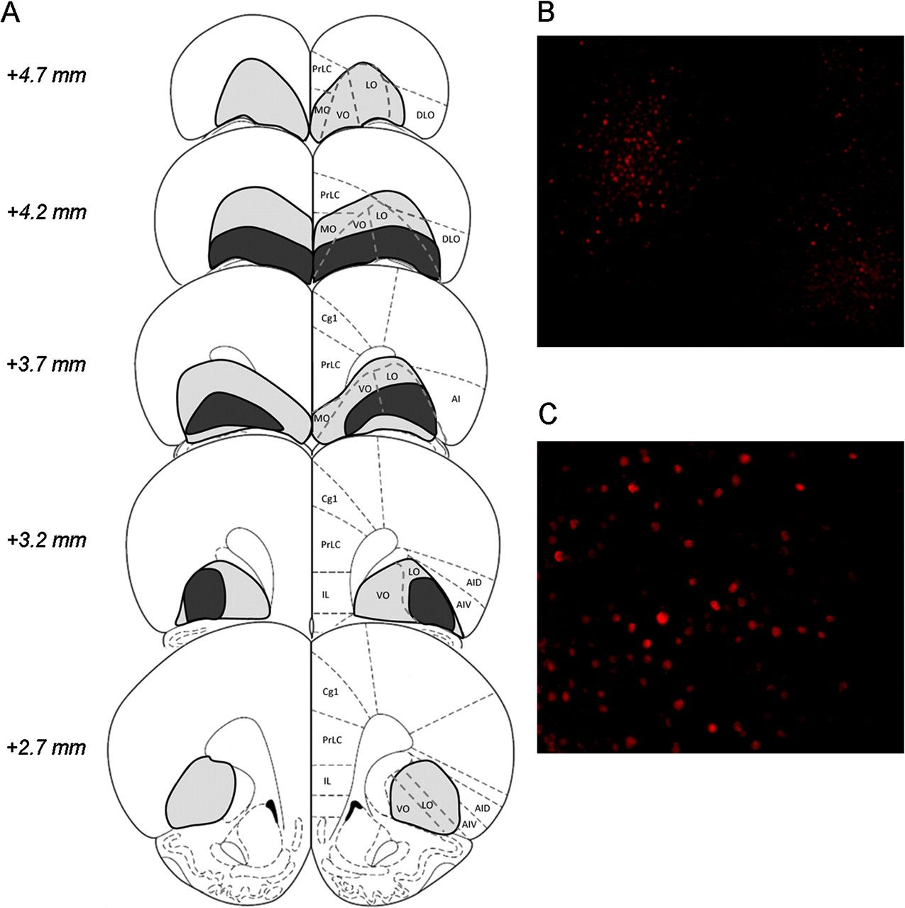
Figure 1. Localization and extent of viral overexpression. Panel (A) shows a schematic of the area infected by the ...
Notes:
Figure 1. Localization and extent of viral overexpression. Panel (A) shows a schematic of the area infected by the virus, based on Paxinos and Watson (1998). The largest area affected in any individual is shown in gray and the smallest in black. Viral overexpression encompassed the medial, ventral, and lateral areas of the OFC. There was minimal evidence of spread into other frontal regions, although some viral infection was occasionally detected in very anterior parts of the prelimbic cortex and the more ventral aspect of the agranular insular cortex. Photomicrographs depicting the immunohistochemical detection of ΔFosB overexpression in the ventral/lateral OFC of a representative animal are also provided, magnified 4× (panel B) and 20× (panel C). PrLC, prelimbic cortex; MO, medial orbitofrontal cortex; VO, ventral orbitofrontal cortex; LO, lateral orbitofrontal cortex; DLO, dorsolateral orbitofrontal cortex; Cg1, anterior cingulate cortex; IL, infralimbic cortex; AIV, ventral anterior insular cortex; AID, dorsal anterior insular cortex.
Unless provided in the caption above, the following copyright applies to the content of this slide: © The Author 2008. Published by Oxford University Press. All rights reserved. For permissions, please e-mail: journals.permissions@oxfordjournals.org

Slide 2
Figure 2. Acquisition of cocaine self-administration transiently increases omissions and premature responding on the ...
Notes:
Figure 2. Acquisition of cocaine self-administration transiently increases omissions and premature responding on the 5CSRT. The number of infusions of cocaine or saline self-administered over 24 sessions (A) and the percentage of omissions (B) and premature responses (C) made during the concurrent 5CSRT sessions, averaged per week. Data shown are mean ± standard error of the mean. Asterisk denotes P < 0.05.
Unless provided in the caption above, the following copyright applies to the content of this slide: © The Author 2008. Published by Oxford University Press. All rights reserved. For permissions, please e-mail: journals.permissions@oxfordjournals.org

Slide 3
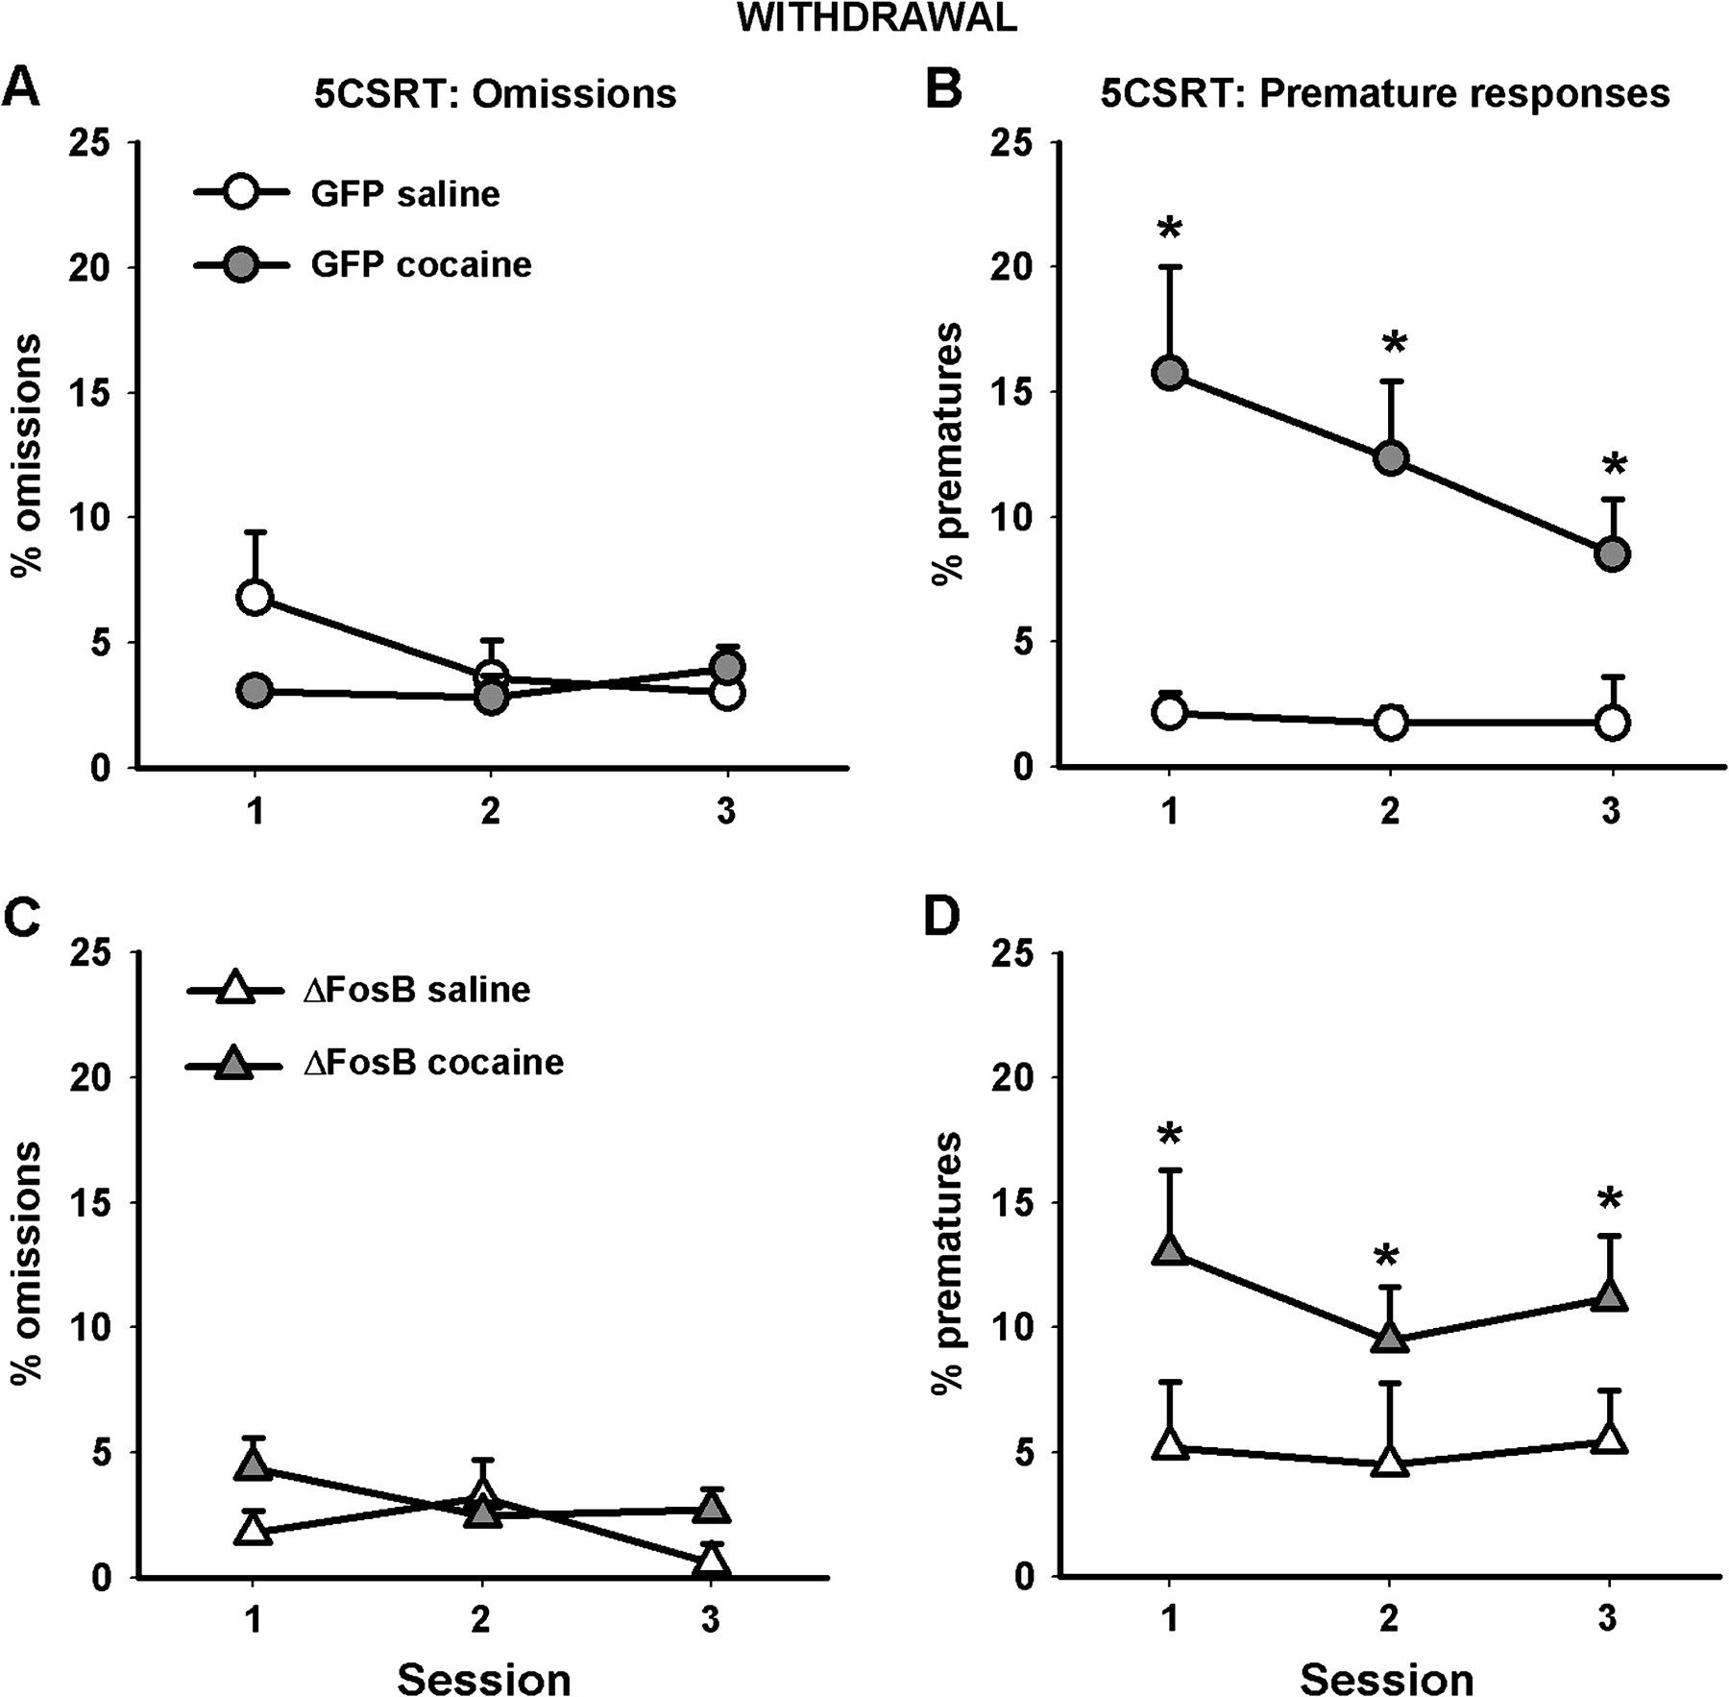
Figure 3. Withdrawal from cocaine self-administration increases premature responding on the 5CSRT. The left-hand column ...
Notes:
Figure 3. Withdrawal from cocaine self-administration increases premature responding on the 5CSRT. The left-hand column shows the percentage of trials omitted by both GFP control animals (A) and those overexpressing ΔFosB (C). The right-hand column shows the percentage of premature responses made by both GFP control animals (B) and those overexpressing ΔFosB (D). Data shown are mean ± standard error of the mean. Asterisk denotes P < 0.05.
Unless provided in the caption above, the following copyright applies to the content of this slide: © The Author 2008. Published by Oxford University Press. All rights reserved. For permissions, please e-mail: journals.permissions@oxfordjournals.org

Slide 4
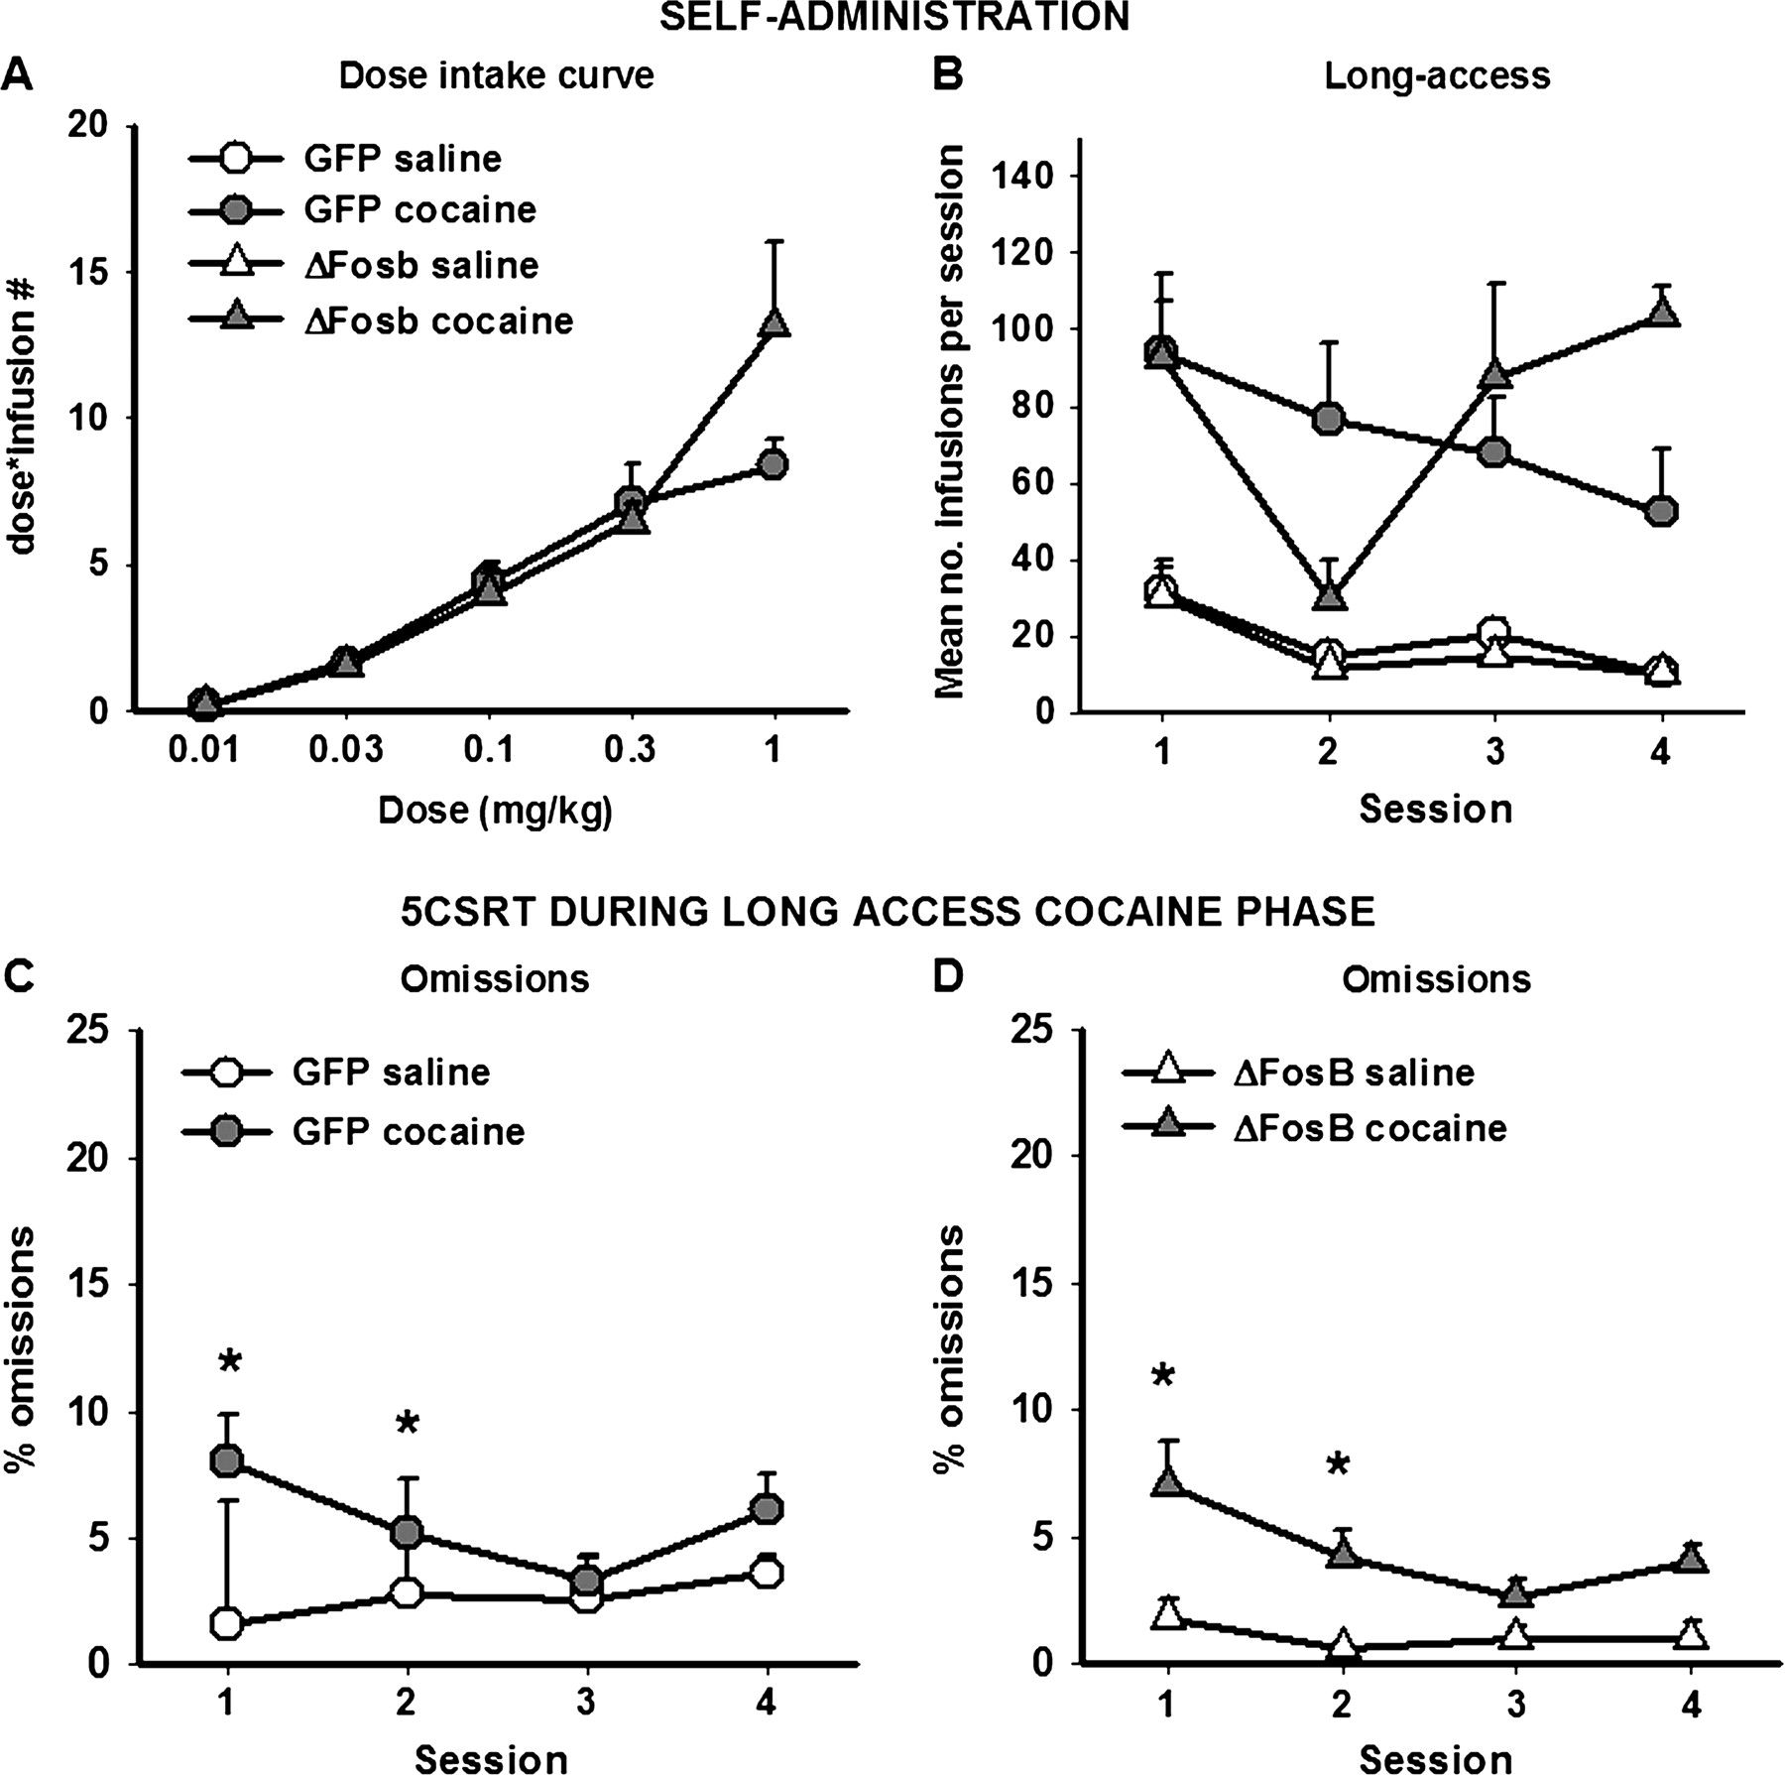
Figure 4. Changes in behavior when the amount of cocaine available increases. The dose–response intake curve indicates ...
Notes:
Figure 4. Changes in behavior when the amount of cocaine available increases. The dose–response intake curve indicates that animals overexpressing ΔFosB tend to take more cocaine at the highest dose offered (A). Animals overexpressing ΔFosB show less stable responding and tend to increase the amount of cocaine taken when given longer access to cocaine per session (B). The number of trials omitted during the 5CSRT sessions corresponding to the long-access sessions is provided in panels (C) (GFP control animals) and (D) (animals overexpressing ΔFosB). Data shown are mean ± standard error of the mean. Asterisk denotes P < 0.05.
Unless provided in the caption above, the following copyright applies to the content of this slide: © The Author 2008. Published by Oxford University Press. All rights reserved. For permissions, please e-mail: journals.permissions@oxfordjournals.org

Slide 5
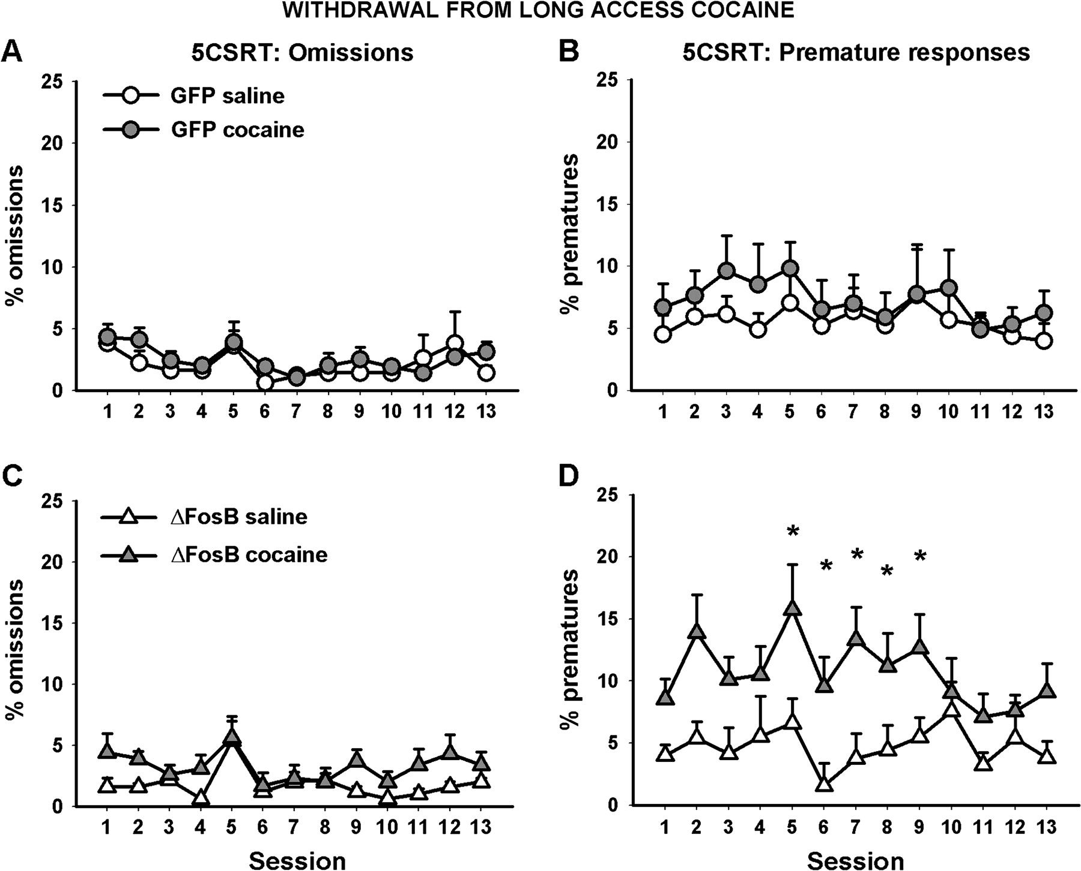
Figure 5. The effects of withdrawal from long-access cocaine on 5CSRT performance. The left-hand column shows the ...
Notes:
Figure 5. The effects of withdrawal from long-access cocaine on 5CSRT performance. The left-hand column shows the percentage of trials omitted by both GFP control animals (A) and those overexpressing ΔFosB (C). The right-hand column shows the percentage of premature responses made by both GFP control animals (B) and those overexpressing ΔFosB (D). ΔFosB overexpression increased premature responses during this withdrawal period. Data shown are mean ± standard error of the mean. Asterisk denotes P < 0.05.
Unless provided in the caption above, the following copyright applies to the content of this slide: © The Author 2008. Published by Oxford University Press. All rights reserved. For permissions, please e-mail: journals.permissions@oxfordjournals.org

Slide 6
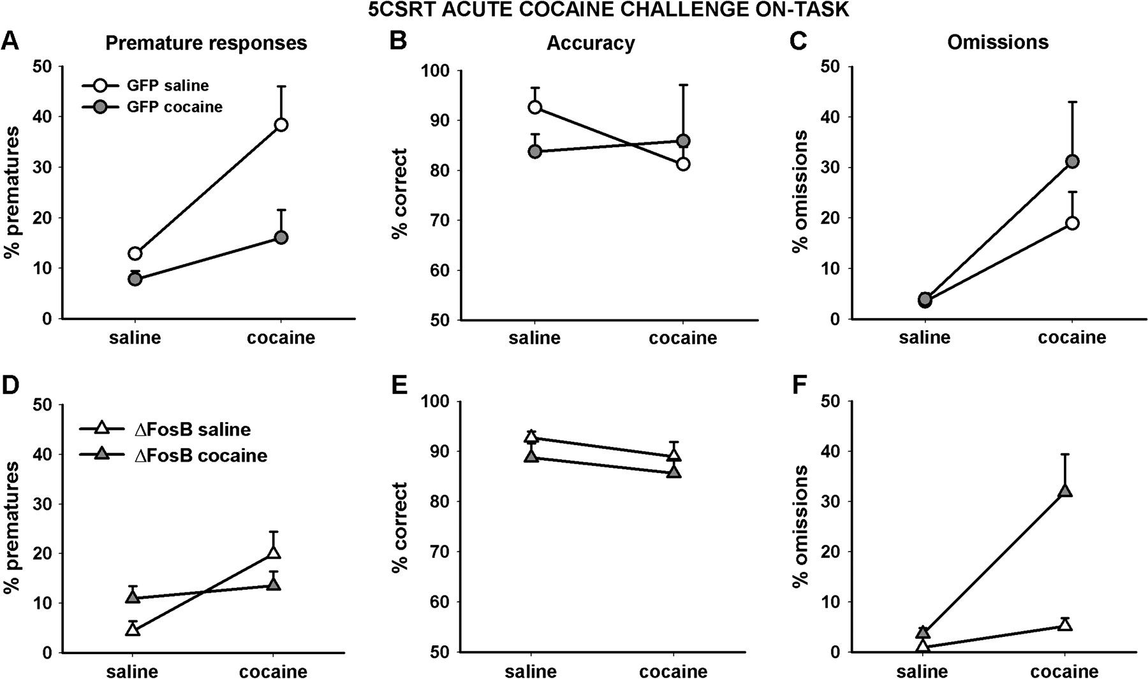
Figure 6. The effects of an acute cocaine challenge (10 mg/kg) on 5CSRT performance compared with performance after an ...
Notes:
Figure 6. The effects of an acute cocaine challenge (10 mg/kg) on 5CSRT performance compared with performance after an injection of saline. The xaxis denotes the injection given to the animals on that session, whereas the color of the symbols indicates the self-administration group to which the animals had been assigned, that is, whether they had been self-administering saline (white) or cocaine (gray). The left-hand column shows the percentage of premature responses made by both GFP control animals (A) and those overexpressing ΔFosB (D). The center column shows the percentage of correct responses made by both GFP control animals (B) and those overexpressing ΔFosB (E). The right-hand column shows the percentage of trials omitted by both GFP control animals (C) and those overexpressing ΔFosB (F). ΔFosB overexpression reduced the increase in premature responding and in omissions elicited by the acute cocaine challenge in animals previously trained with saline. Data shown are mean ±standard error of the mean.
Unless provided in the caption above, the following copyright applies to the content of this slide: © The Author 2008. Published by Oxford University Press. All rights reserved. For permissions, please e-mail: journals.permissions@oxfordjournals.org

