Slide 1
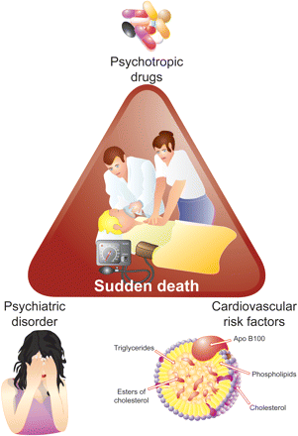
Figure 1 The triangle of sudden death in psychiatric patients.
Notes:
Figure 1 The triangle of sudden death in psychiatric patients.
Unless provided in the caption above, the following copyright applies to the content of this slide: Published on behalf of the European Society of Cardiology. All rights reserved. © The Author 2011. For permissions please email: journals.permissions@oup.com

