Slide 1
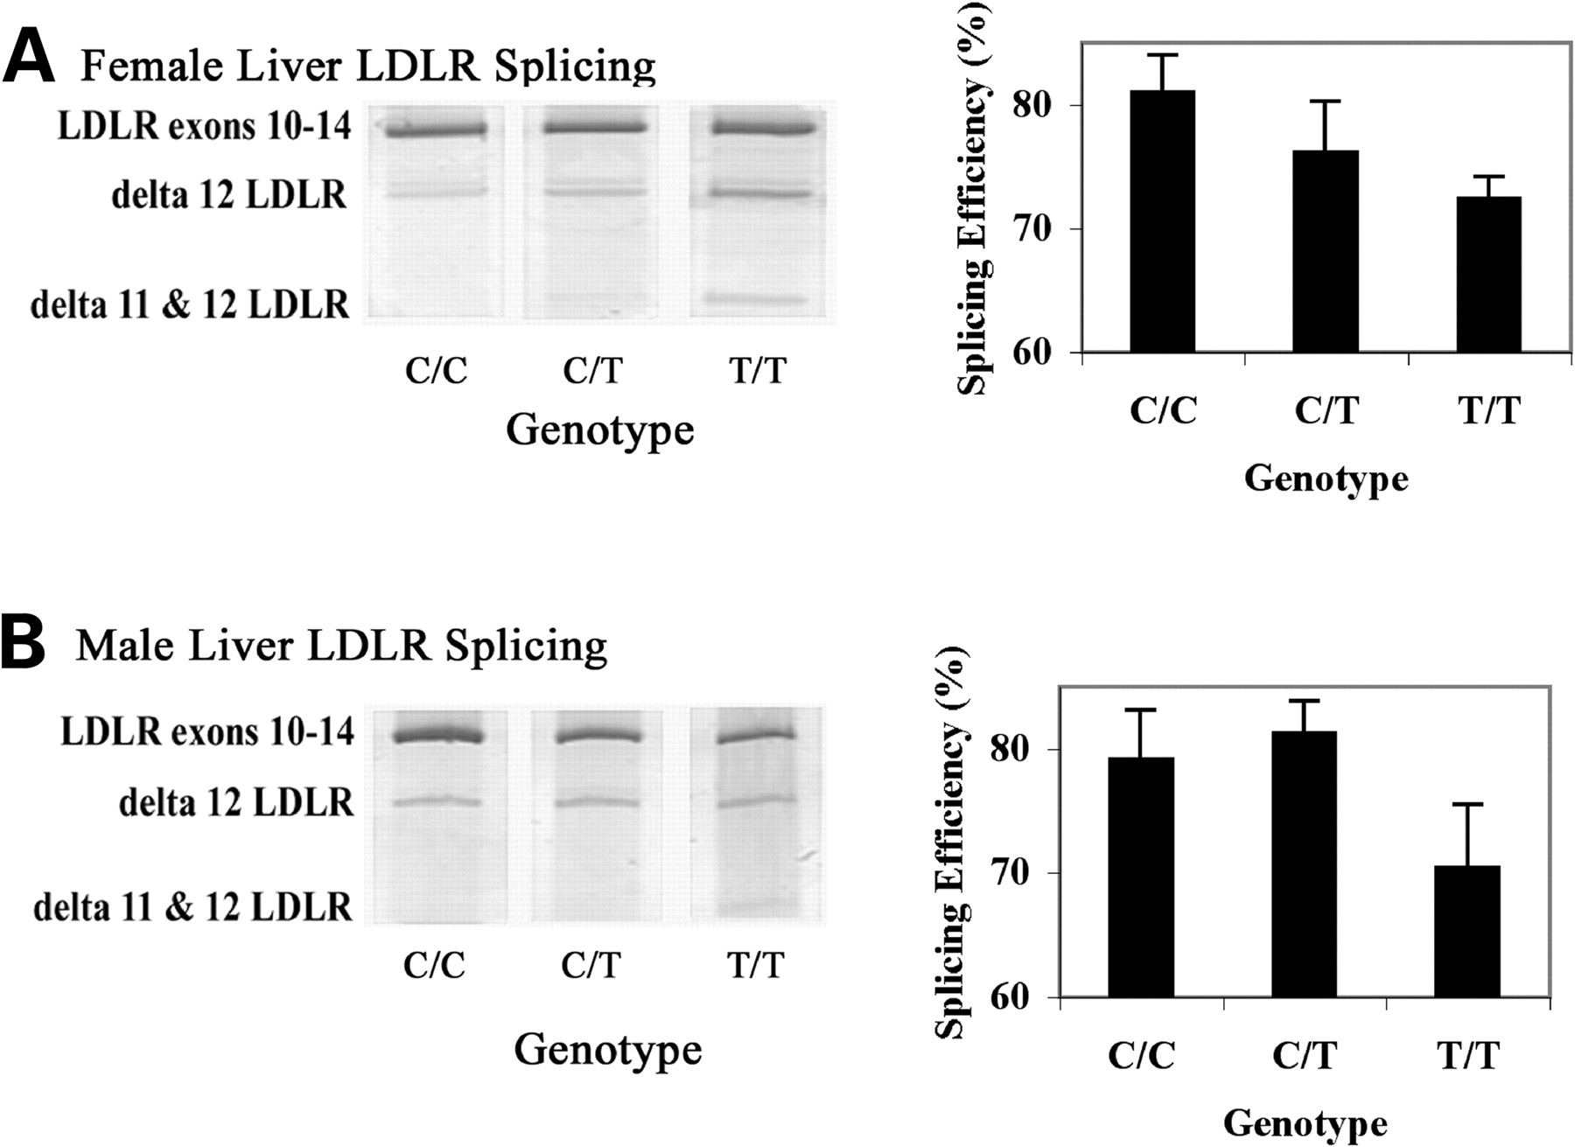
Figure 1. rs688 associates with LDLR splicing efficiency in female human livers in vivo . This figure depicts ...
Notes:
Figure 1. rs688 associates with LDLR splicing efficiency in female human livers in vivo . This figure depicts representative splicing results as well as quantitation for female ( A ) and male ( B ) liver samples. The bands corresponding to LDLR exons 10–14, as well as LDLR exons 10–11–13–14 (delta 12 LDLR), and LDLR exons 10–13–14 (delta 11 & 12 LDLR) are labeled. Sequencing established that the faint and inconsistent band above delta 12 LDLR represents delta 11 LDLR, which was not included in the quantitative analysis. rs688 was significantly associated with decreased splicing efficiency in females, i.e. P = 0.024 by non-parametric analysis. rs688 was not significantly associated with splicing efficiency in males ( P = 0.114).
Unless provided in the caption above, the following copyright applies to the content of this slide: © The Author 2007. Published by Oxford University Press. All rights reserved. For Permissions, please email: journals.permissions@oxfordjournals.org

Slide 2
Figure 2. rs688 in vivo splicing patterns are replicated in vitro . Minigenes containing genomic LDLR exons 9–14 were ...
Notes:
Figure 2. rs688 in vivo splicing patterns are replicated in vitro . Minigenes containing genomic LDLR exons 9–14 were cloned from two rs688C/C individuals and two rs688T/T individuals. One clone from each person was transfected into HepG2 cells and splicing patterns analyzed in triplicate beginning with cell transfections. The two rs688C genotype clones were associated with a higher splicing efficiency, i.e. 56 ± 3.8 and 53.4 ± 0.4 (%, mean ± SD, triplicate analysis) than the two rs699T genotype clones, i.e. 42.6 ± 0.8 and 40.4 ± 1.3. Similar results were observed in two separate experiments. Hence, relative differences in splicing efficiency in vivo are replicated in vitro .
Unless provided in the caption above, the following copyright applies to the content of this slide: © The Author 2007. Published by Oxford University Press. All rights reserved. For Permissions, please email: journals.permissions@oxfordjournals.org

Slide 3
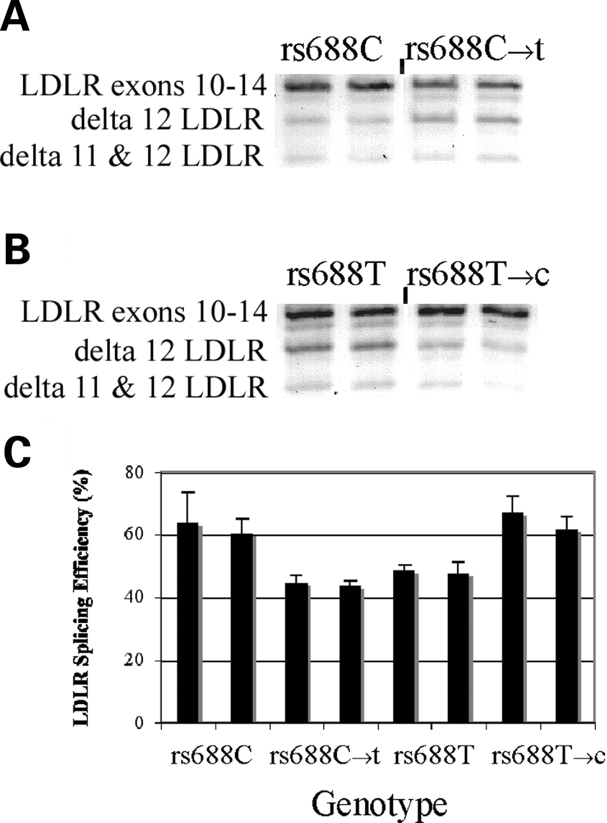
Figure 3. rs688 specifically modulates LDLR splicing efficiency in vitro . For each of the rs688C and rs688T ...
Notes:
Figure 3. rs688 specifically modulates LDLR splicing efficiency in vitro . For each of the rs688C and rs688T minigenes, we used site-directed mutagenesis to convert the C allele to the minor T allele, or vice versa. The eight constructs were then transfected into HepG2 cells in parallel and RNA isolated for analyses 24 h later. These results depict representative images ( A and B ) and quantitation [ C , mean ± SD ( n = 3)]. Splicing efficiency was increased by the rs688C allele, regardless of haplotypic background ( P < 0.001).
Unless provided in the caption above, the following copyright applies to the content of this slide: © The Author 2007. Published by Oxford University Press. All rights reserved. For Permissions, please email: journals.permissions@oxfordjournals.org

Slide 4
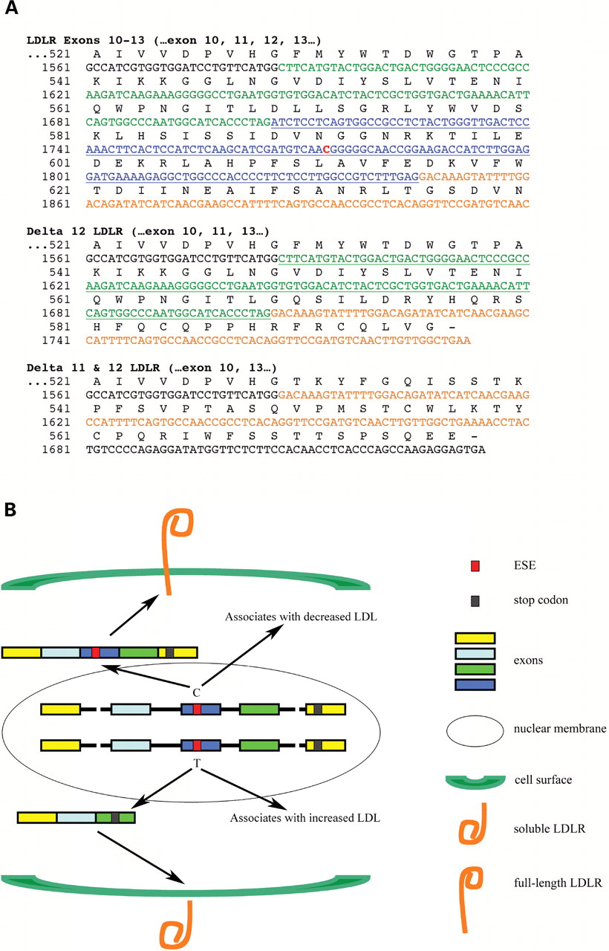
Figure 4. Inefficient LDLR exon splicing: primary sequence and LDLR function. ( A ) The sequence whereby the lack of ...
Notes:
Figure 4. Inefficient LDLR exon splicing: primary sequence and LDLR function. ( A ) The sequence whereby the lack of exon 12 or exons 11 and 12 alters the LDLR reading frame, leading to premature stop codons. Exons 10 are 14 are presented in black font while exons 11, 12 and 13 are presented in green, blue and orange font, respectively. rs688 is in red font. The corresponding amino acids are above the nucleotide sequence. ( B ) The opposing effects of the rs688C and rs688T alleles on (i) the LDLR exon 12 ESE, (ii) the proportion of LDLR mRNA lacking exon 12, (iii) the generation of predicted soluble forms of LDLR and (iv) cholesterol homeostasis. In addition to reflecting the findings of this report, this model proposes the testable hypothesis that the soluble LDLR isoforms antagonize LDL uptake; such actions have been reported previously for recombinant soluble LDLR isoforms and for a soluble form of ApoER2 ( 27–29 ).
Unless provided in the caption above, the following copyright applies to the content of this slide: © The Author 2007. Published by Oxford University Press. All rights reserved. For Permissions, please email: journals.permissions@oxfordjournals.org

