Slide 1
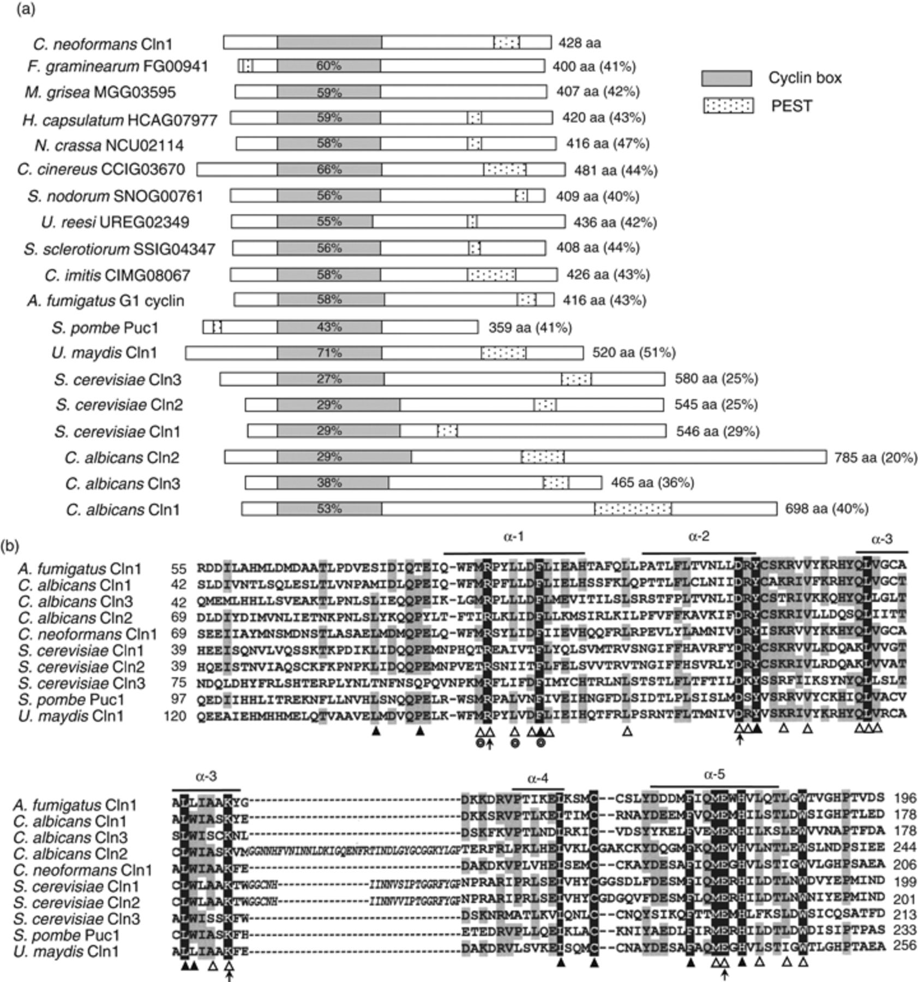
1 (a) This figure shows a comparison of the G1 cyclins of fungi. The sequences are aligned on their cyclin box ...
Notes:
1 (a) This figure shows a comparison of the G1 cyclins of fungi. The sequences are aligned on their cyclin box regions (gray box); putative PEST regions are indicated as dotted boxes. Percentage values inside the box show the sequence identity with Cln1 cyclin box. ‘aa’ shows the amino acid length and percentage values representing the overall sequence identity with Cln1 are shown in parentheses. Putative G1 cyclin sequences of Fusarium graminearum, Magnaporthe griseae, Histoplasma capsulatum, Neurospora crassa, Coprinus cinereus, Stagonospora nodorum, Uncinocarpus reesi, Sclerotinia sclerotiorum and Coccidioides imitis were obtained from the Fungal Genome Initiative of the Broad Institute, MIT (http://www.broad.mit.edu/annotation/fgi/). (b) This figure shows an alignment of the cyclin boxes of certain G1 cyclins from fungi. △, residues that are highly conserved in cyclins; ▲, residues that distinguish the G1 cyclins; ↑, highly conserved residues that participate in Cdk interaction; ⊚, conserved residues of the HPD. Numbers indicate the residues encompassing the cyclin box domain. The five bars above the sequence show the postulated positions of the five α helices of the cyclin box based on structural modeling in Saccharomyces cerevisiae G1 cyclins Cln2 and Cln3 (Huang, 1997; Miller, 2005).
Unless provided in the caption above, the following copyright applies to the content of this slide: © 2010 Federation of European Microbiological Societies. Published by Blackwell Publishing Ltd. All rights reserved

Slide 2
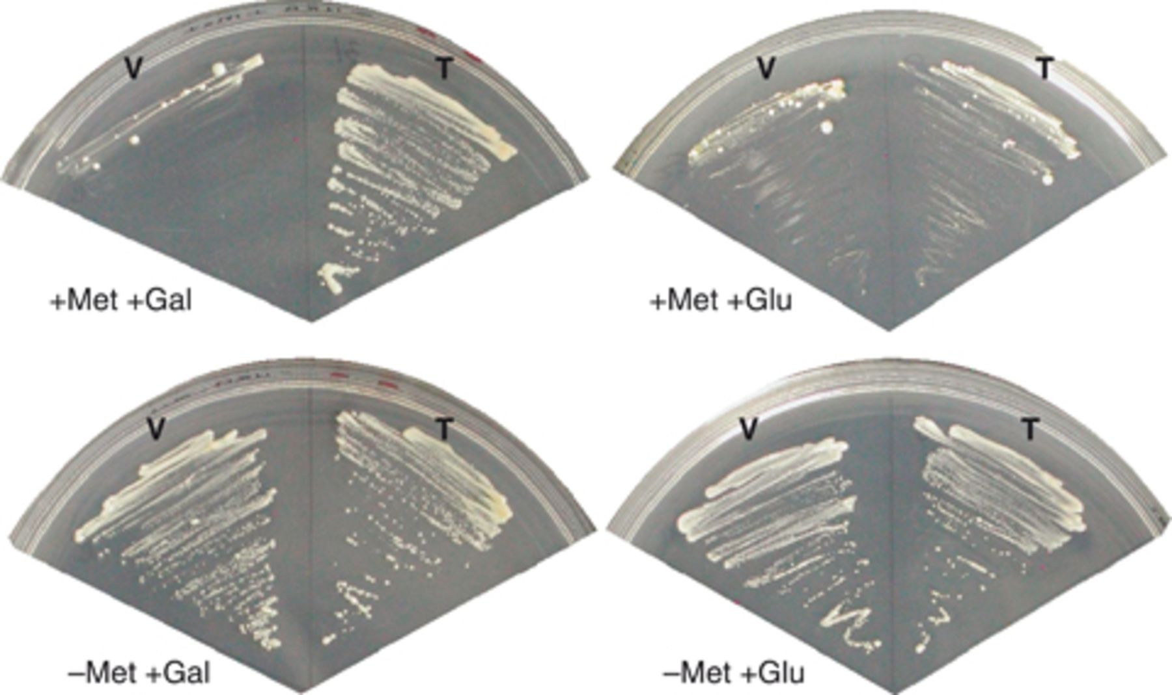
2 This figure shows the results of complementation of Saccharomyces cerevisiae G1 cyclin mutation by CLN1. ...
Notes:
2 This figure shows the results of complementation of Saccharomyces cerevisiae G1 cyclin mutation by CLN1. Here, it is shown that cells transformed with the pYES2-ORF17 (T) construct, but not those transformed with the empty pYES2 vector (V), can grow in the presence of methionine (where endogenous CLN2 expression is repressed) and only when supplied with galactose instead of glucose (wherein the expression of ORF17 from pYES2 is induced).
Unless provided in the caption above, the following copyright applies to the content of this slide: © 2010 Federation of European Microbiological Societies. Published by Blackwell Publishing Ltd. All rights reserved

Slide 3
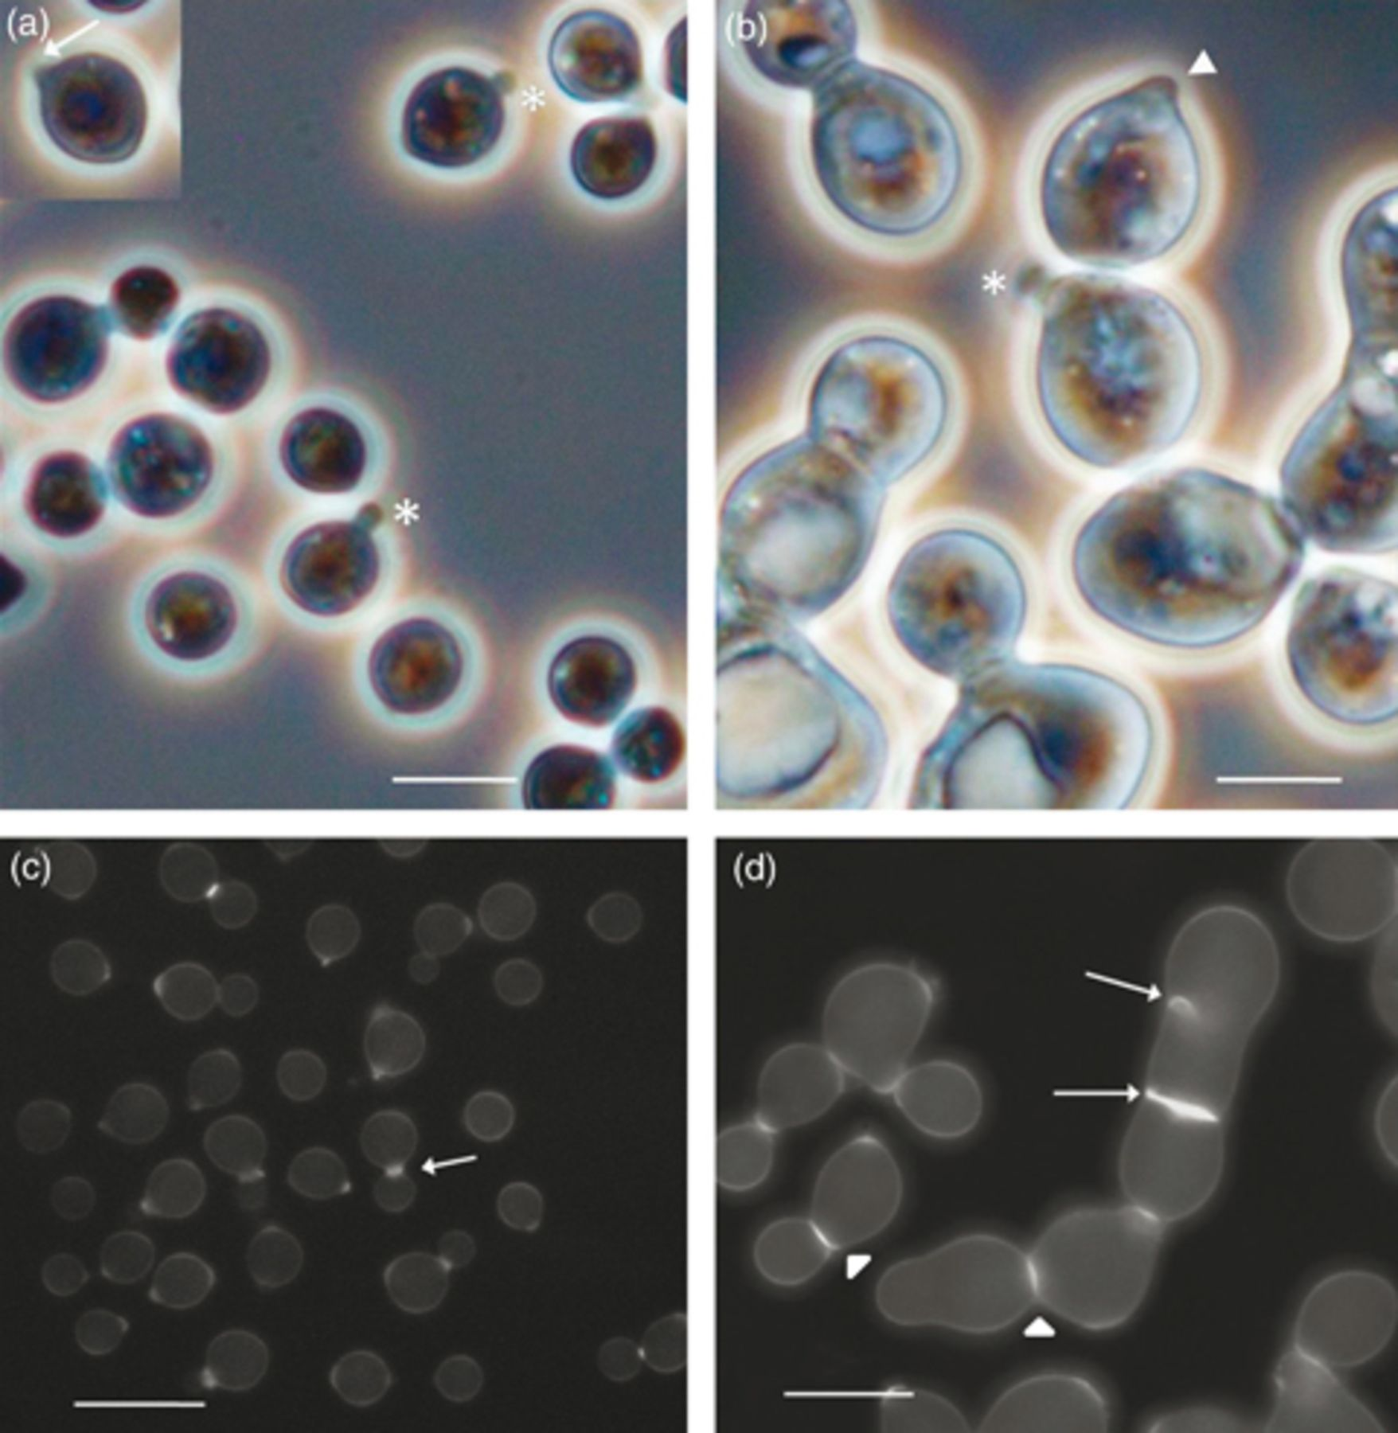
3 Phase-contrast micrographs of (a) wild type and (b) cln1Δ mutant. Wild-type cells show spike-like initial bud ...
Notes:
3 Phase-contrast micrographs of (a) wild type and (b) cln1Δ mutant. Wild-type cells show spike-like initial bud protrusions [arrow in (a)] and a small spherical bud [asterisks in (a)]. Morphologically altered initial bud protrusion [arrowhead in (b)]. The smallest spherical bud discerned [asterisk in (b)] was also enlarged much wider than the wild type. In wild-type, necks are narrow [arrow in (c)], and the buds are separated from the mother. In cln1Δ mutant, necks are wide. To show further abnormal morphology in cln1Δ mutant, a seemingly elongated cell is shown in upper right of (d). It is actually composed of three cells, but due to the existence of a very wide septum [lower arrow in (d)] and an incomplete septum [upper arrow in (d)], cells remained attached to each other. Scale bar=5 μm. Fluorescence images of calcofluor-stained wild type (c) and deletion mutant cells (d). Scale bar=10 μm.
Unless provided in the caption above, the following copyright applies to the content of this slide: © 2010 Federation of European Microbiological Societies. Published by Blackwell Publishing Ltd. All rights reserved

Slide 4
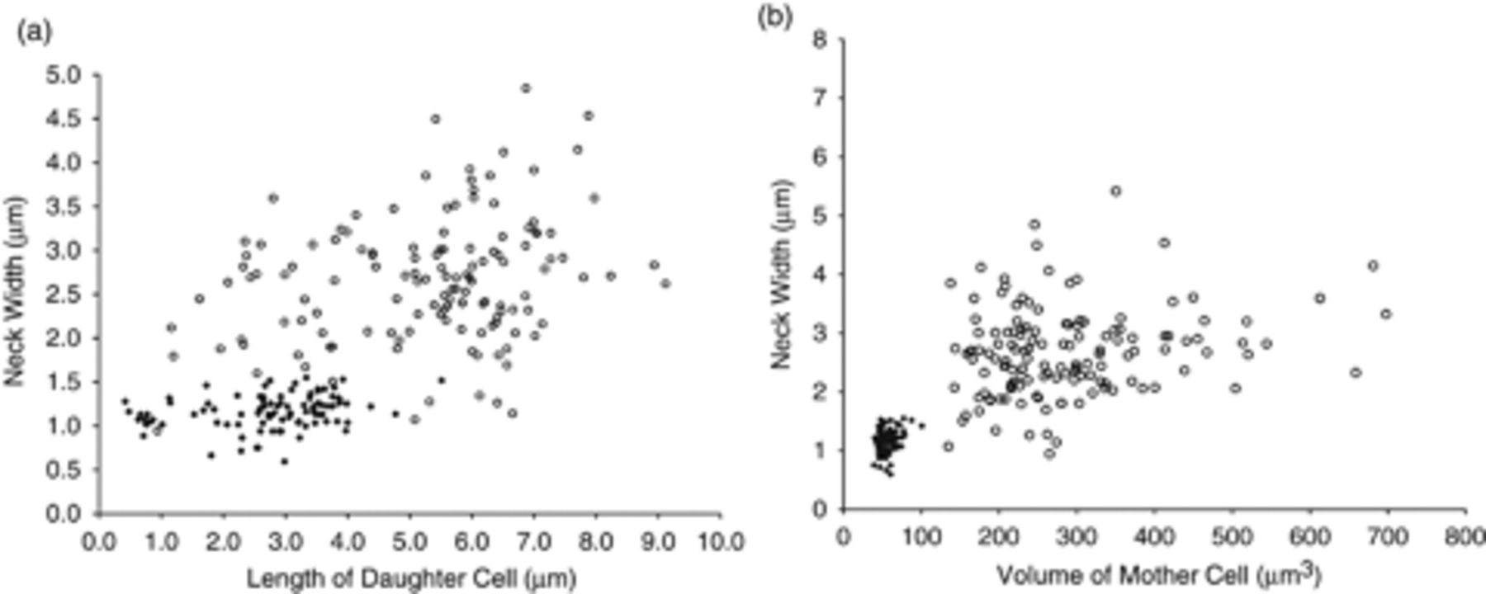
4 (a) Neck width of the cln1Δ mutant (○) and the wild type (▲) against the width of daughter cells. Both the ...
Notes:
4 (a) Neck width of the cln1Δ mutant (○) and the wild type (▲) against the width of daughter cells. Both the average neck width and deviation from average become much wider in the deletion mutant. Increase of the neck width with the growth of the daughter was small if at all. (b) In the wild-type cells (▲), the volume of the mother cell and neck width had a narrow size distribution. On the other hand, in the cln1Δ mutant (○), the variation of volume of mother cell was considerably increased and the neck width became larger as the variation in size increased. The neck width did not correlate strongly with the volume of the mother cell.
Unless provided in the caption above, the following copyright applies to the content of this slide: © 2010 Federation of European Microbiological Societies. Published by Blackwell Publishing Ltd. All rights reserved

Slide 5
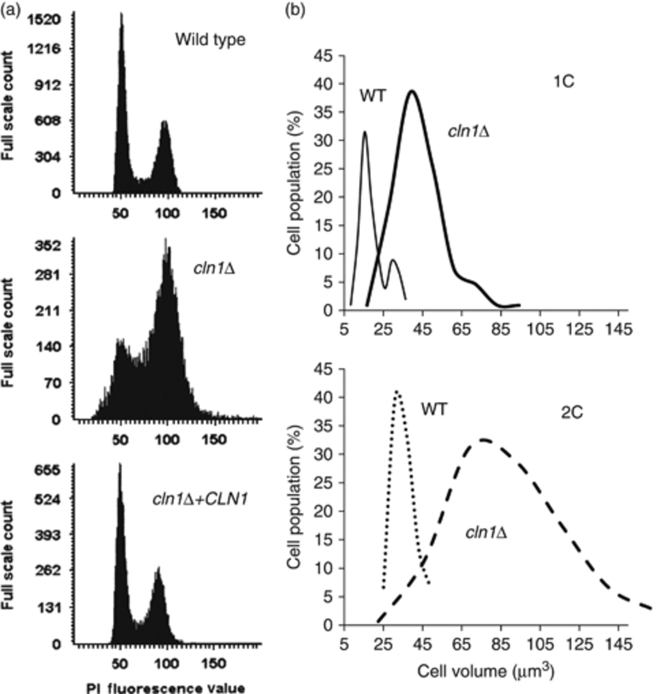
5 (a) Change of the cell cycle distribution of the wild type, cln1Δ mutant and CLN1 reconstitution strain cells ...
Notes:
5 (a) Change of the cell cycle distribution of the wild type, cln1Δ mutant and CLN1 reconstitution strain cells grown at the log phase as examined by a laser-scanning cytometer. The horizontal axis shows the propidium iodide fluorescence value. The vertical axis shows the full scale count, i.e., number of cells showing a particular propidium iodide fluorescence value. Laser-scanning cytometer allowed measurement of a large number of cells (c. 20 000) so that essentially the same results as FACS were obtained. Most of the mutant cells (70%) had a 2C DNA content. On the other hand, most of the wild type and reconstituted strain cells (70%) had a 1C DNA content. (b) Measurement of cell size in relation to the DNA content. The cell sizes were analyzed based on their DNA content as measured by a laser-scanning cytometer (Fig. 5a). Cell size distribution of G1 cells of the wild type is represented by the thin solid line and the cln1Δ mutant by the thick one, respectively, in the upper graph. The cell size distribution of G2 cells of the wild type is represented by the dotted line and the cln1Δ mutant by the dashed one, respectively, in the lower graph. The average sizes of G1 cells in the wild type and the cln1Δ mutant were 18.9±7.8 (n=102) and 39.7±6.2 (n=109), respectively. The average sizes of G2 cells in the wild type and the cln1Δ mutant were 32.2+6.2 (n=30) and 78.9+35.4 (n=150), respectively.
Unless provided in the caption above, the following copyright applies to the content of this slide: © 2010 Federation of European Microbiological Societies. Published by Blackwell Publishing Ltd. All rights reserved

Slide 6
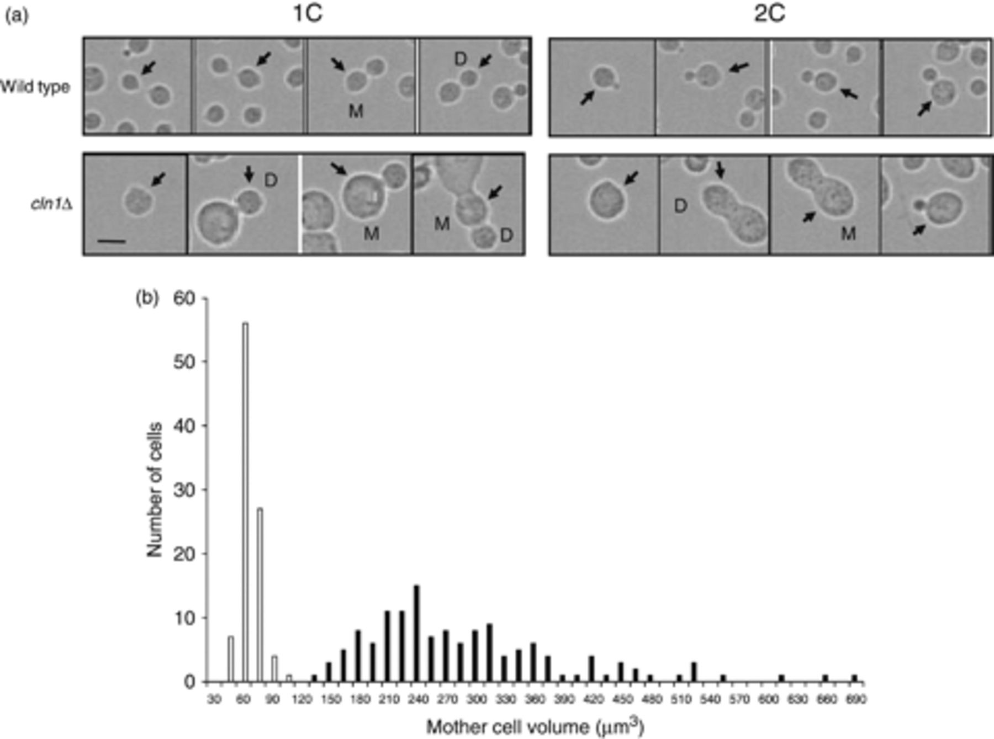
6 (a) Typical morphology of cells having a similar DNA content, as shown after using the recall function of a ...
Notes:
6 (a) Typical morphology of cells having a similar DNA content, as shown after using the recall function of a laser-scanning cytometer. The arrow shows the recalled cell whose nucleus was measured for DNA content. Left figures show wild type and deletion mutant recalled cells having a DNA content between 0.8C and 1.2C (G1). Right figures show wild type and deletion mutant recalled cells having a DNA content between 1.8C and 2.2C (G2). Wild type and cln1Δ mutant cells with a G1 DNA content were unbudded, i.e., these cells have not yet produced new buds, while wild-type G2 cells were almost always budded, i.e., these cells already produced new buds. Note that cln1Δ mutant cells were mostly unbudded even in the G2 phase. Daughter cells (D) and mother cells (M) with one nucleus each, showing that they have finished nuclear division, but remain attached, are indicated. Cells were measured for DNA content (Fig. 5a) and size (Fig. 5b). Through the laser-scanning cytometer recall function, each cell (at the center of the microscopic field and indicated by an arrow in the photo) that was measured for DNA quantity could be examined closely to allow combining morphological data with DNA content without the need for arrest or synchronization experiments. Scale bar=5 μm. All figures are of the same magnification. (b) Size distribution of the cln1Δ mutant (black bars) and wild-type (white bars) mother cells having buds. On average, the volume of wild-type mother cells was around 70 μm3, while it became three to four times larger in the deletion mutant. Also, the deviation from the average was much larger in the mutant, showing that size control was disrupted.
Unless provided in the caption above, the following copyright applies to the content of this slide: © 2010 Federation of European Microbiological Societies. Published by Blackwell Publishing Ltd. All rights reserved

Slide 7
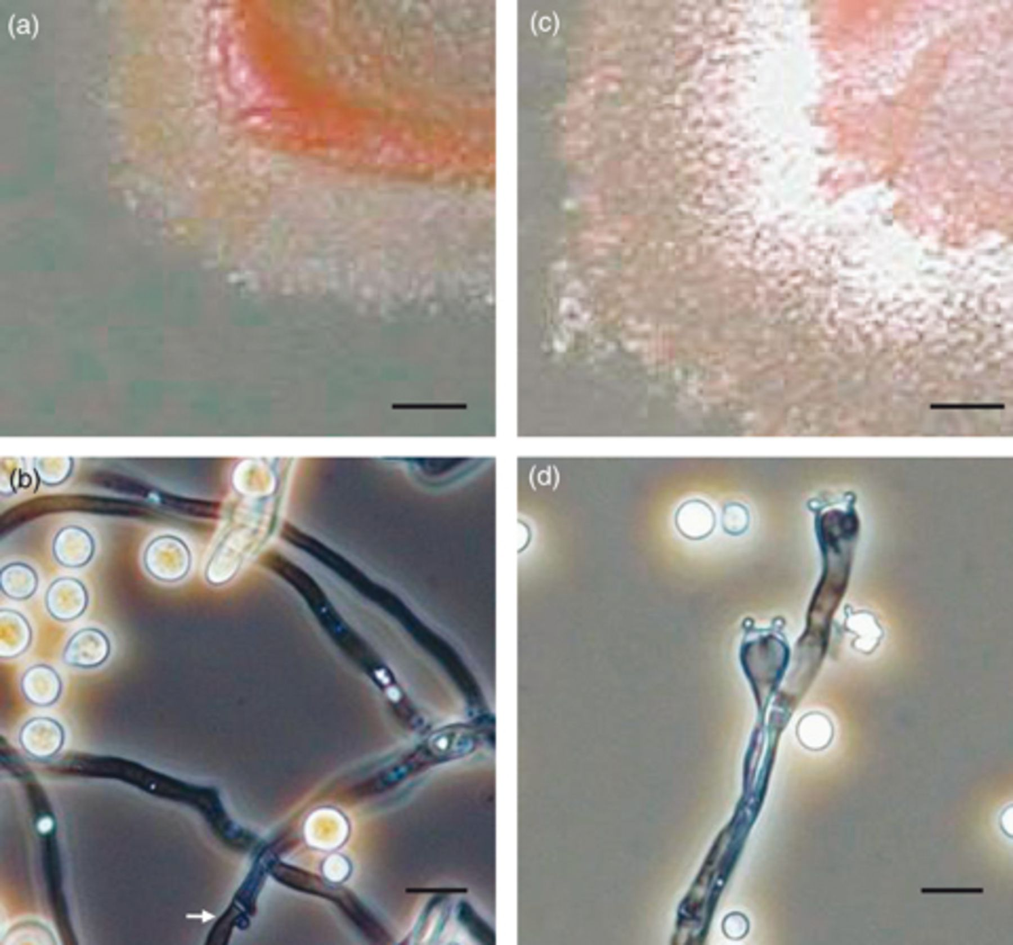
7 Mating test of the cln1Δ mutant. Cells were grown in a Hay Cube Agar at 25°C for 1 week. (a) cln1Δ mutant ...
Notes:
7 Mating test of the cln1Δ mutant. Cells were grown in a Hay Cube Agar at 25°C for 1 week. (a) cln1Δ mutant grown singly showing filamentous growth from the colony, but no whitish spores present as confirmed by microscopy (b). Arrow shows clamp-connection-like structures. (c) cln1Δ mutant mated with a B3501 mating type a tester strain showing whitish hyphae-producing spores. Basidia visible in (d). Scale bar in (a, c)=0.5 cm. Scale bar in (b, d)=25 μm.
Unless provided in the caption above, the following copyright applies to the content of this slide: © 2010 Federation of European Microbiological Societies. Published by Blackwell Publishing Ltd. All rights reserved

