Slide 1
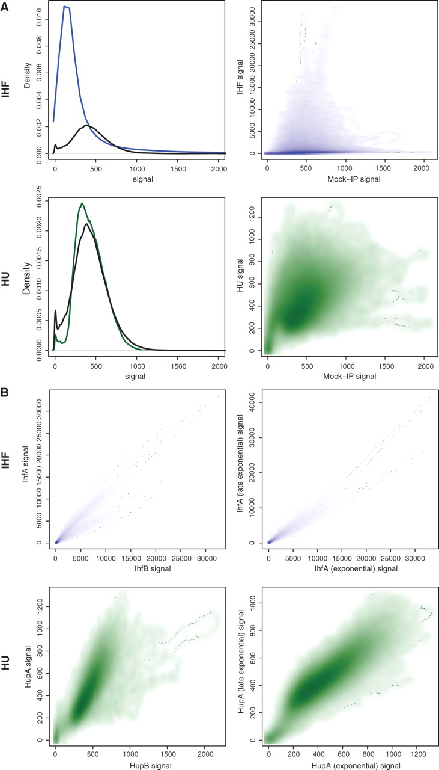
Figure 1. ( A ) The left panels show the distribution of read counts ( x -axis truncated at 20) for IHF (blue), HU ...
Notes:
Figure 1. ( A ) The left panels show the distribution of read counts ( x -axis truncated at 20) for IHF (blue), HU (green) and the mock-IP (black). The right panels show the correlation (at single-base resolution) in read counts between the mock-IP ( x -axis) and HupA (green) or IhfA (blue) ChIP-seq ( y -axis). ( B ) The left panels show the base-level correlation in read counts between IhfA and IhfB (blue), and HupA and HupB (green). The above are all for exponential phase data. The right panels show similar correlations for the same protein, but between the two exponential phase time-points. The signal is the number of reads mapping to a given base position divided by the total number of reads in the sample (multiplied by a factor 10 7 ).
Unless provided in the caption above, the following copyright applies to the content of this slide: © The Author(s) 2011. Published by Oxford University Press.This is an Open Access article distributed under the terms of the Creative Commons Attribution Non-Commercial License (http://creativecommons.org/licenses/by-nc/3.0), which permits unrestricted non-commercial use, distribution, and reproduction in any medium, provided the original work is properly cited.

Slide 2
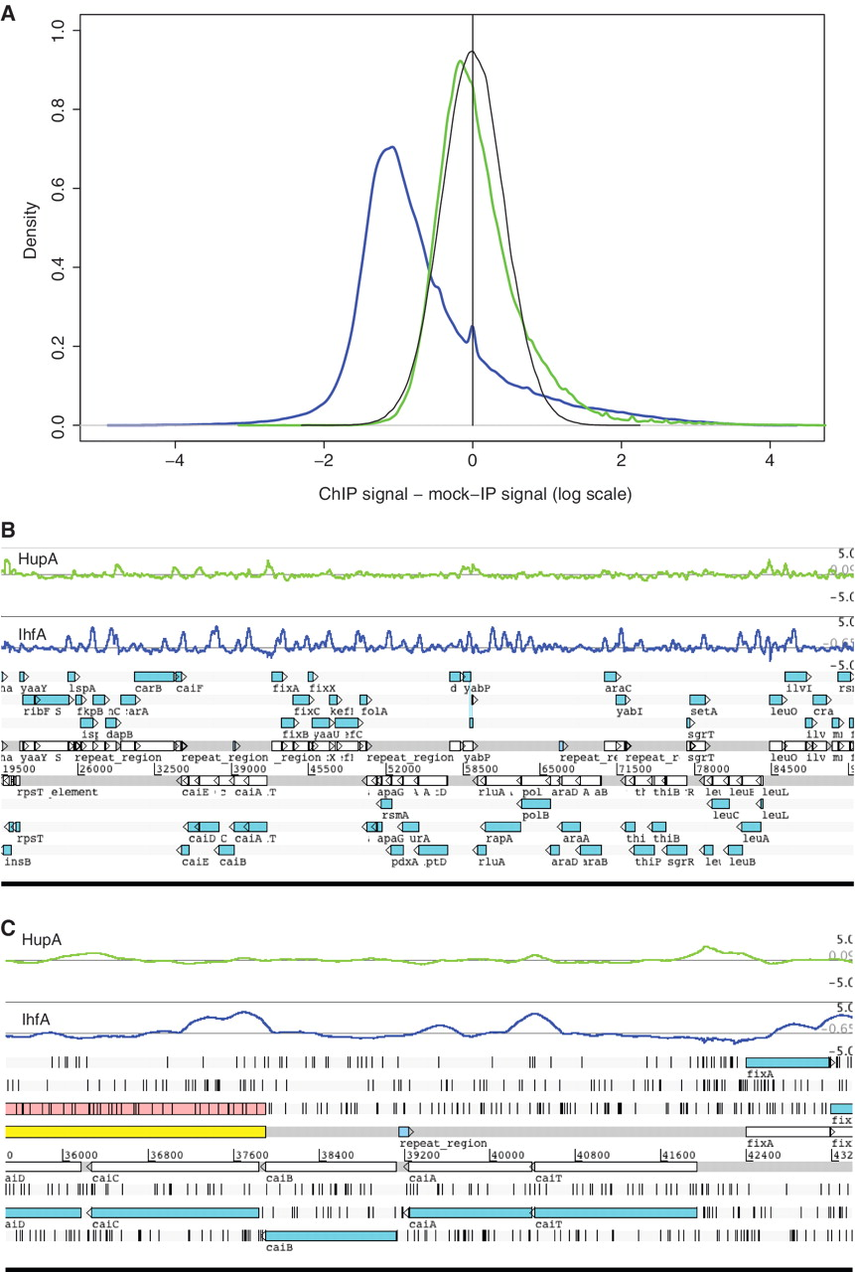
Figure 2. ( A ) Comparison of mock-IP-subtracted binding signals (log-scale of the number of reads mapping to a given ...
Notes:
Figure 2. ( A ) Comparison of mock-IP-subtracted binding signals (log-scale of the number of reads mapping to a given position normalized by the total number of reads from that sequencing experiment multiplied by a factor 10 7 ) for IhfA (blue) and HupA (green). For HupA, the distribution is centered around zero with a slight right tail; this is similar to what might be expected when a simulated replicate of the mock-IP signal is subtracted from the reference mock-IP (black line; where each data point for the in silico replicate is derived from a normal distribution with mean equal to the signal on the mock-IP and standard deviation equal to that across the mock-IP dataset). On the other hand, for IhfA, the distribution has a strong offset from zero, with many points being below zero indicating lack of binding and a considerable number above zero indicating strong signal. ( B ) Tracks—rendered in Artemis—showing binding signals for IHF (blue) and HU (green) across an ∼70 kb region of the genome. ( C ) A zoomed-in image of a portion of B, showing an ∼8 kb region of the genome.
Unless provided in the caption above, the following copyright applies to the content of this slide: © The Author(s) 2011. Published by Oxford University Press.This is an Open Access article distributed under the terms of the Creative Commons Attribution Non-Commercial License (http://creativecommons.org/licenses/by-nc/3.0), which permits unrestricted non-commercial use, distribution, and reproduction in any medium, provided the original work is properly cited.

Slide 3
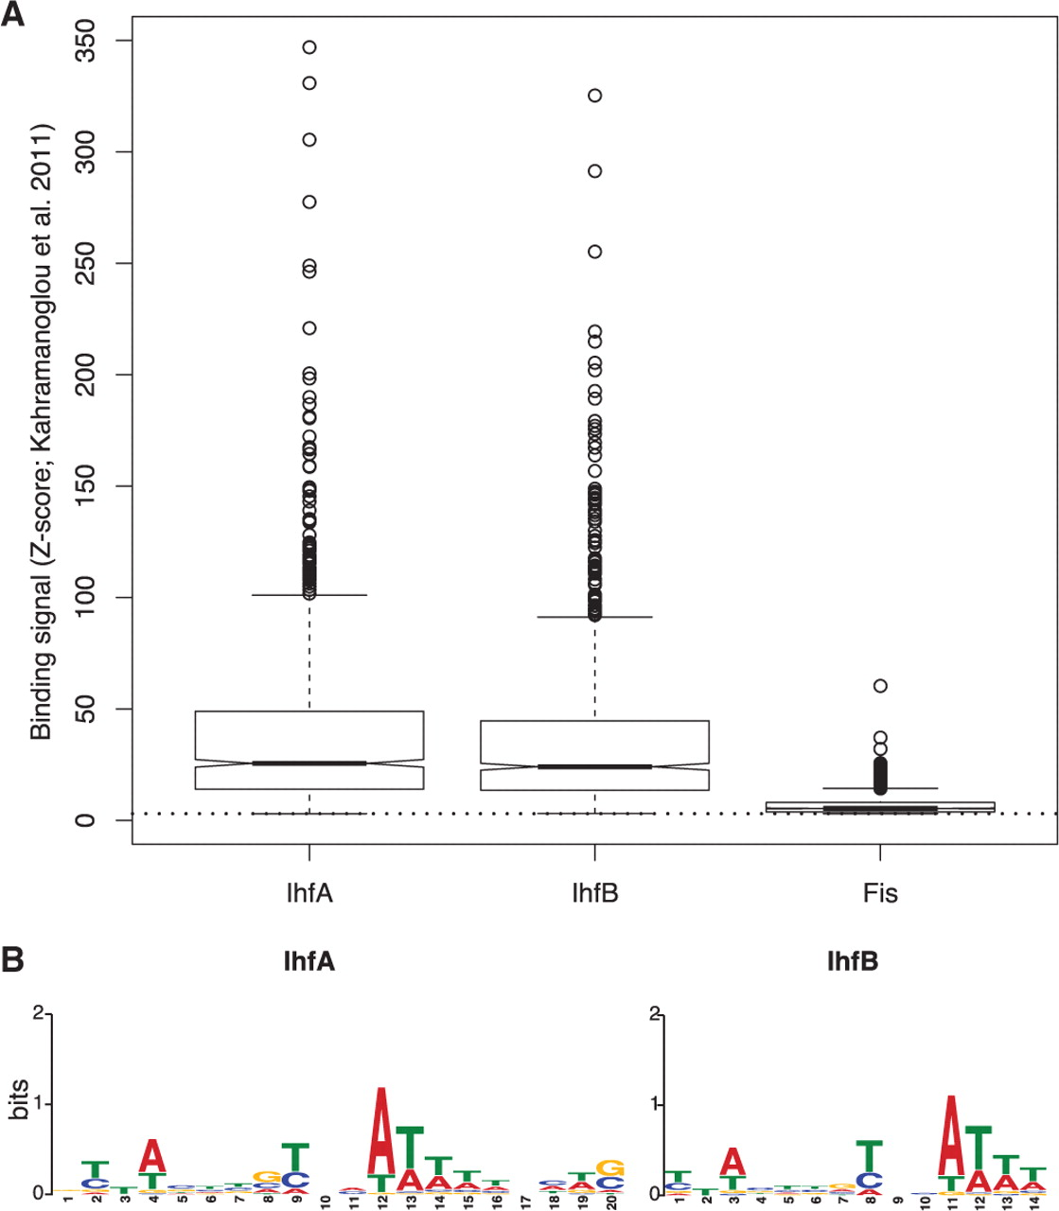
Figure 3. ( A ) Comparison of binding signals, represented by Z -scores as described in Kahramanoglou et al . ( 4 ), ...
Notes:
Figure 3. ( A ) Comparison of binding signals, represented by Z -scores as described in Kahramanoglou et al . ( 4 ), for IhfA, IhfB and Fis. This shows that binding signals for IHF are considerably higher than those for Fis ( B ) Weblogo representing the binding motifs for IHF.
Unless provided in the caption above, the following copyright applies to the content of this slide: © The Author(s) 2011. Published by Oxford University Press.This is an Open Access article distributed under the terms of the Creative Commons Attribution Non-Commercial License (http://creativecommons.org/licenses/by-nc/3.0), which permits unrestricted non-commercial use, distribution, and reproduction in any medium, provided the original work is properly cited.

Slide 4
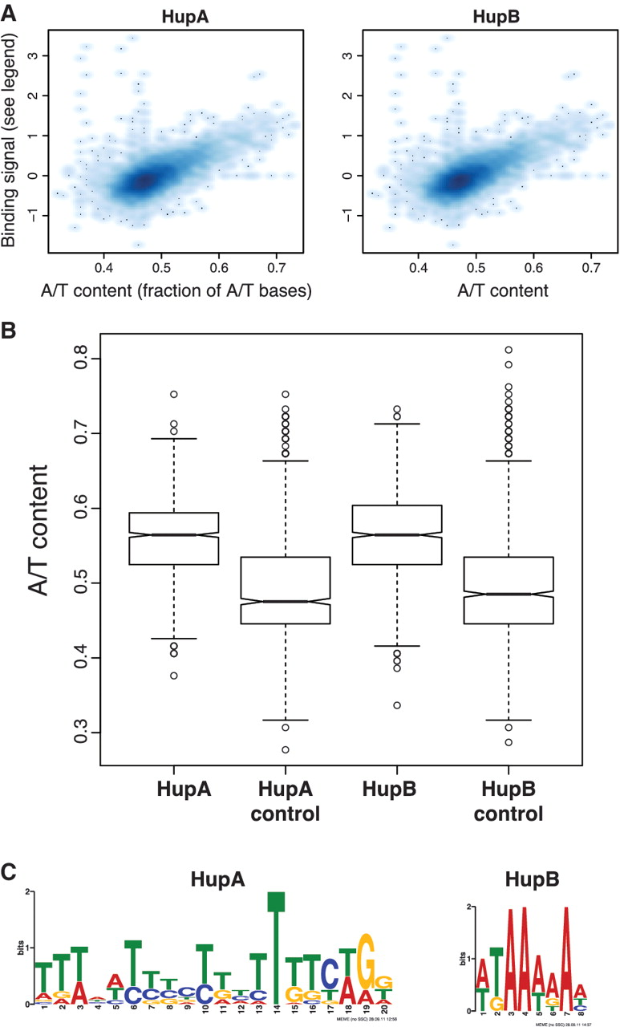
Figure 4. ( A ) Correlation between HU binding signal (as the median of read counts across the gene body, where read ...
Notes:
Figure 4. ( A ) Correlation between HU binding signal (as the median of read counts across the gene body, where read counts are divided by the total number of reads obtained for that sample and multiplied by a factor of 10 7 ; this number was then subtracted by the corresponding value from the mock-IP experiment) and A/T content (as a fraction of the total number of bases). These are for exponential phase data. ( B ) A/T content of regions of enriched mock-IP-subtracted ChIP-seq signal for HupA and HupB [modified from Kind et al . ( 45 )], compared to the A/T content of randomly picked regions of the same length as regions of enriched signal (marked as controls). ( C ) Best motif identified by MEME for HupA and HupB.
Unless provided in the caption above, the following copyright applies to the content of this slide: © The Author(s) 2011. Published by Oxford University Press.This is an Open Access article distributed under the terms of the Creative Commons Attribution Non-Commercial License (http://creativecommons.org/licenses/by-nc/3.0), which permits unrestricted non-commercial use, distribution, and reproduction in any medium, provided the original work is properly cited.

Slide 5
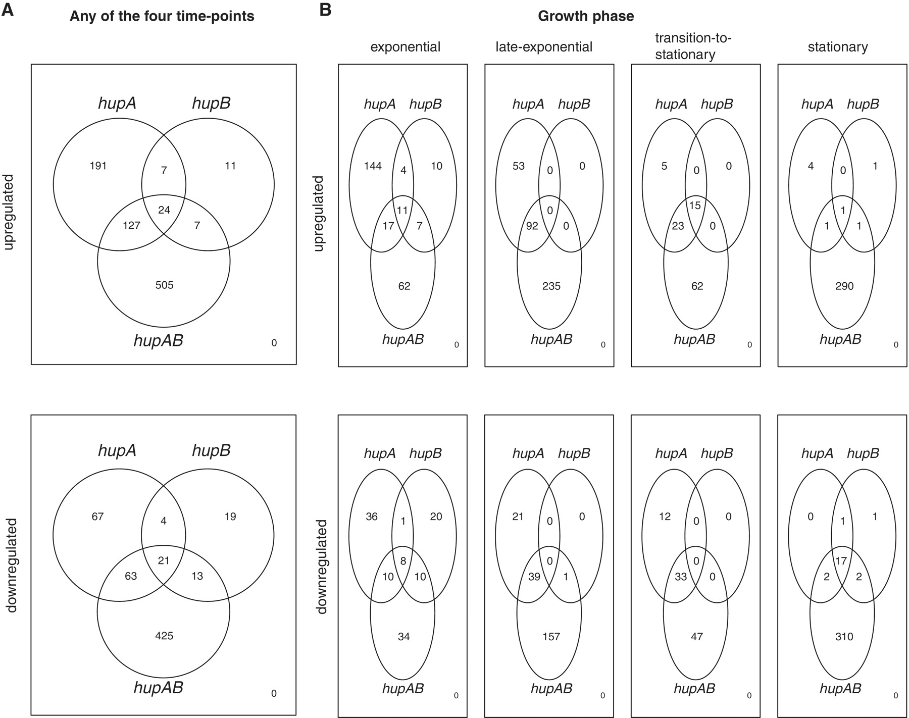
Figure 5. Venn diagrams showing the degree of overlap in numbers of genes that are differentially expressed in the ...
Notes:
Figure 5. Venn diagrams showing the degree of overlap in numbers of genes that are differentially expressed in the various hup deletions at different time-points.
Unless provided in the caption above, the following copyright applies to the content of this slide: © The Author(s) 2011. Published by Oxford University Press.This is an Open Access article distributed under the terms of the Creative Commons Attribution Non-Commercial License (http://creativecommons.org/licenses/by-nc/3.0), which permits unrestricted non-commercial use, distribution, and reproduction in any medium, provided the original work is properly cited.

Slide 6
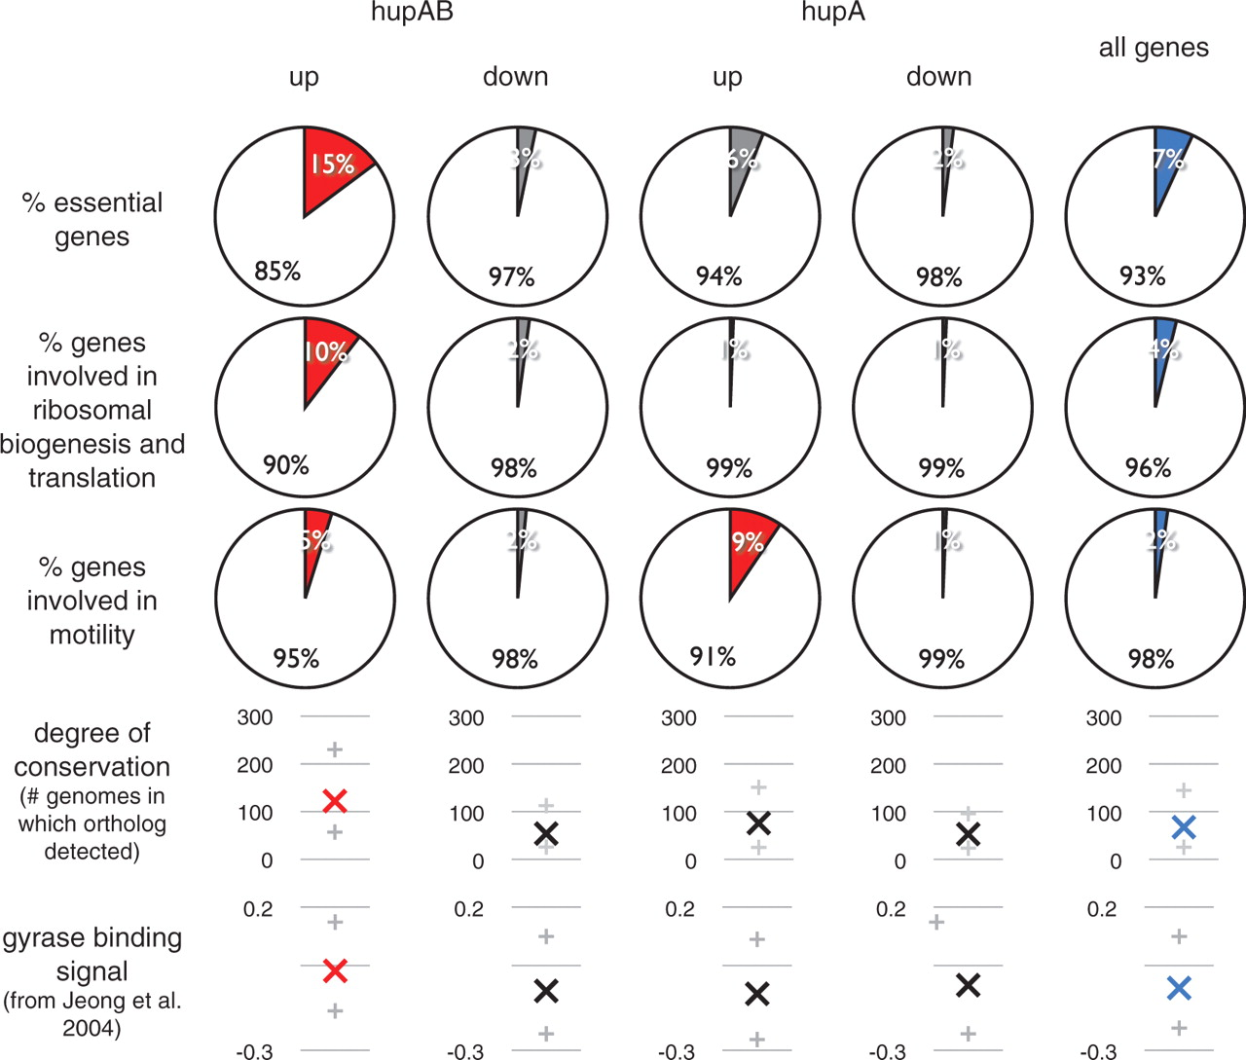
Figure 6. Pie charts showing the proportions of genes in various sets (up or downregulated in hupAB, hupA or hupB ...
Notes:
Figure 6. Pie charts showing the proportions of genes in various sets (up or downregulated in hupAB, hupA or hupB across any of the four time-points) that are essential, involved in ribosome biogenesis and translation, and motility. Also shown are plots displaying the degree of conservation (as determined by the presence of bi-directional best-hit FASTA orthologs across 380 prokaryotic genomes) and DNA gyrase binding signal [from Jeong et al . ( 40 )]; in these plots ‘X’ is the median of the distribution and ‘+’ shows the first and the third quartiles. Red shows statistical enrichment (pie charts) or statistically higher medians (distributions) when compared to the reference set of all genes (blue).
Unless provided in the caption above, the following copyright applies to the content of this slide: © The Author(s) 2011. Published by Oxford University Press.This is an Open Access article distributed under the terms of the Creative Commons Attribution Non-Commercial License (http://creativecommons.org/licenses/by-nc/3.0), which permits unrestricted non-commercial use, distribution, and reproduction in any medium, provided the original work is properly cited.

