Slide 1
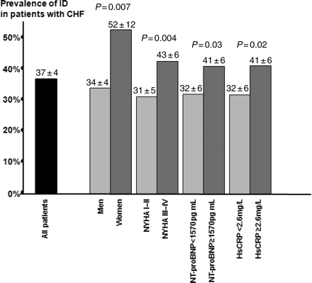
Figure 1 Prevalence of iron deficiency in patients with chronic heart failure (CHF), also in clinical subgroups ...
Notes:
Figure 1 Prevalence of iron deficiency in patients with chronic heart failure (CHF), also in clinical subgroups (percentages ± 95% confidence intervals). In the case of plasma N-terminal pro-type B natriuretic peptide (NT-proBNP) and serum high-sensitivity C-reactive protein (hs-C-reactive protein), medians were used as cut-off values.
Unless provided in the caption above, the following copyright applies to the content of this slide: Published on behalf of the European Society of Cardiology. All rights reserved. © The Author 2011. For permissions please email: journals.permissions@oup.comThe online version of this article has been published under an open access model. Users are entitled to use, reproduce, disseminate, or display the open access version of this article for non-commercial purposes provided that the original authorship is properly and fully attributed; the Journal, Learned Society and Oxford University Press are attributed as the original place of publication with correct citation details given; if an article is subsequently reproduced or disseminated not in its entirety but only in part or as a derivative work this must be clearly indicated. For commercial re-use, please contact journals.permissions@oup.com

Slide 2
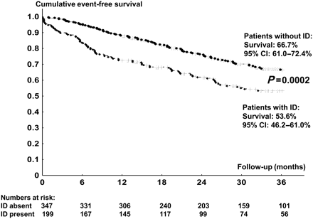
Figure 2 Kaplan–Meier curves reflecting 3-year event-free survival rates in patients with systolic chronic heart ...
Notes:
Figure 2 Kaplan–Meier curves reflecting 3-year event-free survival rates in patients with systolic chronic heart failure with vs. without iron deficiency.
Unless provided in the caption above, the following copyright applies to the content of this slide: Published on behalf of the European Society of Cardiology. All rights reserved. © The Author 2011. For permissions please email: journals.permissions@oup.comThe online version of this article has been published under an open access model. Users are entitled to use, reproduce, disseminate, or display the open access version of this article for non-commercial purposes provided that the original authorship is properly and fully attributed; the Journal, Learned Society and Oxford University Press are attributed as the original place of publication with correct citation details given; if an article is subsequently reproduced or disseminated not in its entirety but only in part or as a derivative work this must be clearly indicated. For commercial re-use, please contact journals.permissions@oup.com

