Slide 1
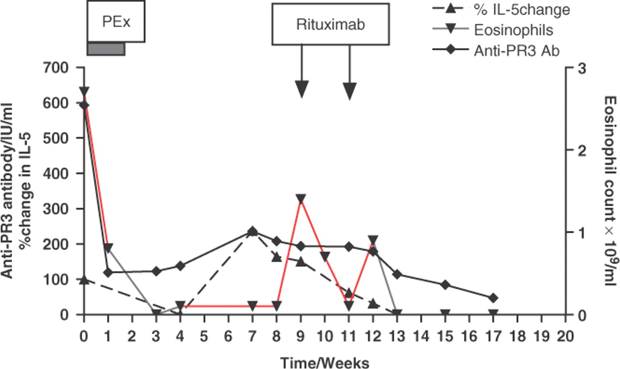
Fig. 1. Graph demonstrating the anti-PR3-ANCA titre, eosinophil cell number and change in serum IL-5 levels compared ...
Notes:
Fig. 1. Graph demonstrating the anti-PR3-ANCA titre, eosinophil cell number and change in serum IL-5 levels compared to baseline, during the course of treatment, in Patient 1.
Unless provided in the caption above, the following copyright applies to the content of this slide: © The Author 2008. Published by Oxford University Press on behalf of the British Society for Rheumatology. All rights reserved. For Permissions, please email: journals.permissions@oxfordjournals.org

