Slide 1
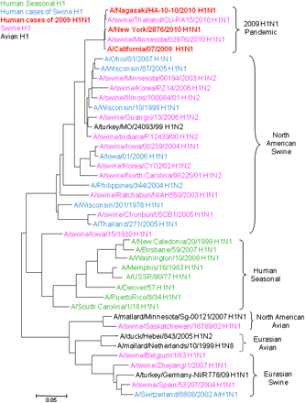
Figure 1. Evolutionary Relationships Among Influenza A (H1) Hemagglutinin (HA1) Genes. A neighbor-joining phylogenetic ...
Notes:
Figure 1. Evolutionary Relationships Among Influenza A (H1) Hemagglutinin (HA1) Genes. A neighbor-joining phylogenetic tree for nucleotide sequences coding the H1 subtype, HA1 open reading frame, from different influenza hosts. The select viruses were chosen from available sequences in GenBank. Trees were inferred using MEGA 4, with evolutionary distances computed using the nucleotide model of Tamura–Nei [37]. Scale (.05) represents approximately 49 nucleotide changes.
Unless provided in the caption above, the following copyright applies to the content of this slide: Published by Oxford University Press on behalf of the Infectious Diseases Society of America 2011.

Slide 2
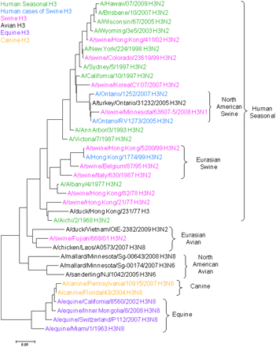
Figure 2. Evolutionary Relationships Among Influenza A (H3) Hemagglutinin (HA1) Genes. A neighbor-joining phylogenetic ...
Notes:
Figure 2. Evolutionary Relationships Among Influenza A (H3) Hemagglutinin (HA1) Genes. A neighbor-joining phylogenetic tree for nucleotide sequences coding the H3 subtype, HA1 open reading frame, from different influenza hosts. The select viruses were chosen from available sequences in GenBank. Trees were inferred using MEGA 4, with evolutionary distances computed using the nucleotide model of Tamura–Nei [37]. Scale (.05) represents approximately 49 nucleotide changes.
Unless provided in the caption above, the following copyright applies to the content of this slide: Published by Oxford University Press on behalf of the Infectious Diseases Society of America 2011.

