Slide 1
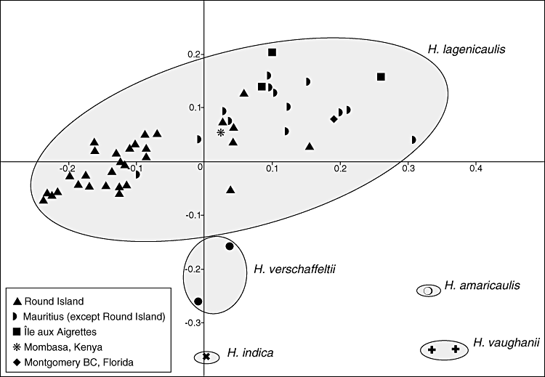
Figure 2. The result of a principal coordinates analysis of 81 variable amplified fragment length polymorphism (AFLP) ...
Notes:
Figure 2. The result of a principal coordinates analysis of 81 variable amplified fragment length polymorphism (AFLP) bands from 48 individuals of Hyophorbe lagenicaulis, two individuals of H. verschaffeltii, two individuals of H. vaughanii, one accession of H. amaricaulis and one accession of H. indica. The first two coordinates accounted for 21.8% and 13.5% (=34.3%), respectively, of the variation.
Unless provided in the caption above, the following copyright applies to the content of this slide: © 2011 The Linnean Society of London

Slide 2
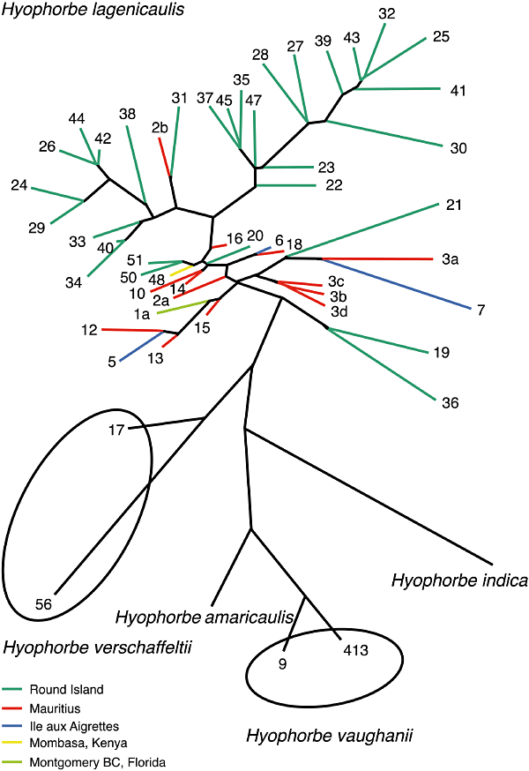
Figure 1. Unrooted neighbor joining tree based on 81 variable amplified fragment length polymorphism (AFLP) bands from ...
Notes:
Figure 1. Unrooted neighbor joining tree based on 81 variable amplified fragment length polymorphism (AFLP) bands from 48 individuals of Hyophorbe lagenicaulis, two individuals of H. verschaffeltii, two individuals of H. vaughanii, one accession of H. amaricaulis and one accession of H. indica. The tree is shown as an unrooted network. Accession numbers from Table 1.
Unless provided in the caption above, the following copyright applies to the content of this slide: © 2011 The Linnean Society of London

