Slide 1
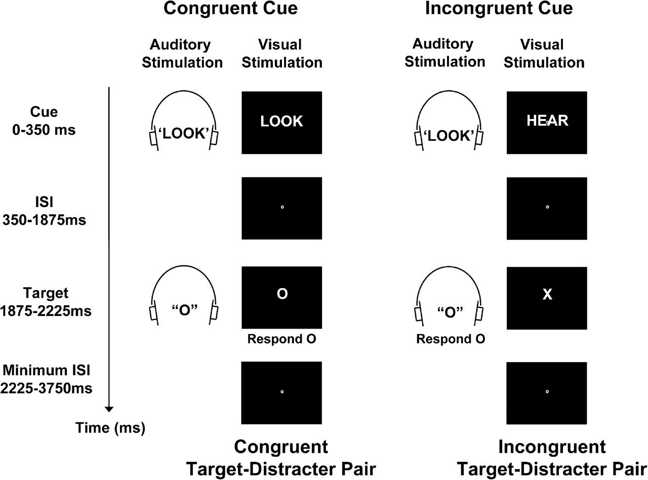
Figure 1. Experimental task. In each trial, a visually presented cue word (“Look” or “Hear”) instructed participants to ...
Notes:
Figure 1. Experimental task. In each trial, a visually presented cue word (“Look” or “Hear”) instructed participants to attend to and identify either the visual letter (“X” or “O”) or the auditory letter (“X” or “O”) of a possibly upcoming target–distracter letter pair. To modulate demands on cue-triggered processes that increase attention to relevant stimuli, we varied whether an irrelevant auditory word signaled the same task as the visual word (“Congruent Cue”) or a different task (“Incongruent Cue”). After a 1.875-s interval, an audiovisual target–distracter letter pair was presented. To modulate demands on target-triggered processes that detect response conflict, we varied whether the distracter letter was mapped to the same response as the target (“Congruent Target–Distracter Pair”) or to a different response (“Incongruent Target–Distracter Pair”). In cue-only trials (33%, not shown), the cue was not followed by a target–distracter letter pair.
Unless provided in the caption above, the following copyright applies to the content of this slide: © The Author 2008. Published by Oxford University Press. All rights reserved. For permissions, please e-mail: journals.permissions@oxfordjournals.org

Slide 2
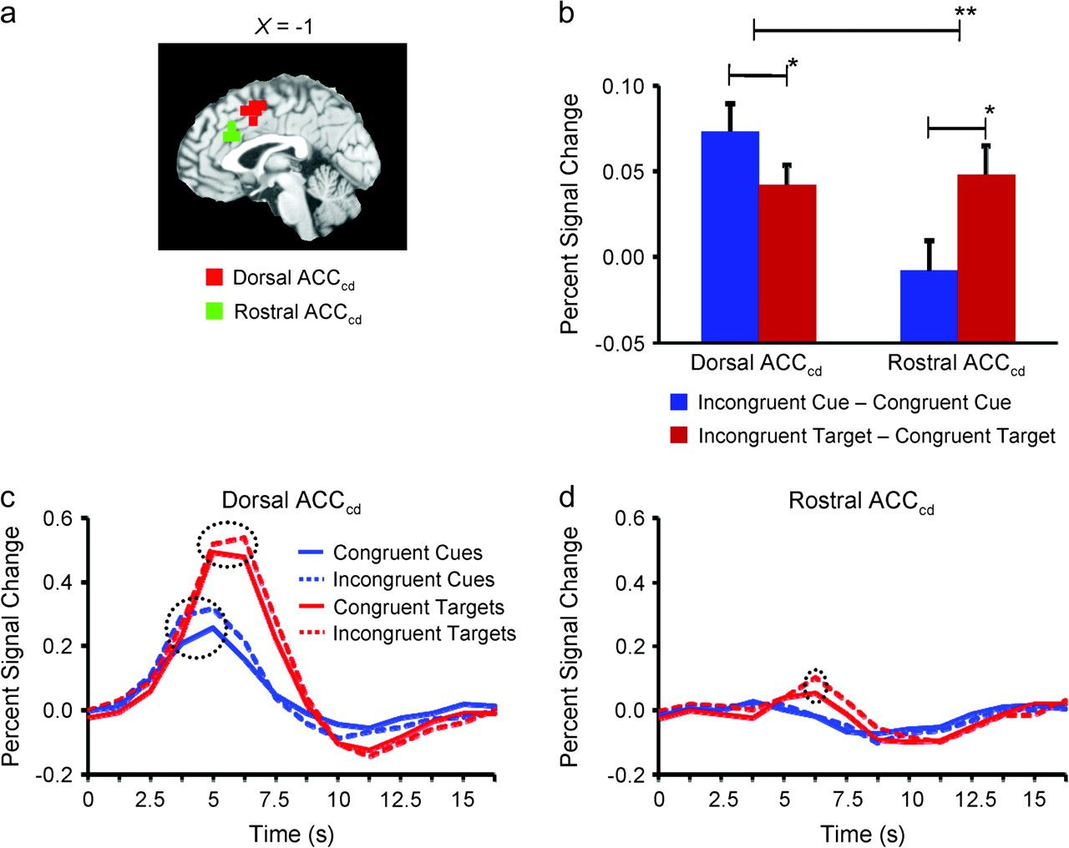
Figure 2. Regional specialization for cognitive control in the ACC_{cd}. (a) Saggital slice indicating our ...
Notes:
Figure 2. Regional specialization for cognitive control in the ACCcd. (a) Saggital slice indicating our rostral ACCcd subregion (green) and our dorsal ACCcd subregion (red) on the MNI-normalized brain. (b) Activity specific to cue congruency and target congruency in the dorsal ACCcd and in the rostral ACCcd. In the dorsal ACCcd, we observed significantly greater activity specific to cue congruency than to target congruency, whereas in the rostral ACCcd we observed exactly the opposite effect. (c) The average fMRI signal across time (in units of percent signal change from baseline) in the dorsal ACCcd for the various cue and target stimuli. There were significant effects of both cue congruency (i.e., greater peak activity for incongruent cues than for congruent cues) and target congruency (i.e., greater peak activity for incongruent target–distracter pairs than for congruent target–distracter pairs). (d) The average fMRI signal across time for the various cue and target stimuli in the rostral ACCcd. There was a significant effect of target congruency, but not of cue congruency. In (b), a single asterisk denotes P < 0.05, whereas 2 asterisks denote P < 0.005. Error bars represent S.E.M. Dashed circles in (c) and (d) indicate significant differences in peak activity (P < 0.05).
Unless provided in the caption above, the following copyright applies to the content of this slide: © The Author 2008. Published by Oxford University Press. All rights reserved. For permissions, please e-mail: journals.permissions@oxfordjournals.org

Slide 3
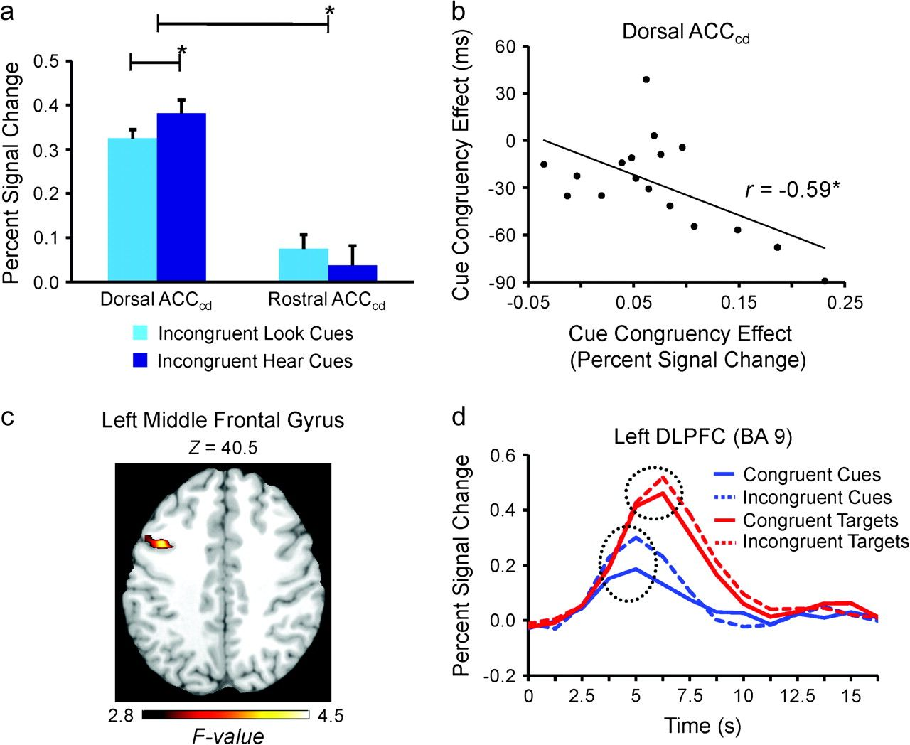
Figure 3. Effects of cue type, cue congruency, and target congruency in the ACC_{cd} and in the left DLPFC. (a) ...
Notes:
Figure 3. Effects of cue type, cue congruency, and target congruency in the ACCcd and in the left DLPFC. (a) Peak activity was significantly greater for incongruent hear cue-only trials than for incongruent look cue-only trials in the dorsal ACCcd, but not in the rostral ACCcd. (b) An across-participants correlation showing that participants with larger differences in peak activity between incongruent cue-only trials and congruent cue-only trials in the dorsal ACCcd tended to respond more quickly to targets following incongruent cues than to targets following congruent cues. (c) A region of the left prefrontal cortex (24 voxels; BAs 6, 8, and 9), centered in the left DLPFC, in which cue congruency modulated activity significantly more than target congruency displayed on the MNI-normalized brain. (d) The average fMRI signal across time in the left DLPFC (10 voxels; BA 9) for the various cue and target stimuli. Dashed circles represent significant differences in peak activity (P < 0.05). In (a) and (b), a single asterisk represents P < 0.05. Error bars represent SEM.
Unless provided in the caption above, the following copyright applies to the content of this slide: © The Author 2008. Published by Oxford University Press. All rights reserved. For permissions, please e-mail: journals.permissions@oxfordjournals.org

