Slide 1
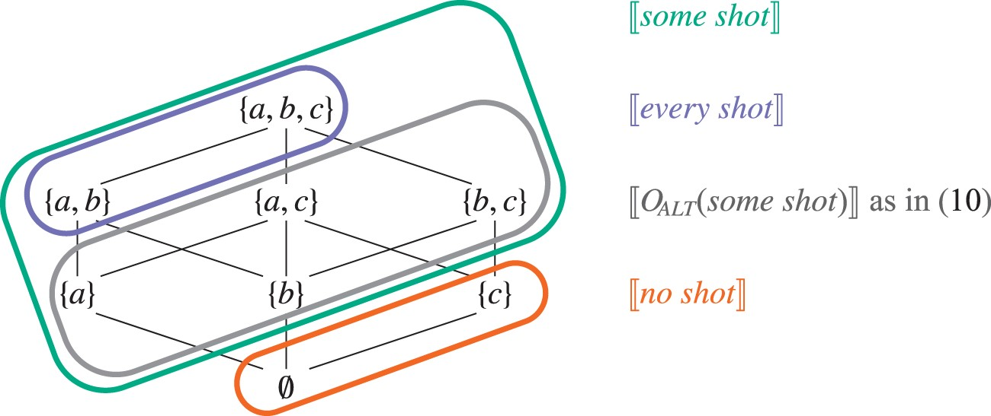
Figure 1 Given a domain {a,b,c} with 〚shot〛 = {a,b}, 〚some shot〛 is equal to the set of sets in the green box, 〚every ...
Notes:
Figure 1 Given a domain {a,b,c} with 〚shot〛 = {a,b}, 〚some shot〛 is equal to the set of sets in the green box, 〚every shot〛 to the set of sets in the purple box, and 〚no shot〛 to the set of sets in the orange box. If ALT(some shot) contains 〚every shot〛, then some shot is refined to exclude the purple subset.
Unless provided in the caption above, the following copyright applies to the content of this slide: © The Author 2015. Published by Oxford University Press. All rights reserved. For Permissions, please email: journals.permissions@oup.com

Slide 2
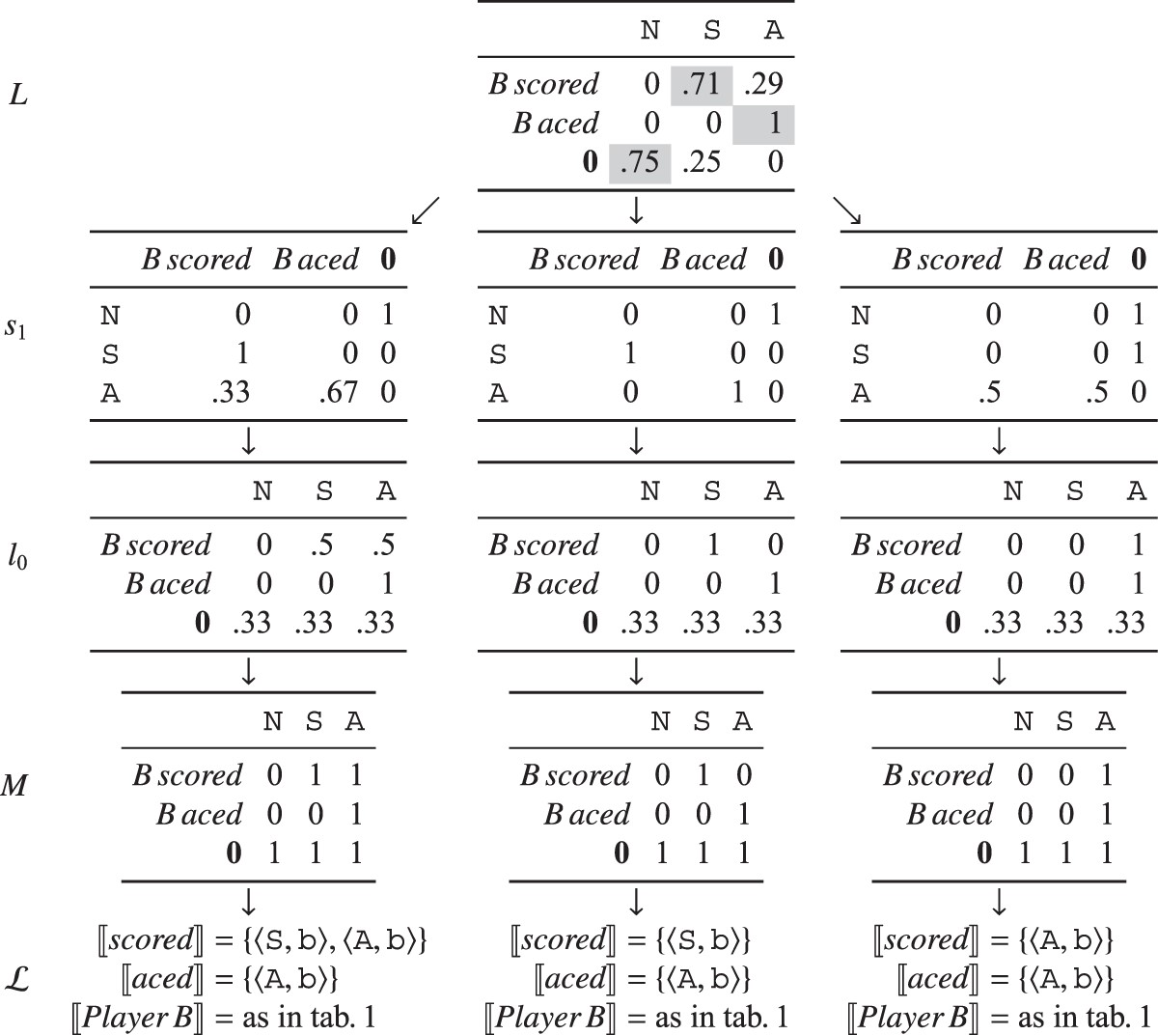
Figure 2 Simple scalar inference. We assume a flat prior over states and lexica. C(0) = 5, and C(m) = 0 for the other ...
Notes:
Figure 2 Simple scalar inference. We assume a flat prior over states and lexica. C(0) = 5, and C(m) = 0 for the other messages. The uncertainty listener L infers that the general term scored excludes its specific counterpart aced in this context.
Unless provided in the caption above, the following copyright applies to the content of this slide: © The Author 2015. Published by Oxford University Press. All rights reserved. For Permissions, please email: journals.permissions@oup.com

Slide 3
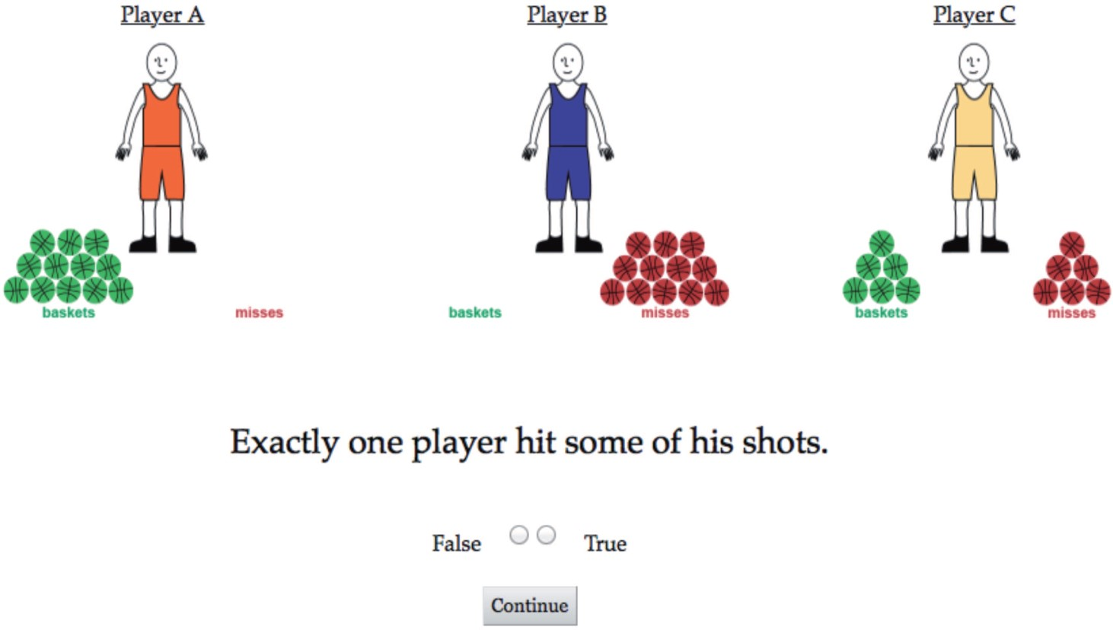
Figure 3 Experiment display.
Notes:
Figure 3 Experiment display.
Unless provided in the caption above, the following copyright applies to the content of this slide: © The Author 2015. Published by Oxford University Press. All rights reserved. For Permissions, please email: journals.permissions@oup.com

Slide 4
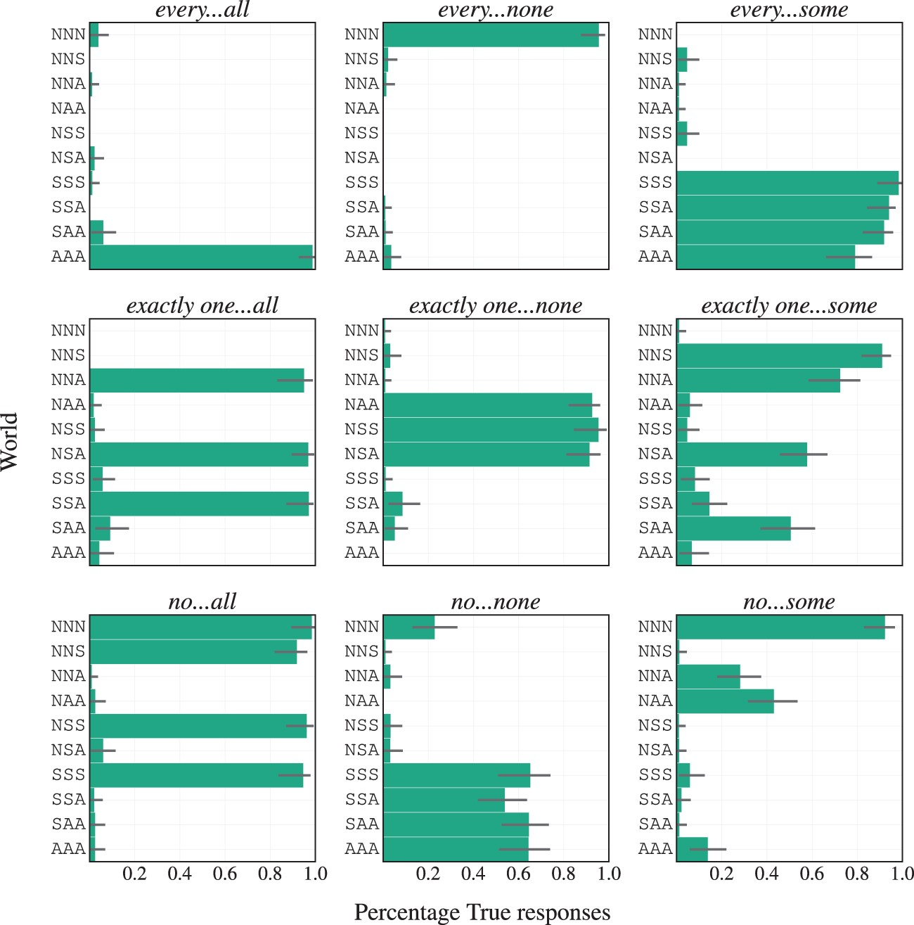
Figure 4 Mean truth-value judgment responses by sentence with bootstrapped 95% confidence intervals.
Notes:
Figure 4 Mean truth-value judgment responses by sentence with bootstrapped 95% confidence intervals.
Unless provided in the caption above, the following copyright applies to the content of this slide: © The Author 2015. Published by Oxford University Press. All rights reserved. For Permissions, please email: journals.permissions@oup.com

Slide 5
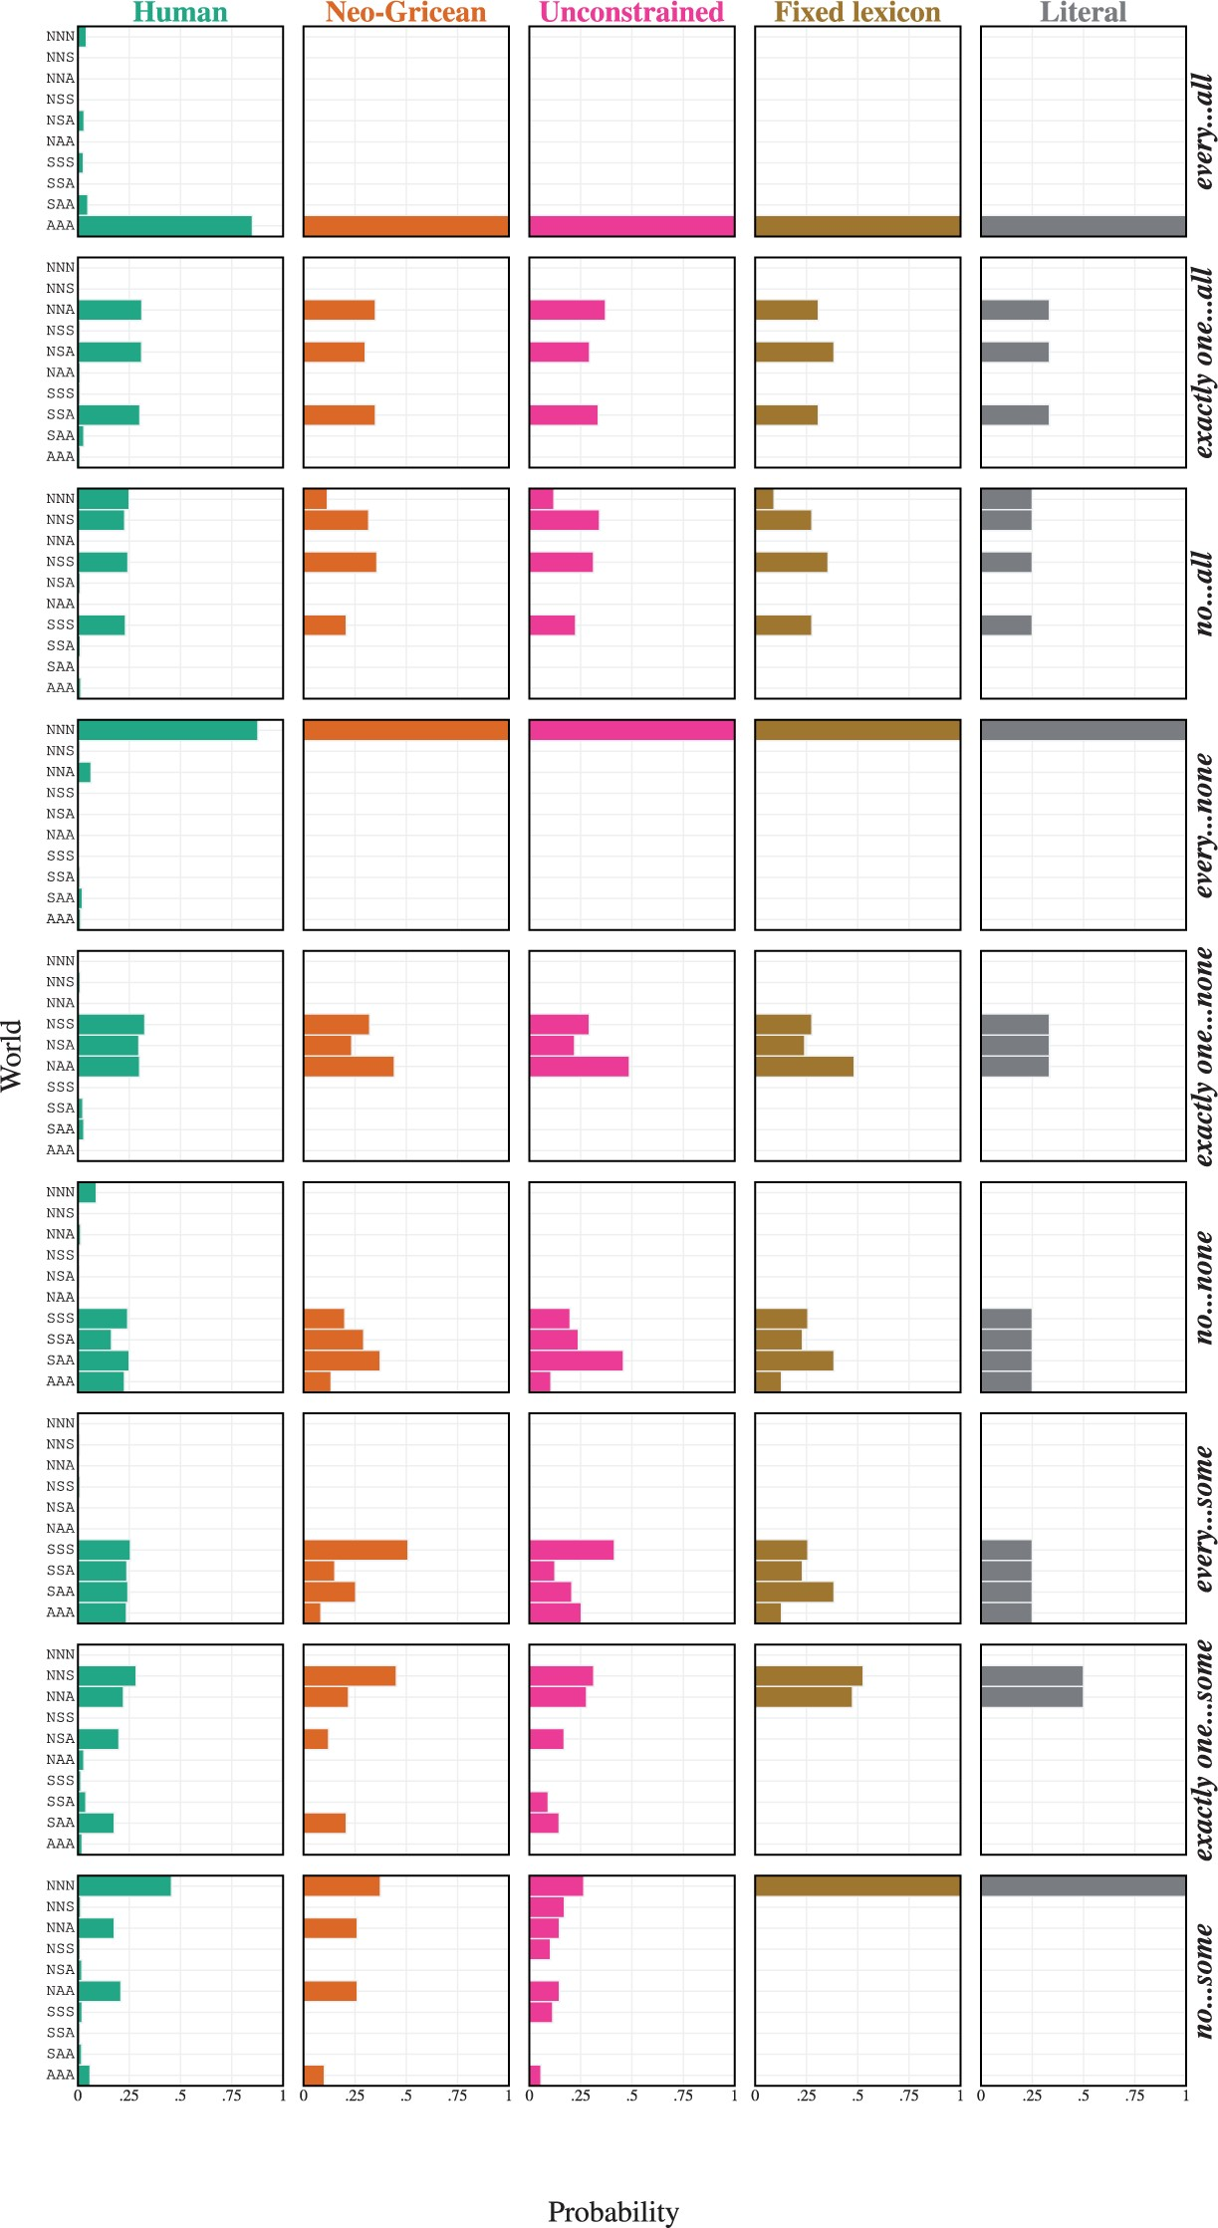
Figure 5 Analysis by target sentence, comparing model predictions with human responses.
Notes:
Figure 5 Analysis by target sentence, comparing model predictions with human responses.
Unless provided in the caption above, the following copyright applies to the content of this slide: © The Author 2015. Published by Oxford University Press. All rights reserved. For Permissions, please email: journals.permissions@oup.com

Slide 6
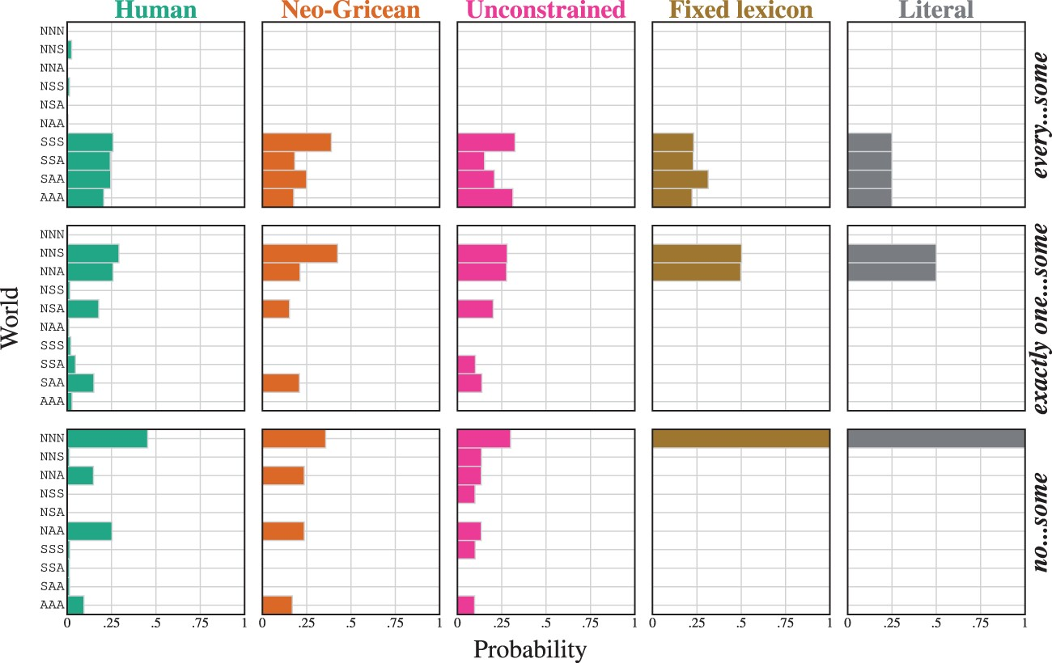
Figure 6 The crucial target sentences comparing the human data with L₁, using parameters in the range that ...
Notes:
Figure 6 The crucial target sentences comparing the human data with L1, using parameters in the range that seem to be nearly optimal for all of these models: λ = 0.1 and C(0) = 1.
Unless provided in the caption above, the following copyright applies to the content of this slide: © The Author 2015. Published by Oxford University Press. All rights reserved. For Permissions, please email: journals.permissions@oup.com

Slide 7
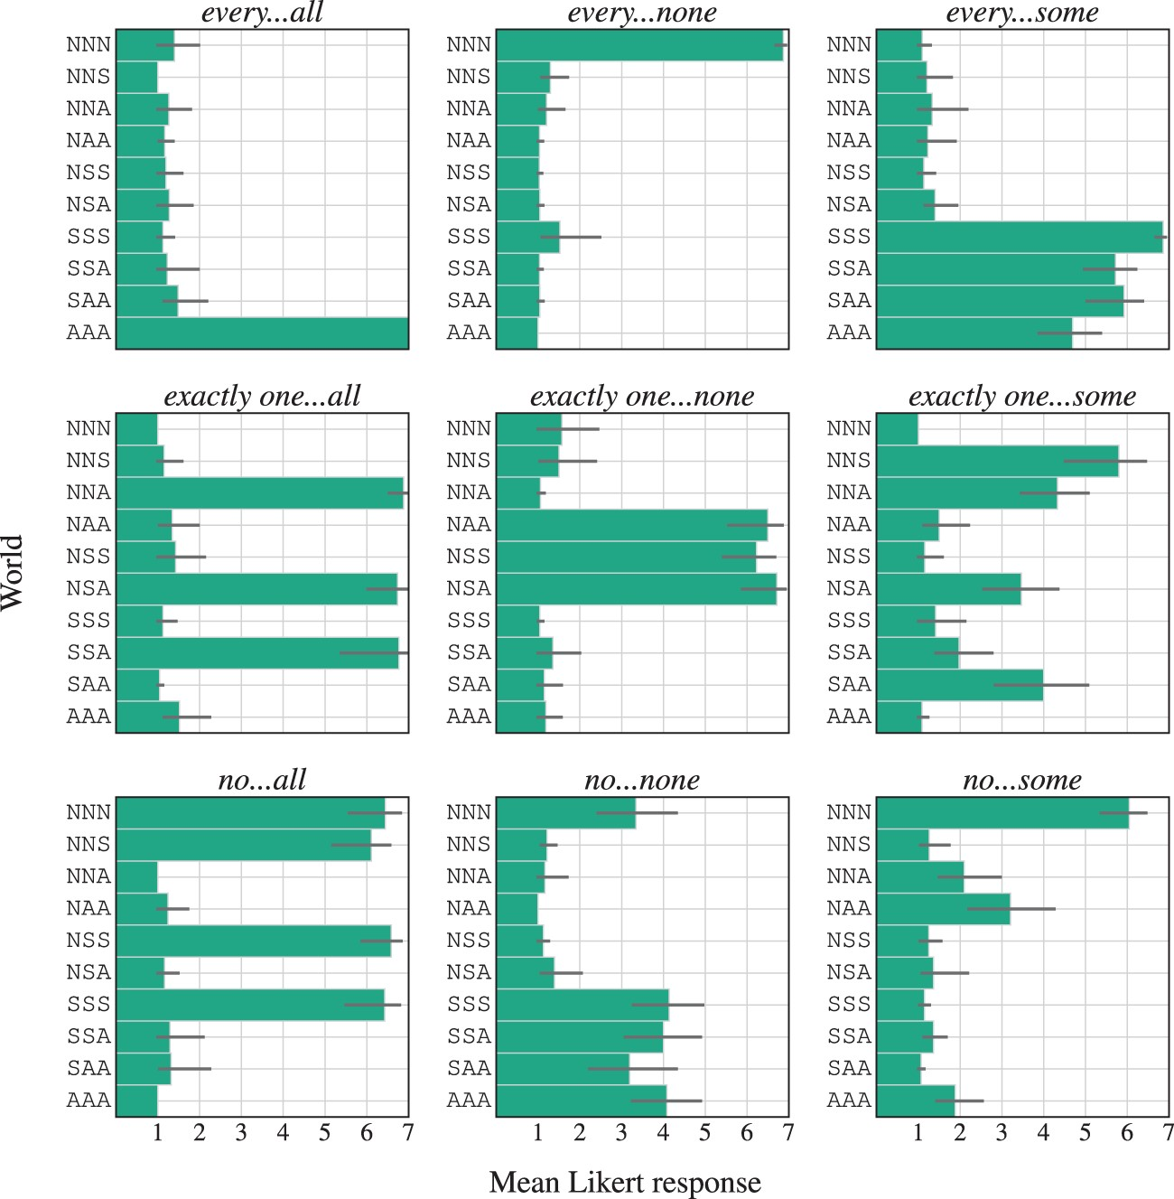
Figure 7 Likert-scale experimental results. Mean ratings by sentence with bootstrapped 95% confidence intervals.
Notes:
Figure 7 Likert-scale experimental results. Mean ratings by sentence with bootstrapped 95% confidence intervals.
Unless provided in the caption above, the following copyright applies to the content of this slide: © The Author 2015. Published by Oxford University Press. All rights reserved. For Permissions, please email: journals.permissions@oup.com

