Slide 1
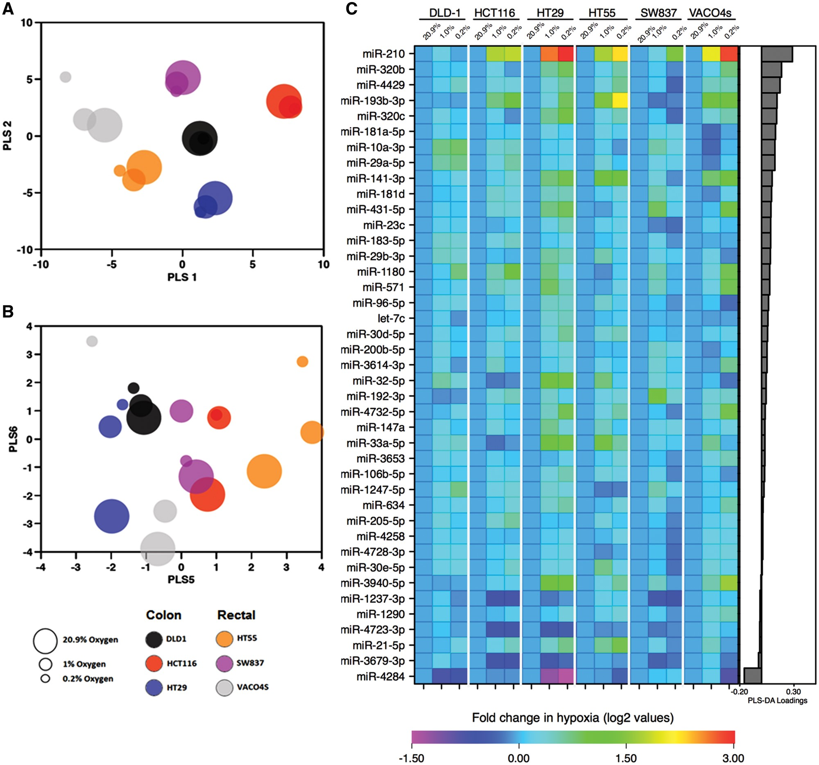
Figure 1 Altered miRNA expression profile under hypoxic conditions. Log-transformed fold change expression of ...
Notes:
Figure 1 Altered miRNA expression profile under hypoxic conditions. Log-transformed fold change expression of significant miRNAs between normoxia (20.9%) and both low oxygen conditions (1 and 0.2%) in six CRC cell lines for 48 h. (A) Data were subjected to PLS-DA, which was supervised according to cell line and unsupervised to oxygen tension. Observation of the first two axes (PLS 1 and PLS 2) demonstrated a clear separation of the miRNA data between the different cell lines, suggesting the main variation in the data is because of the differential expression of the miRNAs between the cell lines; further cell line differences were observed on additional PLS axes and are not shown here (six axes were fitted on the basis of cross-validation). (B) A separation of the data according to oxygen tension was observed along PLS axis 6 in five of the six cell lines (excluding SW837). This model indicates an existence of differential expression of miRNA between cells maintained under the three different oxygen conditions. (C) miRNAs that are significantly altered under hypoxia were subsequently identified by linear regression multivariate analysis. A heatmap of log-transformed fold changes between the different oxygen tensions normalized to 20.9% is shown. The miRNAs are ranked according to PLS-DA loadings.
Unless provided in the caption above, the following copyright applies to the content of this slide: © The Author 2017. Published by Oxford University Press.This is an Open Access article distributed under the terms of the Creative Commons Attribution License (http://creativecommons.org/licenses/by/4.0/), which permits unrestricted reuse, distribution, and reproduction in any medium, provided the original work is properly cited.

Slide 2
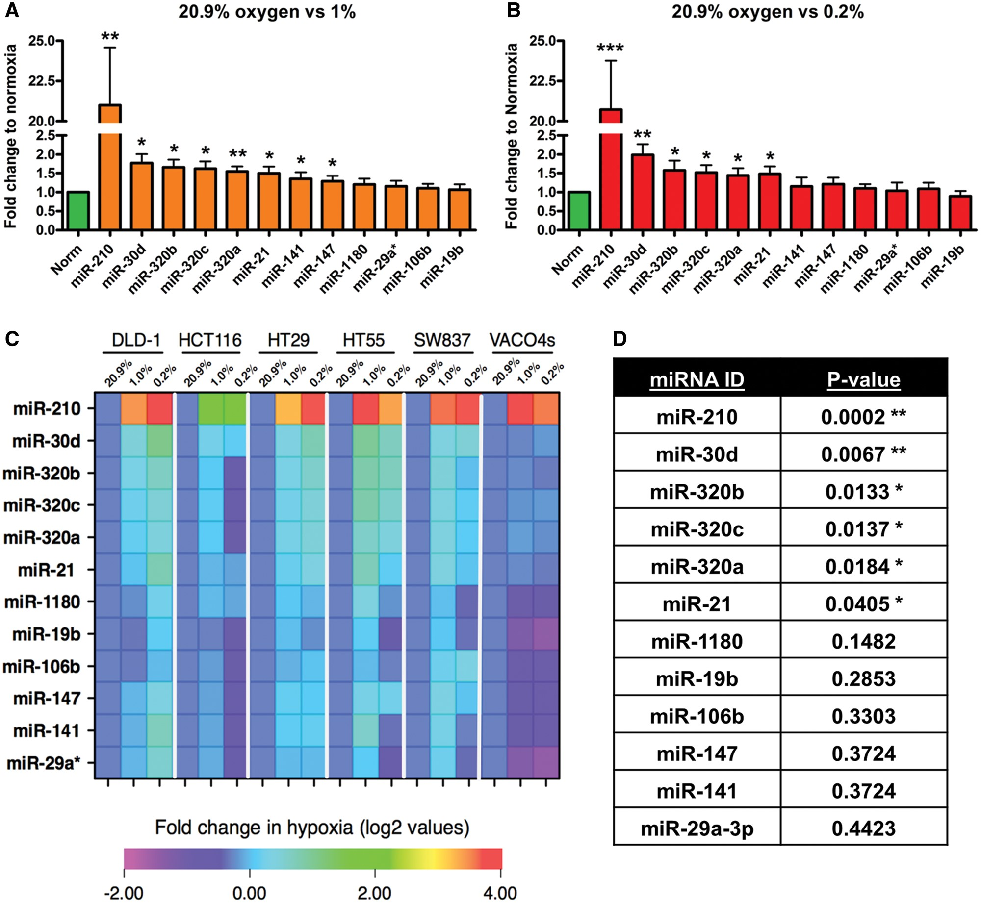
Figure 2 Validation of hypoxia-responsive miRNAs by qRT-PCR in six CRC cell lines. (A and B) Fold change expression of ...
Notes:
Figure 2 Validation of hypoxia-responsive miRNAs by qRT-PCR in six CRC cell lines. (A and B) Fold change expression of candidate miRNAs in normoxia (20.9%) and low oxygen tensions (1 and 0.2% oxygen) in six CRC cell lines combined. (C) Heatmap of fold change (log 2) in miRNA expression between the three oxygen conditions normalized to 20.9% oxygen (n = 3). (D) Multivariate analysis (linear regression model) identified a significant up-regulation of 6 of the 12 miRNAs between in hypoxia. The heatmap is ranked according to P-values obtained from the multivariate analysis. Asterisks indicate significantly altered (P < 0.05) miRNAs. Bars represent mean values with SEM calculated from three individual experiments. *P < 0.05, **P < 0.01 and ***P < 0.001.
Unless provided in the caption above, the following copyright applies to the content of this slide: © The Author 2017. Published by Oxford University Press.This is an Open Access article distributed under the terms of the Creative Commons Attribution License (http://creativecommons.org/licenses/by/4.0/), which permits unrestricted reuse, distribution, and reproduction in any medium, provided the original work is properly cited.

Slide 3
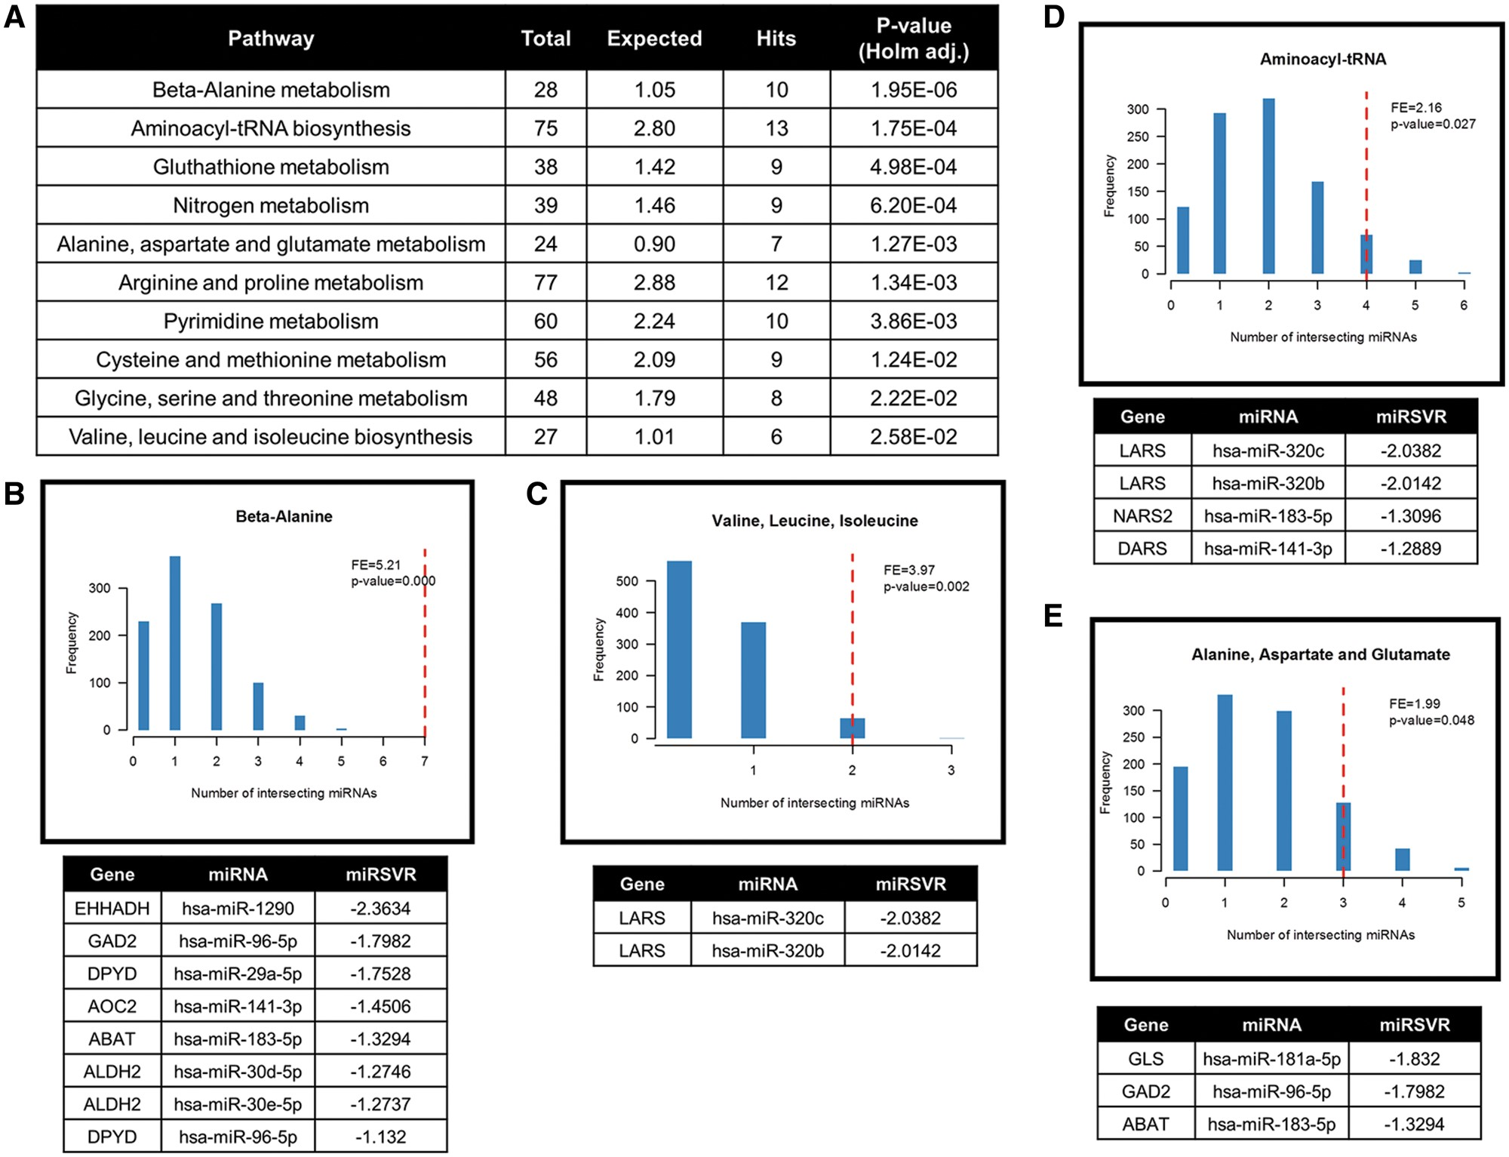
Figure 3 Cellular metabolism altered under hypoxic conditions in CRC cell lines. Metabolite analysis via CE-TOF/MS ...
Notes:
Figure 3 Cellular metabolism altered under hypoxic conditions in CRC cell lines. Metabolite analysis via CE-TOF/MS between six CRC cell lines maintained under normoxic (20.9%) and low oxygen conditions (1 and 0.2%). Over-representation analysis of significantly altered metabolites was performed using MetaboAnalyst. (A) Ten significant pathways associated with altered metabolites under hypoxic conditions. (B–E) In silico analysis of miRNA target prediction of genes involved in the ten pathways. Four pathways showed a significant association between hypoxia-responsive miRNAs. Genes with a miRSVR score lower than -1.25 are listed.
Unless provided in the caption above, the following copyright applies to the content of this slide: © The Author 2017. Published by Oxford University Press.This is an Open Access article distributed under the terms of the Creative Commons Attribution License (http://creativecommons.org/licenses/by/4.0/), which permits unrestricted reuse, distribution, and reproduction in any medium, provided the original work is properly cited.

Slide 4
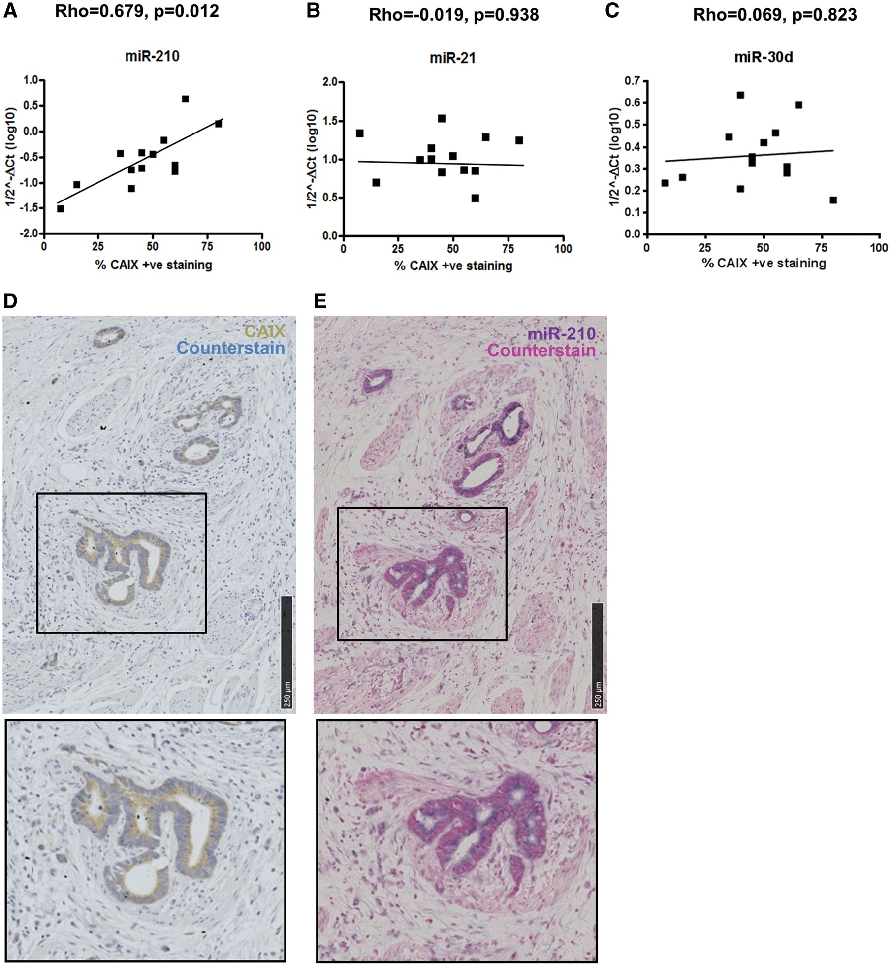
Figure 4 In situ expression of miR-210 positively correlates to hypoxia marker CAIX in CRC tissue. (A–C) Scatter plots ...
Notes:
Figure 4 In situ expression of miR-210 positively correlates to hypoxia marker CAIX in CRC tissue. (A–C) Scatter plots of miR-210, miR-21 and miR-30d expression (1/2−ΔCT) assessed by qRT-PCR and percentage of CAIX-positive staining within the tumour (n = 13). Correlation efficiency calculated with Spearman’s Rank analysis showed a significant positive correlation between miR-210 and CAIX expression CRC tumours (D and E) IHC of CAIX and in situ hybridization of miR-210 performed on serial sections of FFPE blocks of CRC tumours (n = 8). Staining of miR-210 was observed in the epithelial cells along the crypts and overlapped with CAIX staining within these cells.
Unless provided in the caption above, the following copyright applies to the content of this slide: © The Author 2017. Published by Oxford University Press.This is an Open Access article distributed under the terms of the Creative Commons Attribution License (http://creativecommons.org/licenses/by/4.0/), which permits unrestricted reuse, distribution, and reproduction in any medium, provided the original work is properly cited.

Slide 5
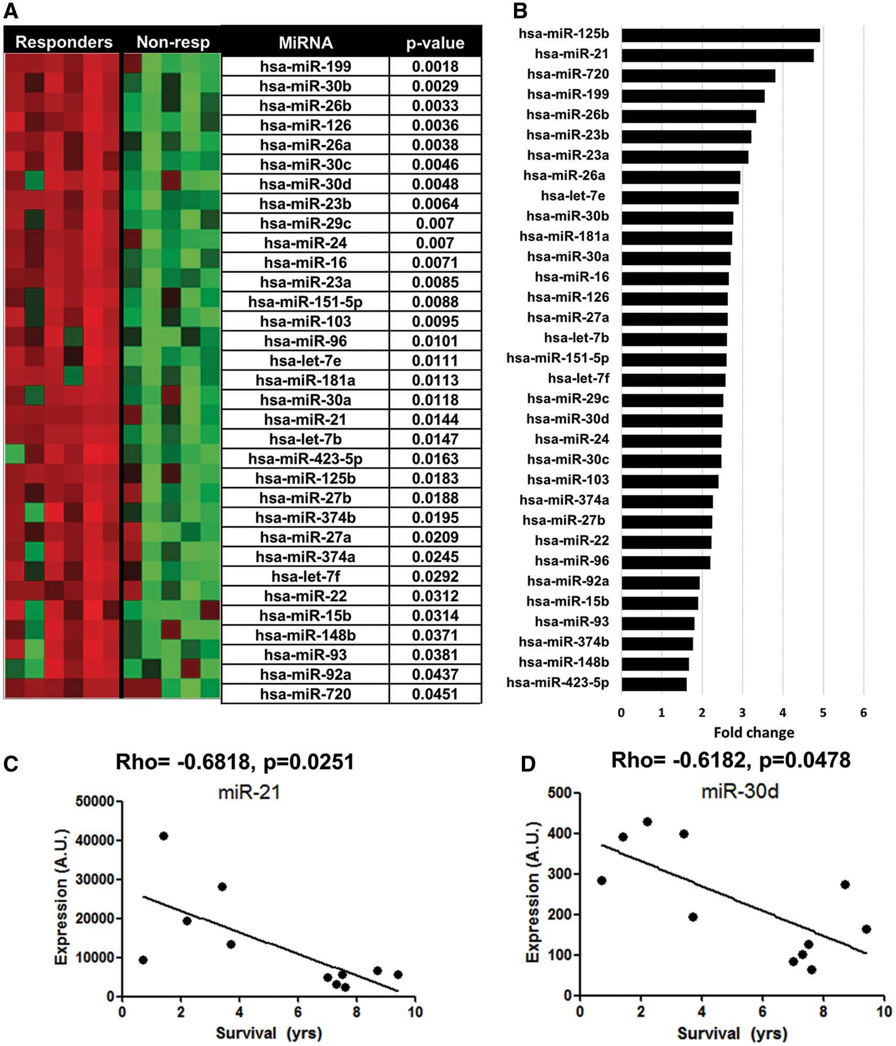
Figure 5 MiRNA expression profiling in 5FU resistant CRC tumours and modulation of resistance in hypoxic DLD-1 cells. ...
Notes:
Figure 5 MiRNA expression profiling in 5FU resistant CRC tumours and modulation of resistance in hypoxic DLD-1 cells. Eleven CRC tumours treated with 5-FU treatment (six non-responders, five responders) were subjected to miRNA profiling. (A) Heatmap of significant altered miRNAs (P < 0.05, Benjamini-Hochberg adjusted). Corrected P-values are shown. (B) Fold change in expression of miRNAs significantly altered between each group. (C and D) Correlation between patient survival and expression of miR-21 or miR-30d. Spearman’s rank analysis indicated a significant correlation between each miRNA and patient survival.
Unless provided in the caption above, the following copyright applies to the content of this slide: © The Author 2017. Published by Oxford University Press.This is an Open Access article distributed under the terms of the Creative Commons Attribution License (http://creativecommons.org/licenses/by/4.0/), which permits unrestricted reuse, distribution, and reproduction in any medium, provided the original work is properly cited.

Slide 6
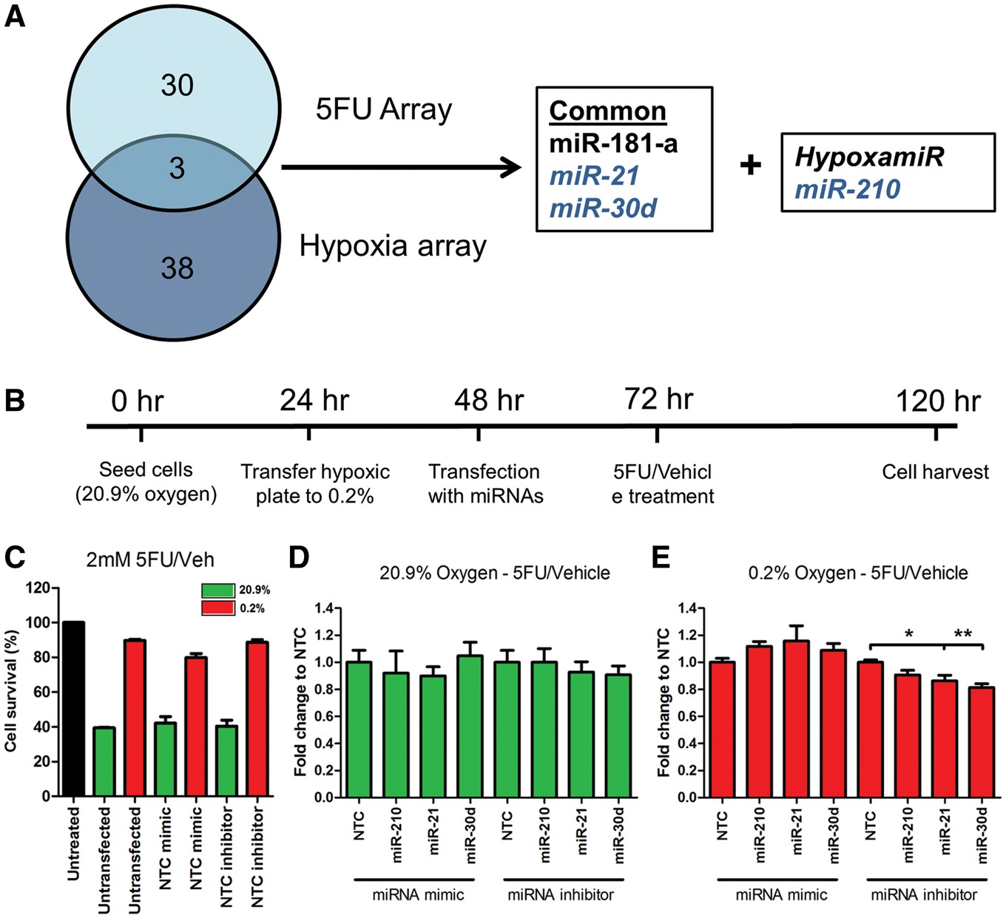
Figure 6 MiR-30d modulates 5-FU resistance in hypoxic DLD-1 cells. (A) Venn diagram of common miRNAs that are ...
Notes:
Figure 6 MiR-30d modulates 5-FU resistance in hypoxic DLD-1 cells. (A) Venn diagram of common miRNAs that are dysregulated in both arrays (in vivo hypoxia array and ex vivo CRC tissue array). (B) DLD-1 cells were transfected with miRNA mimic and inhibitors under normoxic and hypoxic conditions. Experimental timeline of the experiments is shown. (C) Cell survival following treatment with 2 mM 5-FU and vehicle (DMSO). Data normalized to untreated cells. (D and E) Graph represents fold change in survival following treatment with 5-FU and vehicle. Data normalized to vehicle and then to its transfection control (NTC) inhibition of miR-30d under hypoxic conditions resulted in a significant reduction in resistance to 5-FU. Bars represent mean values with SEM calculated from three individual experiments. *P < 0.05, **P < 0.01.
Unless provided in the caption above, the following copyright applies to the content of this slide: © The Author 2017. Published by Oxford University Press.This is an Open Access article distributed under the terms of the Creative Commons Attribution License (http://creativecommons.org/licenses/by/4.0/), which permits unrestricted reuse, distribution, and reproduction in any medium, provided the original work is properly cited.

