Slide 1
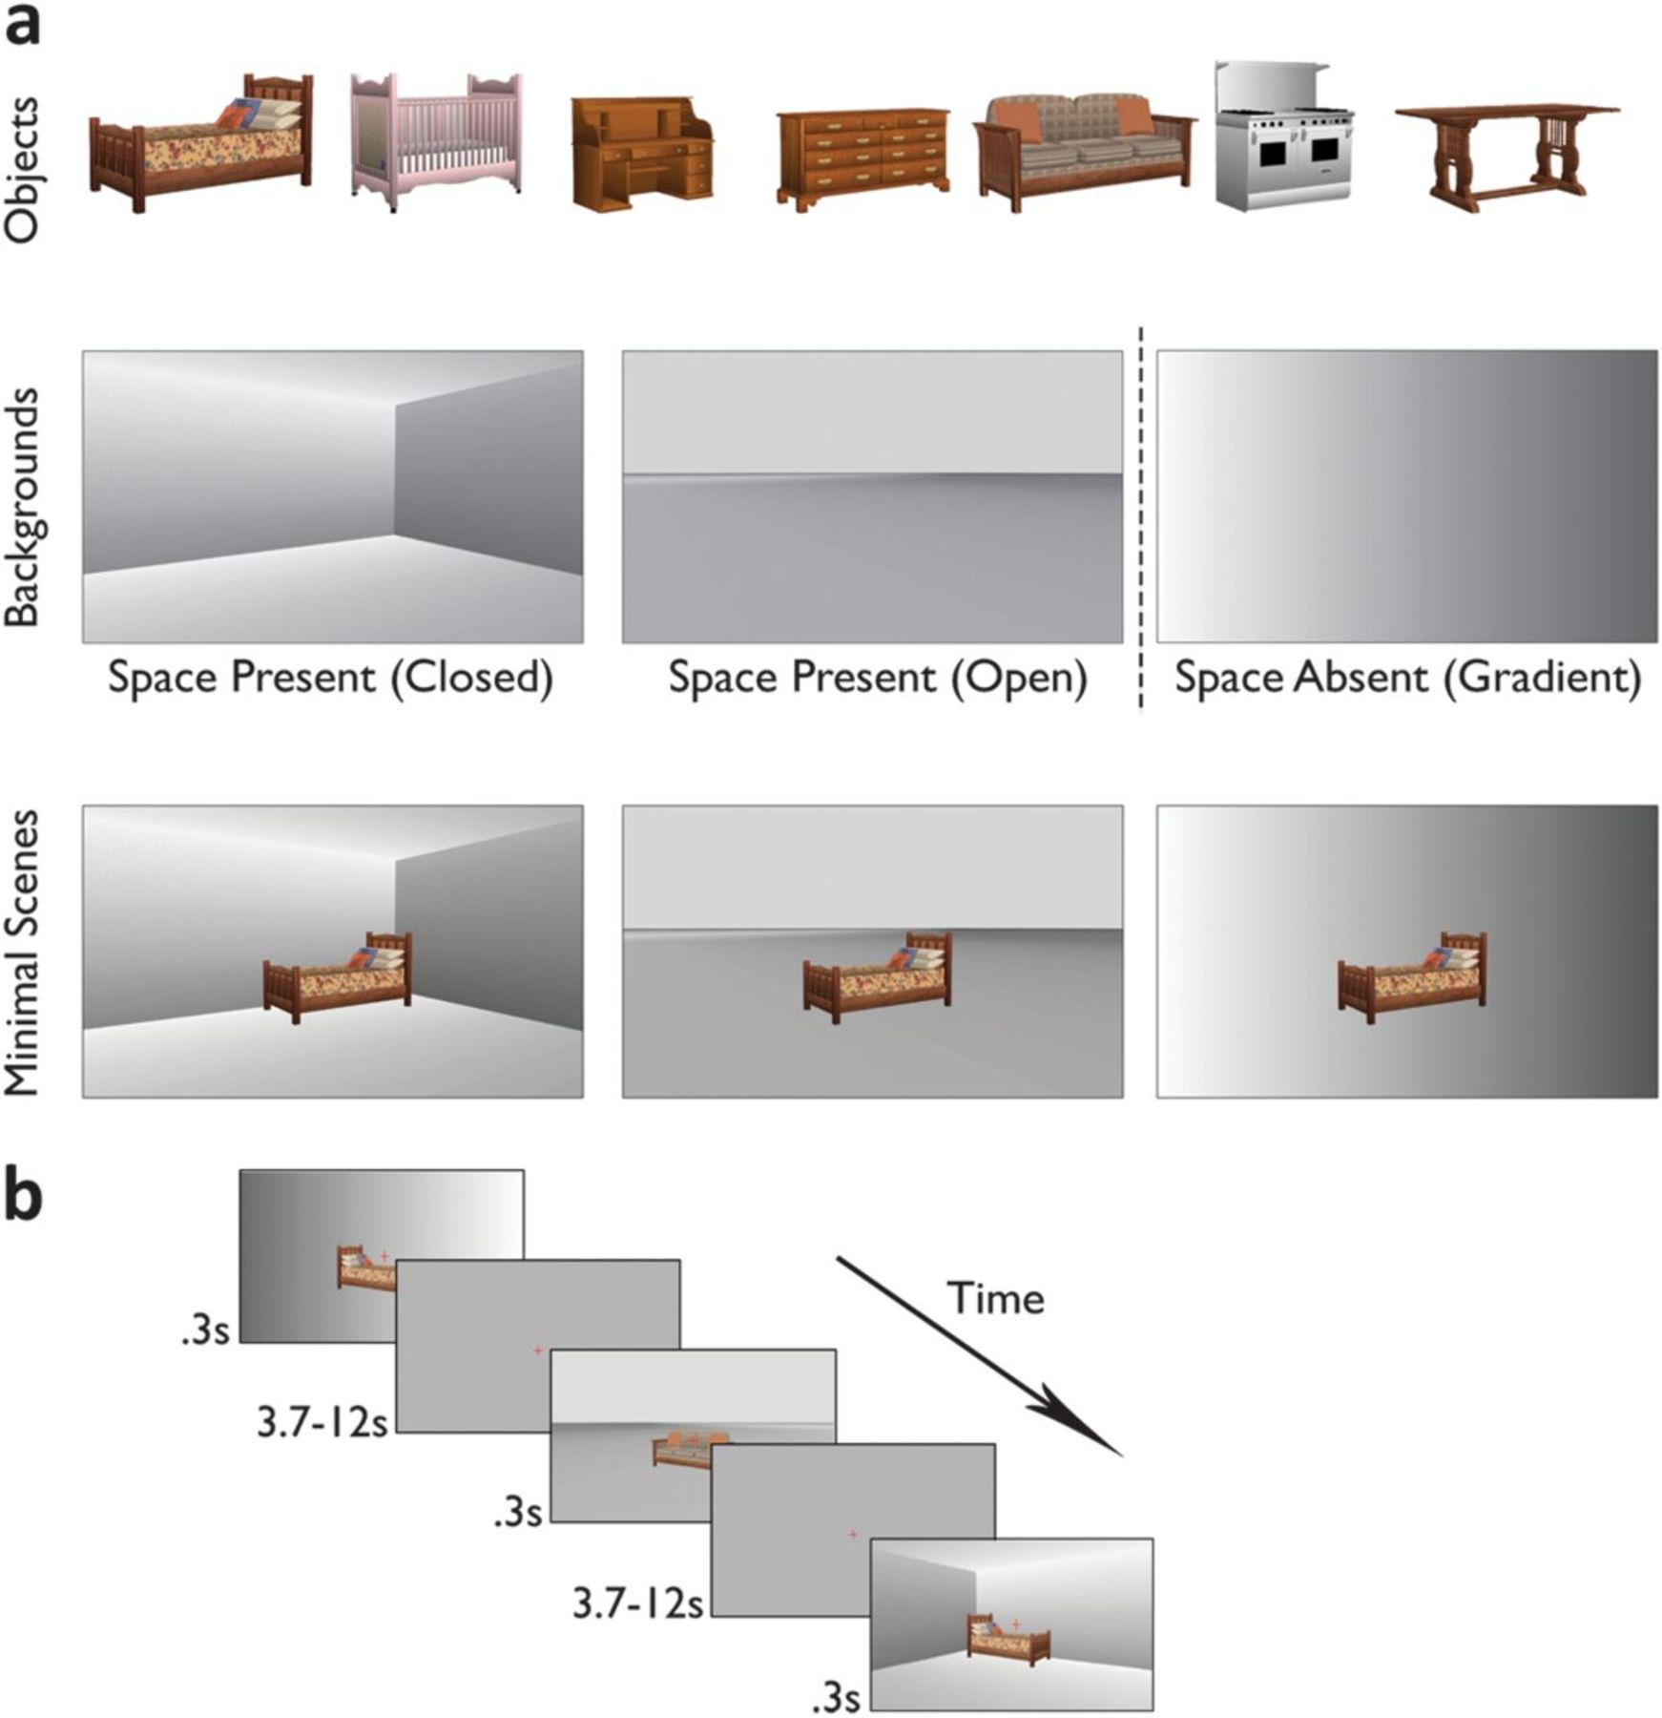
Figure 1. Stimuli and task. (a) Depiction of the stimuli used in the event-related runs. Each of the 7 objects pictured ...
Notes:
Figure 1. Stimuli and task. (a) Depiction of the stimuli used in the event-related runs. Each of the 7 objects pictured in the top row was superimposed on each of the 3 backgrounds in the second row. Two of the backgrounds implied a spatial layout (open and closed—space present), while one was matched for overall luminance but contained no spatial layout information (gradient—space absent). Images of the backgrounds only formed the object-absent condition (second row). The combined minimal scenes (third row) contained a single object and background, and every combination of the 2 was presented. This fully crossed design allowed the effect of background and object to be evaluated separately in the subsequent response magnitude and response pattern analyses. (b) Depiction of the sequence of events in a typical series of trials during the event-related runs. Each minimal scene was presented for 300 ms. To ensure participants maintained fixation, they performed a shape judgment task on the central fixation cross (see text for details). Intertrial intervals varied from 3700 to 12000 ms, and no response was required from the participants in this period. This variable delay was introduced to allow for efficient deconvolution of the responses.
Unless provided in the caption above, the following copyright applies to the content of this slide: © The Author 2012. Published by Oxford University Press. All rights reserved. For permissions, please e-mail: journals.permissions@oup.com

Slide 2
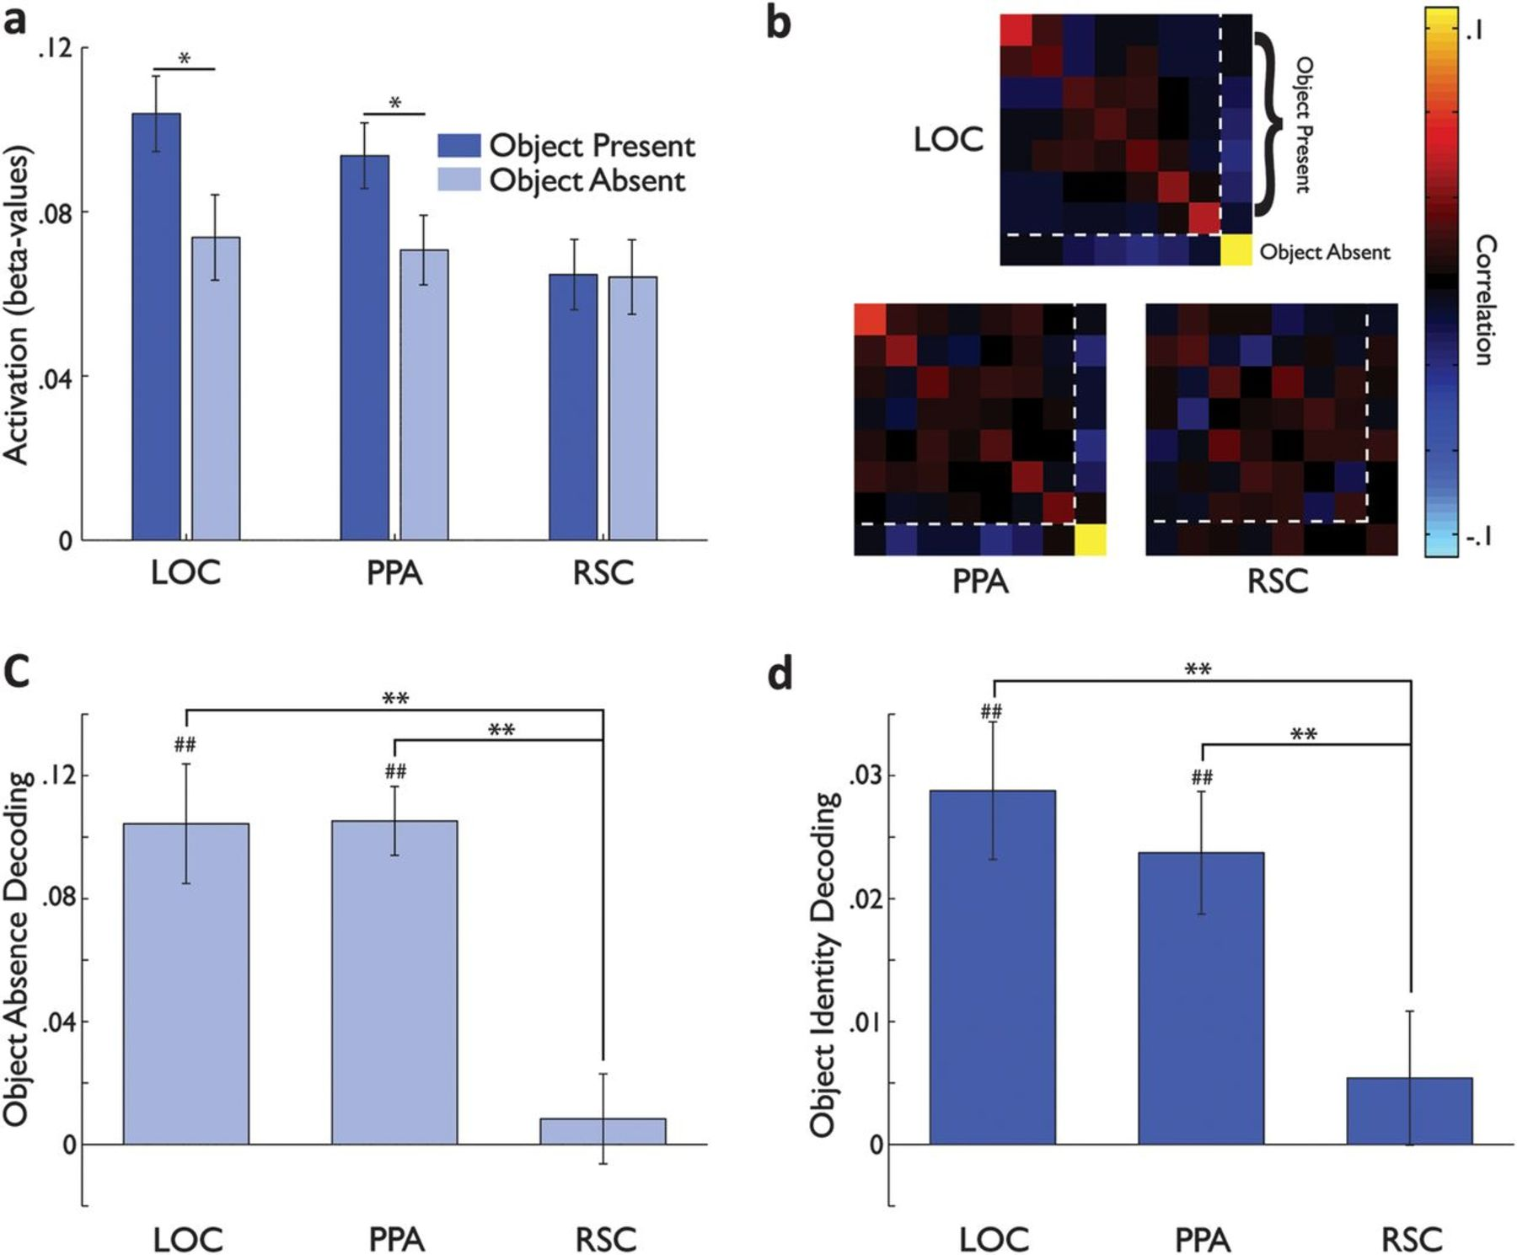
Figure 2. Object information across background. (a) Average response magnitude across the ROIs when an object was ...
Notes:
Figure 2. Object information across background. (a) Average response magnitude across the ROIs when an object was presented (dark blue) and when the object was absent (light blue) and only a background was presented. Note the effect of object presence in LOC and PPA (larger in LOC than in PPA) and the complete lack of any effect in RSC. (b) The similarity matrices for each ROI averaged by object (see Materials and Methods). The main diagonal from the top left to bottom right shows the within-object correlation and represents the consistency of the response pattern to a particular object across backgrounds. The off-diagonal values are the correlations between different objects across backgrounds. The order of the objects is the same as in Figure 1a. The first 7 conditions are the object-present conditions (same order as in Fig. 1a) and are bounded by the dotted white lines. The object-absent condition is the eighth and final condition in each plot. Note the strong diagonal value for the object-absent condition in both LOC and PPA but not in RSC. (c) Object absence decoding in LOC, PPA, and RSC. Any number significantly greater than zero indicates that object presence could be decoded in the region. Note the significant decoding in LOC and PPA but not in RSC. (d) Object identity decoding in LOC, PPA, and RSC. Any number significantly greater than zero indicates that object identity (excluding the object-absent condition) could be decoded in the ROI. Note the significant decoding in LOC and PPA but not in RSC and the significant differences in decoding between every pair of ROIs. All error bars in this and every other plot indicate the between-subjects standard error. ##P < 0.001 difference from zero; #P < 0.05 difference from zero; **P < 0.001 difference between ROIs; and *P < 0.05 difference between ROIs.
Unless provided in the caption above, the following copyright applies to the content of this slide: © The Author 2012. Published by Oxford University Press. All rights reserved. For permissions, please e-mail: journals.permissions@oup.com

Slide 3
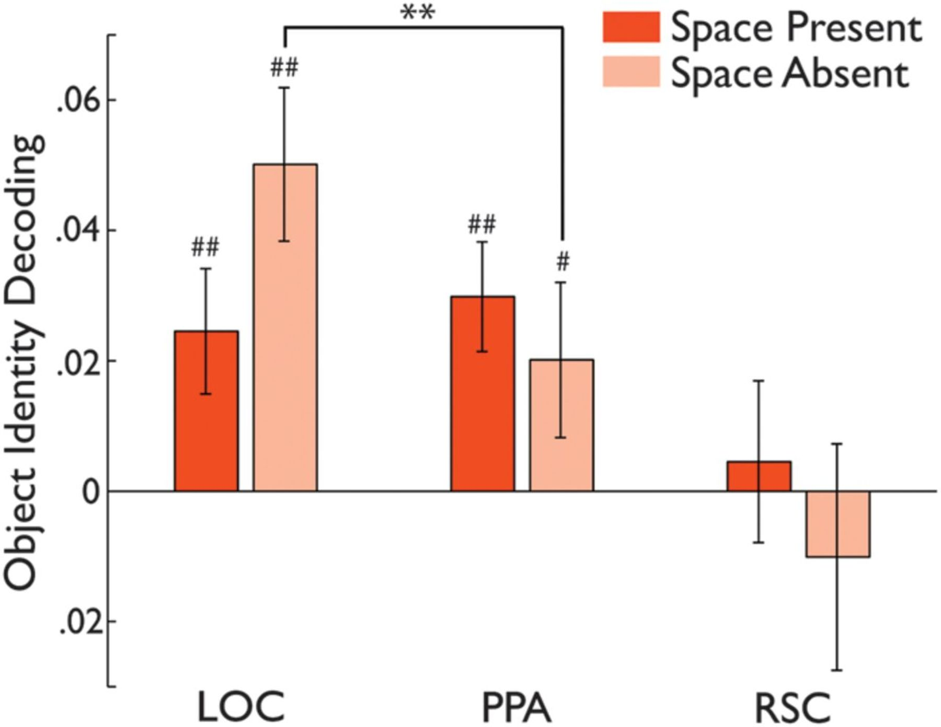
Figure 3. Object information within background. Average object identity decoding within the space-present (dark red) ...
Notes:
Figure 3. Object information within background. Average object identity decoding within the space-present (dark red) and space-absent (light red) backgrounds (see Materials and Methods). Note that average decoding evidenced a gradient across the ROIs with stronger decoding in LOC than in PPA or RSC and stronger decoding in PPA than in RSC (all P < 0.05). Note also the different patterns of decoding across the space-present and space-absent backgrounds in LOC and PPA resulting in a significant interaction between them (P < 0.05). All plotting conventions are the same as in Figure 3. ##P < 0.01 difference from zero; #P < 0.05 difference from zero; and **P < 0.01 difference between ROIs.
Unless provided in the caption above, the following copyright applies to the content of this slide: © The Author 2012. Published by Oxford University Press. All rights reserved. For permissions, please e-mail: journals.permissions@oup.com

Slide 4
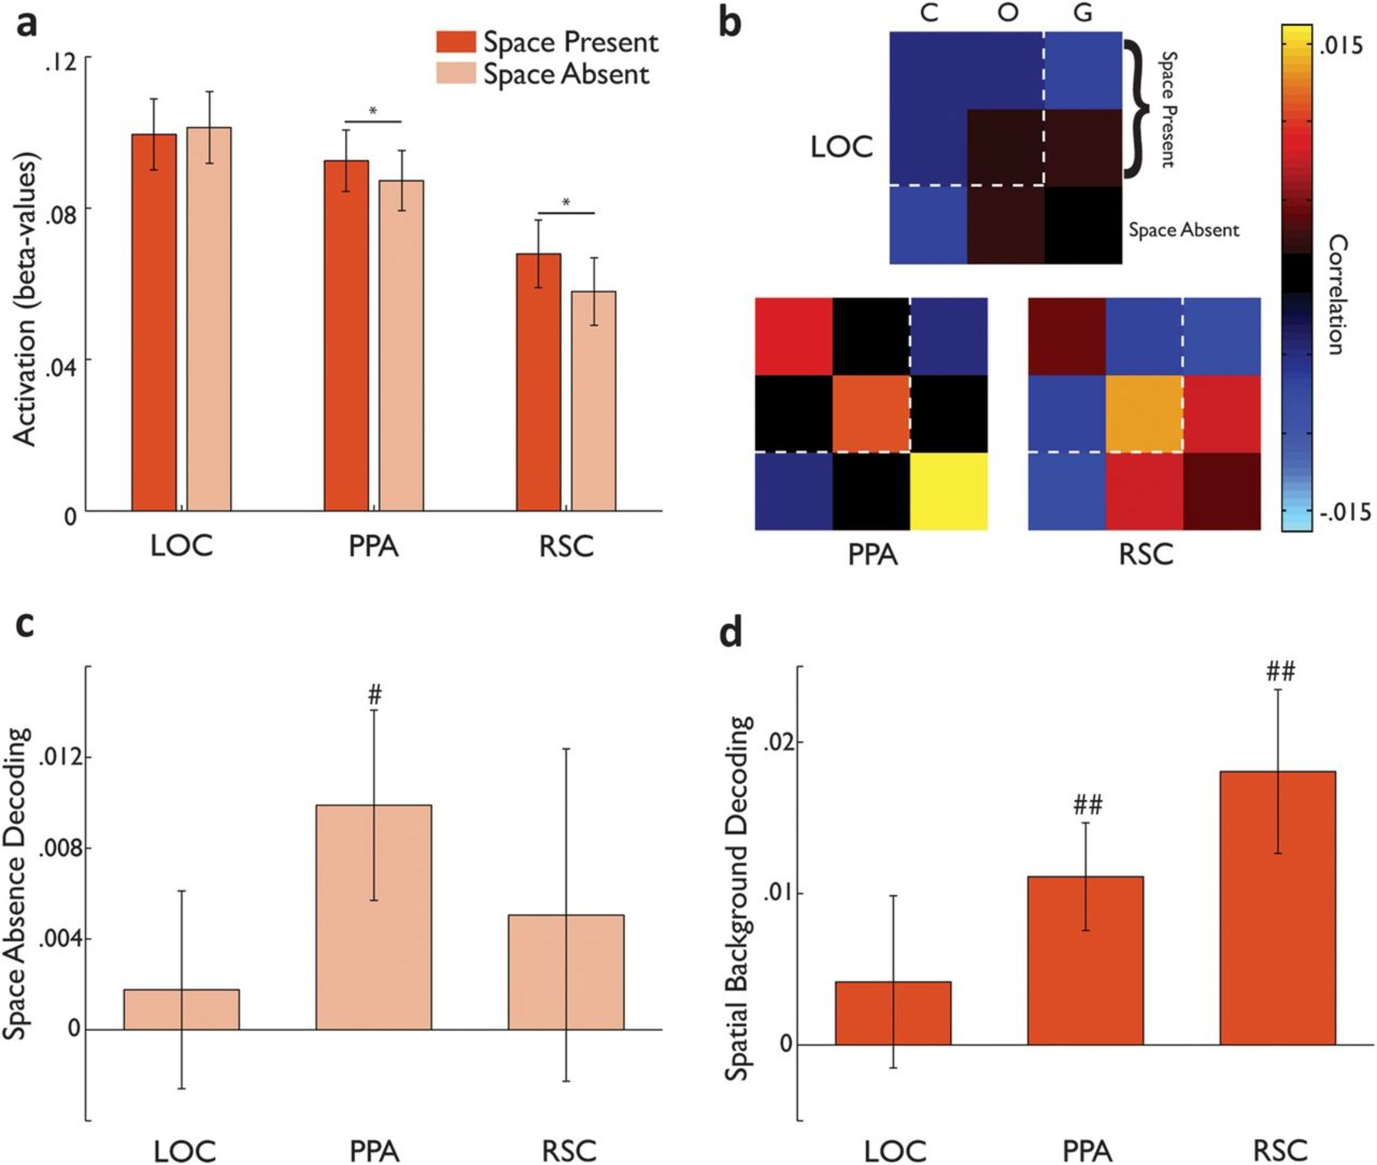
Figure 4. Background information across objects. (a) Average response magnitude across the ROIs for the space-present ...
Notes:
Figure 4. Background information across objects. (a) Average response magnitude across the ROIs for the space-present and space-absent backgrounds. Note the different patterns across backgrounds in LOC compared with PPA and RSC. (b) The similarity matrices for LOC, PPA, and RSC averaged by background (see Materials and Methods). The main diagonal shows the within-background correlation and represents the consistency of the response pattern to a particular background across objects. The off-diagonal values show the average correlation between different objects and different backgrounds. The order of the backgrounds is as in Figure 4a. The first 2 conditions are the space-present backgrounds and are bounded by the dotted white lines. The last condition is the gradient background, which did not contain any spatial layout information (space absent). Note the strong diagonals in PPA and RSC but not in LOC. (c) Space absence decoding in LOC, PPA, and RSC. Note that only PPA evidenced any coding of the absence of spatial layout information. (d) Spatial background decoding in LOC, PPA, and RSC. Note the significant decoding in PPA and RSC but not in LOC. ##P < 0.01 difference from zero; #P < 0.05 difference from zero; and *P < 0.05 difference between conditions.
Unless provided in the caption above, the following copyright applies to the content of this slide: © The Author 2012. Published by Oxford University Press. All rights reserved. For permissions, please e-mail: journals.permissions@oup.com

Slide 5
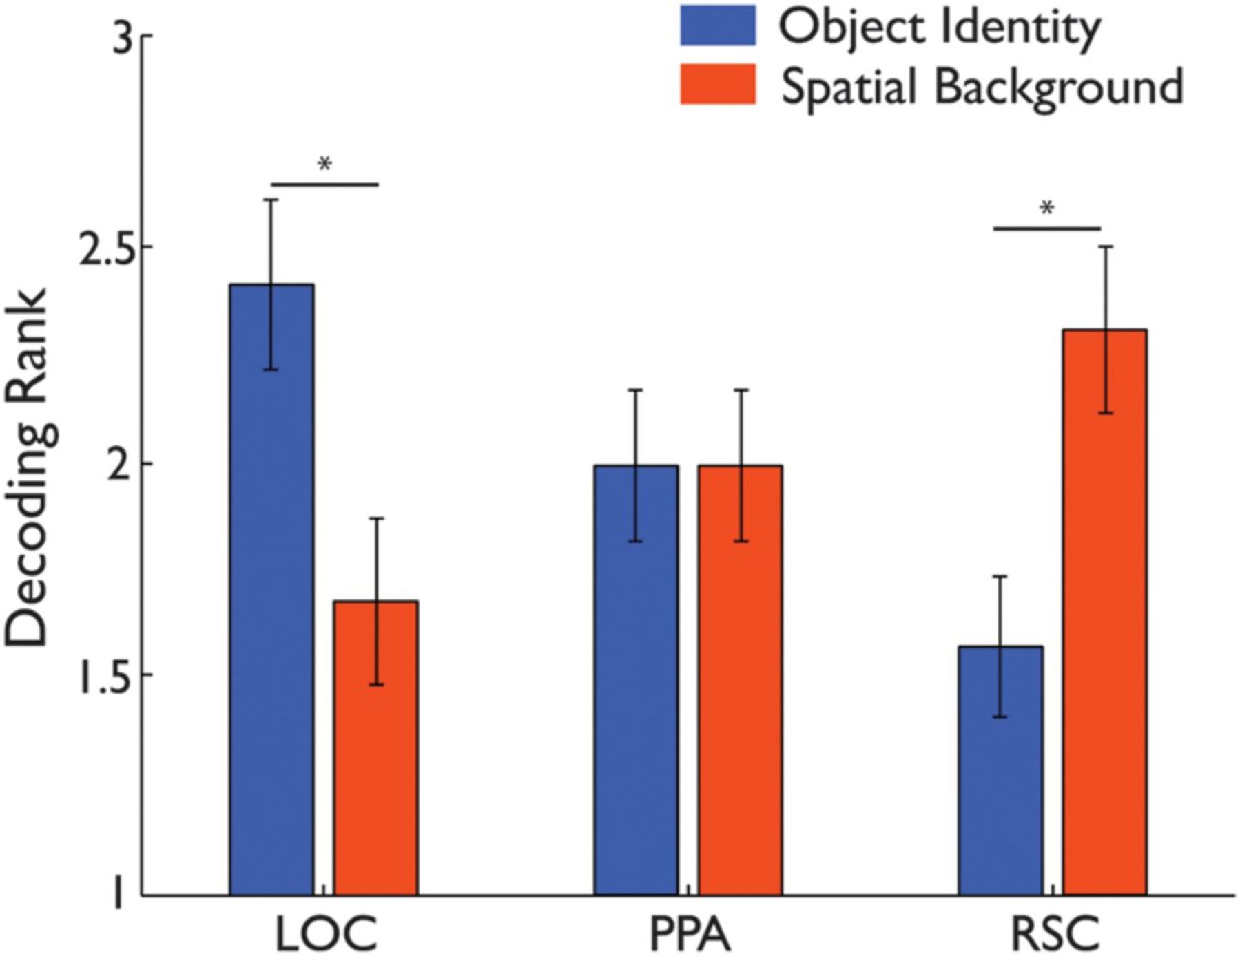
Figure 5. Opposite gradients of object and spatial information. The average object identity (Fig. 2d) and spatial ...
Notes:
Figure 5. Opposite gradients of object and spatial information. The average object identity (Fig. 2d) and spatial background (Fig. 4d) decoding rankings plotted across LOC, PPA, and RSC. Note the opposing gradients for the 2 types of information. Note also the significantly higher object identity decoding ranks in LOC, spatial background decoding ranks in RSC, and the equivalent ranks for both types of information in PPA. *P < 0.05 difference between information types (Wilcoxon signed-ranks test).
Unless provided in the caption above, the following copyright applies to the content of this slide: © The Author 2012. Published by Oxford University Press. All rights reserved. For permissions, please e-mail: journals.permissions@oup.com

Slide 6
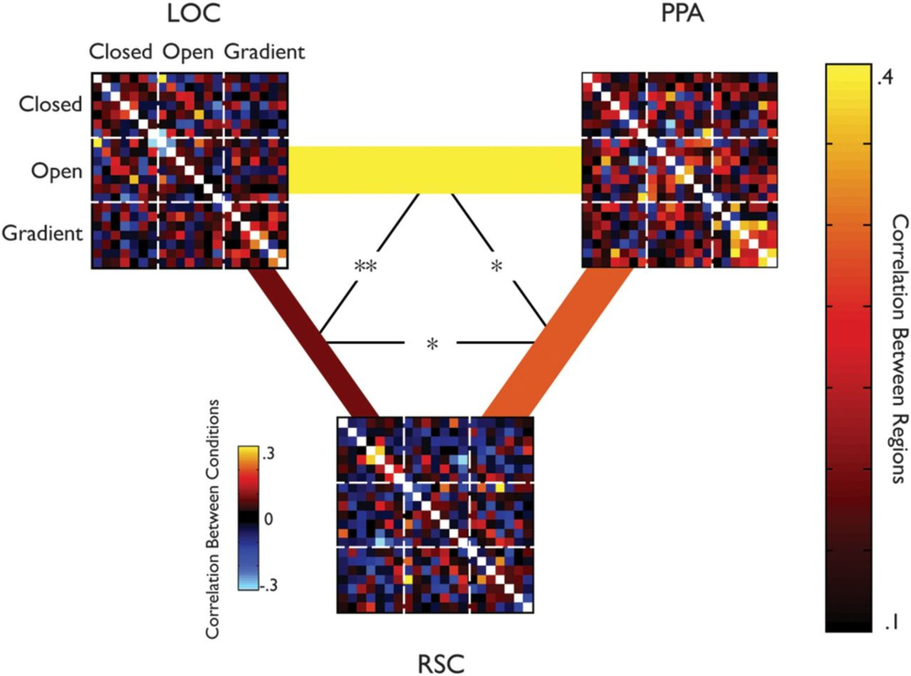
Figure 6. Structure correlations across ROIs. To systematically compare the structure of representations across PPA, ...
Notes:
Figure 6. Structure correlations across ROIs. To systematically compare the structure of representations across PPA, RSC, and LOC, we cross-correlated the full similarity matrices between every possible pair of the 3 ROIs, in each participant. Examples of these matrices for a single subject are presented for the 3 ROIs. These similarity matrices (21 × 21 conditions, by excluding the space-absent and object-absent conditions) capture the structure of representations for each region across the set of scenes. We correlated these matrices between regions within each subject and then averaged the correlation values across subjects. Note that the diagonal values within each matrix were excluded from this analysis and hence are colored white. The lines connecting the similarity matrices for each ROI depict the average correlation between them across subjects. The color and width of each line represent the strength of the correlation between the similarity matrices in each pair of regions. Note the greater correlation between RSC and PPA than between RSC and LOC. **P < 0.001 difference between the correlation between 2 pairs of ROIs; *P < 0.05 difference between the correlation between 2 pairs of ROIs.
Unless provided in the caption above, the following copyright applies to the content of this slide: © The Author 2012. Published by Oxford University Press. All rights reserved. For permissions, please e-mail: journals.permissions@oup.com

