Slide 1
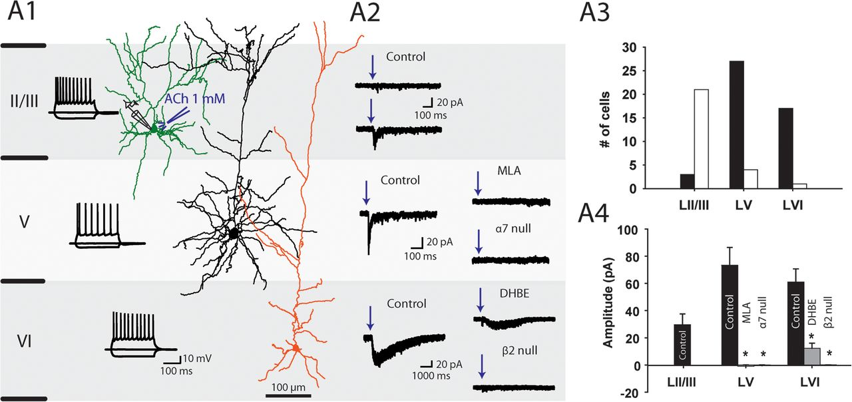
Figure 1. nAChR modulation of pyramidal neurons. (A1) Membrane potential responses to step current injections of ...
Notes:
Figure 1. nAChR modulation of pyramidal neurons. (A1) Membrane potential responses to step current injections of pyramidal cells in the different layers of the medial PFC (current injections of −100 and +140 pA) and examples of post hoc reconstructed pyramidal neuron morphologies. (A2) Current responses of pyramidal neurons to local ACh (1 mM) application (all experiments in the presence of atropine 200 nM). Pyramidal neurons display a layer-specific modulation by nAChRs. (A3) Histogram quantifying the amount of pyramidal neurons positive (black) or negative (white) for functional nAChRs in each layer. (A4) Summary plot of average amplitudes of the ACh-induced currents. Currents in layer V pyramidal neurons were blocked by the α7 antagonist MLA (n = 7, Student's t-test, P < 0.01) and absent in mice lacking the gene for the α7 subunit (n = 8, Student's t-test, P < 0.001). Currents in layer VI pyramidal neurons were blocked by β2* antagonist DHβE (n = 8, Student's t-test, P < 0.01) and absent in β2-null mice (n = 7, Student's t-test, P < 0.001).
Unless provided in the caption above, the following copyright applies to the content of this slide: © The Authors 2012. Published by Oxford University Press.This is an Open Access article distributed under the terms of the Creative Commons Attribution Non-Commercial License (http://creativecommons.org/licenses/by-nc/3.0), which permits unrestricted non-commercial use, distribution, and reproduction in any medium, provided the original work is properly cited.

Slide 2
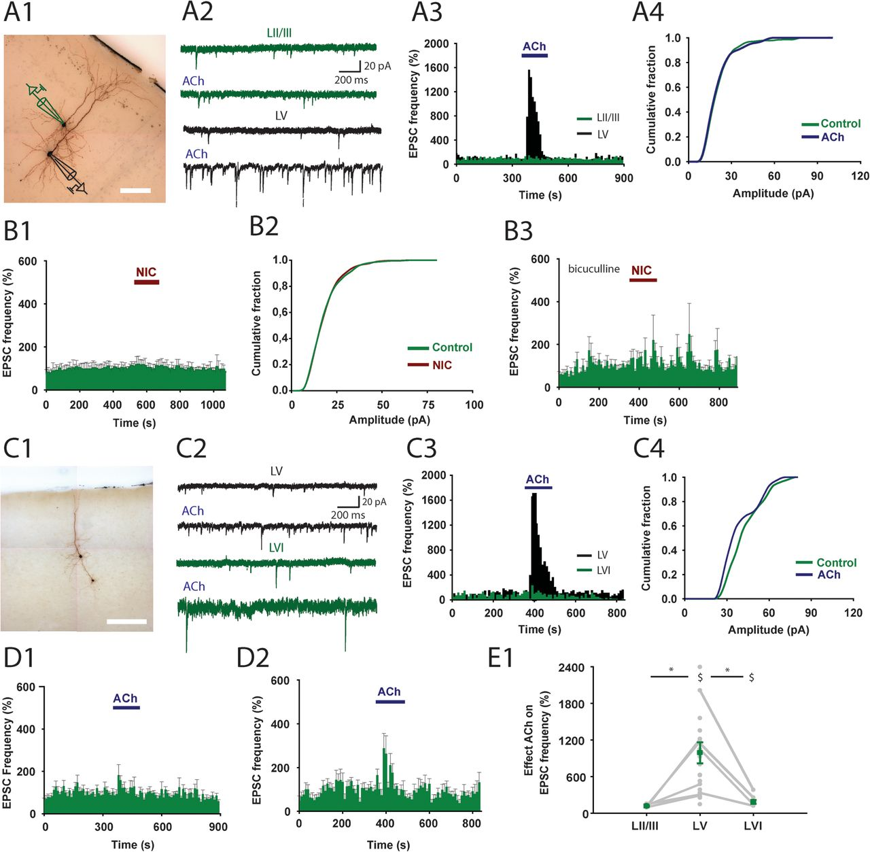
Figure 2. nAChR modulation of glutamatergic synaptic transmission. (A1) Biocytin-filled cells showing the morphology of ...
Notes:
Figure 2. nAChR modulation of glutamatergic synaptic transmission. (A1) Biocytin-filled cells showing the morphology of 2 pyramidal neurons in layers II/III and V recorded simultaneously. On top, the recording setup for data in A2–A4 is depicted. Scale bar = 100 μm. (A2) Example traces of spontaneous excitatory transmission (EPSCs) during baseline (top) and ACh (1 mM) application (bottom) for a double recording of LII/III (green) and LV (black). (A3) Histogram of the EPSC frequency. Same neurons as in A2. (A4) Cumulative amplitude distribution of EPSCs recorded from a layer II/III pyramidal neuron. ACh application had no effect on the distribution (Kolmogorov–Smirnov test, P > 0.05). (B1) Histogram showing the average EPSC frequency over time during nicotine (10 μM) application (n = 11). (B2) Cumulative amplitude distribution of EPSCs recorded from a layer II/III pyramidal neuron. Nicotine (10 μM) application had no effect on the distribution (n = 11, Kolmogorov–Smirnov test, P > 0.05). (B3) Same experiment as in B1 in addition of the GABAa receptor blocker bicuculline (10 μM). (C1–C3) Same as in A1–A3 but now for a layer V (black) and LVI pyramidal neuron (green). Scale bar = 250 μm. (C4) Cumulative amplitude distribution of EPSCs recorded from a layer VI pyramidal neuron. ACh application had no effect on the distribution (Kolmogorov–Smirnov test, P > 0.05). (D1) Average EPSC frequency histogram of layer II/III pyramidal neurons (n = 8). Duration of ACh application is indicated by blue bar. (D2) Average EPSC frequency histogram of layer VI pyramidal neurons (n = 8). Duration of ACh application is indicated by blue bar. (E1) Summary plot of ACh effects on EPSC frequency in pyramidal neurons from different layers. Individual recordings are shown with grey dots. Simultaneous recordings in different layers are connected with grey line (n = 6 layer II/III and LV, n = 4 layer V and LVI). Green dot shows average frequency during acetylcholine application. Layers V and VI showed a significant increase in EPSC frequency on ACh application (Indicated by $, n = 21, Student's t-test, P < 0.01 and n = 8, Student's t-test, P = 0.03). The increase in EPSC frequency was significantly lower in LVI (Student's t-test, P < 0.01). All error bars in figure indicate standard error of the mean.
Unless provided in the caption above, the following copyright applies to the content of this slide: © The Authors 2012. Published by Oxford University Press.This is an Open Access article distributed under the terms of the Creative Commons Attribution Non-Commercial License (http://creativecommons.org/licenses/by-nc/3.0), which permits unrestricted non-commercial use, distribution, and reproduction in any medium, provided the original work is properly cited.

Slide 3
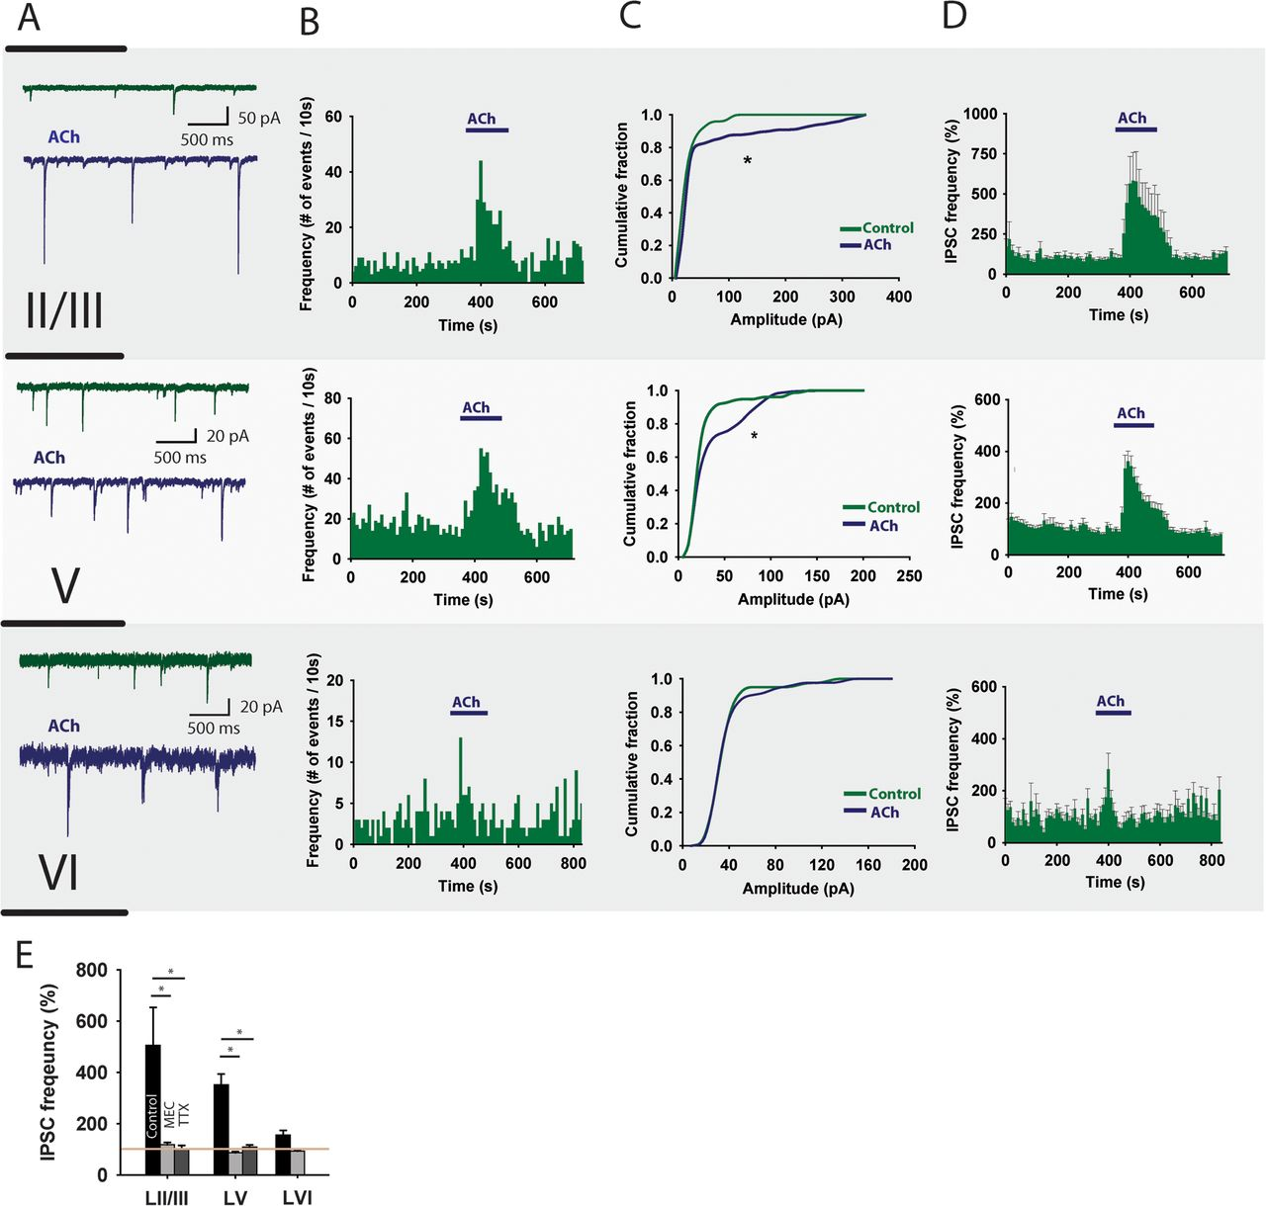
Figure 3. nAChR modulation of inhibitory transmission received by pyramidal neurons. (A) Example traces showing ...
Notes:
Figure 3. nAChR modulation of inhibitory transmission received by pyramidal neurons. (A) Example traces showing spontaneous IPSCs recorded from PFC pyramidal neurons in the absence (green) and presence of 1 mM ACh (blue). (B) Histograms showing the frequency of IPSCs during a single experiment. (C) Cumulative amplitude distribution showing that during acetylcholine application IPSCs with larger amplitude appeared in layers II/III (6 of 10 neurons) and LV (10 of 16 neurons, Kolmogorov–Smirnov test, P 0.05). (D) Average IPSC frequency histogram for pyramidal neurons in different PFC layers during acetylcholine application. Blue bar indicates the time when acetylcholine is present. Acetylcholine significantly increased the IPSC frequency in LII/III (505.3 ± 148.2%, Student's t-test, P < 0.01) and LV (351.2 ± 42.8%, P < 0.001) but not in LVI (153.6 ± 18.4%, P = 0.09). (E) Summary bar graph quantifying the effect of acetylcholine and different blockers on the IPSC frequency measured in prefrontal cortical pyramidal neurons (mecamylamine; LII/III: 505.3 ± 148.2% of control [n = 10] vs. 117.9 ± 9.2% [n = 3], P < 0.05. LV: 351.2 ± 42.8% [n = 16] vs. 87.4 ± 3.4% [n = 3], P < 0.01, TTX; LII/III: 505.3 ± 148.2% [n = 10] vs. 101.3 ± 13.8% [n = 2], P < 0.05. LV: 351.2 ± 42.8% [n = 16] vs. 108.6 ± 8.2% [n = 3], P < 0.01).
Unless provided in the caption above, the following copyright applies to the content of this slide: © The Authors 2012. Published by Oxford University Press.This is an Open Access article distributed under the terms of the Creative Commons Attribution Non-Commercial License (http://creativecommons.org/licenses/by-nc/3.0), which permits unrestricted non-commercial use, distribution, and reproduction in any medium, provided the original work is properly cited.

Slide 4
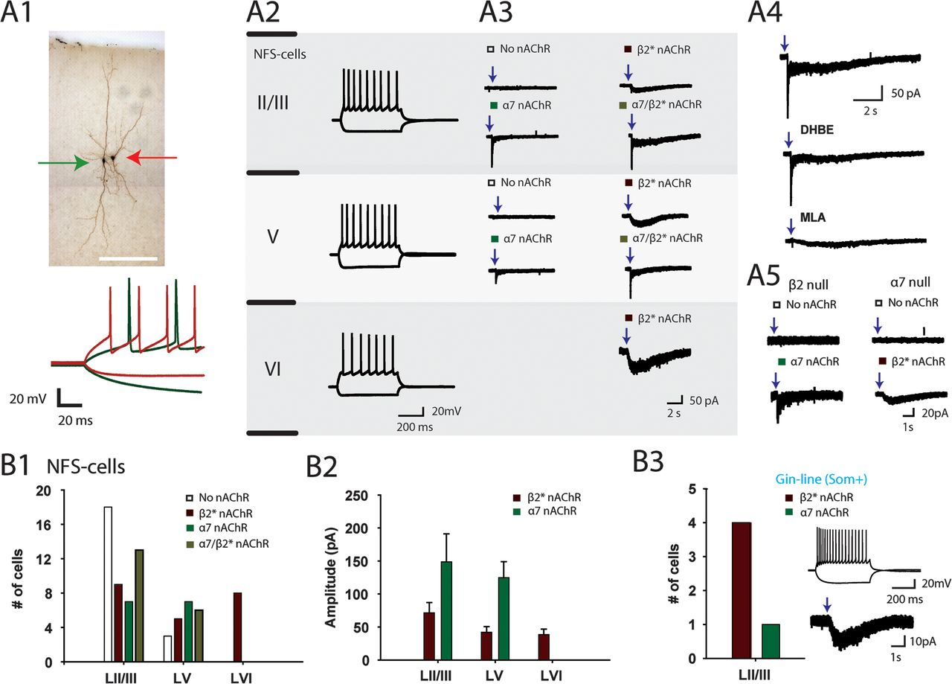
Figure 4. nAChR modulation of NFS interneurons. (A1) Biocytin staining of NFS and FS interneurons in layer V. Lower ...
Notes:
Figure 4. nAChR modulation of NFS interneurons. (A1) Biocytin staining of NFS and FS interneurons in layer V. Lower panel shows characteristic action potential firing of NFS and FS cells. Scale bar is 250 μM. (A2) Spike profile of NFS interneurons in different layers (current injection −100 and +140 pA). (A3) Example traces of ACh-induced responses in NFS interneurons. Fast α7-like, slow β2*-like, and mixed nAChR responses were observed. (A4) NFS cell showing mixed nAChR response. Fast α7-like components were blocked by MLA (10 nM), whereas the slow β2*-like component was blocked by DHβE (10 μM). (A5) Example traces of NFS cells recorded in β2- and α7-null mice. β2-null mice only exhibited fast onset nAChR responses or cells without a nAChR response. α7-null mice showed either no nAChR response or slow nAChR responses. (B1) Histogram summarizing the nicotinic receptor distribution on NFS cells for each layer. (B2) Average amplitude of the α7-like and β2*-like nAChR-mediated responses in different layers. (B3) Somatostatin-positive cells expressing eGFP are positive for β2*-like nAChR-mediated currents.
Unless provided in the caption above, the following copyright applies to the content of this slide: © The Authors 2012. Published by Oxford University Press.This is an Open Access article distributed under the terms of the Creative Commons Attribution Non-Commercial License (http://creativecommons.org/licenses/by-nc/3.0), which permits unrestricted non-commercial use, distribution, and reproduction in any medium, provided the original work is properly cited.

Slide 5
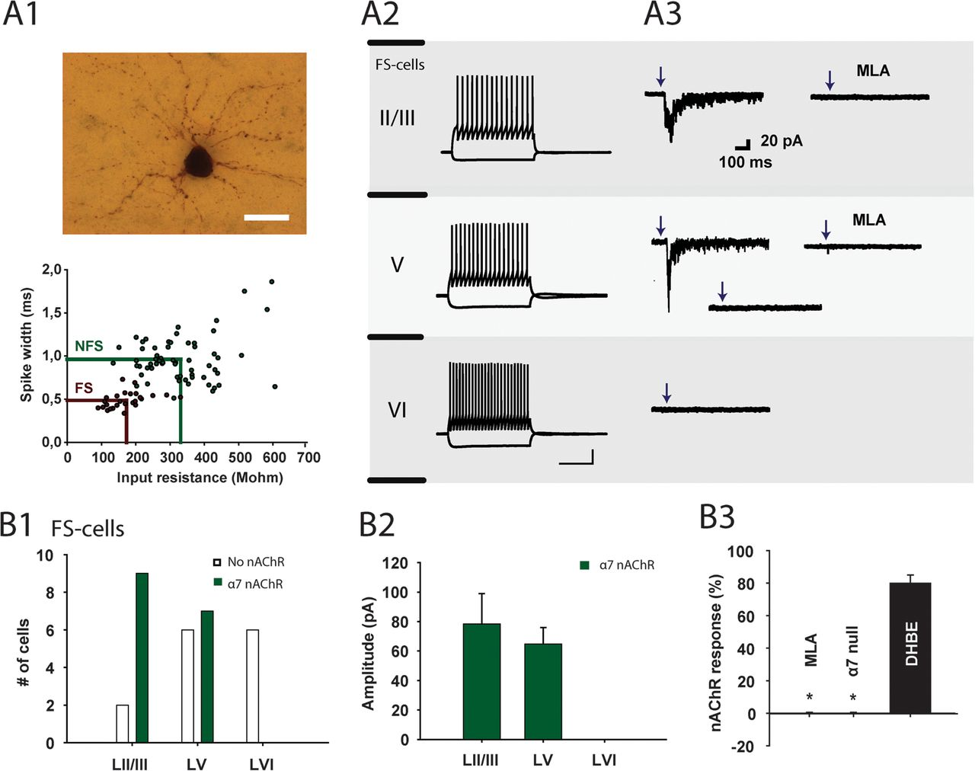
Figure 5. nAChR modulation of FS interneurons. (A1) Biocyting staining of an FS interneuron. Lower panel indicates ...
Notes:
Figure 5. nAChR modulation of FS interneurons. (A1) Biocyting staining of an FS interneuron. Lower panel indicates spike width and input resistance for FS and NFS cells. Scale bar = 25 μm. (A2) Spike profile of FS interneurons in different layers. (A3) Example traces of ACh-induced responses in FS interneurons. α7-mediated responses were observed in layer II/III and half of the layer V neurons (positive and negative example shown) but not in layer VI. (B1) Histogram summarizing the amount of FS cells positive for nAChRs. (B2) Summary of the average amplitudes of α7 currents on FS cells per layer. (B3) All nAChR-induced currents on FS cells could be blocked by MLA (n = 3) but not by DHβE (n = 2). FS cells in α7-null mice were not found to express functional nAChRs (n = 2).
Unless provided in the caption above, the following copyright applies to the content of this slide: © The Authors 2012. Published by Oxford University Press.This is an Open Access article distributed under the terms of the Creative Commons Attribution Non-Commercial License (http://creativecommons.org/licenses/by-nc/3.0), which permits unrestricted non-commercial use, distribution, and reproduction in any medium, provided the original work is properly cited.

Slide 6
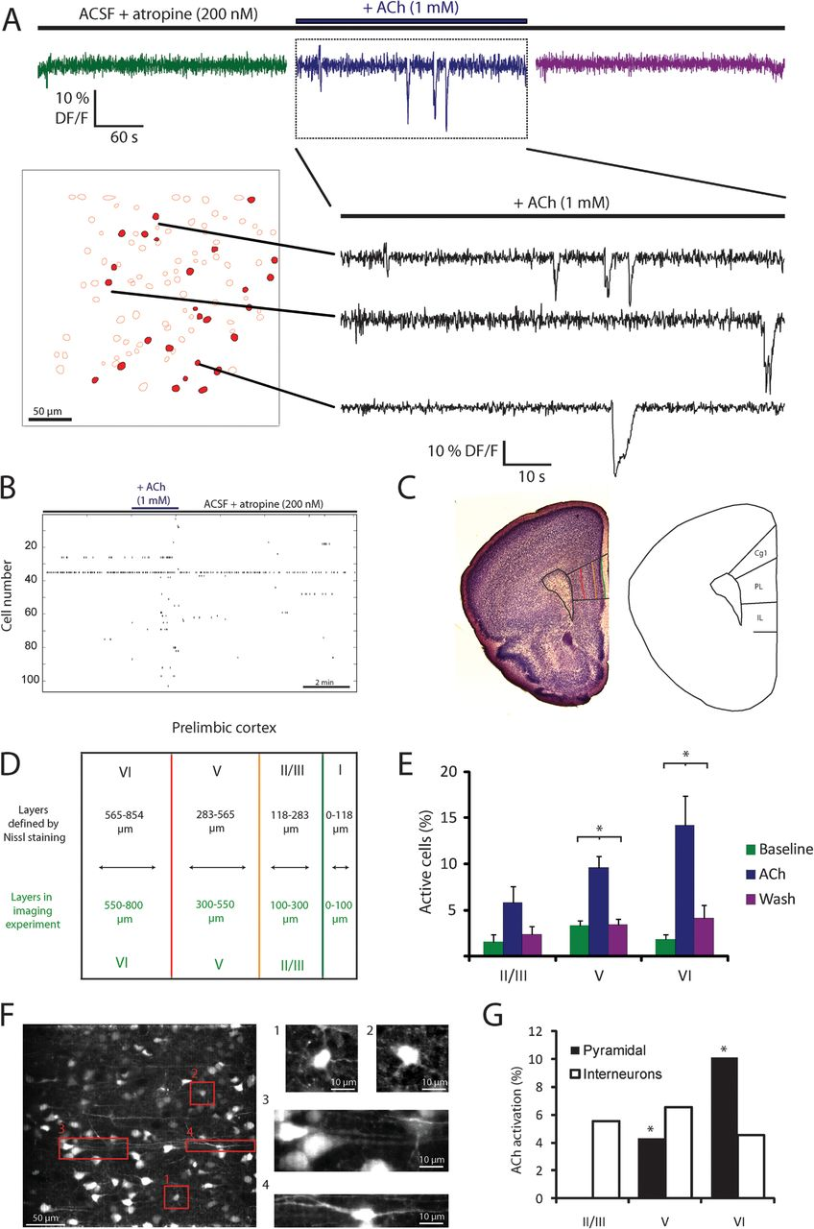
Figure 6. ACh-induced neuronal activation is most prominent in deep layers. (A) Top traces: schematic representation of ...
Notes:
Figure 6. ACh-induced neuronal activation is most prominent in deep layers. (A) Top traces: schematic representation of the experimental protocol and an example of the fluorescence of one cell during the entire experiment. Bottom panels: example of automatically detected cell contours and fluorescence traces from these cells. Cells that are indicated in red showed increased activity during ACh application. Fluorescence traces of 3 highlighted neurons during ACh application show downward deflections that indicate calcium influx due to neuronal activity. (B) Rasterplot of network activity during a single experiment. Black ticks represent the occurrence of a calcium event. During application of ACh, there is an increase in the number of cells showing calcium events. (C) Left: example of a Nissl-stained coronal slice, prelimbic area is indicated by black lines. Colored lines indicate the depth of layers within the prelimbic area (yellow is LII/III, red is LV, and LVI is black). Right: schematic cartoon indicating the medial prefrontal cortical areas. (D) Overview of the average depth of prefrontal cortical layers defined by Nissl staining (upper black values) and depth of layers used to categorize the imaged cells (lower green values). (E) Percentage of cells that is active per minute in different layers (n = 82 slices). ANOVA repeated measure testing indicated that the drug effect (P < 0.001) and its interaction with the layers (P < 0.05) are significant. In deep layers, there is a significant effect of ACh application (layer V: P < 0.01 [n = 37]; layer VI: P < 0.001 [n = 23, Newman–Keuls post hoc test]). During wash out, activity returned to baseline (layer V: P < 0.01; layer VI: P < 0.001). (F) Example of identification of neurons. On the left, a collapsed z-stack at high resolution. On the right, examples of identified neurons, interneurons (1, 2, and 4), and pyramidal neurons (3). (G) Percentage of identified pyramidal and interneurons which activity was increased during ACh application. Pyramidal cells showed a significant increase in the percentage of cells that was active in both layer V (P < 0.01) and layer VI (P < 0.001, binomial test). In addition, the size of the activation was significantly different between layers (P < 0.01). Interneuron activation was not significantly different between the 3 layers. All error bars represent standard error of the mean.
Unless provided in the caption above, the following copyright applies to the content of this slide: © The Authors 2012. Published by Oxford University Press.This is an Open Access article distributed under the terms of the Creative Commons Attribution Non-Commercial License (http://creativecommons.org/licenses/by-nc/3.0), which permits unrestricted non-commercial use, distribution, and reproduction in any medium, provided the original work is properly cited.

Slide 7
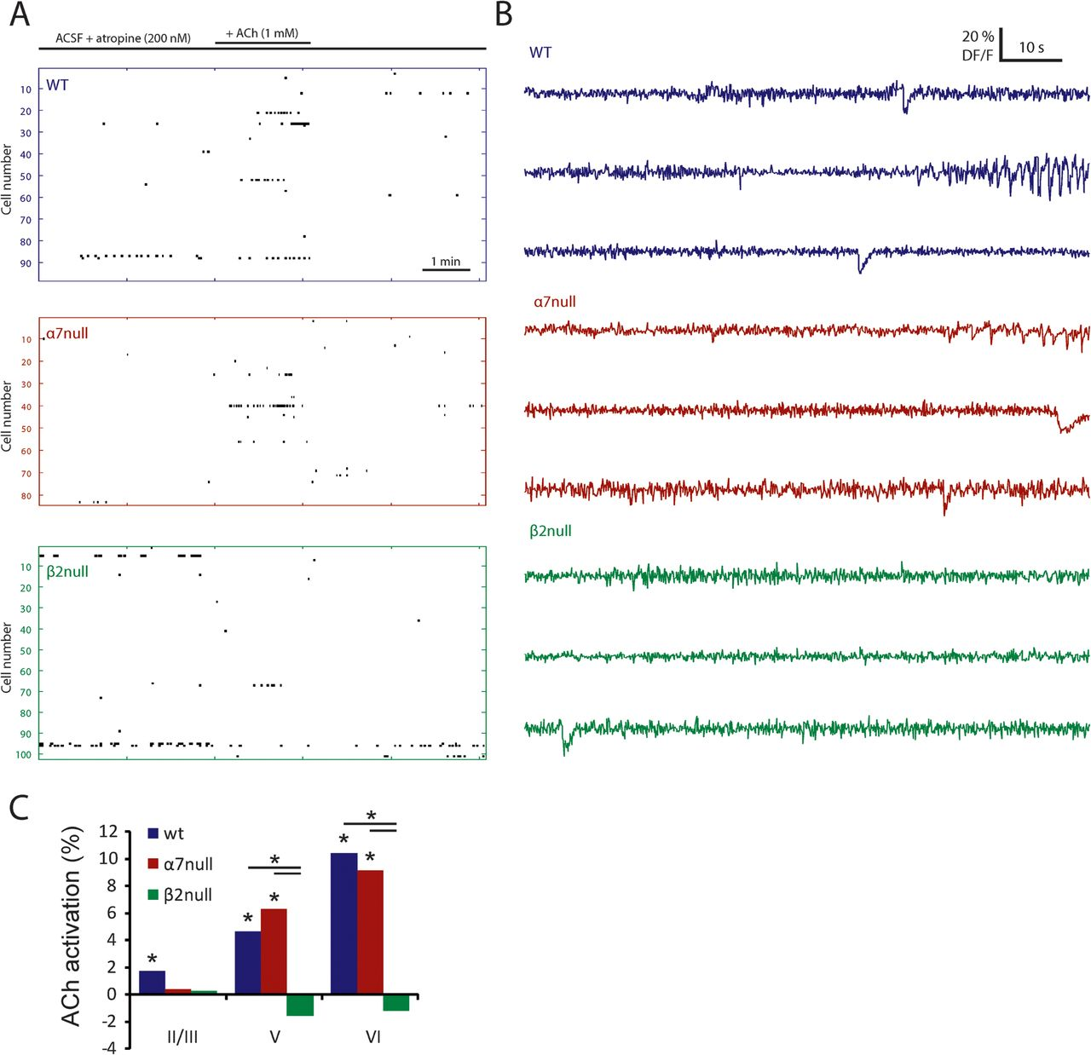
Figure 7. ACh-induced network activity in α7- and β2-null mice. Activation of PFC neurons by ACh (1 mM) in mice lacking ...
Notes:
Figure 7. ACh-induced network activity in α7- and β2-null mice. Activation of PFC neurons by ACh (1 mM) in mice lacking β2 and α7 subunits shows a strong contribution of β2 subunits to the observed activation of the network. (A) Rasterplot of network activity in slices from WT, α7-null and β2-null mice. (B) Fluorescence traces during ACh application for WT, α7-null and β2-null mice. (C) Summary histogram showing that both WT and α7-null mice show strong layer-dependent (WT: P < 0.001; α7 null: P < 0.001) activations (binomial tests: WT layer II/III: P < 0.01; layer V: P < 0.001; layer VI: P < 0.001; α7 null: layer II/III: not significant, ns; layer V: P < 0.001; layer VI: P < 0.001), whereas none of the layers shows a significant activation in β2-null mice. The activation is significantly stronger in PFC slices of WT and α7-null than in β2-null animals in layer V and layer VI (WT vs. β2 null: layer V: P < 0.001; layer VI: P < 0.001; α7 null vs. β2 null: layer V: P < 0.001; layer VI: P < 0.001).
Unless provided in the caption above, the following copyright applies to the content of this slide: © The Authors 2012. Published by Oxford University Press.This is an Open Access article distributed under the terms of the Creative Commons Attribution Non-Commercial License (http://creativecommons.org/licenses/by-nc/3.0), which permits unrestricted non-commercial use, distribution, and reproduction in any medium, provided the original work is properly cited.

Slide 8
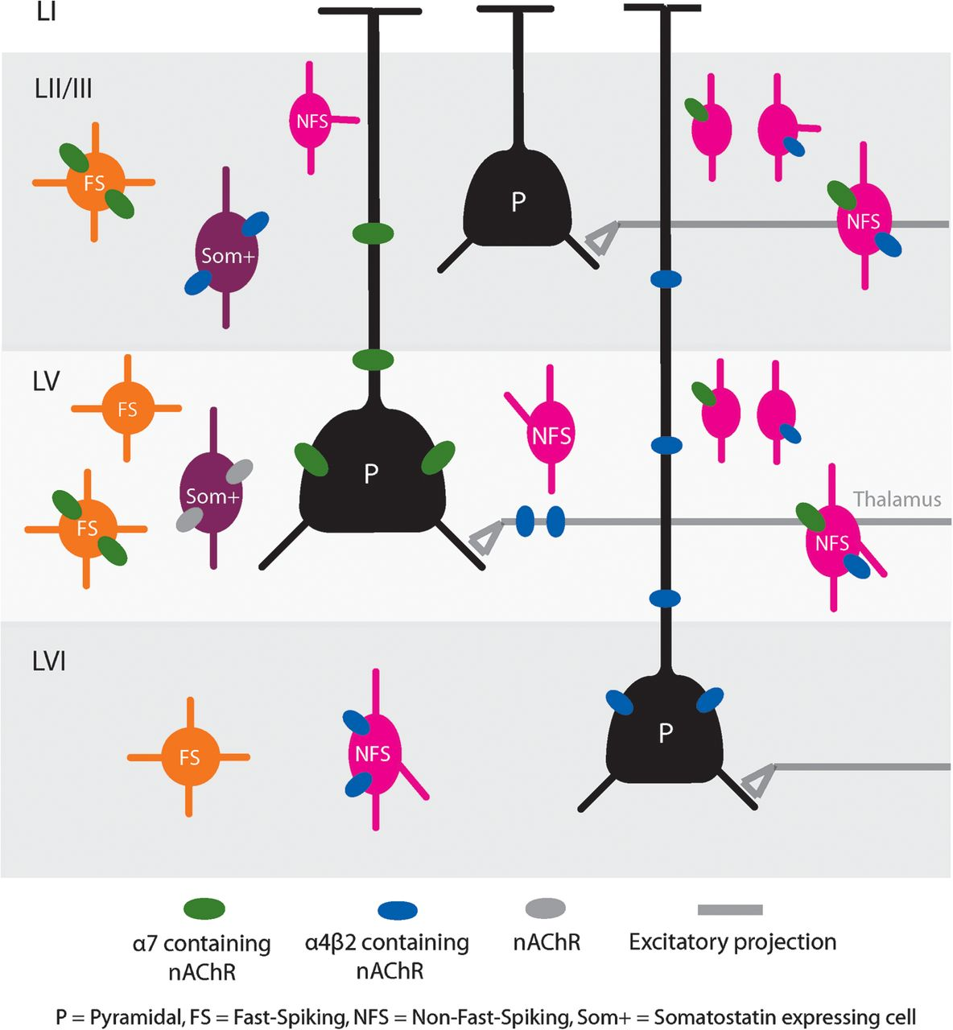
Figure 8. Overview of nicotinic receptor modulation of the different cell types in all PFC layers.
Notes:
Figure 8. Overview of nicotinic receptor modulation of the different cell types in all PFC layers.
Unless provided in the caption above, the following copyright applies to the content of this slide: © The Authors 2012. Published by Oxford University Press.This is an Open Access article distributed under the terms of the Creative Commons Attribution Non-Commercial License (http://creativecommons.org/licenses/by-nc/3.0), which permits unrestricted non-commercial use, distribution, and reproduction in any medium, provided the original work is properly cited.

