Slide 1
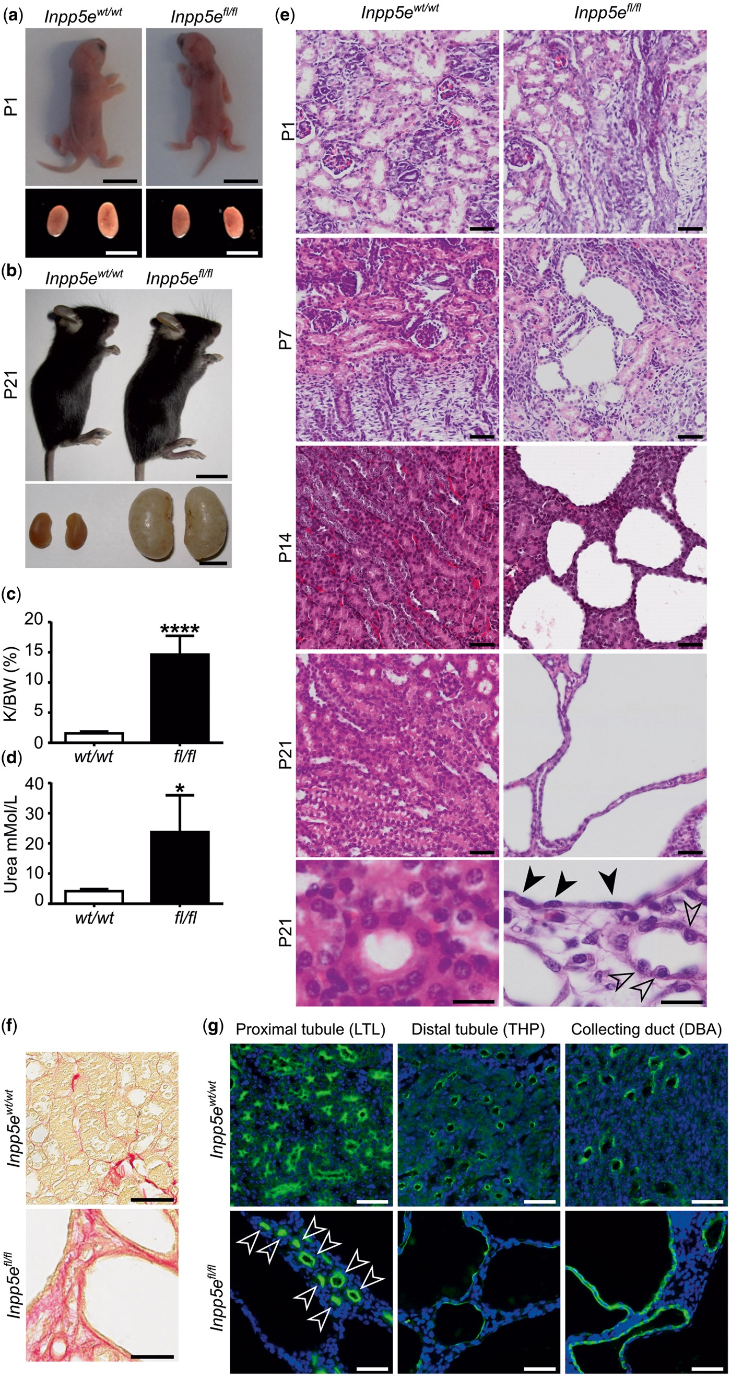
Figure 1. Inpp5e regulates renal epithelial cell function and kidney architecture. Inpp5e ^{wt/wt} ;Ksp-Cre ...
Notes:
Figure 1. Inpp5e regulates renal epithelial cell function and kidney architecture. Inpp5e wt/wt ;Ksp-Cre ( Inpp5e wt/wt ) and Inpp5e fl/fl ;Ksp-Cre ( Inpp5e fl/fl ) whole mice and kidneys at (a) P1 and (b) P21. (c) Kidney/body weight ratio (K/BW (%)) and (d) serum urea at P21. (e) H&E staining of kidney sections at indicated days. Bottom panels show zoomed images of P21 kidneys, solid arrows indicate flattened; and open arrows indicate bulging cellular morphology. (f) Picrosirius red staining of collagen deposition in P21 Inpp5e wt/wt ;Ksp-Cre ( Inpp5e wt/wt ) and Inpp5e fl/fl ;Ksp-Cre ( Inpp5e fl/fl ) kidney sections. (g) Immunofluorescent staining of proximal tubule (LTL, Lotus Tetragonolobus Lectin, green), distal tubule and loop of Henle (THP, Tamm-Horsfall protein, green), and collecting duct (DBA, Dolichos Biflorus Agglutinin, green), with DAPI (nuclear counterstain, blue) at P21 in Inpp5e wt/wt ;Ksp-Cre ( Inpp5e wt/wt ) and Inpp5e fl/fl ;Ksp-Cre ( Inpp5e fl/fl ) kidney sections . Open arrows indicate normal tubular morphology in proximal tubules. Graphs in c and d depict mean ± SD of n ≥ 4 mice per genotype, * P < 0.05, **** P < 0.0001. Scale: (a) 10 mm upper, 2 mm lower (b) 10 mm upper, 7.5 mm lower (e) 50 µ m ; 20 µ m zoomed (f) 50 µ m (g) 50 µ m . SD, standard deviation.
Unless provided in the caption above, the following copyright applies to the content of this slide: © The Author 2016. Published by Oxford University Press. All rights reserved. For permissions, please e-mail: journals.permissions@oup.com

Slide 2
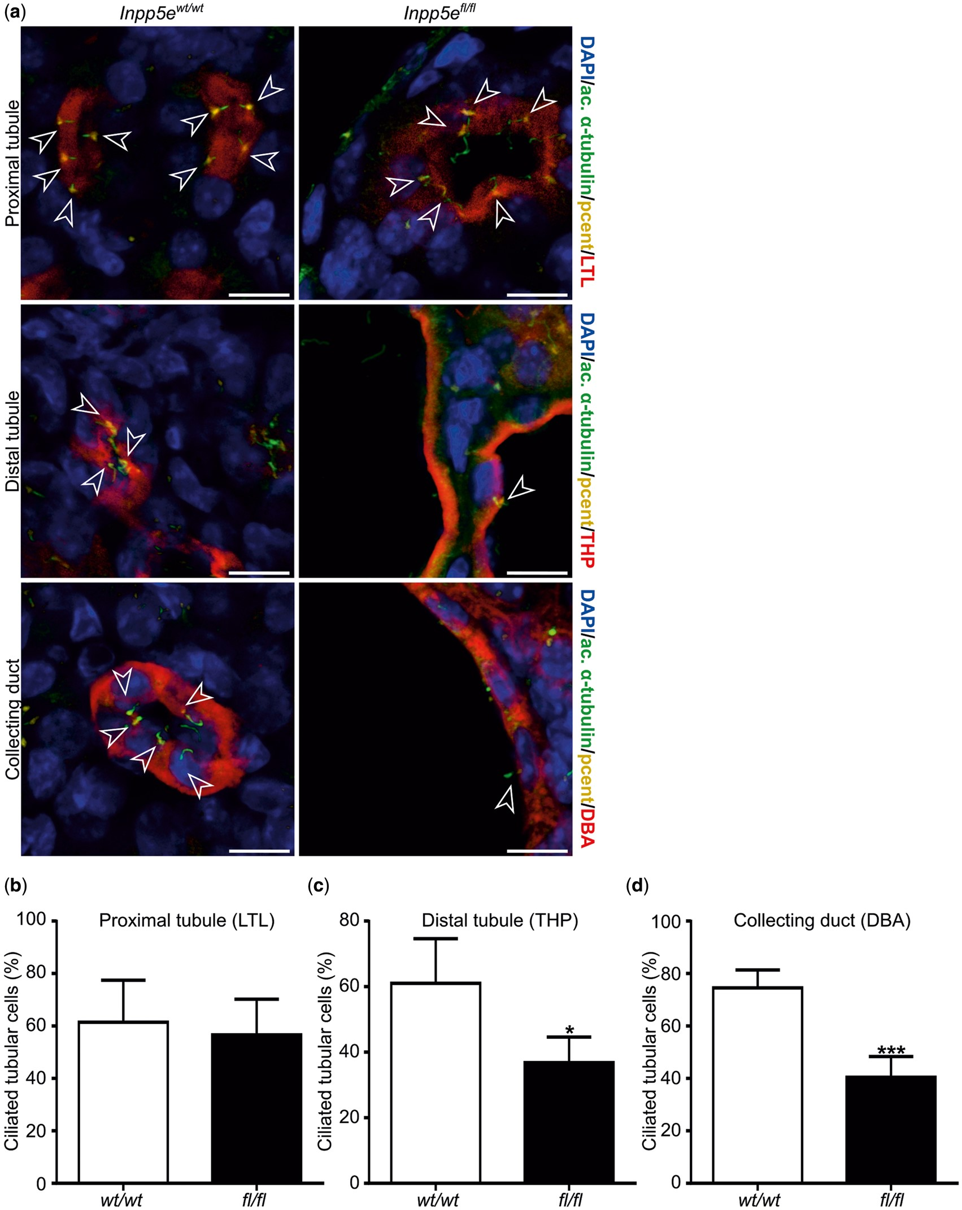
Figure 2. Renal cysts in Inpp5e ^{fl/fl} ;Ksp-Cre mice are characterized by partial cilia loss. (a) Confocal ...
Notes:
Figure 2. Renal cysts in Inpp5e fl/fl ;Ksp-Cre mice are characterized by partial cilia loss. (a) Confocal x , y , z images of P21 Inpp5e wt/wt ;Ksp-Cre ( Inpp5e wt/wt ) and Inpp5e fl/fl ;Ksp-Cre ( Inpp5e fl/fl ) kidney sections stained to visualize cilia (acetylated α-tubulin/ac. α-tubulin, green), basal bodies (pericentrin/pcent, yellow), nephron segments (proximal tubule (LTL, Lotus Tetragonolobus Lectin), distal tubule (THP, Tamm-Horsfall protein) and collecting duct (DBA, Dolichos Biflorus Agglutinin)) shown in red and nuclei (DAPI, blue). Cilia (white open arrowheads) number was scored separately for each tubule segment; proximal tubule, distal tubule and collecting duct. (b–d) Graphical tabulation of nephron segment-specific cilia number in P21 Inpp5e wt/wt ;Ksp-Cre ( wt/wt ) and Inpp5e fl/fl ;Ksp-Cre ( fl/fl ) kidneys. Graphs represent mean ± SD, n ≥ 4 mice per genotype, * P < 0.05, *** P < 0.001. Scale: 10 µ m . SD, standard deviation.
Unless provided in the caption above, the following copyright applies to the content of this slide: © The Author 2016. Published by Oxford University Press. All rights reserved. For permissions, please e-mail: journals.permissions@oup.com

Slide 3
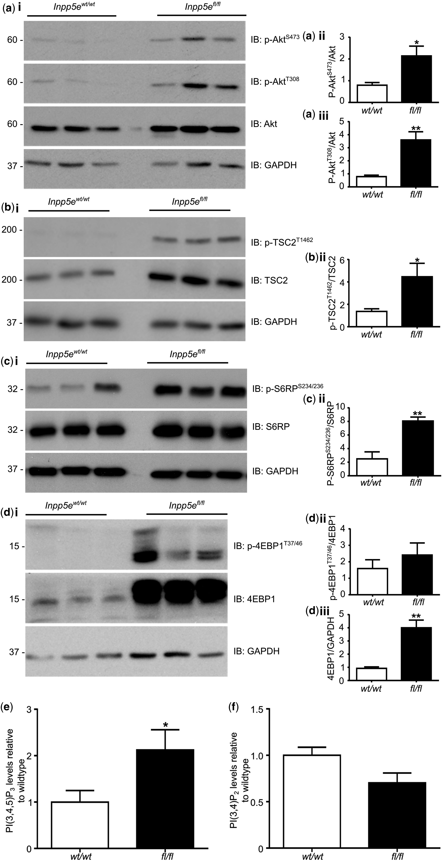
Figure 3. Increased PI3K/Akt/mTORC1 signaling in cystic Inpp5e ^{fl/fl} ;Ksp-Cre mouse kidneys and pRECs. (a ...
Notes:
Figure 3. Increased PI3K/Akt/mTORC1 signaling in cystic Inpp5e fl/fl ;Ksp-Cre mouse kidneys and pRECs. (a i, b i, c i and d i) Immunoblot of P21 Inpp5e wt/wt ;Ksp-Cre ( Inpp5e wt/wt ) and Inpp5e fl/fl ;Ksp-Cre ( Inpp5e fl/fl ) whole kidney lysates using indicated antibodies to total and phospho-proteins. Each lane represents kidney lysate from a separate mouse. Phospho-proteins were compared with total protein and/or GAPDH as loading control for densitometric analysis which is presented graphically in (a ii and iii, b ii, c ii and d ii and iii). (e) PI(3,4,5)P 3 and (f) PI(3,4)P 2 mass ELISA analysis of Inpp5e wt/wt ;Ksp-Cre ( wt/wt ) and Inpp5e fl/fl ;Ksp-Cre ( fl/fl ) primary kidney epithelial cells. Graphs for a ii and iii, b ii, c ii and d ii and iii represent mean ± SD of n ≥ 4 mice per genotype. Graphs in e and f represents mean ± SEM of n ≥ 4 mice per genotype. * P < 0.05, ** P < 0.01. SD, standard deviation; SEM, standard error of mean.
Unless provided in the caption above, the following copyright applies to the content of this slide: © The Author 2016. Published by Oxford University Press. All rights reserved. For permissions, please e-mail: journals.permissions@oup.com

Slide 4
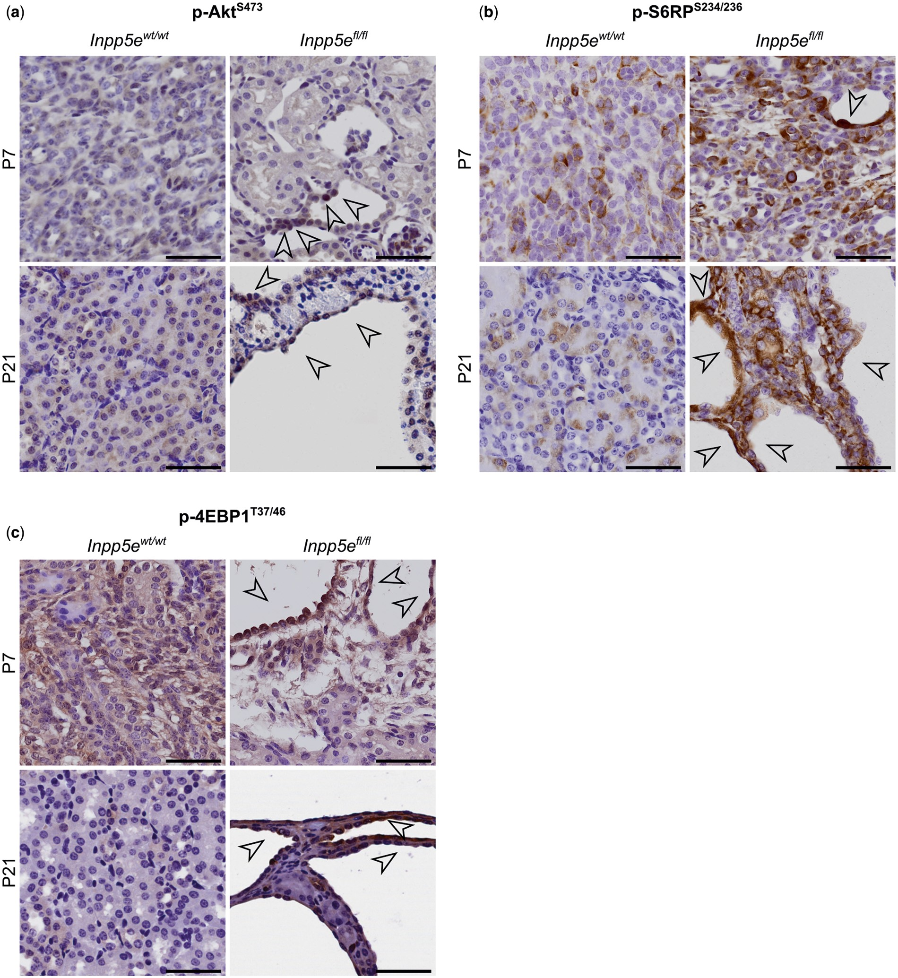
Figure 4. mTORC1 signaling is activated during cyst development and progression. IHC of (a) p-Akt ^{S473} , ...
Notes:
Figure 4. mTORC1 signaling is activated during cyst development and progression. IHC of (a) p-Akt S473 , (b) p-S6RP S234/236 and (c) p-4EBP1 T37/46 in P7 and P21 Inpp5e wt/wt ;Ksp-Cre ( Inpp5e wt/wt ) and Inpp5e fl/fl ;Ksp-Cre ( Inpp5e fl/fl ) kidneys. Black open arrowheads indicate epithelial cells displaying strong staining. Images are representative of analysis of n ≥ 3 mice per genotype. Scale: 50 µ m .
Unless provided in the caption above, the following copyright applies to the content of this slide: © The Author 2016. Published by Oxford University Press. All rights reserved. For permissions, please e-mail: journals.permissions@oup.com

Slide 5
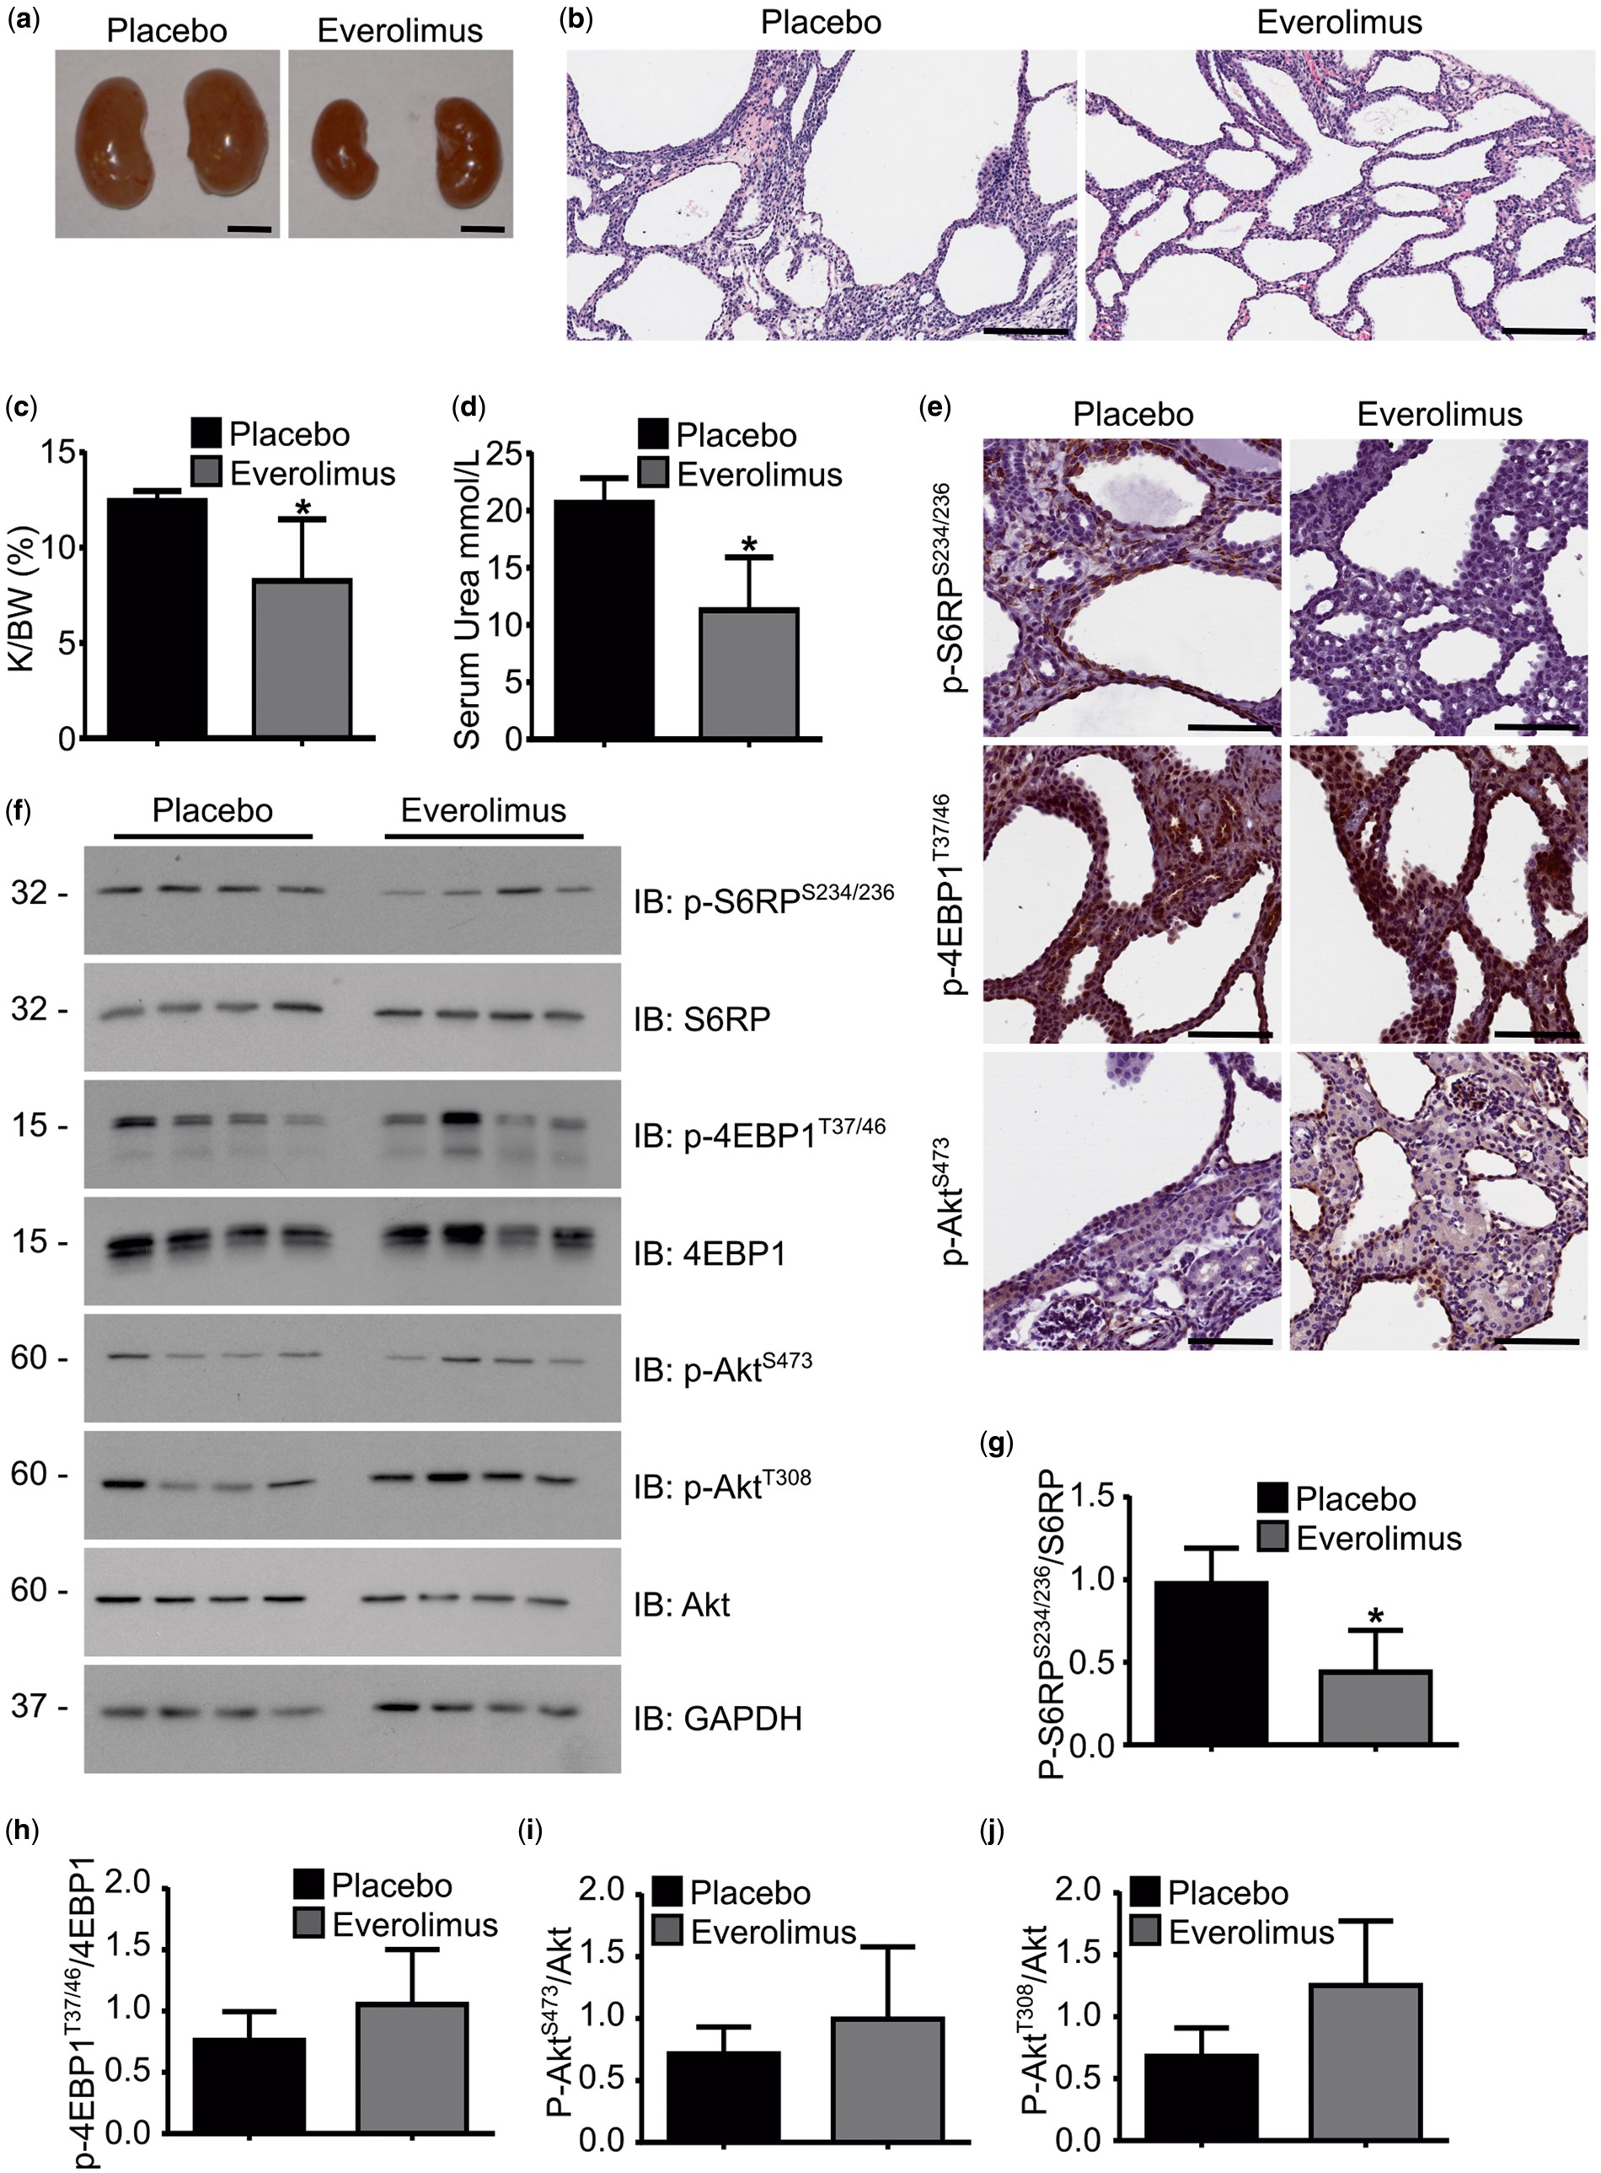
Figure 6. Everolimus treatment partially attenuates mTORC1 signaling and rescues PKD in Inpp5e ^{fl/fl} ...
Notes:
Figure 6. Everolimus treatment partially attenuates mTORC1 signaling and rescues PKD in Inpp5e fl/fl ;Ksp-Cre mice. (a) P21 Inpp5e fl/fl ;Ksp-Cre mouse kidneys following Everolimus or placebo treatment. (b) H&E staining of P21 Inpp5e fl/fl ;Ksp-Cre mouse kidney sections following Everolimus or placebo treatment. (c) Kidney/body weight ratio (K/BW (%)) and (d) serum urea in P21 Inpp5e fl/fl ;Ksp-Cre mice following Everolimus or placebo treatment. (e) IHC of p-S6RP S234/236 , p-4EBP1 T37/46 and p-Akt S473 in P21 Inpp5e fl/fl ;Ksp-Cre mouse kidney sections following Everolimus or placebo treatment. (f) Immunoblot of P21 Everolimus or placebo treated Inpp5e fl/fl ;Ksp-Cre mouse kidneys using indicated antibodies. Phospho-proteins were compared with total protein and/or GAPDH as loading control and represented graphically in (g–j). Graphs represent mean ± SD, n = 4 mice per treatment group, * P < 0.05. Scale: (a) 5 mm (b) 200 µ m (e) 100 µ m . SD, standard deviation.
Unless provided in the caption above, the following copyright applies to the content of this slide: © The Author 2016. Published by Oxford University Press. All rights reserved. For permissions, please e-mail: journals.permissions@oup.com

Slide 6
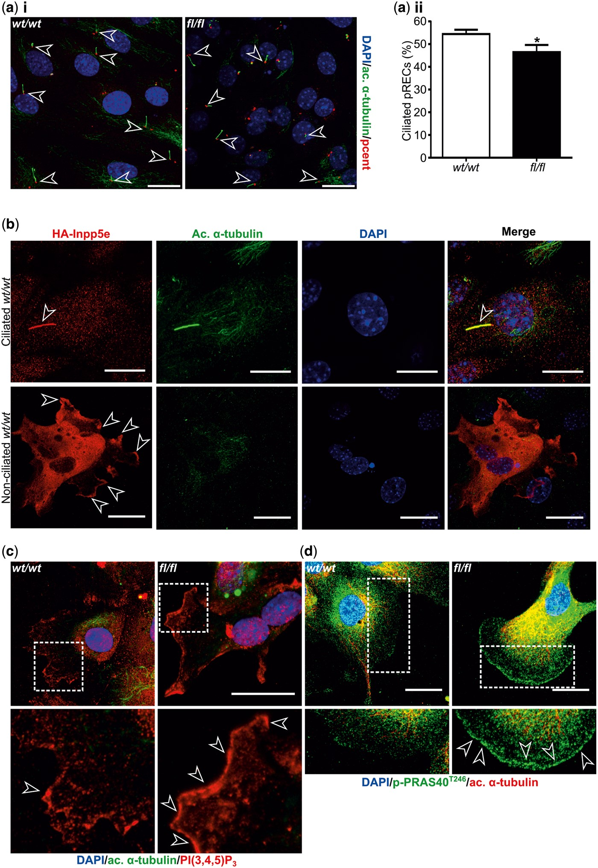
Figure 5. mTORC1 signaling is increased in both ciliated and non-ciliated Inpp5e -deficient pRECs. (a i) Confocal x , ...
Notes:
Figure 5. mTORC1 signaling is increased in both ciliated and non-ciliated Inpp5e -deficient pRECs. (a i) Confocal x , y , z images of Inpp5e wt/wt ;Ksp-Cre (wt/wt) and Inpp5e fl/fl ;Ksp-Cre (fl/fl) pRECs stained for visualization of cilia (acetylated α-tubulin/ac. α-tubulin, green), basal bodies (pericentrin/pcent, red), and nuclei (DAPI, blue). (a ii) Graphical tabulation of ciliated cell number in Inpp5e wt/wt ;Ksp-Cre (wt/wt) and Inpp5e fl/fl ;Ksp-Cre (fl/fl) pRECs. Ciliated cells (white open arrowheads) were scored from ≥5 fields for both genotypes. (b) Confocal x , y , z images of Inpp5e wt/wt ;Ksp-Cre (wt/wt) pRECs transfected with HA-tagged Inpp5e (HA-Inpp5e) stained for visualization of HA-Inpp5e (red), cilia (acetylated α-tubulin/ac. α-tubulin, green) and nuclei (DAPI, blue) in ciliated (top panel) and non-ciliated (bottom panel) pRECs. White open arrows show cilia (upper panels) and plasma membrane (lower panels) localization. (c) Confocal x , y , z images of Inpp5e wt/wt ;Ksp-Cre (wt/wt) and Inpp5e fl/fl ;Ksp-Cre (fl/fl) pRECs stained for visualization of PI(3,4,5)P 3 (red), cilia (acetylated α-tubulin/ac. α-tubulin, green) and nuclei (DAPI, blue). Boxed regions indicate area shown in 3× zoom images below, with PI(3,4,5)P 3 enrichment indicated by white open arrowheads. (d) Confocal x , y , z images of Inpp5e wt/wt ;Ksp-Cre (wt/wt) and Inpp5e fl/fl ;Ksp-Cre (fl/fl) pRECs stained for visualization of p-PRAS40 T246 (green), cilia (acetylated α-tubulin/ac. α-tubulin, red) and nuclei (DAPI, blue). Boxed regions indicate area shown in 1.5× zoom images below, with p-PRAS40 T246 enrichment indicated by white open arrowheads. (e i) Confocal x , y , z images of Inpp5e wt/wt ;Ksp-Cre (wt/wt) and Inpp5e fl/fl ;Ksp-Cre (fl/fl) pRECs stained for visualization of p-S6RP T234/236 (red), cilia (acetylated α-tubulin/ac. α-tubulin, green) and nuclei (DAPI, blue). p-S6RP T234/236 –positive pRECs (white asterisks) were scored and are presented graphically (e ii). (f i) Confocal x , y , z images of Inpp5e wt/wt ;Ksp-Cre (wt/wt) and Inpp5e fl/fl ;Ksp-Cre (fl/fl) pRECs stained for visualization of p-S6RP T234/236 (red), cilia (acetylated α-tubulin/ac. α-tubulin, green) and nuclei (DAPI, blue). p-S6RP T234/236 –positive ciliated cells (white open arrowheads) and p-S6RP T234/236 –positive non-ciliated cells (white asterisks) were scored and are presented graphically in (f ii) and (f iii). All graphs represent mean ± SEM using n = 3 mice per genotype, * P < 0.05, **** P < 0.0001. Scale: (a i), (b), (c), (d), (e i) and (f i) 25µ m . SEM, standard error of mean.
Unless provided in the caption above, the following copyright applies to the content of this slide: © The Author 2016. Published by Oxford University Press. All rights reserved. For permissions, please e-mail: journals.permissions@oup.com

Slide 7
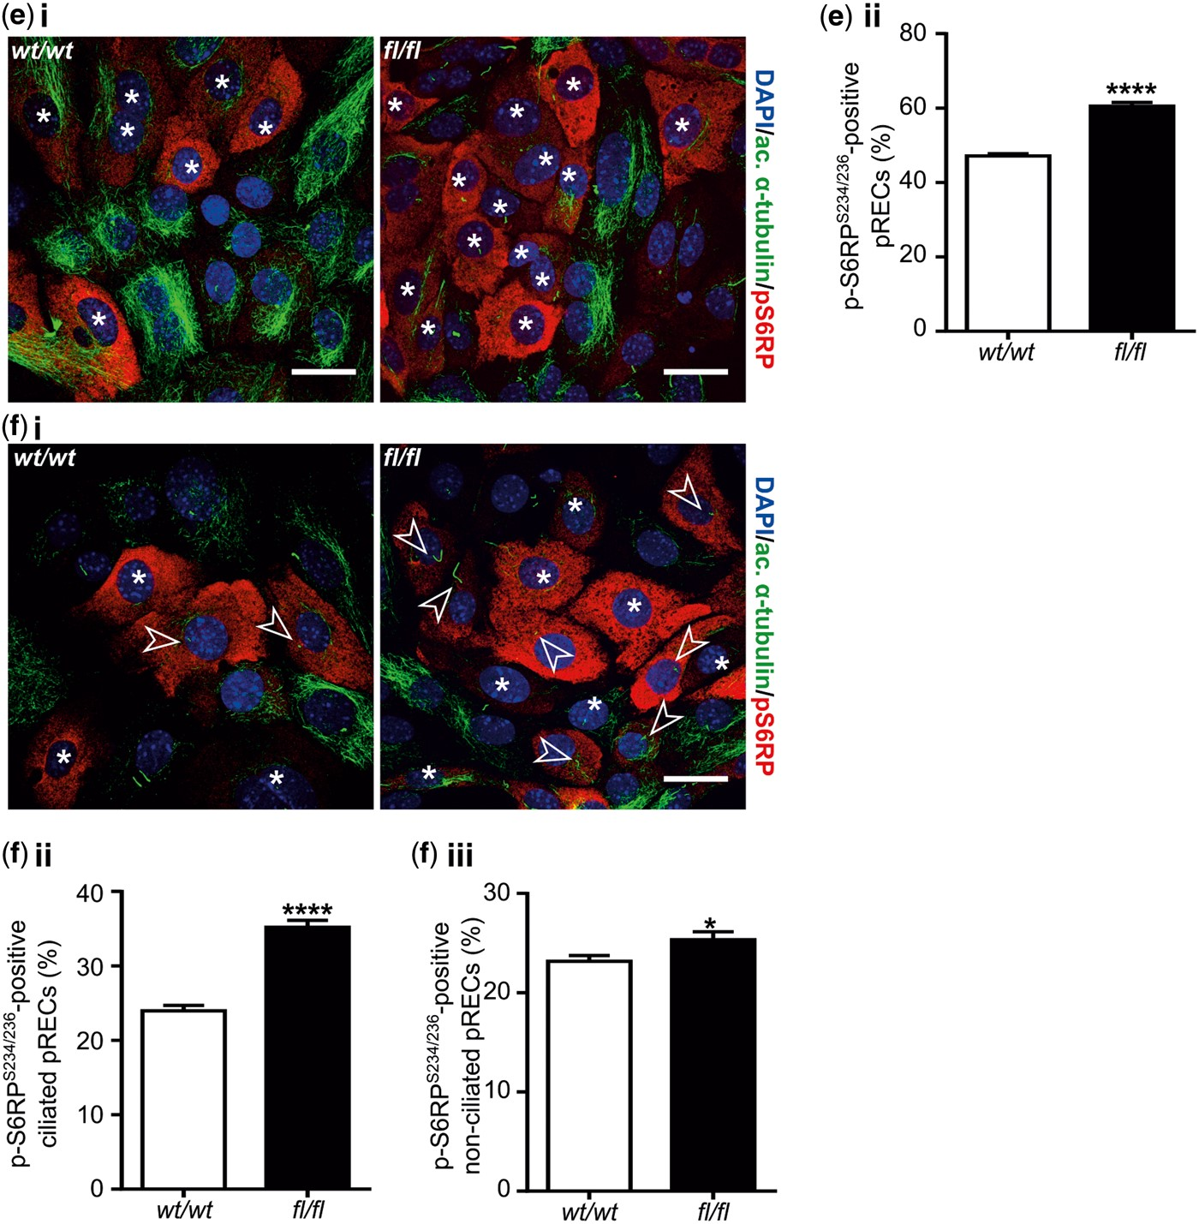
Figure 5. mTORC1 signaling is increased in both ciliated and non-ciliated Inpp5e -deficient pRECs. (a i) Confocal x , ...
Notes:
Figure 5. mTORC1 signaling is increased in both ciliated and non-ciliated Inpp5e -deficient pRECs. (a i) Confocal x , y , z images of Inpp5e wt/wt ;Ksp-Cre (wt/wt) and Inpp5e fl/fl ;Ksp-Cre (fl/fl) pRECs stained for visualization of cilia (acetylated α-tubulin/ac. α-tubulin, green), basal bodies (pericentrin/pcent, red), and nuclei (DAPI, blue). (a ii) Graphical tabulation of ciliated cell number in Inpp5e wt/wt ;Ksp-Cre (wt/wt) and Inpp5e fl/fl ;Ksp-Cre (fl/fl) pRECs. Ciliated cells (white open arrowheads) were scored from ≥5 fields for both genotypes. (b) Confocal x , y , z images of Inpp5e wt/wt ;Ksp-Cre (wt/wt) pRECs transfected with HA-tagged Inpp5e (HA-Inpp5e) stained for visualization of HA-Inpp5e (red), cilia (acetylated α-tubulin/ac. α-tubulin, green) and nuclei (DAPI, blue) in ciliated (top panel) and non-ciliated (bottom panel) pRECs. White open arrows show cilia (upper panels) and plasma membrane (lower panels) localization. (c) Confocal x , y , z images of Inpp5e wt/wt ;Ksp-Cre (wt/wt) and Inpp5e fl/fl ;Ksp-Cre (fl/fl) pRECs stained for visualization of PI(3,4,5)P 3 (red), cilia (acetylated α-tubulin/ac. α-tubulin, green) and nuclei (DAPI, blue). Boxed regions indicate area shown in 3× zoom images below, with PI(3,4,5)P 3 enrichment indicated by white open arrowheads. (d) Confocal x , y , z images of Inpp5e wt/wt ;Ksp-Cre (wt/wt) and Inpp5e fl/fl ;Ksp-Cre (fl/fl) pRECs stained for visualization of p-PRAS40 T246 (green), cilia (acetylated α-tubulin/ac. α-tubulin, red) and nuclei (DAPI, blue). Boxed regions indicate area shown in 1.5× zoom images below, with p-PRAS40 T246 enrichment indicated by white open arrowheads. (e i) Confocal x , y , z images of Inpp5e wt/wt ;Ksp-Cre (wt/wt) and Inpp5e fl/fl ;Ksp-Cre (fl/fl) pRECs stained for visualization of p-S6RP T234/236 (red), cilia (acetylated α-tubulin/ac. α-tubulin, green) and nuclei (DAPI, blue). p-S6RP T234/236 –positive pRECs (white asterisks) were scored and are presented graphically (e ii). (f i) Confocal x , y , z images of Inpp5e wt/wt ;Ksp-Cre (wt/wt) and Inpp5e fl/fl ;Ksp-Cre (fl/fl) pRECs stained for visualization of p-S6RP T234/236 (red), cilia (acetylated α-tubulin/ac. α-tubulin, green) and nuclei (DAPI, blue). p-S6RP T234/236 –positive ciliated cells (white open arrowheads) and p-S6RP T234/236 –positive non-ciliated cells (white asterisks) were scored and are presented graphically in (f ii) and (f iii). All graphs represent mean ± SEM using n = 3 mice per genotype, * P < 0.05, **** P < 0.0001. Scale: (a i), (b), (c), (d), (e i) and (f i) 25µ m . SEM, standard error of mean.
Unless provided in the caption above, the following copyright applies to the content of this slide: © The Author 2016. Published by Oxford University Press. All rights reserved. For permissions, please e-mail: journals.permissions@oup.com

Slide 8
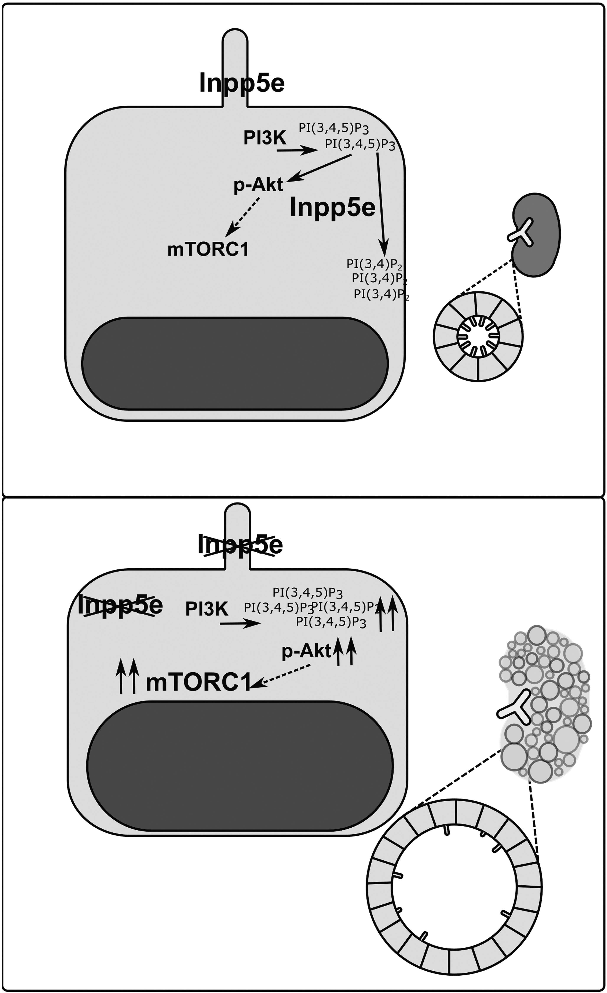
Figure 7. Inpp5e loss promotes PKD development via PI3K/Akt-dependent mTORC1 activation. The proposed function of ...
Notes:
Figure 7. Inpp5e loss promotes PKD development via PI3K/Akt-dependent mTORC1 activation. The proposed function of Inpp5e in normal renal homeostasis is maintenance of PI(3,4,5)P 3 signals to appropriately restrain PI3K/Akt signaling (upper panel). Upon its depletion, Inpp5e-mediated PI(3,4,5)P 3 dephosphorylation is lost, leading to aberrant Akt and mTORC1 activation in both ciliated and non-ciliated cells, thereby promoting cyst development (lower panel). Phosphorylated Akt (p-Akt) promotes the activation of mTORC1 via inhibitory phosphorylation of TSC2, enabling Rheb-mediated mTORC1 activation to occur (dashed arrow, not shown).
Unless provided in the caption above, the following copyright applies to the content of this slide: © The Author 2016. Published by Oxford University Press. All rights reserved. For permissions, please e-mail: journals.permissions@oup.com

