Slide 1
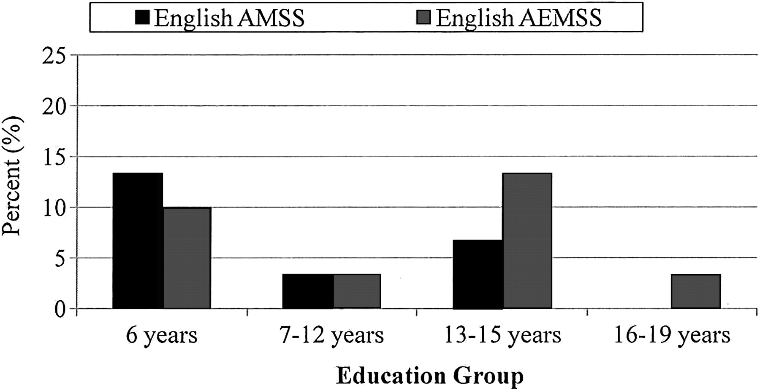
Fig. 1. Frequencies of misclassification by education group for ST-DRS-2 Total scores utilizing a cutoff of 1.5SD ...
Notes:
Fig. 1. Frequencies of misclassification by education group for ST-DRS-2 Total scores utilizing a cutoff of 1.5SD below the mean of the English normative data.
Unless provided in the caption above, the following copyright applies to the content of this slide: © The Author 2012. Published by Oxford University Press. All rights reserved. For permissions, please e-mail: journals.permissions@oup.com.

Slide 2
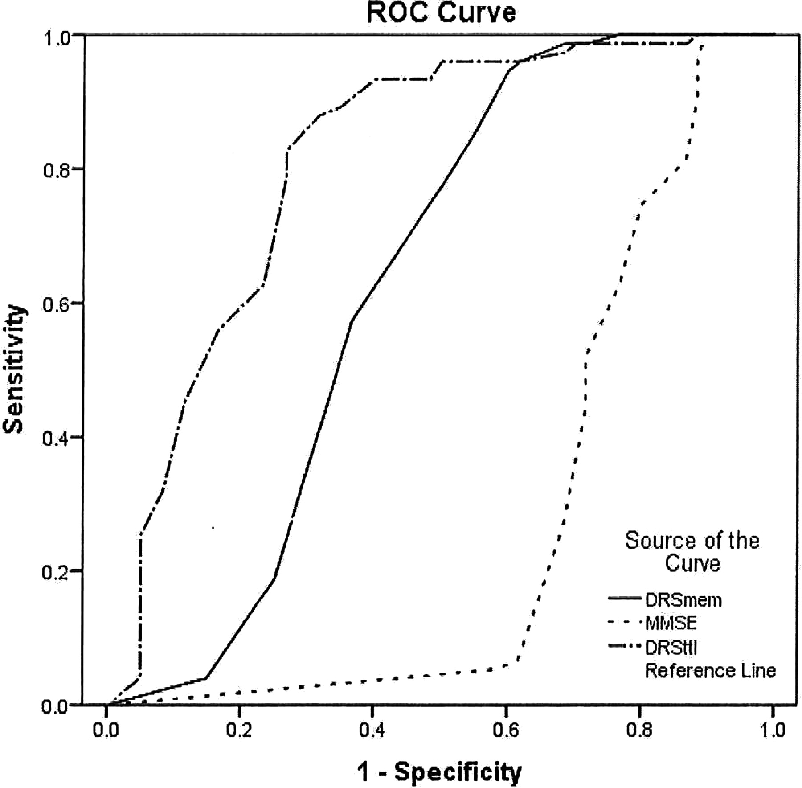
Fig. 2. ROC curves of the MMSE, ST-DRS Memory, and ST-DRS Total.
Notes:
Fig. 2. ROC curves of the MMSE, ST-DRS Memory, and ST-DRS Total.
Unless provided in the caption above, the following copyright applies to the content of this slide: © The Author 2012. Published by Oxford University Press. All rights reserved. For permissions, please e-mail: journals.permissions@oup.com.

