Slide 1
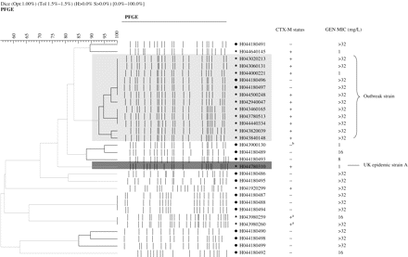
Figure 1 Dendrogram (UPGMA, Dice) showing the relatedness of PFGE banding patterns for 30 E. coli isolates from ...
Notes:
Figure 1 Dendrogram (UPGMA, Dice) showing the relatedness of PFGE banding patterns for 30 E. coli isolates from Cornwall. Bold lines indicate clusters with >85% similarity. Symbols: +, CTX-M group 1 producer; +a, CTX-M group 9 producer; −b, ESBL (non-CTX-M) producer; −, non-ESBL producer. Isolates of the local outbreak strain and UK epidemic strain A are shaded light grey and dark grey, respectively.
Unless provided in the caption above, the following copyright applies to the content of this slide: © The Author 2006. Published by Oxford University Press on behalf of the British Society for Antimicrobial Chemotherapy. All rights reserved. For Permissions, please e-mail: journals.permissions@oxfordjournals.org

