Slide 1
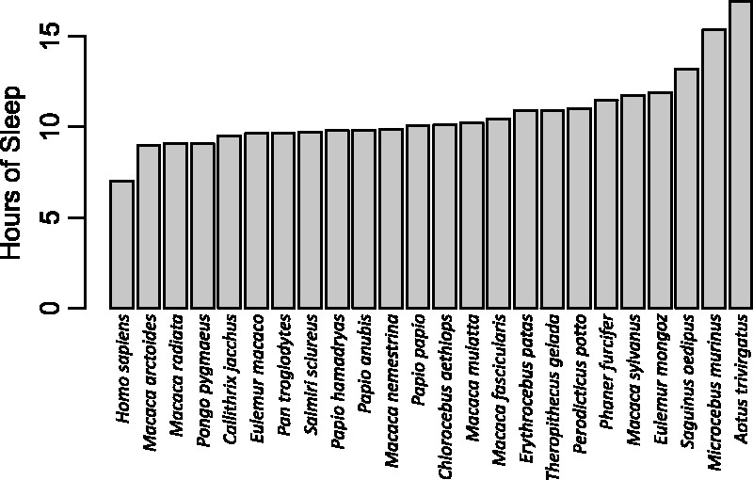
Figure 1. Duration of total sleep time in primates, including humans. Humans are the shortest sleeping primate (here, ...
Notes:
Figure 1. Duration of total sleep time in primates, including humans. Humans are the shortest sleeping primate (here, using a value of 7 h, see text). The data on nonhuman primates come from studies in which sleep was staged, most often by EEG, in adult animals, and thus exclude some studies based on videography [37] or studies of juvenile animals [38]
Unless provided in the caption above, the following copyright applies to the content of this slide: © The Author(s) 2017. Published by Oxford University Press on behalf of the Foundation for Evolution, Medicine, and Public Health.This is an Open Access article distributed under the terms of the Creative Commons Attribution License (http://creativecommons.org/licenses/by/4.0/), which permits unrestricted reuse, distribution, and reproduction in any medium, provided the original work is properly cited.

