Slide 1
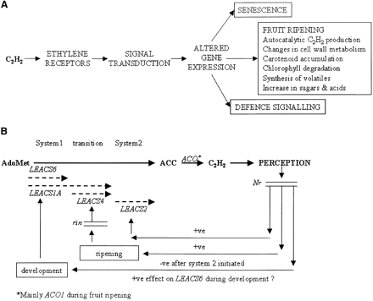
Fig. 1. (A) Schematic representation of the role that ethylene plays during tomato fruit ripening. (B) Model ...
Notes:
Fig. 1. (A) Schematic representation of the role that ethylene plays during tomato fruit ripening. (B) Model proposing the differential regulation of ACS gene expression during the transition from system 1 to system 2 ethylene synthesis in tomato. The symbols –ve (negative) and +ve (positive) refer to the action of ethylene on signalling pathways resulting in repression (–ve) or stimulation (+ve) of ACS gene expression. (Redrawn from Barry et al., 2000.)
Unless provided in the caption above, the following copyright applies to the content of this slide:

Slide 2
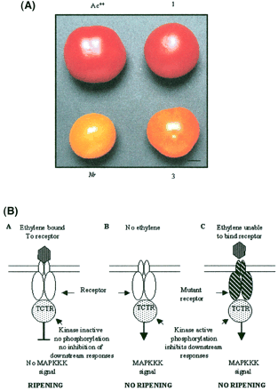
Fig. 2. (A) Antisense repression of the mutant NR gene in the Nr background restored normal ripening. The ...
Notes:
Fig. 2. (A) Antisense repression of the mutant NR gene in the Nr background restored normal ripening. The phenotype of fruit from T1 progeny of Nr transformants: Top row, left to right: non‐transformed wild type, (1) T1 plant with antisense inhibition of mutant Nr mRNA (red fruit); lower row, left to right: non‐transformed Nr, (3) T1 plant with partial antisense inhibition of antisense NR mRNA (orange fruit). Fruit were harvested at 7 d post‐breaker and allowed to ripen for a further 16 d before photographing (Hackett et al., 2000). (B) Model of ethylene signalling from receptors to TCTR2. Ethylene receptors and TCTR2 are negative regulators of the ethylene signal transduction pathway. When ethylene binds the receptor (A) the receptors and TCTR are inactivated allowing signal transduction. In the absence of ethylene (B) or with a loss of function receptor mutant unable to bind ethylene (C) the receptors activate TCTR, possibly by phosphorylation, which results in an inhibition of ethylene signal transduction.
Unless provided in the caption above, the following copyright applies to the content of this slide:

Slide 3
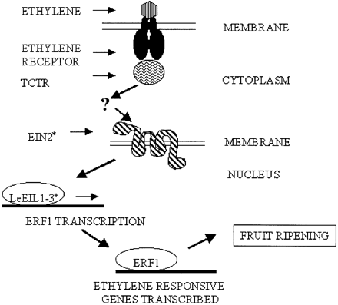
Fig. 3. Schematic diagram of the putative ethylene signal transduction pathway downstream of TCTR2 in ...
Notes:
Fig. 3. Schematic diagram of the putative ethylene signal transduction pathway downstream of TCTR2 in ripening tomato fruit. TCTR has homology to MAP3K and therefore probably acts as the first component in a kinase signalling cascade. The components of this cascade have yet to be identified as has the tomato counterpart of EIN2. Synthesis of LeEILs, with homology to the Arabidopsis EIN3 transcription factor, are then thought to be activated by EIN2, which in turn activate ERF1. ERF1 transcription factors are though to activate ethylene‐dependent ripening genes.
Unless provided in the caption above, the following copyright applies to the content of this slide:

Slide 4
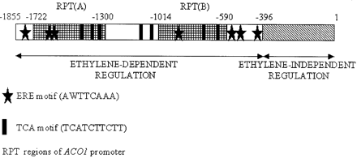
Fig. 4. Structure of the tomato ACO1 promoter. The position of the two repeat regions (RPT) which contains ...
Notes:
Fig. 4. Structure of the tomato ACO1 promoter. The position of the two repeat regions (RPT) which contains sequences with homology to the ethylene responsive promoters of 2A11 and E4 are shown. The position of the ethylene responsive (ERE) regions and stress related (TCA) motifs are also shown. The –1855 to –396 region of the promoter confers ethylene‐dependent expression whereas the –396 region confers ethylene‐independent expression of GUSACO1 promoter fusions.
Unless provided in the caption above, the following copyright applies to the content of this slide:

