Slide 1
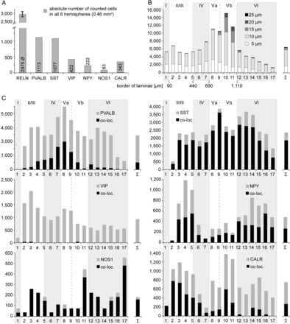
Figure 6. Distribution of cells labeled by different IN-markers and/or RELN. (A) Total number (y-axis) of RELN or ...
Notes:
Figure 6. Distribution of cells labeled by different IN-markers and/or RELN. (A) Total number (y-axis) of RELN or IN-marker stained cells (x-axis) from layers I–VI of all 6 analyzed hemispheres (total cortical volume was 0.46 mm3). In case of RELN, the average (Ø) of all 6 double-immunostainings was calculated. (B) Distribution of RELN stained cells per depth and cell diameter (smallest diameter). (C) Distribution of cells expressing either IN-marker alone (gray) or co-expressing marker and RELN (black, co-loc.) by depth. B + C: x-axis, 1–17 means distance from pial surface (0) to white matter (17) in 100 µm units, y-axis shows number of cells/mm3. Vertical alternating gray and white stripes demonstrate layers I–VI, the border-separating lamina V in Va and Vb is indicated with dashed lines. For exact borders, see Supplementary Material (text).
Unless provided in the caption above, the following copyright applies to the content of this slide: © The Author 2013. Published by Oxford University Press. All rights reserved. For Permissions, please e-mail: journals.permissions@oup.com

Slide 2
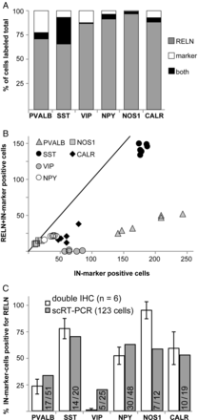
Figure 5. Quantitative analysis of RELN and IN-marker double immunohistochemistry. (A) Proportion of different ...
Notes:
Figure 5. Quantitative analysis of RELN and IN-marker double immunohistochemistry. (A) Proportion of different IN-markers co-localizing with RELN. The amount of cells that are immunoreactive either for RELN, IN-marker, or both are depicted as a percentage of total number of counted cells of layers I–VI (n = 6 columns). (B) Correlation of the total number of IN-marker-labeled cells and cells double-immunoreactive for RELN of 6 individual cortical columns (1 symbol represents 1 cortical column including layers I–VI). (C) Percentage of Reln expression in PVALB-, SST-, VIP-, NPY-, NOS1-, and CALR-positive neurons, white bars = results of double immunohistochemistry (IHC, layers I–IV), with standard deviation, gray bars = results of scRT-PCR, fractions indicating Reln-positive/marker-positive of 123 cells.
Unless provided in the caption above, the following copyright applies to the content of this slide: © The Author 2013. Published by Oxford University Press. All rights reserved. For Permissions, please e-mail: journals.permissions@oup.com

Slide 3
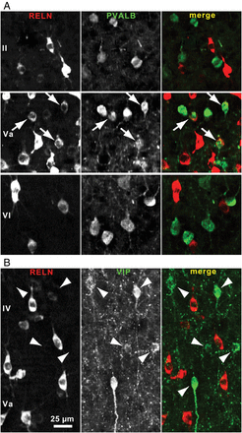
Figure 4. RELN/IN-marker co-localization varied between cortical layers. (A) Image sections of lamina II and lamina VI ...
Notes:
Figure 4. RELN/IN-marker co-localization varied between cortical layers. (A) Image sections of lamina II and lamina VI showing PVALB-positive cells (green) not immunoreactive for RELN (red) and a region in lamina Va showing several double-labeled cells with a weak RELN signal (arrows). (B) In contrast VIP-immunoreactive cells of layers IV and Va lack a RELN signal (arrowheads).
Unless provided in the caption above, the following copyright applies to the content of this slide: © The Author 2013. Published by Oxford University Press. All rights reserved. For Permissions, please e-mail: journals.permissions@oup.com

Slide 4
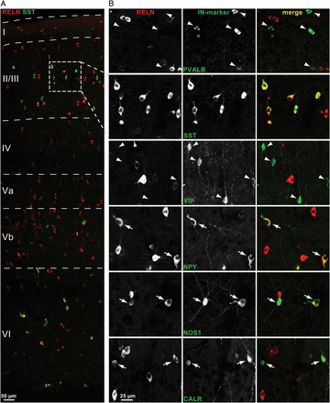
Figure 3. Detection of RELN and IN-marker co-localization by double immunohistochemistry. (A) Part of a rat barrel ...
Notes:
Figure 3. Detection of RELN and IN-marker co-localization by double immunohistochemistry. (A) Part of a rat barrel cortex column from pia (top) to white matter (bottom), showing RELN (red)- and SST (green)-immunostained cells. (B) Double-immunolabeling of all 6 analyzed IN-markers with RELN, exemplarily shown are regions of layer II/III. Arrows indicate cells double-labeled for RELN and IN-marker, arrowheads mark cells labeled only for IN-marker, SST-labeled cells are all positive for RELN and unmarked. SST-, NPY-, NOS1-, and CALR-positive cells shown are all immunoreactive for RELN. PVALB- and VIP-positive cells shown are not immunoreactive for RELN.
Unless provided in the caption above, the following copyright applies to the content of this slide: © The Author 2013. Published by Oxford University Press. All rights reserved. For Permissions, please e-mail: journals.permissions@oup.com

Slide 5
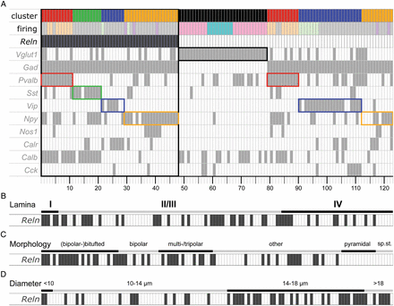
Figure 2. Neurochemical, electrophysiological anatomical properties of the clustered cells, sorted by Reln expression. ...
Notes:
Figure 2. Neurochemical, electrophysiological anatomical properties of the clustered cells, sorted by Reln expression. Alignment of cluster affiliation and different parameters (firing pattern and IN-marker expression) of 123 cells (A). Small rectangles represent the 123 single cells, sorted by Reln expression (anthracite) and cluster affiliation. Color code of Cluster ID: red = fast-spiking PVALB, green = adapting SST, blue = adapting/bursting VIP, and orange = adapting neuropeptide Y (NPY). Color code for firing pattern: gray = adapting [RSNP], light orange = fast-spiking [FS], light green = bursting, lilac = delayed/accelerating [LS], pink = regular-spiking, turquoise = intrinsically bursting. To highlight the correlation of IN-markers and cluster affiliation, the clusters are framed in their corresponding colors. (B–D) Correlation of Reln expression with anatomical parameters. All 123 cells are sorted according to their layering (B), morphology (C, sp.st. = spiny stellate), or average cell diameter (D).
Unless provided in the caption above, the following copyright applies to the content of this slide: © The Author 2013. Published by Oxford University Press. All rights reserved. For Permissions, please e-mail: journals.permissions@oup.com

Slide 6
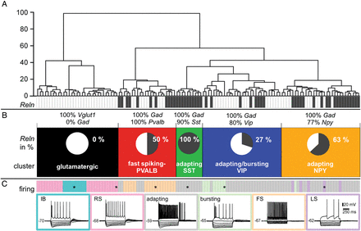
Figure 1. Cluster analysis of the 123 neurons. (A) Branching diagram, the cells are sorted by their cluster affiliation ...
Notes:
Figure 1. Cluster analysis of the 123 neurons. (A) Branching diagram, the cells are sorted by their cluster affiliation (x-axis = individual cells, y-axis = average Euclidian within-cluster linkage distance). Reln expression is illustrated in single-cell resolution by the anthracite gray colored barcode, anthracite gray rectangles = Reln-positive cells. Each neuron is represented by a small rectangle. (B) The neurons are classified into 5 clusters (in black, red, green, blue, and orange). The pie charts illustrate the percentage of Reln-expressing cells for each cluster. Expression of the most discriminating neurochemical markers is denoted as percentages above each cluster. (C) The color code for the predominant firing patterns (illustrative examples are labeled with an * in the bars representing the respective cells) is annotated in the lower panel (IB, intrinsically bursting, RS, regular-spiking, adapting, RSNP, regular-spiking nonpyramidal, FS, fast-spiking, LS, late-spiking (delayed/accelerating).
Unless provided in the caption above, the following copyright applies to the content of this slide: © The Author 2013. Published by Oxford University Press. All rights reserved. For Permissions, please e-mail: journals.permissions@oup.com

Slide 7
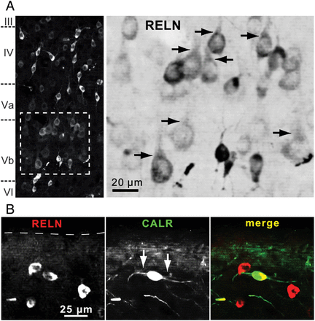
Figure 7. RELN-positive cells in lamina V and the marginal zone. (A) RELN-positive cells in lamina Vb. Some ...
Notes:
Figure 7. RELN-positive cells in lamina V and the marginal zone. (A) RELN-positive cells in lamina Vb. Some RELN-immunoreactive neurons with somata ≥15 µm and RELN-positive apical dendrites (arrows) show morphology reminiscent of pyramidal cells. As the immunoreactivity of RELN-positive, principal neurons is less intense, the magnified region is shown inverted to better visualize the apical dendritic structure. (B) RELN (red) and CALR (green) co-immunoreactive cell in layer I. A few lamina I cells showed a typical Cajal–Retzius cell morphology. One cell with horizontal dendrites (arrows, middle panel) and distance of about 50 µm from pial surface is exemplarily shown here.
Unless provided in the caption above, the following copyright applies to the content of this slide: © The Author 2013. Published by Oxford University Press. All rights reserved. For Permissions, please e-mail: journals.permissions@oup.com

