Slide 1
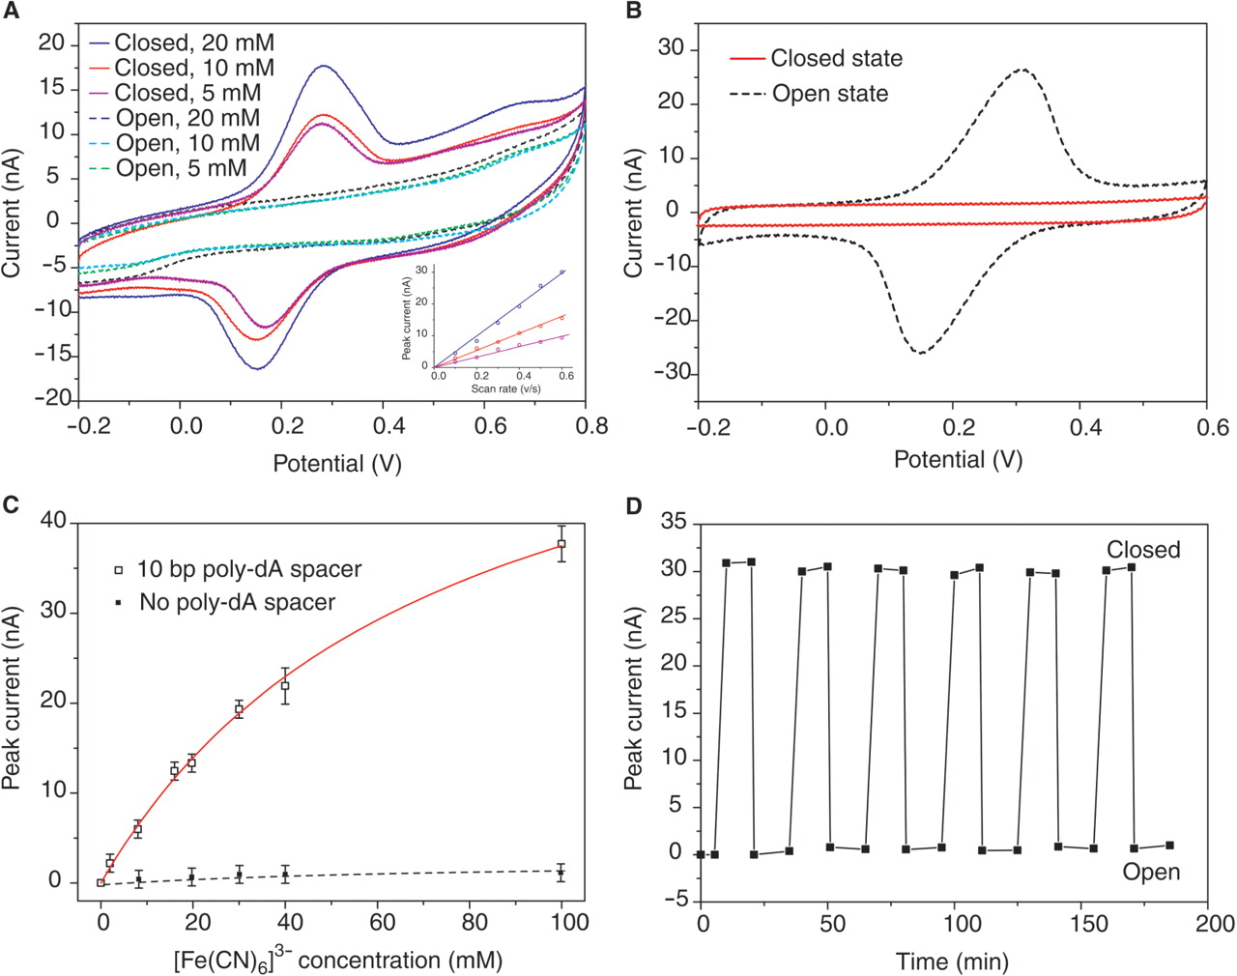
Figure 3. Using the switchable DNA nanocontainer to catch and release small molecules. (A) Cyclic voltammogram for the ...
Notes:
Figure 3. Using the switchable DNA nanocontainer to catch and release small molecules. (A) Cyclic voltammogram for the closed and open states of the device with different [Fe(CN)6]3− concentration. Scan rate is 0.3 Vs−1. No [Fe(CN)6]3− presented in the electrolyte of CV analysis. The linear relationship between peak currents and scan rates shown in inset confirms that the redox species were confined to the electrode surface. Note that the peak current is defined as the difference between maximum current and baseline current. (B) Control experiments show that the [Fe(CN)6]3− can not diffuse into the nanocontainer at the closed state, and can quickly diffuse to the electrode surface at the open state. (C) Isotherms for the molecular encaging effect when applied to capture [Fe(CN)6]3−. Solid line fit to Langmuir isotherm model: y = σmx/(x + K−1), where x is the concentration of the redox reporters and σm is the saturation value of the concentration and K is the association constant. K = 13.7 M−1 in the simulation. (D) Cyclic switching of the device indicated by the peak current in the cyclic voltammograms. It was found that a well-prepared device can be cycled more than twenty times without obvious performance decay.
Unless provided in the caption above, the following copyright applies to the content of this slide: © 2007 The Author(s).This is an Open Access article distributed under the terms of the Creative Commons Attribution Non-Commercial License (http://creativecommons.org/licenses/by-nc/2.0/uk/) which permits unrestricted non-commercial use, distribution, and reproduction in any medium, provided the original work is properly cited.

Slide 2
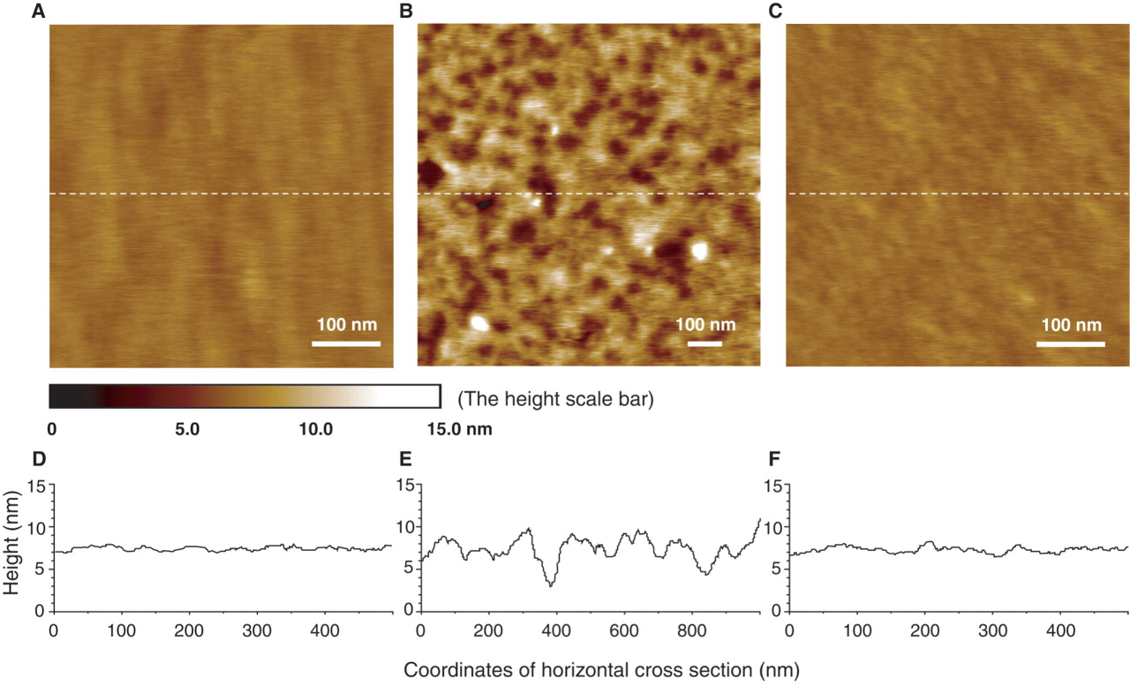
Figure 2. AFM topographic images for the different states of the device on Au(111) surface. (A) Initial closed state at ...
Notes:
Figure 2. AFM topographic images for the different states of the device on Au(111) surface. (A) Initial closed state at pH 4.5 after self-assembly shows 1.5 ± 0.5 nm surface roughness. (B) Open state at pH 8.0 shows 6.0 ± 1.0 nm surface roughness. (C) Repeated closed state at pH 4.5 restores the surface roughness to 1.5 ± 0.5 nm. Height scales for all images are adjusted to a uniform range of 15 nm. The color mapping to height is indicated by the height scale bar. The poly-dA spacer length of DNA motif is 10 bp. (D–F) The height analysis of the horizontal cross sections along the middle dashed white lines shown in (A–C). (D) corresponds to (A), (E) to (B), and (F) to (C), respectively.
Unless provided in the caption above, the following copyright applies to the content of this slide: © 2007 The Author(s).This is an Open Access article distributed under the terms of the Creative Commons Attribution Non-Commercial License (http://creativecommons.org/licenses/by-nc/2.0/uk/) which permits unrestricted non-commercial use, distribution, and reproduction in any medium, provided the original work is properly cited.

Slide 3
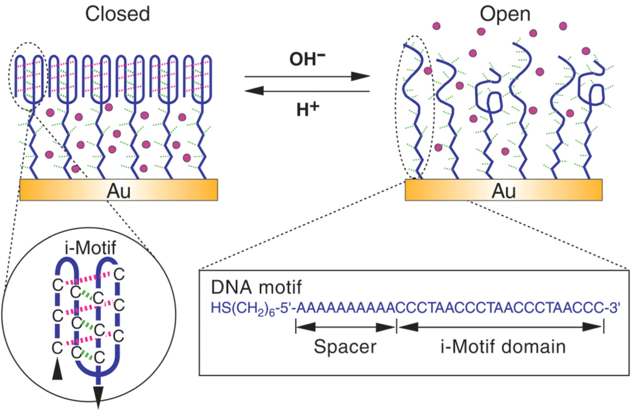
Figure 1. Working principle of the switching DNA nanocontainer. At pH 4.5, the i-motif domain folds into four-stranded ...
Notes:
Figure 1. Working principle of the switching DNA nanocontainer. At pH 4.5, the i-motif domain folds into four-stranded structure and packs into a membrane impermeable for small molecules on gold surfaces. At pH 8.0, the i-motif structures are transformed into single strands, making the packing density of the DNA SAM relatively loose to allow small molecules to diffuse freely.
Unless provided in the caption above, the following copyright applies to the content of this slide: © 2007 The Author(s).This is an Open Access article distributed under the terms of the Creative Commons Attribution Non-Commercial License (http://creativecommons.org/licenses/by-nc/2.0/uk/) which permits unrestricted non-commercial use, distribution, and reproduction in any medium, provided the original work is properly cited.

Slide 4
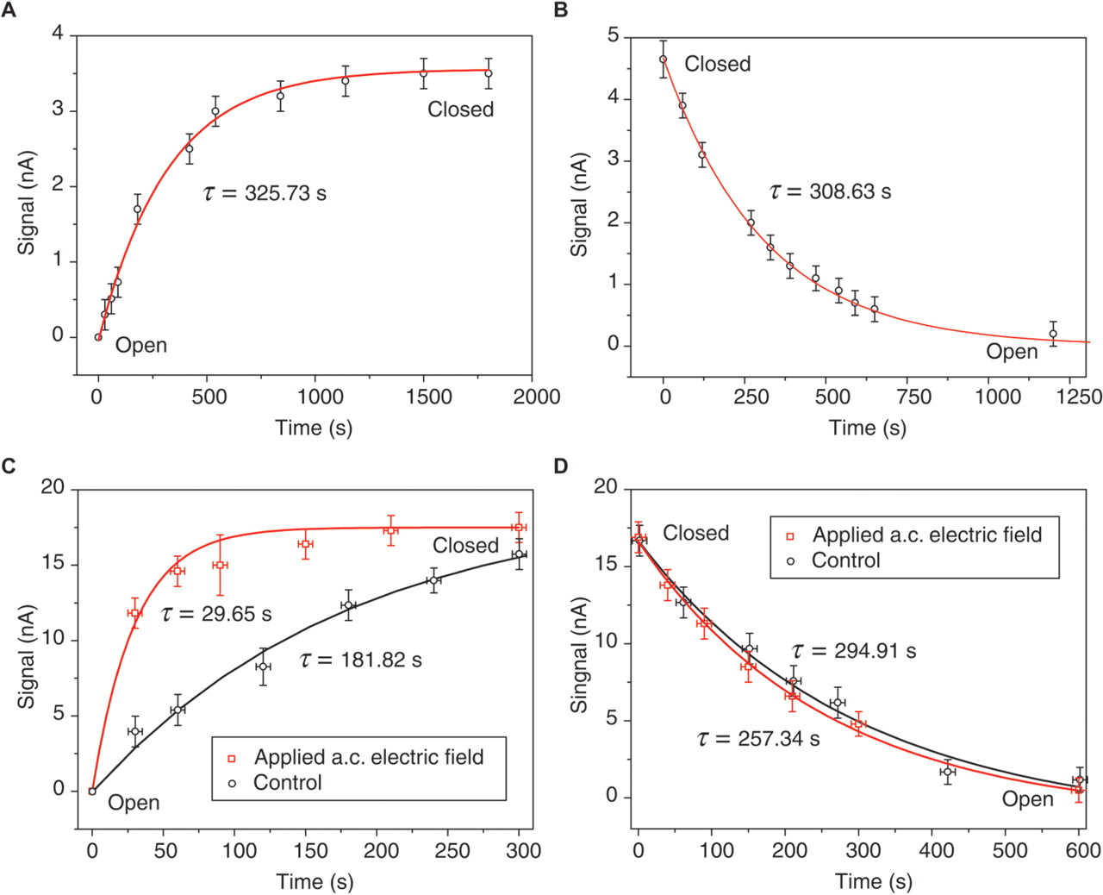
Figure 4. Accelerating device switching by alternating electric field. (A) Closing of the device when switching pH from ...
Notes:
Figure 4. Accelerating device switching by alternating electric field. (A) Closing of the device when switching pH from 8 to 4.5 at t = 0. (B) Opening of the device when switching pH from 4.5 to 8 at t = 0. (C) Closing of the device under alternating (a.c.) electric field. (D) Opening of the device under a.c. electric field. Control in (C) and (D) is based on the same experimental setup only in the absence of a.c. electric field. Redox reporter [Fe(CN)6]3− used in the measurement is 4 mM in (A) and (B), and 40 mM in (C) and (D). Solid lines fitting the data are simulated from model y = A(1 − exp(−t/τ)) in (A) and (C), model y = Aexp(−t/τ) in (B) and (D), where τ is the relaxation time, and A is a constant parameter.
Unless provided in the caption above, the following copyright applies to the content of this slide: © 2007 The Author(s).This is an Open Access article distributed under the terms of the Creative Commons Attribution Non-Commercial License (http://creativecommons.org/licenses/by-nc/2.0/uk/) which permits unrestricted non-commercial use, distribution, and reproduction in any medium, provided the original work is properly cited.

