Slide 1
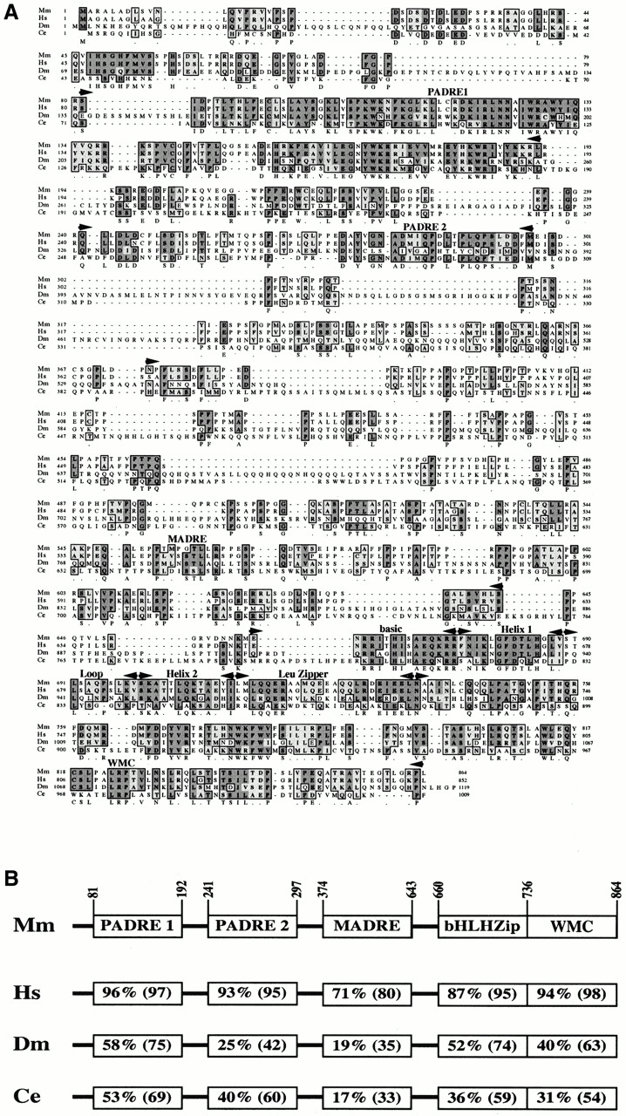
Figure 1. Opposite WBSCR14 was conserved through evolution. (A) Alignment of murine (Mm), human (Hs), ...
Notes:
Figure 1. Opposite WBSCR14 was conserved through evolution. (A) Alignment of murine (Mm), human (Hs), fruitfly (Dm) and nematode (Ce) WBSCR14 proteins. Conserved and similar amino acids are boxed. The consensus sequence is indicated below. The PADRE and MADRE domains, which are able to repress and activate transcription, respectively, when fused to the DNA binding domain of GAL4, are indicated (see text for details). The positions of the bHLHZip domain regions and the WMC portion are shown. (B) Conservation of the different WBSCR14 domains through evolution. Amino acids positions of the different WBSCR14 domains are indicated on top. Percentage of identical and, in parentheses, similar residues are given.
Unless provided in the caption above, the following copyright applies to the content of this slide:

Slide 2
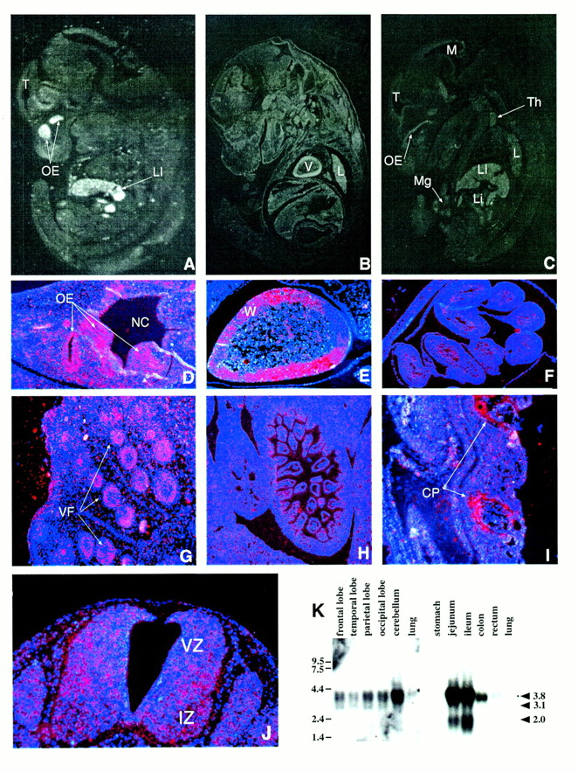
Figure 2.WBSCR14 expression pattern. The Wbscr14 embryonic pattern of expression was examined using in situ ...
Notes:
Figure 2.WBSCR14 expression pattern. The Wbscr14 embryonic pattern of expression was examined using in situ hybridization sagittal sections at E12.5 (A and J), E14.5 (B–F) and E16.5 (G–I). The white signal, indicating expression, is obvious at the level of the CNS, olfactory epithelium, heart, lung, liver, thymus, midgut (within the physiological hernia) and villi of the duodenum (A–C). High magnification fields show expression (red signal) in the olfactory epithelium (D), the wall of the heart (E), midgut (F), vibrissa follicles (G), villi of the large intestine (H) and cartilage primordia of the ribs (I). (J) Wbscr14 expression in the E12.5 murine developing spinal cord. The VZ and IZ define populations of proliferating and differentiating cells, respectively. (K) Northern blot analysis of human adult brain portions (left) and intestine sections (right) probed with WBSCR14-α cDNA. Size markers are shown on the left in kb. Arrowheads on the right indicate the position of the WBSCR14 mRNAs with their relative size. CP, cartilage primordia of the rib; IZ, intermediate zone, L, lung; LI, liver; Li, large intestine; M, mesencephalon; Mg, midgut; NC, nasal cavity; OE, olfactory epithelium; T, telencephalon; Th, thymus; V, heart ventricle; VF, vibrissa follicle; VZ, ventricular zone; W, heart wall.
Unless provided in the caption above, the following copyright applies to the content of this slide:

Slide 3
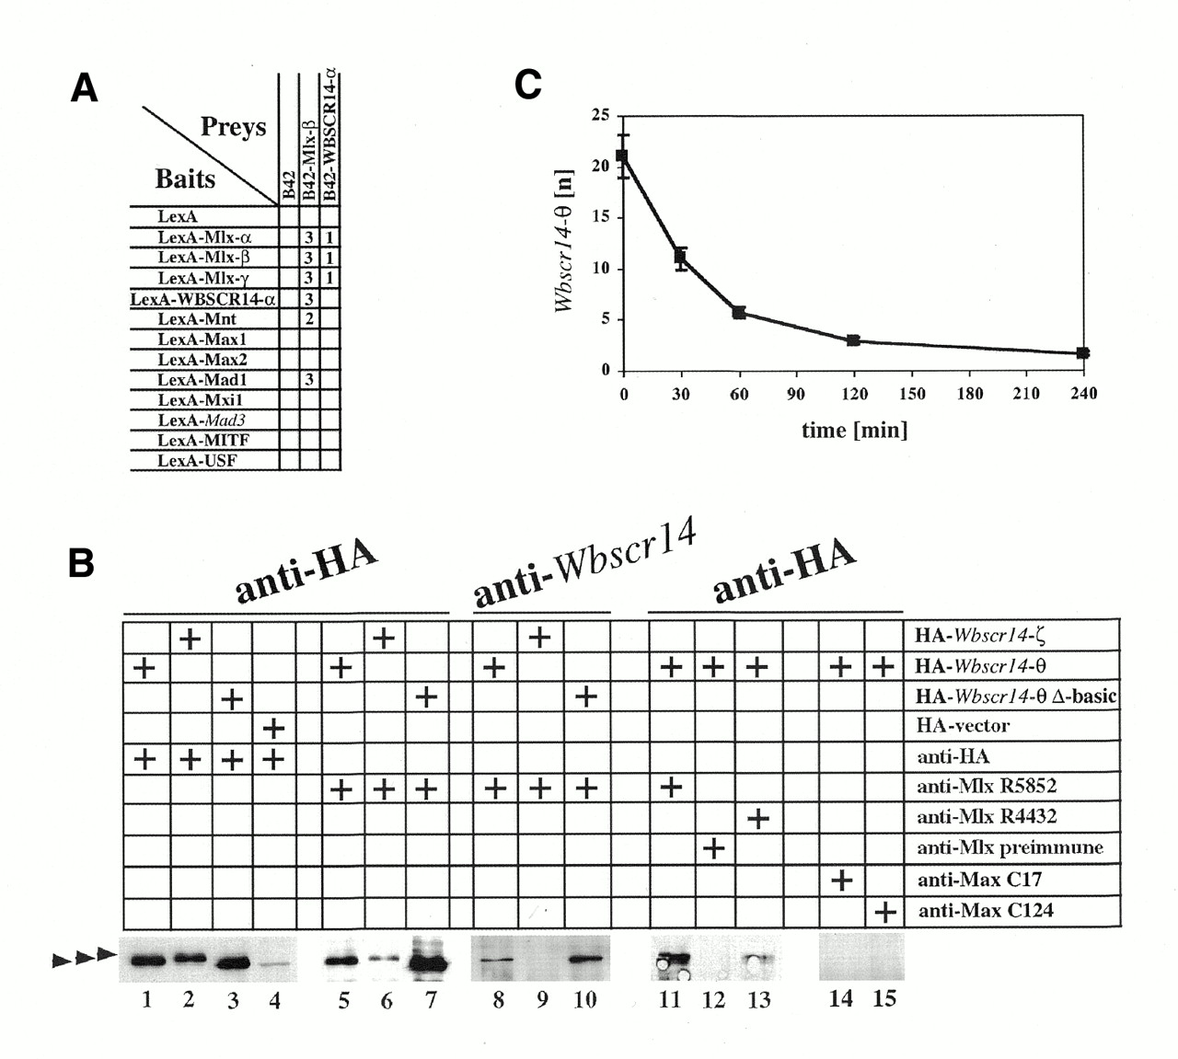
Figure 3. WBSCR14:Mlx heterodimers. (A) Interaction-mating assays between strains carrying bHLHZip family ...
Notes:
Figure 3. WBSCR14:Mlx heterodimers. (A) Interaction-mating assays between strains carrying bHLHZip family members (34). EGY42 bait strains containing plasmids that expressed LexA fusions to human Mlx-α, Mlx-β, Mlx-γ, WBSCR14-α residues 620–852, Mnt 60–582, Max1, Max2, Mad1 ΔSID, Mxi1 ΔSID, MITF and USF, and murine Mad3 ΔSID, were mated to EGY48 derivatives that contained B42 fusions to human Mlx-β and WBSCR14-α residues 620–852. Numbers (1–3) indicate the degree of β-galactosidase activity on GAL plates. No activity was detected for the interaction represented by empty squares. (B) WBSCR14 interacts with endogenous Mlx in vivo. COS-7 cells were transfected with plasmids expressing HA-Wbscr14-ζ, HA-Wbscr14-θ or HA-Wbscr14-θ Δbasic as indicated above the lanes. The cell lysates were immunoprecipitated with two different anti-Mlx antisera or a preimmune counterpart (27), two anti-Max antibodies or an anti-HA mAb as shown. The immunoblot was performed with anti-HA mAb or anti-WBSCR14 P53 immune sera as marked on top. The arrowheads on the left indicate, from top to bottom, the position of HA-Wbscr14-ζ, HA-Wbscr14-θ or HA-Wbscr14-θ Δbasic, respectively. The N-terminal region of HA-Wbscr14-θ, used to produce the Wbscr14 antigen, is not conserved in HA-Wbscr14-ζ, explaining the weakness of the signal in lane 9. (C) Wbscr14-θ has a short half-life. COS-7 cells transfected with HA-Wbscr14-θ were treated with cycloheximide, immunoprecipitated and subjected to western blot. Co-immunoprecipitated HA-Wbscr14-θ was quantitated and plotted against the cycloheximide treatment time. Standard deviations of three experiments are indicated by vertical bars.
Unless provided in the caption above, the following copyright applies to the content of this slide:

Slide 4
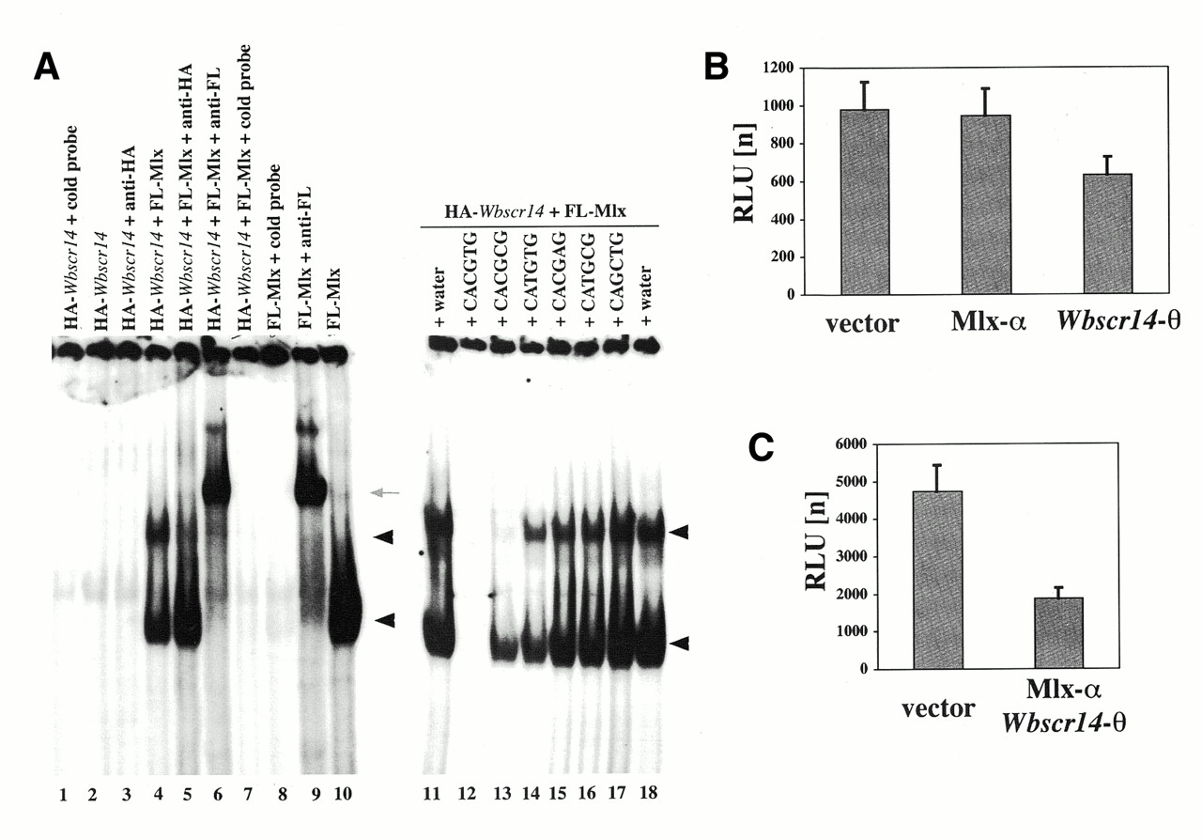
Figure 4. WBSCR14:Mlx dimer binds DNA and represses transcription. The ability of WBSCR14:Mlx dimers to bind ...
Notes:
Figure 4. WBSCR14:Mlx dimer binds DNA and represses transcription. The ability of WBSCR14:Mlx dimers to bind DNA was tested by EMSA. Reticulocyte lysates expressing FL-Mlx-γ and/or HA-Wbscr14-θ 412–842 (A), as specified above, were mixed together with labeled 5′-GGAAGCAGACCACGTGGTCTGCTTCC-3′ DNA. The following additions were made to the reaction mixtures: 200 ng of unlabeled probe, lanes 1, 7, 8 and 12; buffer, lanes 2, 4, 10, 11 and 18; 1 µg of anti-HA mAb, lanes 3 and 5; 1 µg of anti-FLAG mAb, lanes 6 and 9; and 200 ng of the above-specified cold competitors, lanes 13–17. The black arrowheads show the position of the Mlx:Mlx–DNA (bottom) and WBSCR14:Mlx–DNA complexes (top). The gray arrow indicates the Mlx:Mlx-DNA-mAb supershifted band. (B and C) To determine the transcriptional activity of WBSCR14:Mlx heterodimers, HEK293 cells were transiently transfected with expression vector encoding the indicated proteins, together with luciferase and β-galactosidase reporters. The transitional activities of the WMC-containing bHLHZip proteins were tested singularly (B) or in combination (C).
Unless provided in the caption above, the following copyright applies to the content of this slide:

Slide 5
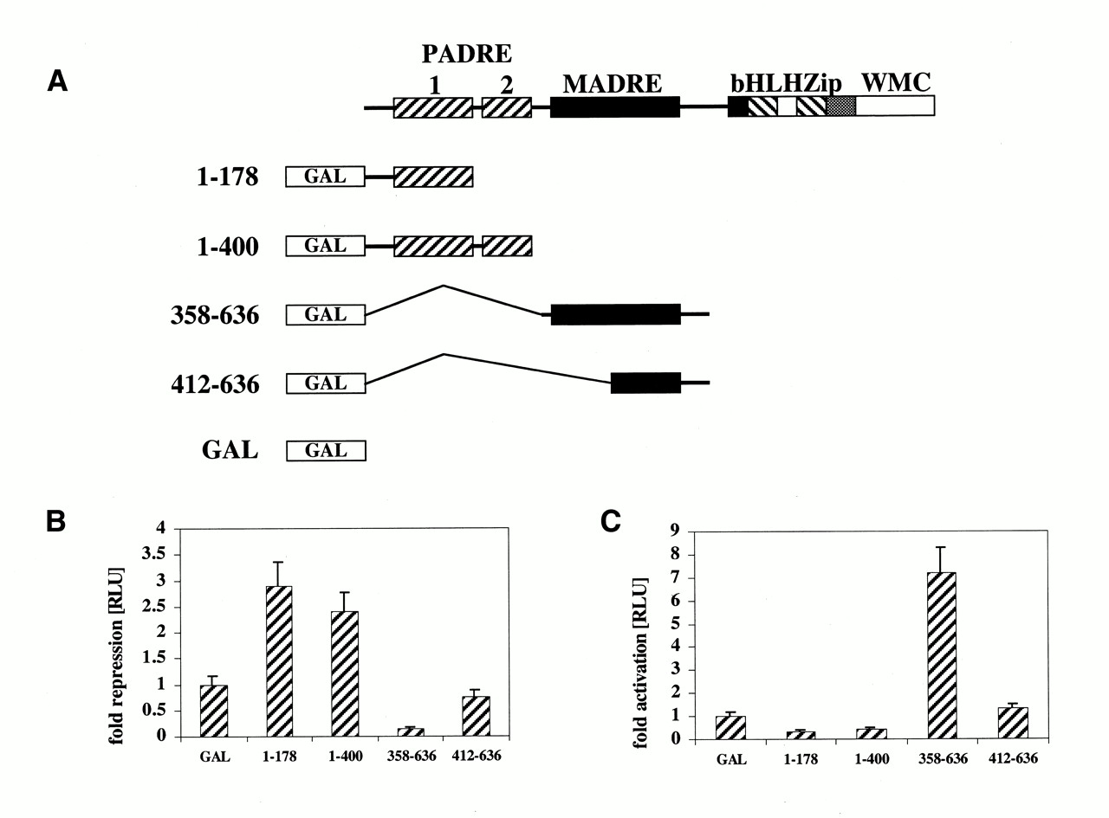
Figure 5. Fold repression (B) and activation (C) of the GAL4-Wbscr14-θ fusion proteins depicted in (A), ...
Notes:
Figure 5. Fold repression (B) and activation (C) of the GAL4-Wbscr14-θ fusion proteins depicted in (A), transiently transfected in HEK293 cells.
Unless provided in the caption above, the following copyright applies to the content of this slide:

Slide 6
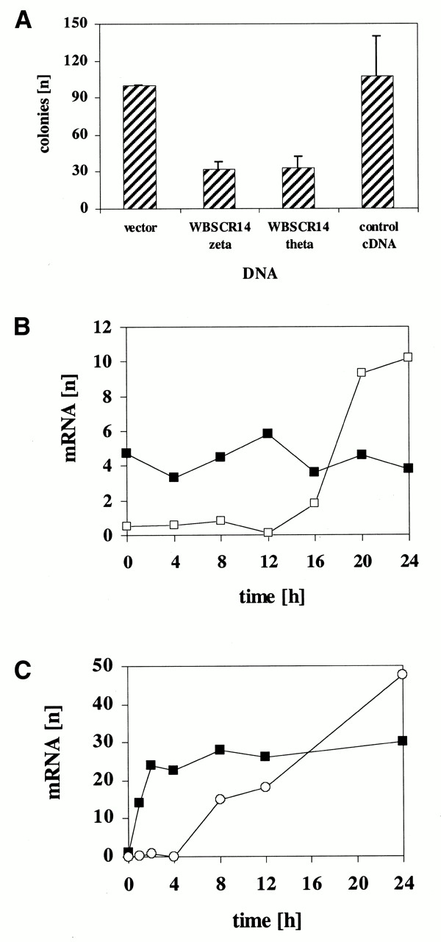
Figure 6. (A) Effects of Wbscr14-θ and -ζ expression on growth of U2OS cells. (B) WBSCR14 and Cyclin A mRNA ...
Notes:
Figure 6. (A) Effects of Wbscr14-θ and -ζ expression on growth of U2OS cells. (B) WBSCR14 and Cyclin A mRNA steady state levels during normal quiescent fibroblast cell cycle re-entry stimulation. RNA was isolated from WI-38 cells at different times after serum addition. Twenty micrograms of total RNA was blotted successively with WBSCR14, Cyclin A and actin probes. WBSCR14 (closed squares) and Cyclin A (open squares) mRNA levels are normalized to actin mRNA. (C) WBSCR14, Mxi1 and actin mRNA steady state levels during monoblasts differentiation. RNA was isolated from U-937 cells at different times after TPA treatment. Twenty micrograms of total RNA was blotted successively with WBSCR14, Mxi1 and actin. WBSCR14 (squares) and Mxi1 (circles) mRNA levels are normalized to actin mRNA.
Unless provided in the caption above, the following copyright applies to the content of this slide:

