Slide 1
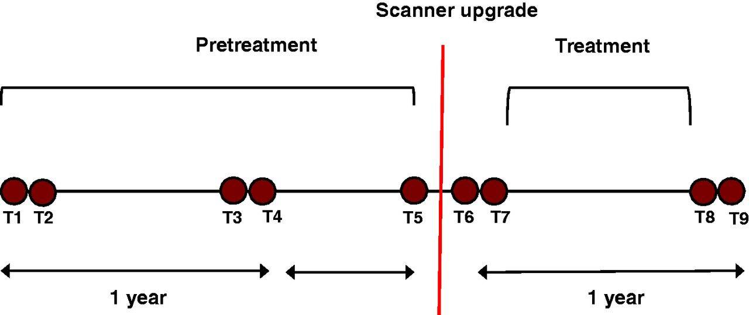
Figure 1 Study design. Time points for MRI scanning are shown as filled circles. Dual scans (e.g. T1 and T2) were ...
Notes:
Figure 1 Study design. Time points for MRI scanning are shown as filled circles. Dual scans (e.g. T1 and T2) were separated by an interval of 2 weeks.
Unless provided in the caption above, the following copyright applies to the content of this slide: © The Author (2013). Published by Oxford University Press on behalf of the Guarantors of Brain. All rights reserved. For Permissions, please email: journals.permissions@oup.com

Slide 2
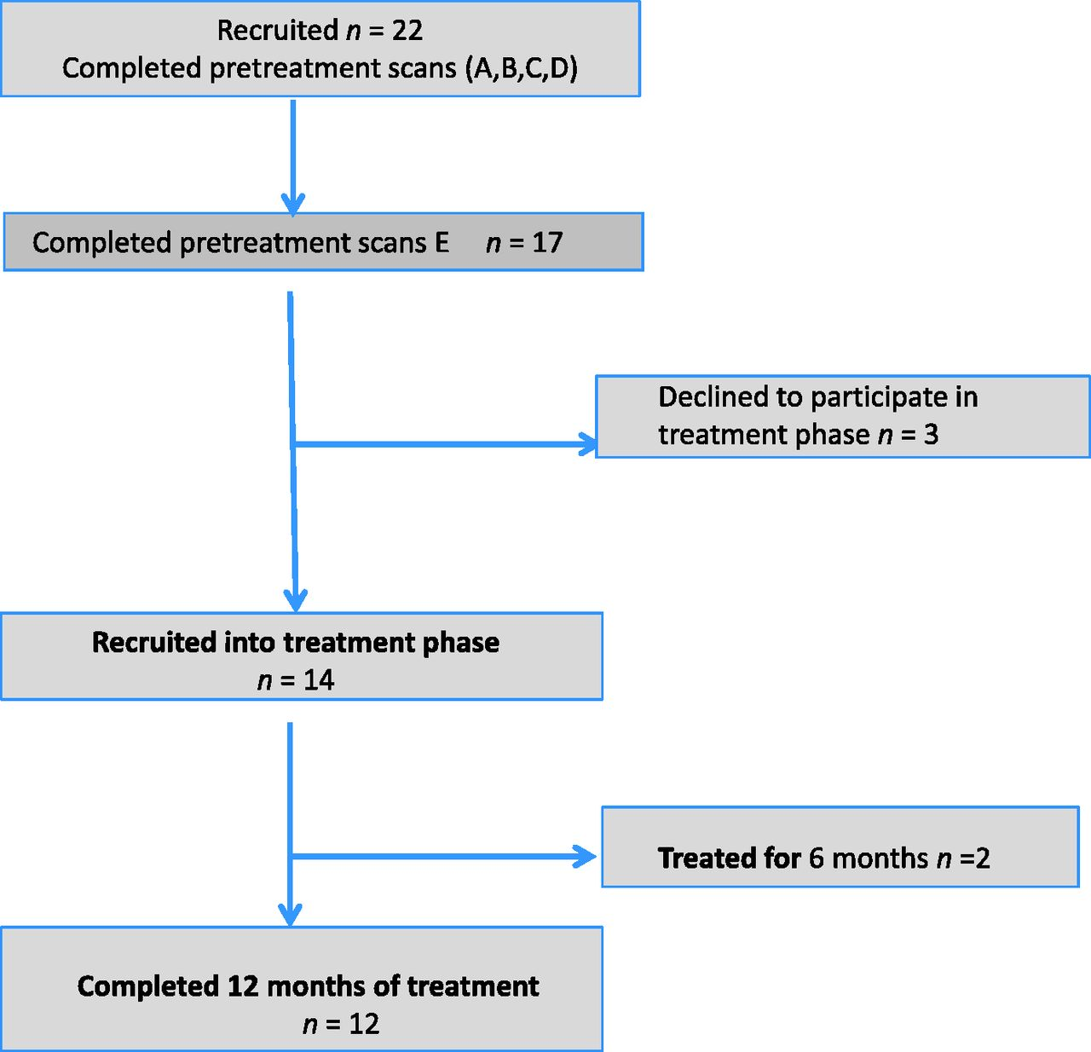
Figure 2 Consort flow diagram demonstrating patient flow through the pretreatment phase (A–E) and amiloride treatment ...
Notes:
Figure 2 Consort flow diagram demonstrating patient flow through the pretreatment phase (A–E) and amiloride treatment phase.
Unless provided in the caption above, the following copyright applies to the content of this slide: © The Author (2013). Published by Oxford University Press on behalf of the Guarantors of Brain. All rights reserved. For Permissions, please email: journals.permissions@oup.com

Slide 3
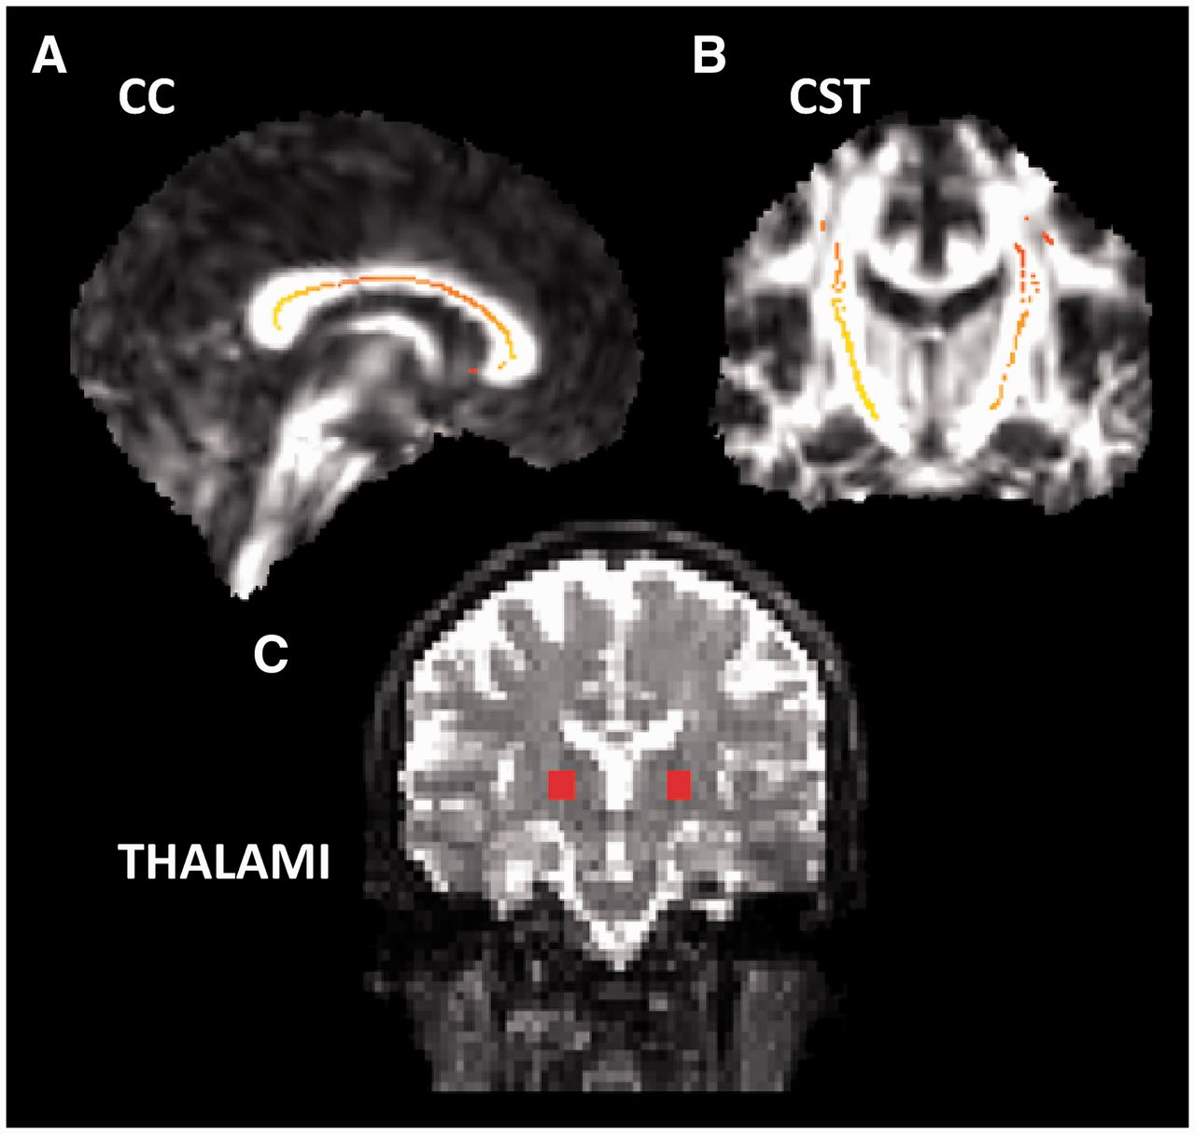
Figure 3 Demonstrates the three regions of interest selected for the combined diffusion tensor imaging outcomes ...
Notes:
Figure 3 Demonstrates the three regions of interest selected for the combined diffusion tensor imaging outcomes (colours are arbitrary): (A) corpus callosum (CC), (B) corticospinal tract (CST) and (C) thalamus.
Unless provided in the caption above, the following copyright applies to the content of this slide: © The Author (2013). Published by Oxford University Press on behalf of the Guarantors of Brain. All rights reserved. For Permissions, please email: journals.permissions@oup.com

Slide 4
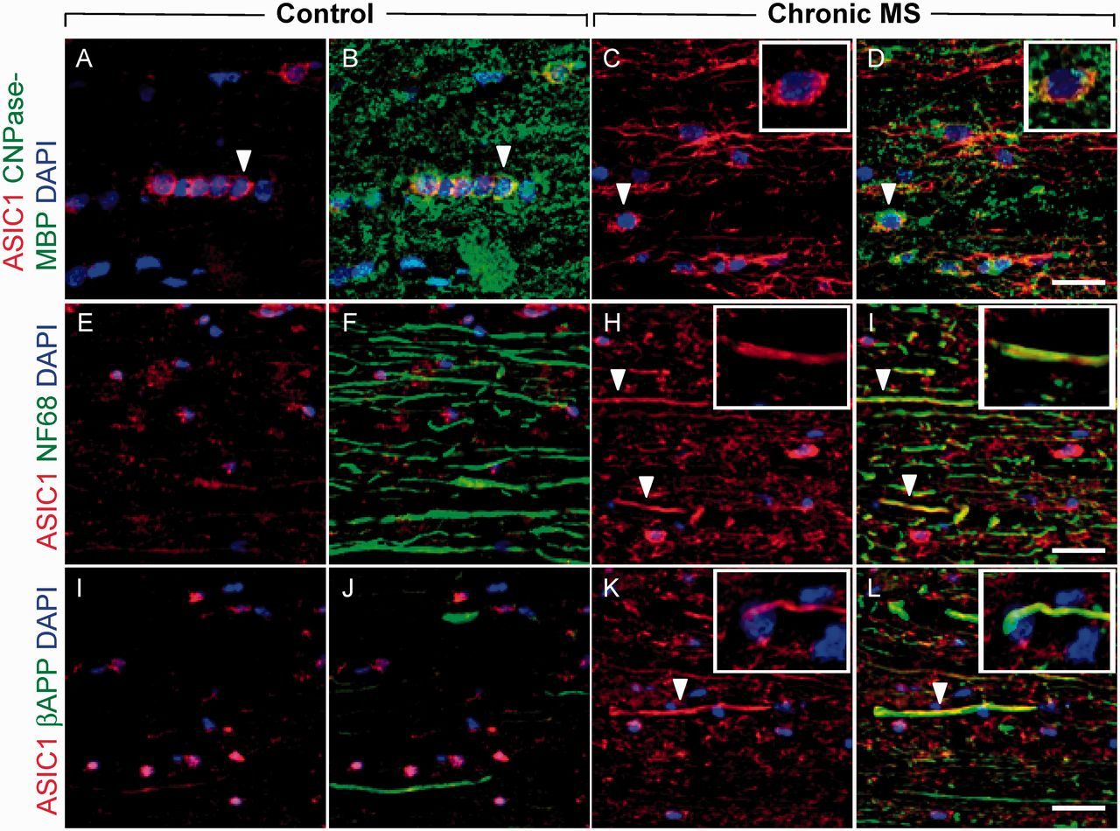
Figure 4 ASIC1 expression in chronic multiple sclerosis (MS) lesions (A–D). Longitudinal spinal cord section showing ...
Notes:
Figure 4 ASIC1 expression in chronic multiple sclerosis (MS) lesions (A–D). Longitudinal spinal cord section showing ASIC1 expression in the majority of oligodendrocytes both in control and chronic multiple sclerosis lesion. Scale bar = 20 µm. (E–H) Axons with intermediate neurofilaments (NF68) demonstrate ASIC1 expression in chronic multiple sclerosis lesions (G and H) but not in control (E and F). Similarly, ASIC1 expression is associated with the axonal injury marker amyloid precursor protein (β-APP) in chronic multiple sclerosis lesions (K and L) but not in control (I and J). Scale bar = 40 µm. White arrows indicate example of ASIC1 immunopositive oligodendrocyte and axons.
Unless provided in the caption above, the following copyright applies to the content of this slide: © The Author (2013). Published by Oxford University Press on behalf of the Guarantors of Brain. All rights reserved. For Permissions, please email: journals.permissions@oup.com

Slide 5
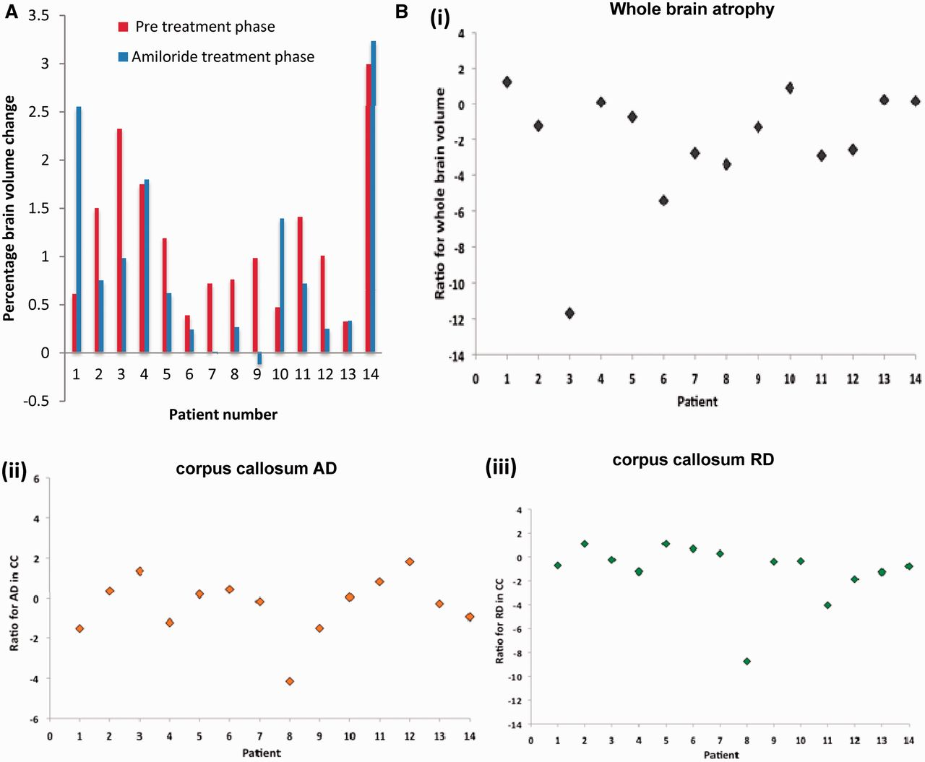
Figure 5 (A) Pretreatment and post-treatment atrophy rates for individual patients. (B) Rate of change on treatment ...
Notes:
Figure 5 (A) Pretreatment and post-treatment atrophy rates for individual patients. (B) Rate of change on treatment minus rate for pretreatment, adjusted for variability (i.e. a ratio formed by dividing the difference in rates by the SD of this difference). Positive values indicate faster rates of changes during the amiloride treatment phase compared with the pretreatment phase, whereas negative values indicate slower rates of change in the amiloride treatment phase compared with the pretreatment phase: (i) brain atrophy, (ii) axial diffusivity (AD) in corpus callosum (CC), (iii) radial diffusivity (RD) in corpus callosum, (iv) axial diffusivity in corticospinal tract (CST), (v) radial diffusivity in corticospinal tract and (vi) mean diffusivity of thalamus. Before statistical testing, an average of the diffusion measures was produced across homologous regions of the two hemispheres.
Unless provided in the caption above, the following copyright applies to the content of this slide: © The Author (2013). Published by Oxford University Press on behalf of the Guarantors of Brain. All rights reserved. For Permissions, please email: journals.permissions@oup.com

Slide 6
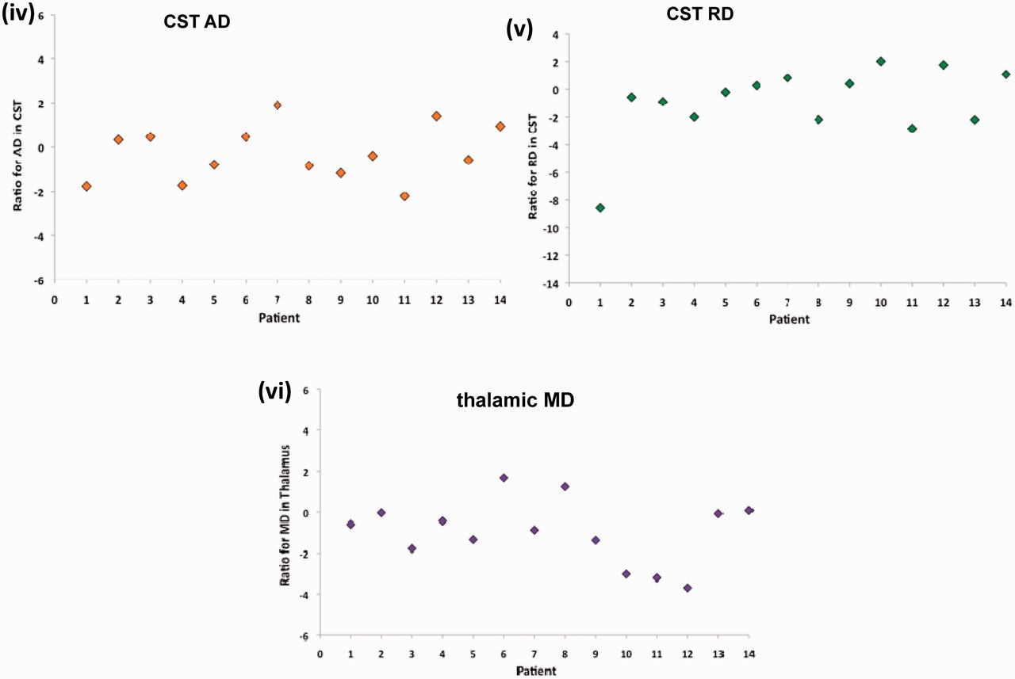
Figure 5 (A) Pretreatment and post-treatment atrophy rates for individual patients. (B) Rate of change on treatment ...
Notes:
Figure 5 (A) Pretreatment and post-treatment atrophy rates for individual patients. (B) Rate of change on treatment minus rate for pretreatment, adjusted for variability (i.e. a ratio formed by dividing the difference in rates by the SD of this difference). Positive values indicate faster rates of changes during the amiloride treatment phase compared with the pretreatment phase, whereas negative values indicate slower rates of change in the amiloride treatment phase compared with the pretreatment phase: (i) brain atrophy, (ii) axial diffusivity (AD) in corpus callosum (CC), (iii) radial diffusivity (RD) in corpus callosum, (iv) axial diffusivity in corticospinal tract (CST), (v) radial diffusivity in corticospinal tract and (vi) mean diffusivity of thalamus. Before statistical testing, an average of the diffusion measures was produced across homologous regions of the two hemispheres.
Unless provided in the caption above, the following copyright applies to the content of this slide: © The Author (2013). Published by Oxford University Press on behalf of the Guarantors of Brain. All rights reserved. For Permissions, please email: journals.permissions@oup.com

