Slide 1
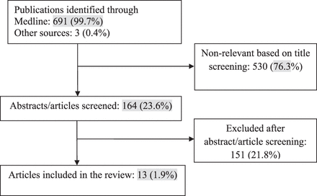
Figure 1. Flow chart of article selection.
Notes:
Figure 1. Flow chart of article selection.
Unless provided in the caption above, the following copyright applies to the content of this slide: © The Author 2012. Published by Oxford University Press on behalf of the Society for Research on Nicotine and Tobacco. All rights reserved. For permissions, please e-mail: journals.permissions@oup.com

