Slide 1
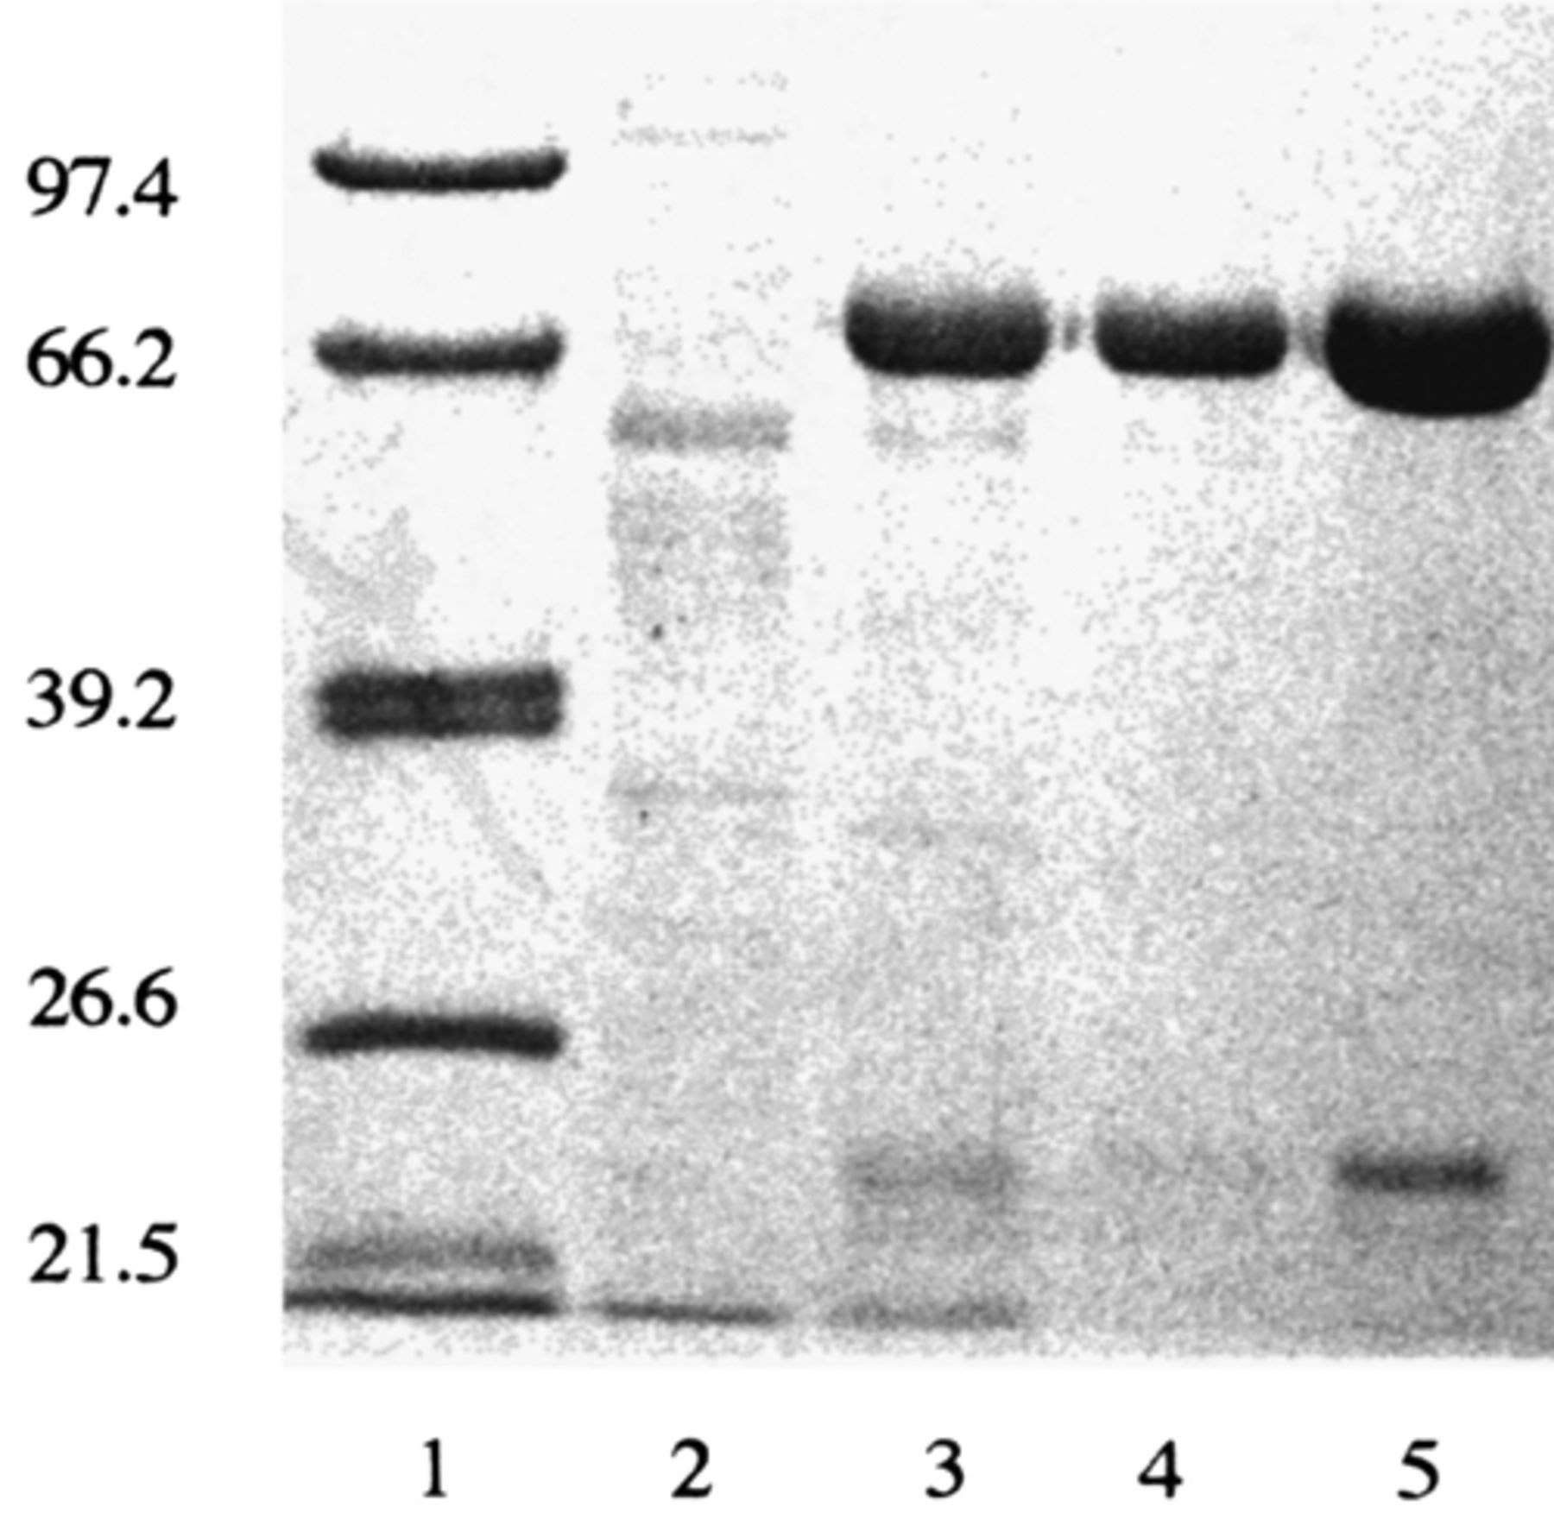
1 SDS–PAGE (10%) of the fractions obtained during the purification of the peptidase from the culture medium ...
Notes:
1 SDS–PAGE (10%) of the fractions obtained during the purification of the peptidase from the culture medium (C2Y). The lanes are as follows: 1, marker proteins with relative molecular masses indicated on the left; 2, culture medium; 3, Q Sepharose eluate; 4, Sephacryl S-300 peak; 5, 1 M NaCl eluate from PBE 94 chromatofocusing gel.
Unless provided in the caption above, the following copyright applies to the content of this slide: © 2001 Federation of European Microbiological Societies

Slide 2
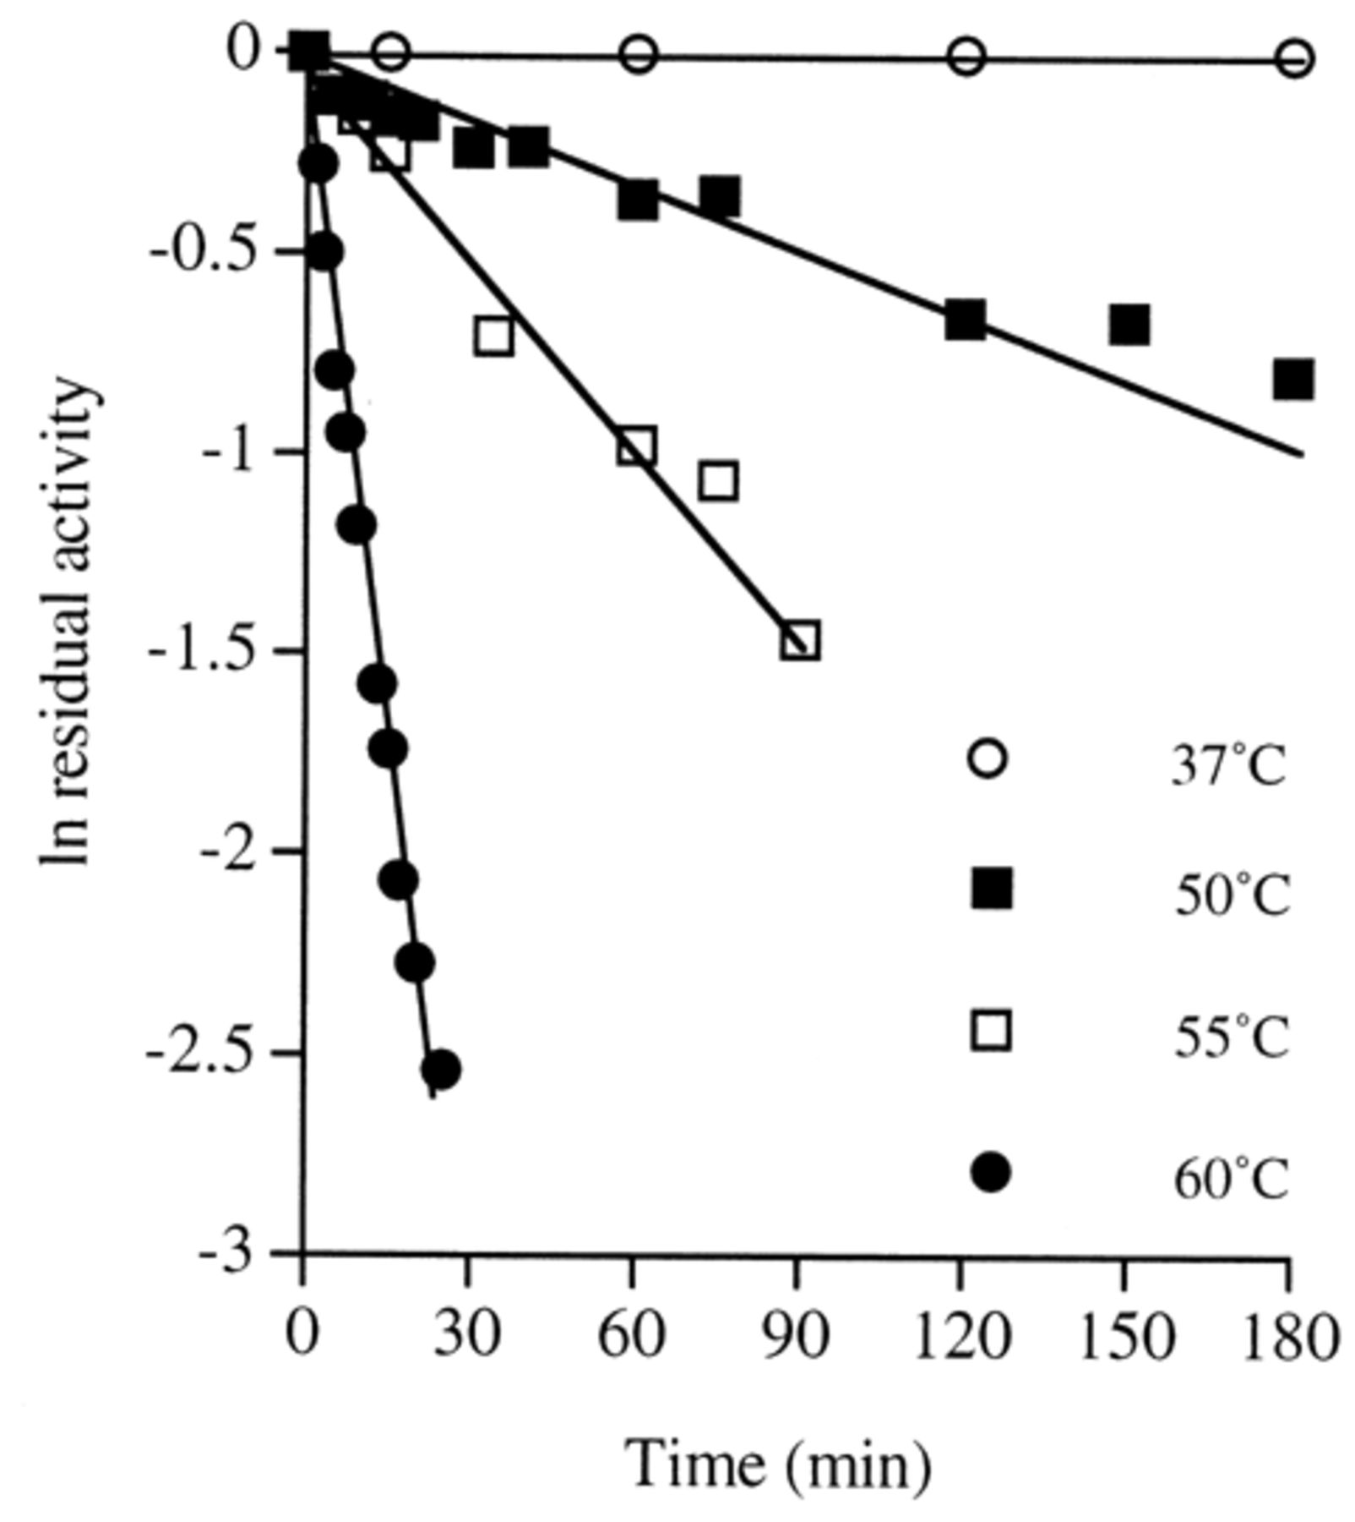
2 Semilogarithmic plot of peptidase activity as a function of time at different temperatures. The purified ...
Notes:
2 Semilogarithmic plot of peptidase activity as a function of time at different temperatures. The purified enzyme (0.5 mg ml−1) was incubated at different temperatures (37, 50, 55, 60°C) in 50 mM Tris–HCl, pH 7.0, and aliquots were withdrawn, cooled, and assayed at 25°C in 0.1 M Tris–HCl buffer containing 0.36 mM AAPF. The residual activity is defined as the activity at a given time divided by the activity at time 0 min.
Unless provided in the caption above, the following copyright applies to the content of this slide: © 2001 Federation of European Microbiological Societies

Slide 3
3 Alignment between the N-terminal sequence of the peptidase and other peptidase sequences. Alignments were ...
Notes:
3 Alignment between the N-terminal sequence of the peptidase and other peptidase sequences. Alignments were carried out with the programme Clustal W (version 1.8). The following EMBL/GenBank accession numbers were used to obtain these sequences; B. subtilis alkaline protease aprx, Z99113; S. coelicolor serine protease, U33176; minor extracellular proteinase VPR precursor from B. subtilis, P29141; intracellular serine protease from P. polymyxa, P29139. An asterisk denotes residue identity and a colon indicates similarity.
Unless provided in the caption above, the following copyright applies to the content of this slide: © 2001 Federation of European Microbiological Societies

