Slide 1
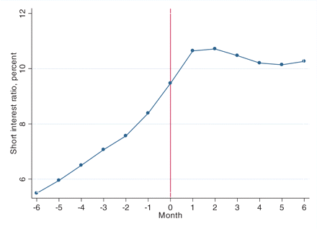
Figure 1 Short interest ratio for all events The figure shows the monthly ratio of short interest to shares ...
Notes:
Figure 1 Short interest ratio for all events The figure shows the monthly ratio of short interest to shares outstanding, in event time. Month zero is the first month that any anti-shorting event takes place for the firm.
Unless provided in the caption above, the following copyright applies to the content of this slide: © The Author 2012. Published by Oxford University Press on behalf of The Society for Financial Studies. All rights reserved. For Permissions, please email: journals.permissions@oup.com.

Slide 2
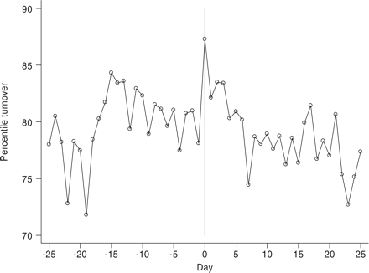
Figure 2 Volume for urge events The figure shows trading volume in event time. Trading volume is measured as share ...
Notes:
Figure 2 Volume for urge events The figure shows trading volume in event time. Trading volume is measured as share turnover, and is expressed as percentile turnover relative to other stocks on the same day and in the same exchange. Day zero is the trading day on which the first urge event occurs, where the firm urges shareholders not to lend shares to shorter sellers.
Unless provided in the caption above, the following copyright applies to the content of this slide: © The Author 2012. Published by Oxford University Press on behalf of The Society for Financial Studies. All rights reserved. For Permissions, please email: journals.permissions@oup.com.

Slide 3
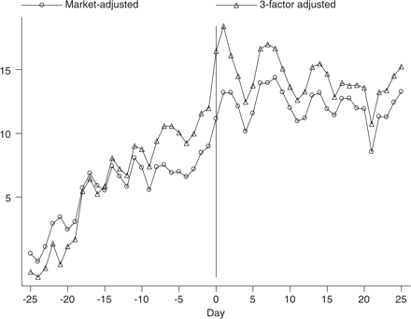
Figure 3 Cumulative returns for urge events The figure shows cumulative returns in event time. Market-adjusted returns ...
Notes:
Figure 3 Cumulative returns for urge events The figure shows cumulative returns in event time. Market-adjusted returns are returns minus the return on the CRSP value-weighted index. Three-factor alpha is the intercept from a regression of returns in excess of Treasury bills on the three factors of Fama and French (1993): size, value, and market. Day zero is the trading day on which the first urge event occurs, where the firm urges shareholders not to lend shares to shorter sellers.
Unless provided in the caption above, the following copyright applies to the content of this slide: © The Author 2012. Published by Oxford University Press on behalf of The Society for Financial Studies. All rights reserved. For Permissions, please email: journals.permissions@oup.com.

