Slide 1
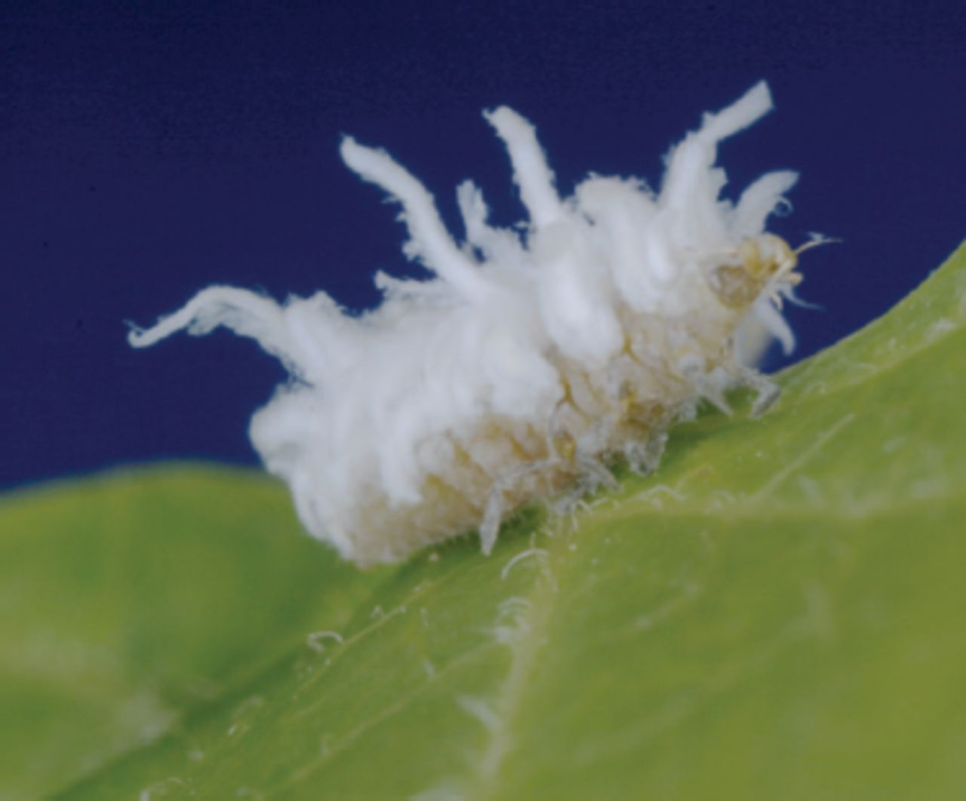
Fig. 1. A wax-covered ladybird beetle larva, S.huisianae, feeding on a soybean aphid, A. glycines, on the leaf of a ...
Notes:
Fig. 1. A wax-covered ladybird beetle larva, S.huisianae, feeding on a soybean aphid, A. glycines, on the leaf of a soybean plant, G. max.
Unless provided in the caption above, the following copyright applies to the content of this slide: © 2010 Entomological Society of America

Slide 2
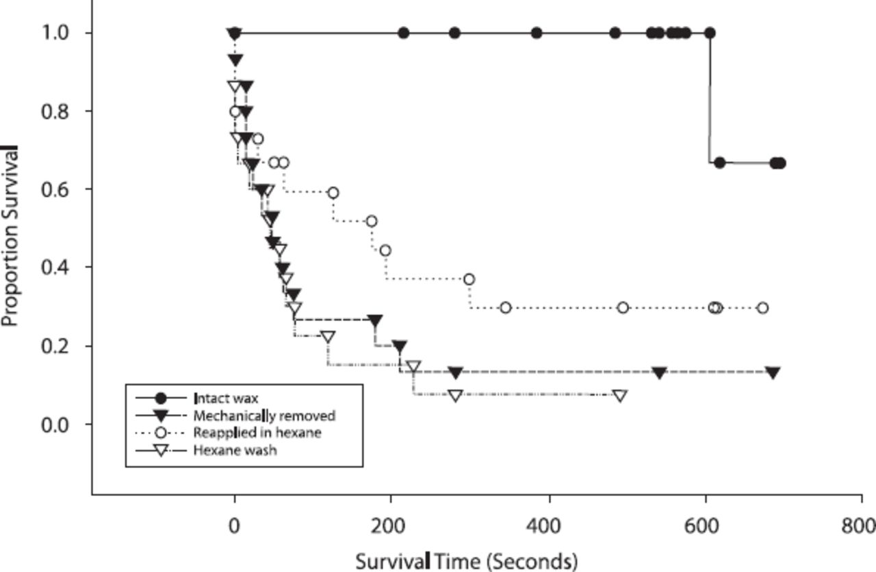
Fig. 2. Survival analysis of S. louisianae subject to interaction with L. neoniger on soybeans. Survival is measured ...
Notes:
Fig. 2. Survival analysis of S. louisianae subject to interaction with L. neoniger on soybeans. Survival is measured as the time a larva remained on the plant before it was removed by an ant.
Unless provided in the caption above, the following copyright applies to the content of this slide: © 2010 Entomological Society of America

Slide 3
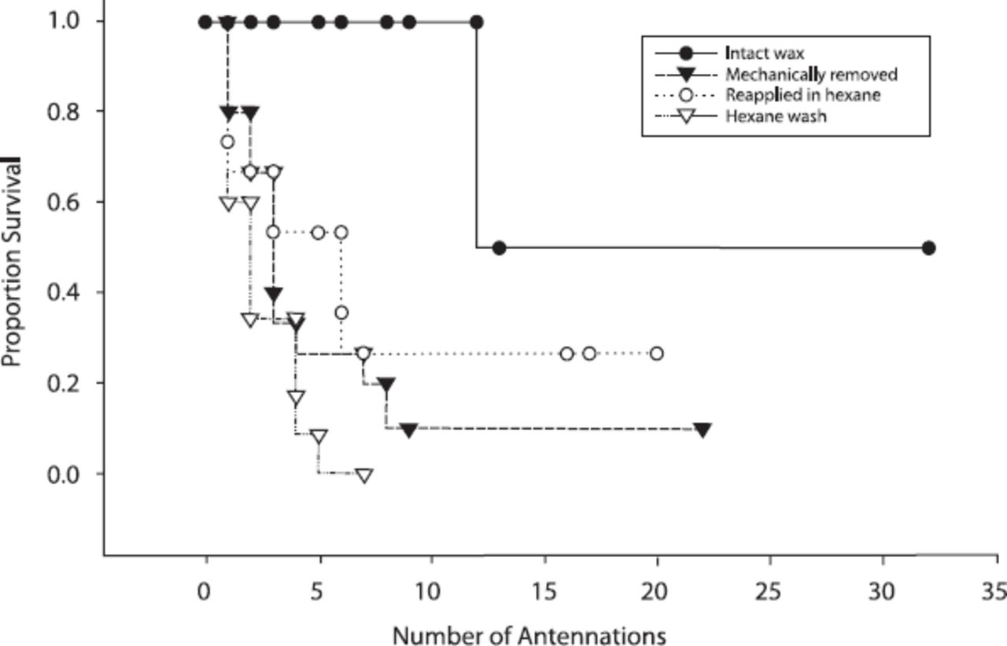
Fig. 3. Survival analysis of S. louisianae subject to interaction with L. neoniger on soybeans. Survival is measured ...
Notes:
Fig. 3. Survival analysis of S. louisianae subject to interaction with L. neoniger on soybeans. Survival is measured as the number of antennations by ants on a larva before it was removed.
Unless provided in the caption above, the following copyright applies to the content of this slide: © 2010 Entomological Society of America

Slide 4
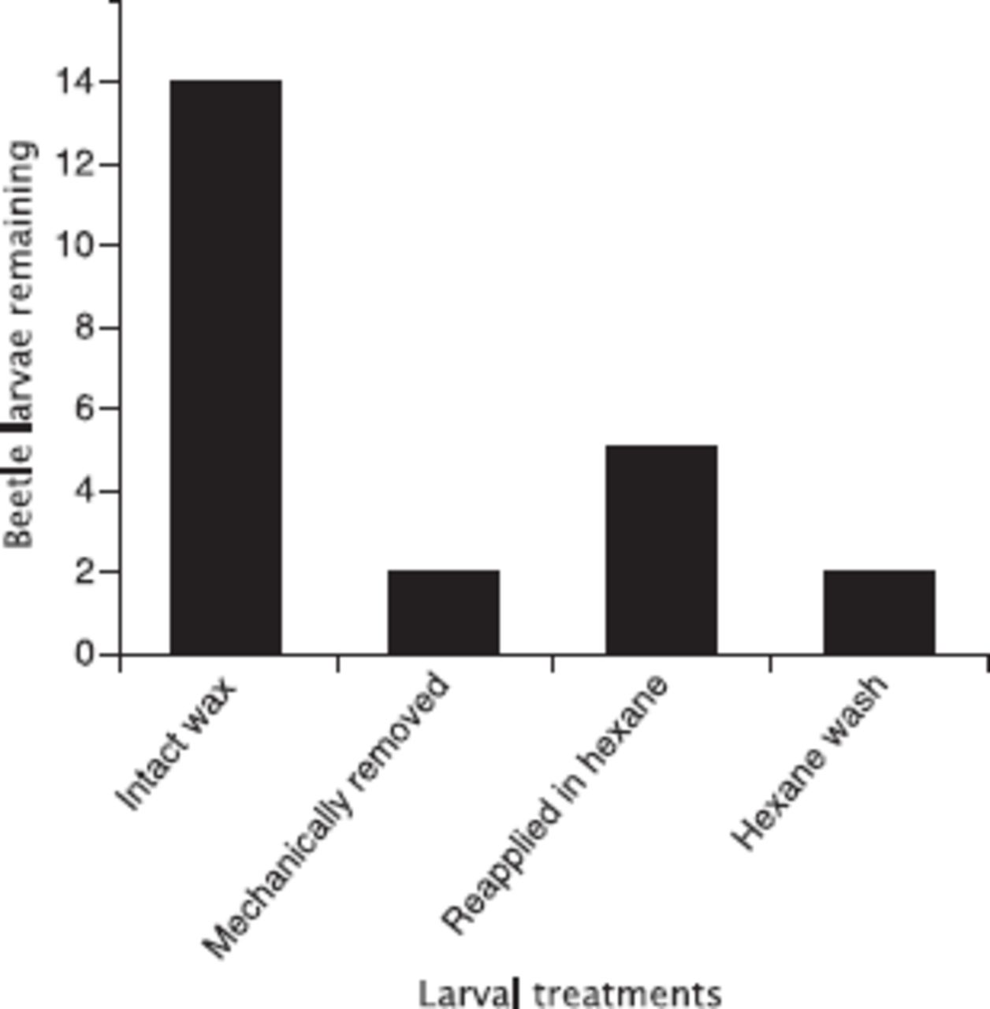
Fig. 4. Number of beetle larvae remaining on the plant from the original 15 for the total duration of the trial ...
Notes:
Fig. 4. Number of beetle larvae remaining on the plant from the original 15 for the total duration of the trial period (≈ 10 min) that have escaped aggression from L. neoniger.
Unless provided in the caption above, the following copyright applies to the content of this slide: © 2010 Entomological Society of America

