Slide 1
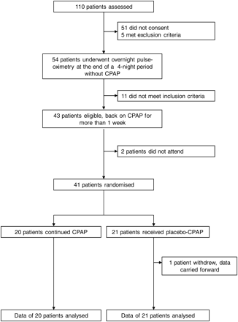
Figure 1 Trial profile.
Notes:
Figure 1 Trial profile.
Unless provided in the caption above, the following copyright applies to the content of this slide: Published on behalf of the European Society of Cardiology. All rights reserved. © The Author 2012. For permissions please email: journals.permissions@oup.com

Slide 2
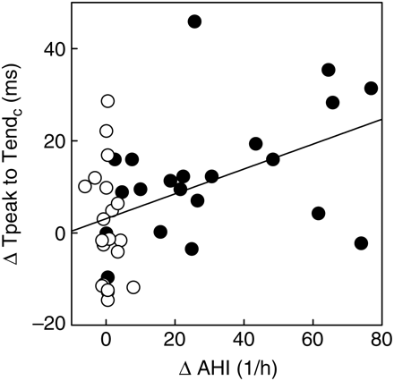
Figure 5 Correlation between the change in the TpTe_{c} interval (change from baseline to 2 weeks) and change ...
Notes:
Figure 5 Correlation between the change in the TpTec interval (change from baseline to 2 weeks) and change in the apnoea/hypopnoea index (r = 0.45, 95% CI 0.17–0.67, P = 0.003, n = 41). Black circles represent patients in the subtherapeutic continuous positive airway pressure group and white circles represent patients in the therapeutic continuous positive airway pressure group.
Unless provided in the caption above, the following copyright applies to the content of this slide: Published on behalf of the European Society of Cardiology. All rights reserved. © The Author 2012. For permissions please email: journals.permissions@oup.com

Slide 3
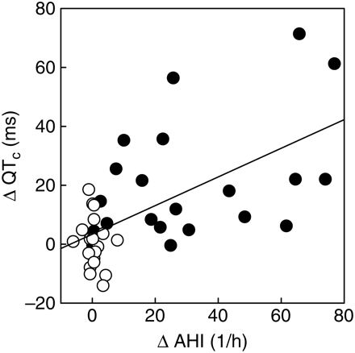
Figure 4 Correlation between the change in the QT_{c} interval (change from baseline to 2 weeks) and change in ...
Notes:
Figure 4 Correlation between the change in the QTc interval (change from baseline to 2 weeks) and change in the apnoea/hypopnoea index (r = 0.60, 95% CI 0.36–.77, P < 0.001, n = 41). Black circles represent patients in the subtherapeutic continuous positive airway pressure group and white circles represent patients in the therapeutic continuous positive airway pressure group.
Unless provided in the caption above, the following copyright applies to the content of this slide: Published on behalf of the European Society of Cardiology. All rights reserved. © The Author 2012. For permissions please email: journals.permissions@oup.com

Slide 4
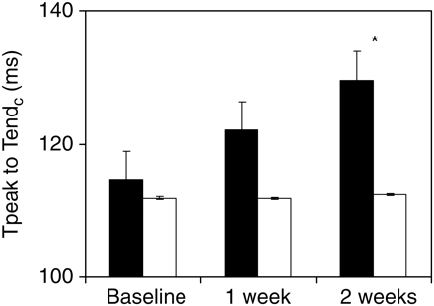
Figure 3 Data are presented as mean and standard error. Black bars represent the subtherapeutic continuous positive ...
Notes:
Figure 3 Data are presented as mean and standard error. Black bars represent the subtherapeutic continuous positive airway pressure group and white bars represent the therapeutic continuous positive airway pressure group. There was a significant increase in the length of the TpTec at 2 weeks in the subtherapeutic continuous positive airway pressure group compared with the therapeutic continuous positive airway pressure group. *P < 0.001 for comparisons of changes from baseline between groups.
Unless provided in the caption above, the following copyright applies to the content of this slide: Published on behalf of the European Society of Cardiology. All rights reserved. © The Author 2012. For permissions please email: journals.permissions@oup.com

Slide 5
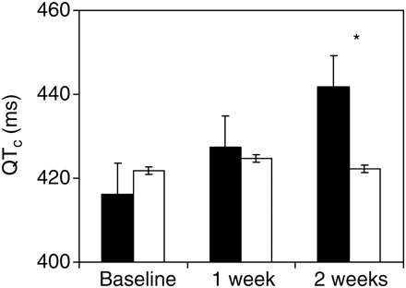
Figure 2 Data are presented as mean and standard error. Black bars represent the subtherapeutic continuous positive ...
Notes:
Figure 2 Data are presented as mean and standard error. Black bars represent the subtherapeutic continuous positive airway pressure group and white bars represent the therapeutic continuous positive airway pressure group. There was a significant increase in the length of the QTc at 2 weeks in the subtherapeutic continuous positive airway pressure group compared with the therapeutic continuous positive airway pressure group. *P < 0.001 for comparisons of changes from baseline between groups.
Unless provided in the caption above, the following copyright applies to the content of this slide: Published on behalf of the European Society of Cardiology. All rights reserved. © The Author 2012. For permissions please email: journals.permissions@oup.com

