Slide 1
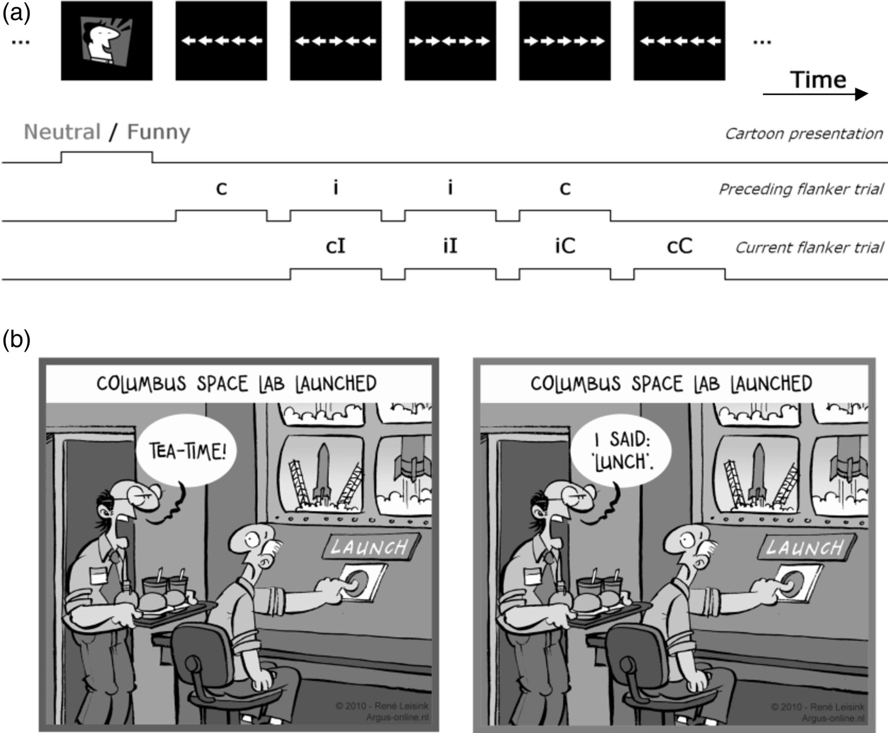
Figure 1. Experimental design. (a) Neutral and funny cartoons were presented in random order. Each cartoon was followed ...
Notes:
Figure 1. Experimental design. (a) Neutral and funny cartoons were presented in random order. Each cartoon was followed by a block of 5 randomly selected flanker trials being either compatible (C) or incompatible (I). Sequential behavioral analyses compared current compatibility (as indicated by upper-case letters C and I) as a function of the compatibility of the preceding trial (indicated by lower-case letters c and i). The neuroimaging analysis focused on the epochs related to the cartoons presentation (hedonic processing) and the preceding and current flanker trials (conflict processing). The brain–behavior analysis focused on whether neural activity during the preceding flanker trial is predictive of the behavioral adjustment observed in the current trial. (b) Example of a neutral (left) and funny (right) cartoon. Cartoons with funny cues omitted were presented as neutral cartoon (© 2010 René Leisink, reprinted with permission).
Unless provided in the caption above, the following copyright applies to the content of this slide: © The Author 2014. Published by Oxford University Press. All rights reserved. For Permissions, please e-mail: journals.permissions@oup.com

Slide 2
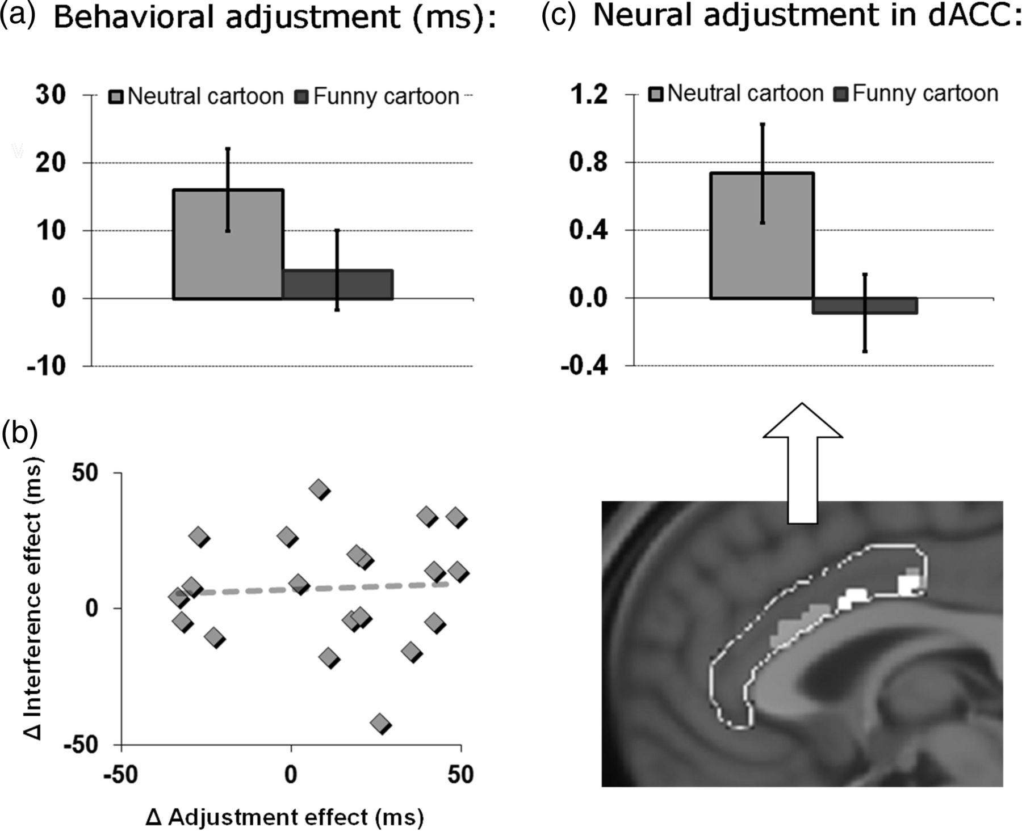
Figure 2. Effects of humor on behavior and brain in current flanker trials. (a) The behavioral conflict-adjustment ...
Notes:
Figure 2. Effects of humor on behavior and brain in current flanker trials. (a) The behavioral conflict-adjustment effect in the flanker task was reduced in the context of a funny (vs. neutral) cartoon. See Table 1 for more details. (b) Individual effects of humor context (Δ = neutral minus funny) on the behavioral adjustment effect (X-axis) and the behavioral interference effect (Y-axis) were uncorrelated. (c) Gray: Neural sequential adaptation (for the contrast cI > iI) in the context of a neutral cartoon in MCC (peak voxel in MNI coordinates: 2, 22, 20; z = 2.90). White: Paralleling the reduced conflict-adjustment effect in behavior, neural sequential adaptation (for the contrast cI > iI) in current conflict processing was significantly reduced by funny (vs. neutral) cartoons in MCC cortex (peak voxels in MNI coordinates: 0, −8, 34; z = 2.37 and −2, 6, 30; z = 2.41). The bar graph shows the interaction extracted from this contrast. The figure only shows activation within the rostral cingulate cortex mask.
Unless provided in the caption above, the following copyright applies to the content of this slide: © The Author 2014. Published by Oxford University Press. All rights reserved. For Permissions, please e-mail: journals.permissions@oup.com

Slide 3
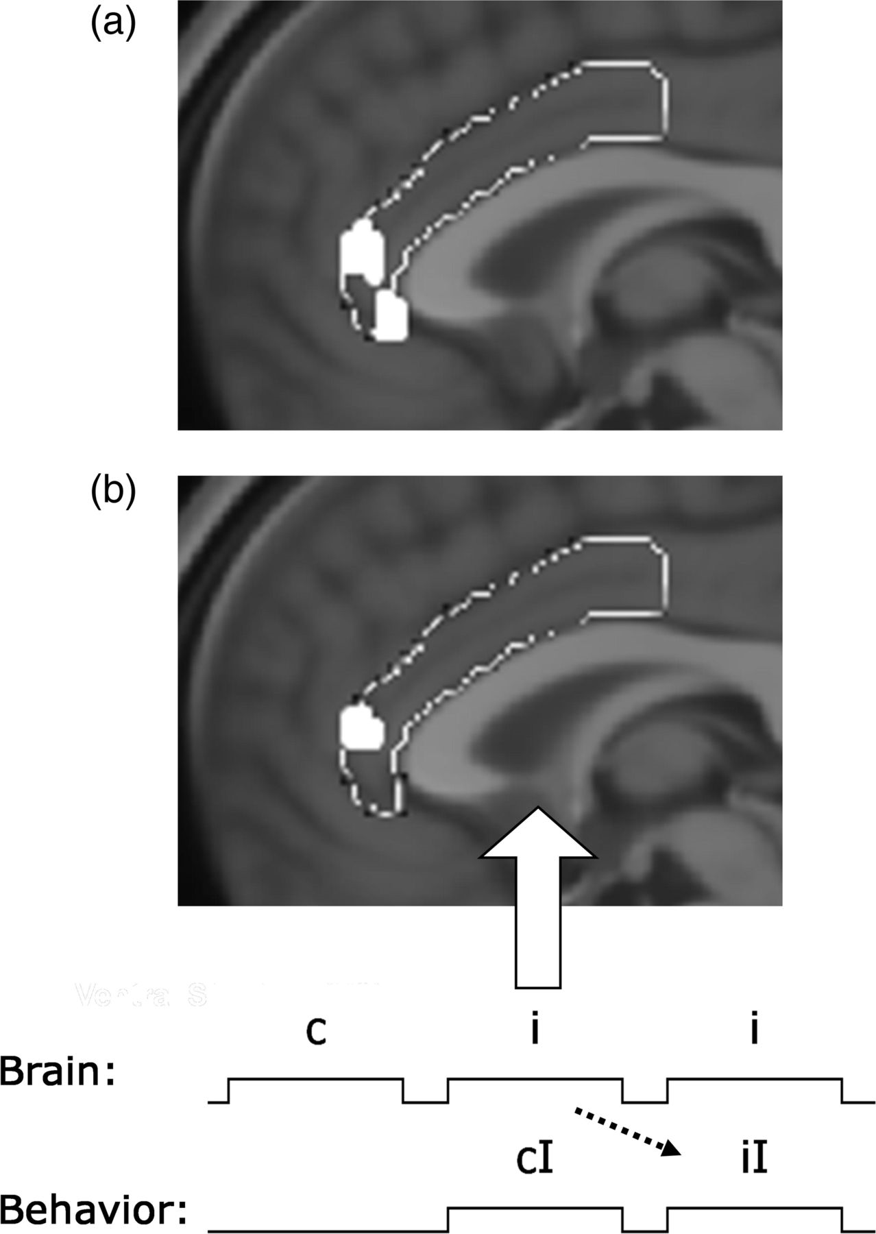
Figure 3. Effects of humor on neural activity in preceding flanker trials. (a) Attenuated conflict processing by ...
Notes:
Figure 3. Effects of humor on neural activity in preceding flanker trials. (a) Attenuated conflict processing by hedonic context: deactivation in ACC (peak voxel in MNI coordinates: 2, 42, 12; z = 2.94) for preceding conflict (iX) trials presented in the context of funny (vs. neutral) cartoons. The figure only shows activation within the rostral cingulate cortex mask. (b) The brain–behavior analyses focused on brain activity that was predictive of subsequent performance adaptation in 2 consecutive conflict (iI) trials in the hedonically neutral context. Activity in ACC (peak voxel in MNI coordinates: −4, 40, 10; z = 2.73) was observed to predict behavioral speeding (RT) for subsequent iI flanker trials in the neutral context. The figure only shows activation within the rostral cingulate cortex mask.
Unless provided in the caption above, the following copyright applies to the content of this slide: © The Author 2014. Published by Oxford University Press. All rights reserved. For Permissions, please e-mail: journals.permissions@oup.com

Slide 4
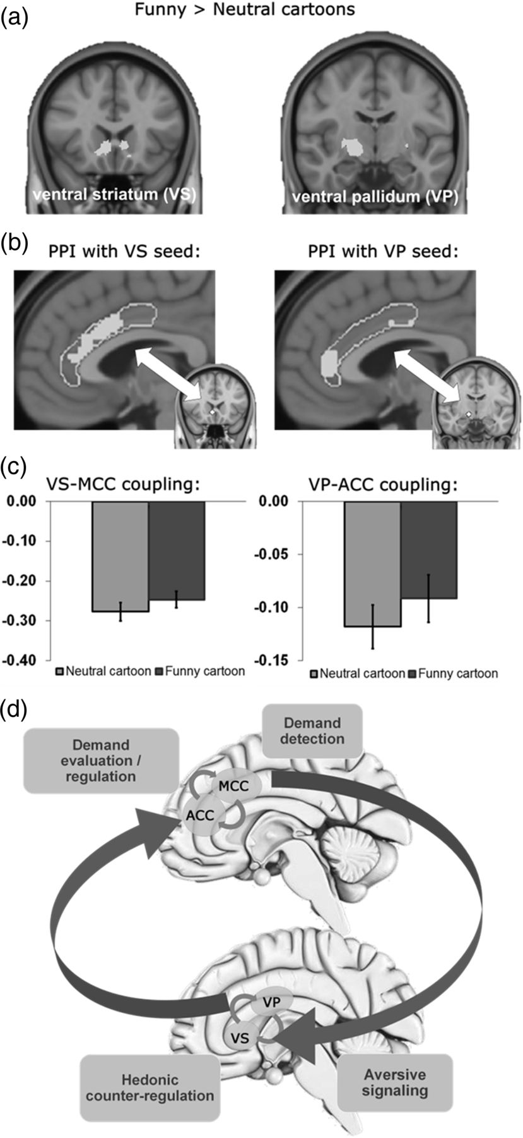
Figure 4. Effects of humor on neural interactions. (a) In comparison to neutral cartoons, funny cartoons increased ...
Notes:
Figure 4. Effects of humor on neural interactions. (a) In comparison to neutral cartoons, funny cartoons increased neural activation in the ventral striatum (left; peak voxel in MNI coordinates: 4, 20, −6; z = 3.66) and right posterior ventral pallidum (right, peak voxel in MNI coordinates: 14, −10, −8; z = 3.68). Images are in radiological convention (left hemisphere to viewer's right) and only show activation within the accumbens and pallidum masks (using the Harvard–Oxford atlas). Activations in other regions for the contrast Funny > Neutral are reported in Supplementary Table 2. (b) Results from the PPI analyses that focused on a pleasure-driven attenuated anti-correlation between regions within the ventral basal ganglia and rostral cingulate cortex. PPI analyses were based on seed regions in the VS and VP using a sphere of radius 4 mm (centered at 6, 20, −4 and 14, −10, −8) that fitted in the respective area and included the peak-activation voxel found in the contrast depicted in (a). Dorsal rostral cingulate cortex (peak voxel in MNI coordinates: 4, 22, 26; z = 2.92) was observed to be functionally connected with the ventral striatum, whereas ACC (peak voxel in MNI coordinates: 0, 40, 8; z = 2.85) was found to be functionally connected with the ventral pallidum (right). Figures only show activation within the rostral cingulate cortex mask. (c) Hedonic context reduced the anti-correlated interactions between VS and MCC (left) and between VP and ACC (right). (d) Summary depicting the observed interactions between basal ganglia and rostral cingulate cortex that support hedonic counter-regulation. Labels indicate the proposed function of the respective areas (see Discussion).
Unless provided in the caption above, the following copyright applies to the content of this slide: © The Author 2014. Published by Oxford University Press. All rights reserved. For Permissions, please e-mail: journals.permissions@oup.com

