Slide 1
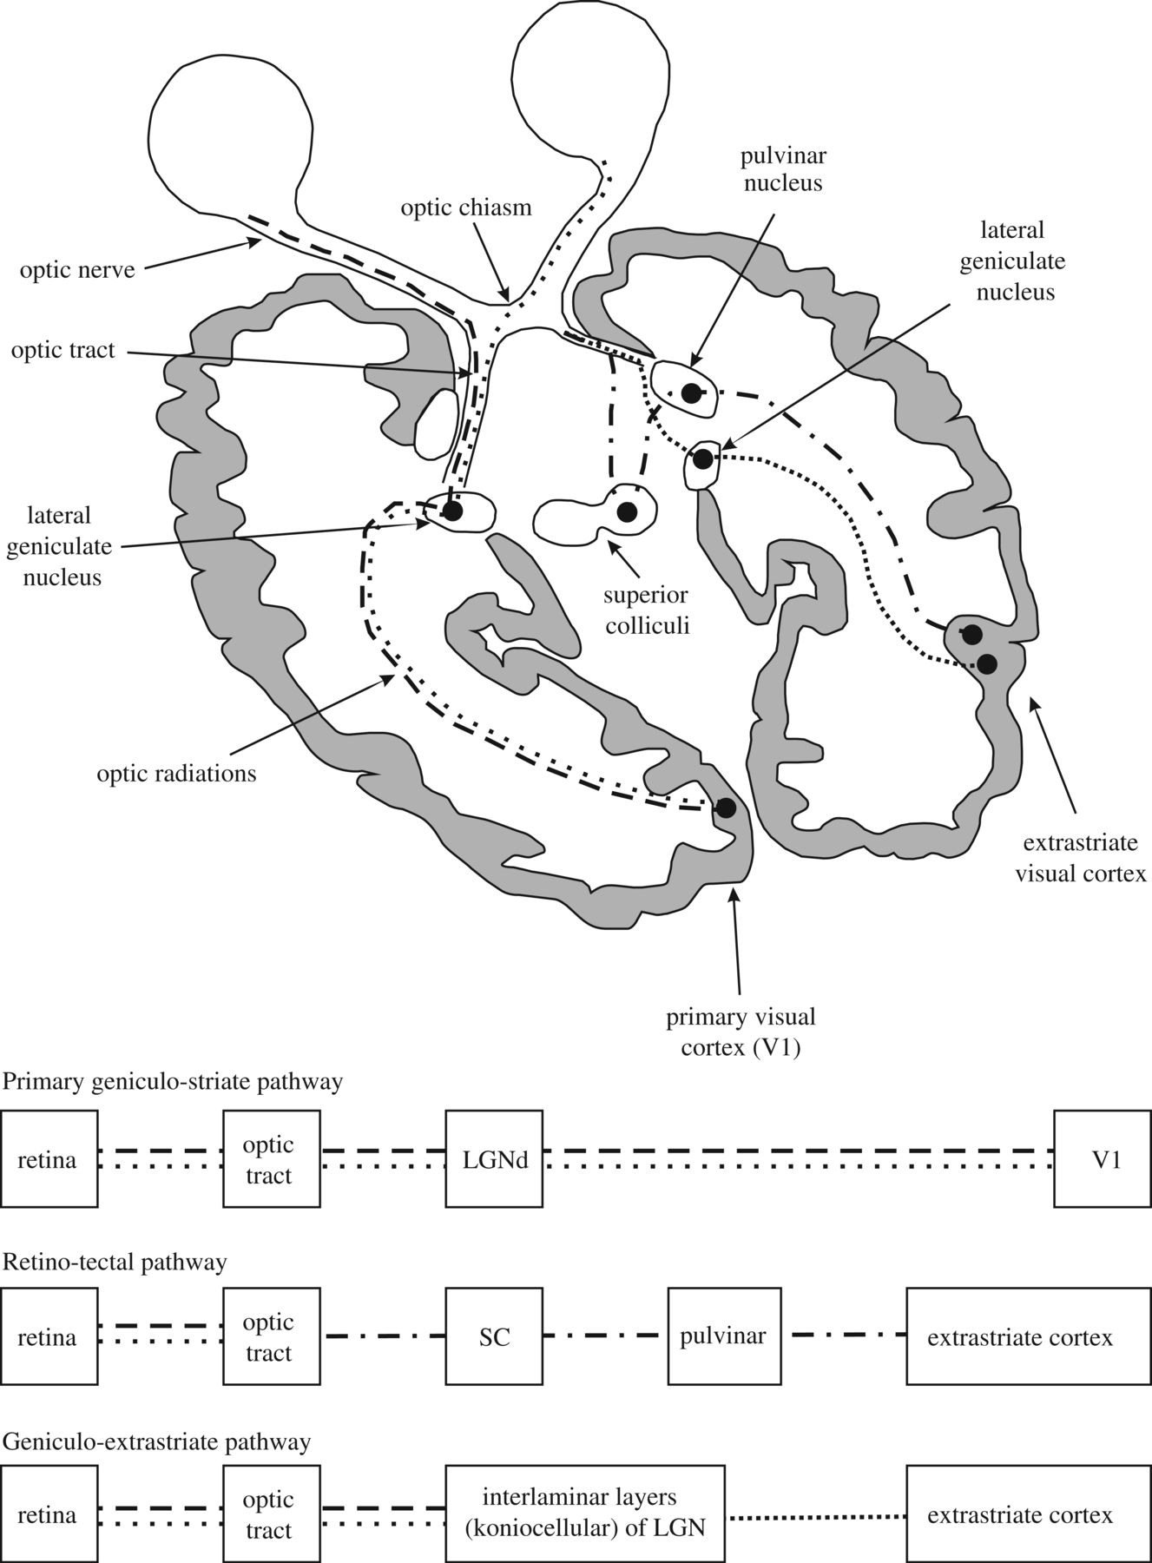
Figure 1 Schematic representation of the visual pathways. Beside the conscious geniculo-striate pathway (dashed ...
Notes:
Figure 1 Schematic representation of the visual pathways. Beside the conscious geniculo-striate pathway (dashed lines), there are two subconscious visual pathways that do not pass through V1: the RCTA (dashed/dotted lines) and the RGES (closely spaced dotted lines). Of note, the discussed extension of the RCTA to the amygdala is not represented in the figure. For further explanations see text from Danckert and Rossetti (2005); with permission. LGN = lateral geniculate nucleus; SC = superior colliculus.
Unless provided in the caption above, the following copyright applies to the content of this slide: © The Author (2014). Published by Oxford University Press on behalf of the Guarantors of Brain.This is an Open Access article distributed under the terms of the Creative Commons Attribution Non-Commercial License (http://creativecommons.org/licenses/by-nc/3.0/), which permits non-commercial re-use, distribution, and reproduction in any medium, provided the original work is properly cited. For commercial re-use, please contact journals.permissions@oup.com

Slide 2
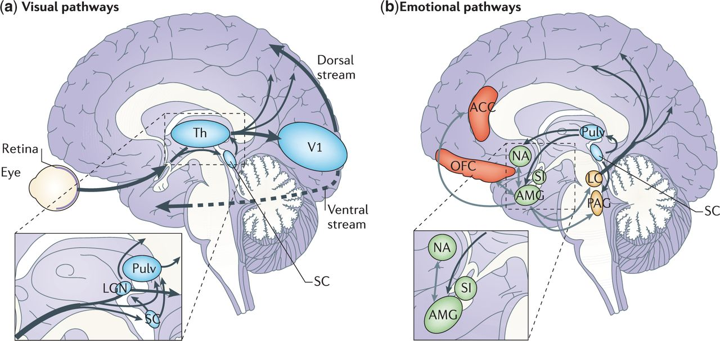
Figure 2 Cortical and subcortical pathways for vision and emotion. (a) The primary visual pathway (shown by thick ...
Notes:
Figure 2 Cortical and subcortical pathways for vision and emotion. (a) The primary visual pathway (shown by thick arrows) originates from the retina and projects to the primary V1 in the occipital lobe via an intermediate station in LGN of Th. From V1, visual information reaches the extrastriate cortex along the ventral (occipitotemporal) and the dorsal (occipitoparietal) stream. However, a minority of fibres originating from the retina take a secondary route (shown by thin arrows) and reach both SC and Pulv. These two subcortical sites are connected and also send direct projections to the extrastriate visual cortex, bypassing V1. Another V1-independent visual pathway consists of the direct projections between the superior colliculus and LGN that, in turn, send efferents to extrastriate cortices in the dorsal stream. (b) The ‘emotion system' includes several cortical and subcortical areas. Among the subcortical structures are AMG and SI (shown in green), which are buried deeply in the temporal lobe and in the basal forebrain, respectively, NA in the basal ganglia (shown in green) and brainstem nuclei (shown in yellow), such as PAG and LC. Among cortical areas (shown in red) are OFC and ACC. The visual and emotional systems are extensively interconnected, especially at the subcortical level, where the superior colliculus is connected to the amygdala via the pulvinar. Direct connections also exist between subcortical and cortical emotion regions (for example, between the amygdala and OFC or ACC), between subcortical structures for emotions and cortical visual areas (for example, between the amygdala and temporal cortex) (not shown) and between brainstem nuclei and the cortex via diffuse projections (shown only from the LC). Grey arrows indicate connections within the emotion system. ACC = anterior cingulate cortex; AMG = amygdala; LC = Locus coeruleus; LGN = lateral geniculate nucleus; NA = nucleus accumbens; OFC = orbitofrontal cortex; PAG = periaqueductal grey; Pulv = pulvinar; SC = superior colliculus; SI = substantia innominata; Th = thalamus; V1 = primary visual cortex.
Unless provided in the caption above, the following copyright applies to the content of this slide: © The Author (2014). Published by Oxford University Press on behalf of the Guarantors of Brain.This is an Open Access article distributed under the terms of the Creative Commons Attribution Non-Commercial License (http://creativecommons.org/licenses/by-nc/3.0/), which permits non-commercial re-use, distribution, and reproduction in any medium, provided the original work is properly cited. For commercial re-use, please contact journals.permissions@oup.com

