Slide 1
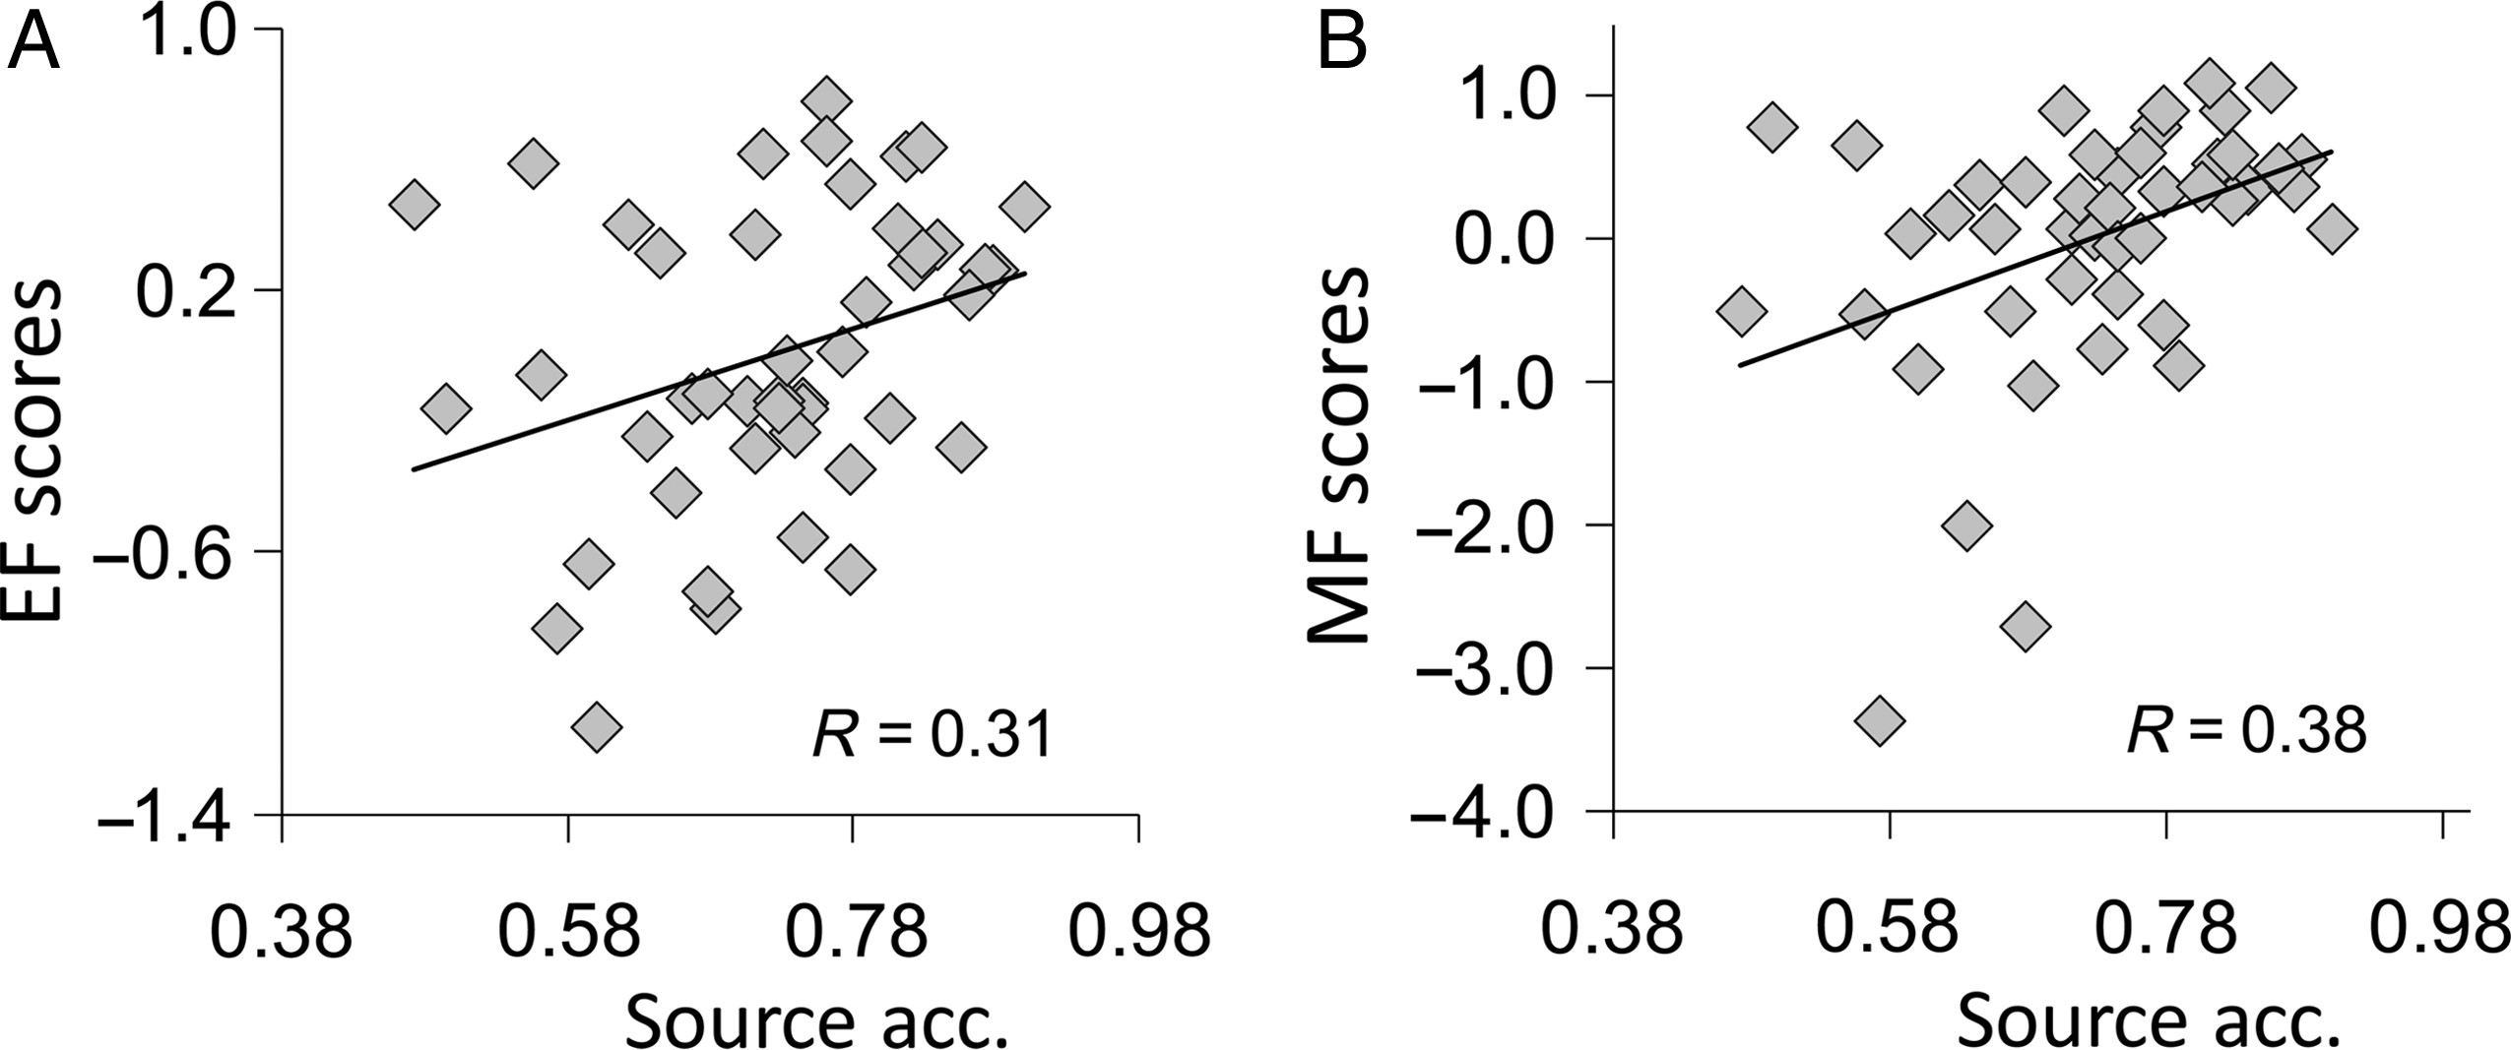
Figure 1. (A) Positive correlation between executive function (EF) scores and source memory accuracy. (B) Correlation ...
Notes:
Figure 1. (A) Positive correlation between executive function (EF) scores and source memory accuracy. (B) Correlation between memory function (MF) scores and source memory accuracy.
Unless provided in the caption above, the following copyright applies to the content of this slide: © The Author 2013. Published by Oxford University Press. All rights reserved. For Permissions, please e-mail: journals.permissions@oup.com

Slide 2
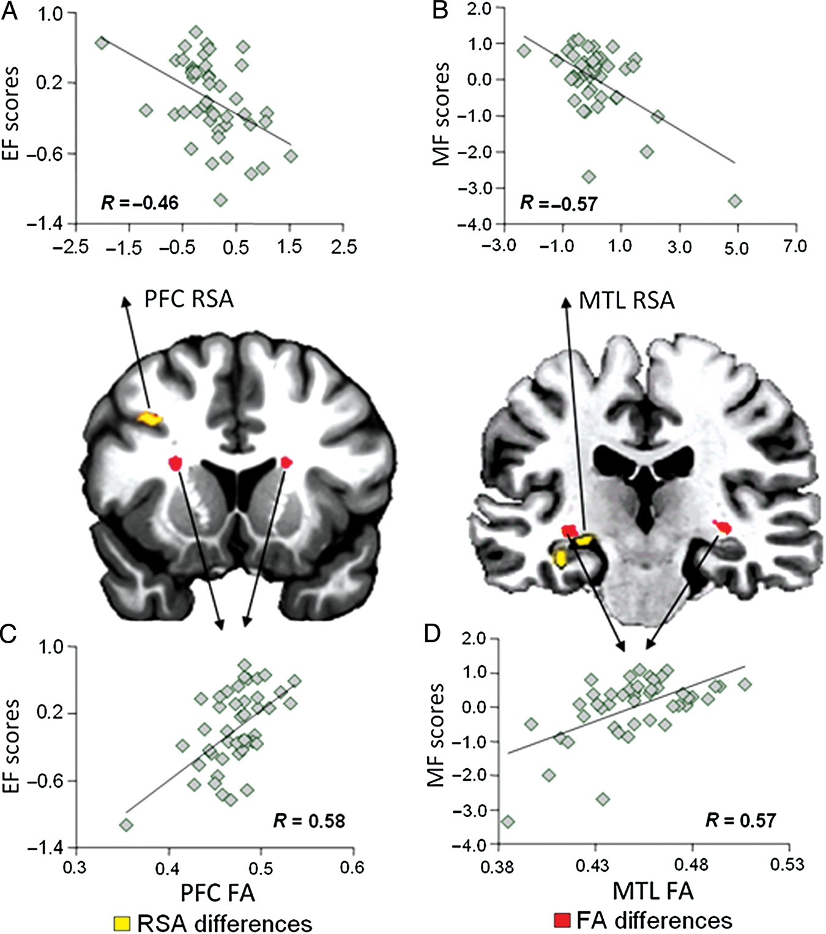
Figure 2. (A) Negative correlation between EF scores and retrieval success activity (RSA) in prefrontal cortex (PFC). ...
Notes:
Figure 2. (A) Negative correlation between EF scores and retrieval success activity (RSA) in prefrontal cortex (PFC). (B) Negative correlation between MF scores and RSA in the medial temporal lobe (MTL). (C) Positive correlation between EF scores and fractional anisotropy (FA) values in PFC. (D) Positive correlation between MF scores and FA values in MTL.
Unless provided in the caption above, the following copyright applies to the content of this slide: © The Author 2013. Published by Oxford University Press. All rights reserved. For Permissions, please e-mail: journals.permissions@oup.com

Slide 3
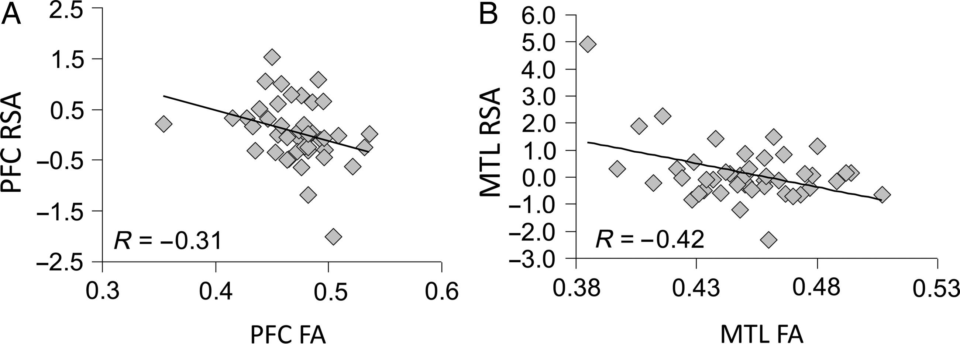
Figure 3. (A) Negative correlation between FA values and RSA in PFC. (B) Negative correlation between FA values and RSA ...
Notes:
Figure 3. (A) Negative correlation between FA values and RSA in PFC. (B) Negative correlation between FA values and RSA in MTL.
Unless provided in the caption above, the following copyright applies to the content of this slide: © The Author 2013. Published by Oxford University Press. All rights reserved. For Permissions, please e-mail: journals.permissions@oup.com

