Slide 1
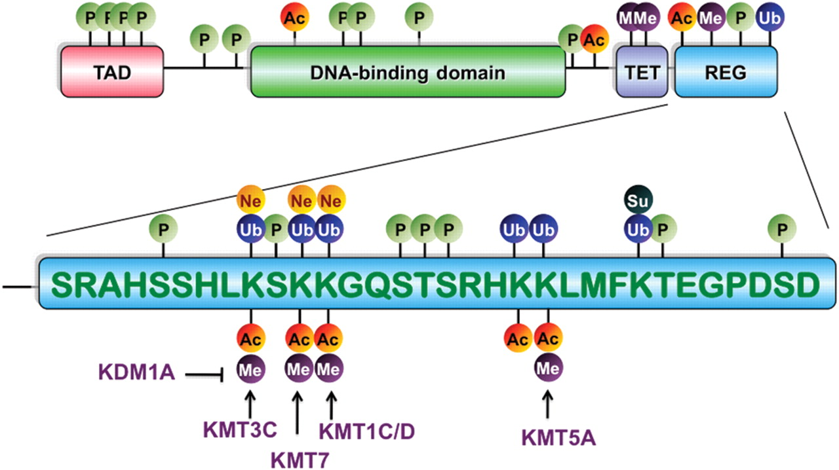
Figure 1 Schematic representation of PTMs of p53 Protein domains are shown as rectangular boxes. TAD, transactivation ...
Notes:
Figure 1 Schematic representation of PTMs of p53 Protein domains are shown as rectangular boxes. TAD, transactivation domain; TET, tetramerisation domain; REG, regulatory domain. Modifications are shown as filled circles: P, phosphorylation; Ac, acetylation; Ub, ubiquitylation; Me, methylation; Ne, neddylation; Su, sumoylation.
Unless provided in the caption above, the following copyright applies to the content of this slide: © The Author 2011. Published by ABBS Editorial Office in association with Oxford University Press on behalf of the Institute of Biochemistry and Cell Biology, Shanghai Institutes for Biological Sciences, Chinese Academy of Sciences.

