Slide 1
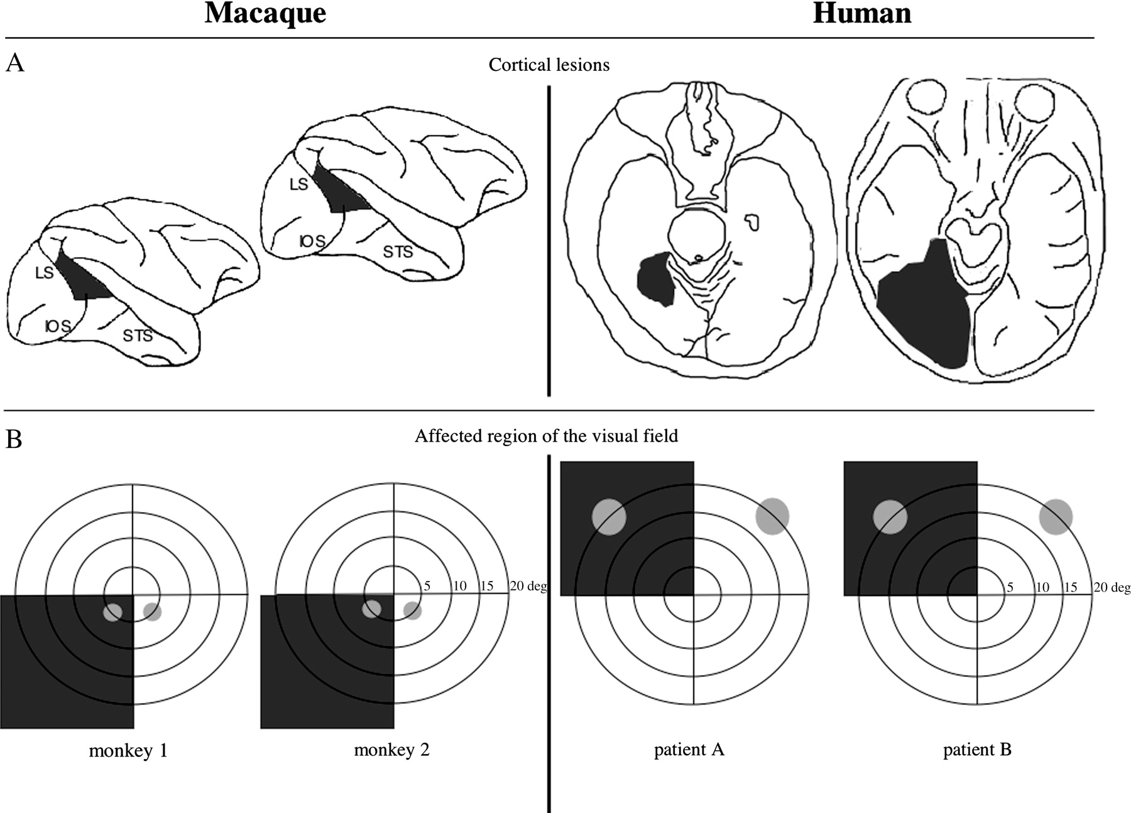
Figure 1. (A) Illustration of the locus of the extrastriate cortical lesions (black) on lateral drawings of the macaque ...
Notes:
Figure 1. (A) Illustration of the locus of the extrastriate cortical lesions (black) on lateral drawings of the macaque brain and on drawings of horizontal magnetic resonance sections through the human brain. The locations of prominent sulci of the macaque brain are indicated by abbreviations; LS, lunate sulcus; IOS, inferior occipital sulcus; STS, superior temporal sulcus. (B) Illustration of the affected quadrants of the visual field (dark gray) and the visual field locations tested in this study (light gray).
Unless provided in the caption above, the following copyright applies to the content of this slide: © The Author 2006. Published by Oxford University Press. All rights reserved. For permissions, please e-mail: journals.permissions@oxfordjournals.org

Slide 2
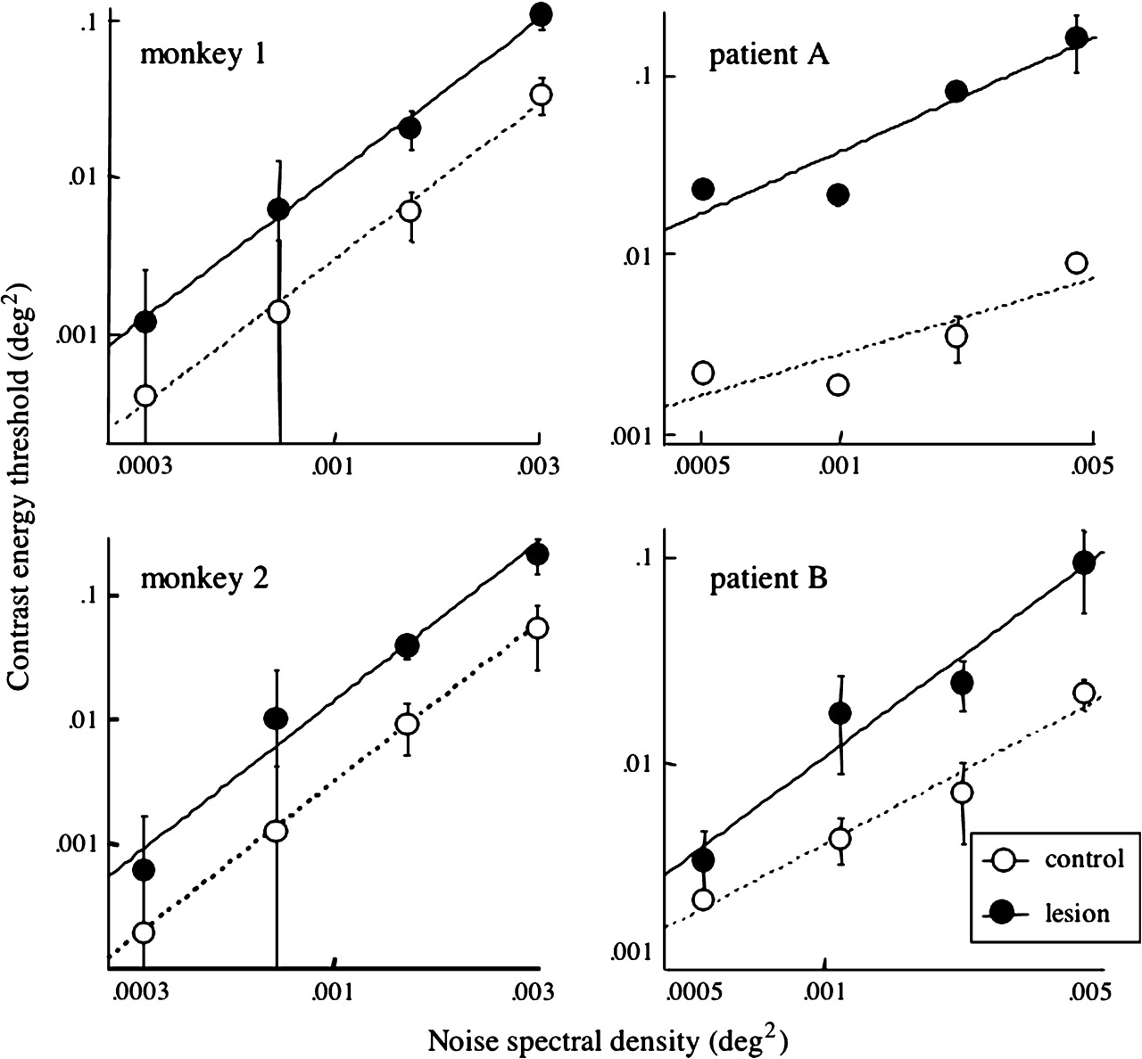
Figure 3. Noise-masked contrast energy thresholds as a function of the spectral density of the masking noise. Open ...
Notes:
Figure 3. Noise-masked contrast energy thresholds as a function of the spectral density of the masking noise. Open symbols show performance in the control visual field and filled symbols in the lesion-affected visual field (mean ± SD).
Unless provided in the caption above, the following copyright applies to the content of this slide: © The Author 2006. Published by Oxford University Press. All rights reserved. For permissions, please e-mail: journals.permissions@oxfordjournals.org

Slide 3
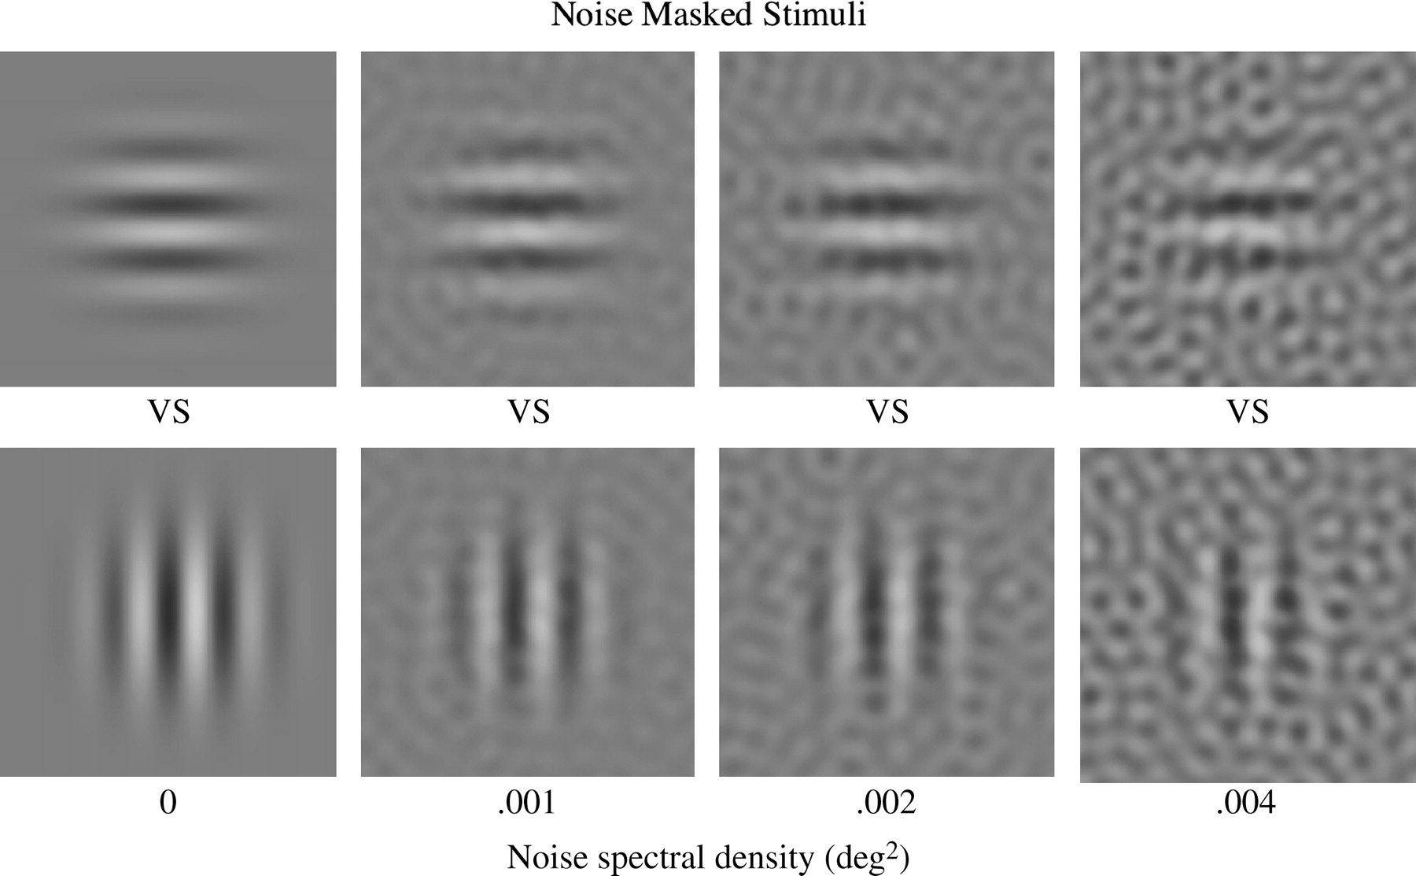
Figure 2. Examples of horizontal and vertical Gabor stimuli of 0.28 contrast added to 2D noise masks with the spectral ...
Notes:
Figure 2. Examples of horizontal and vertical Gabor stimuli of 0.28 contrast added to 2D noise masks with the spectral density illustrated below the stimuli. The spatial frequency of the stimuli was 3 cycles/degree for macaques and 1 cycles/degree for humans.
Unless provided in the caption above, the following copyright applies to the content of this slide: © The Author 2006. Published by Oxford University Press. All rights reserved. For permissions, please e-mail: journals.permissions@oxfordjournals.org

Slide 4
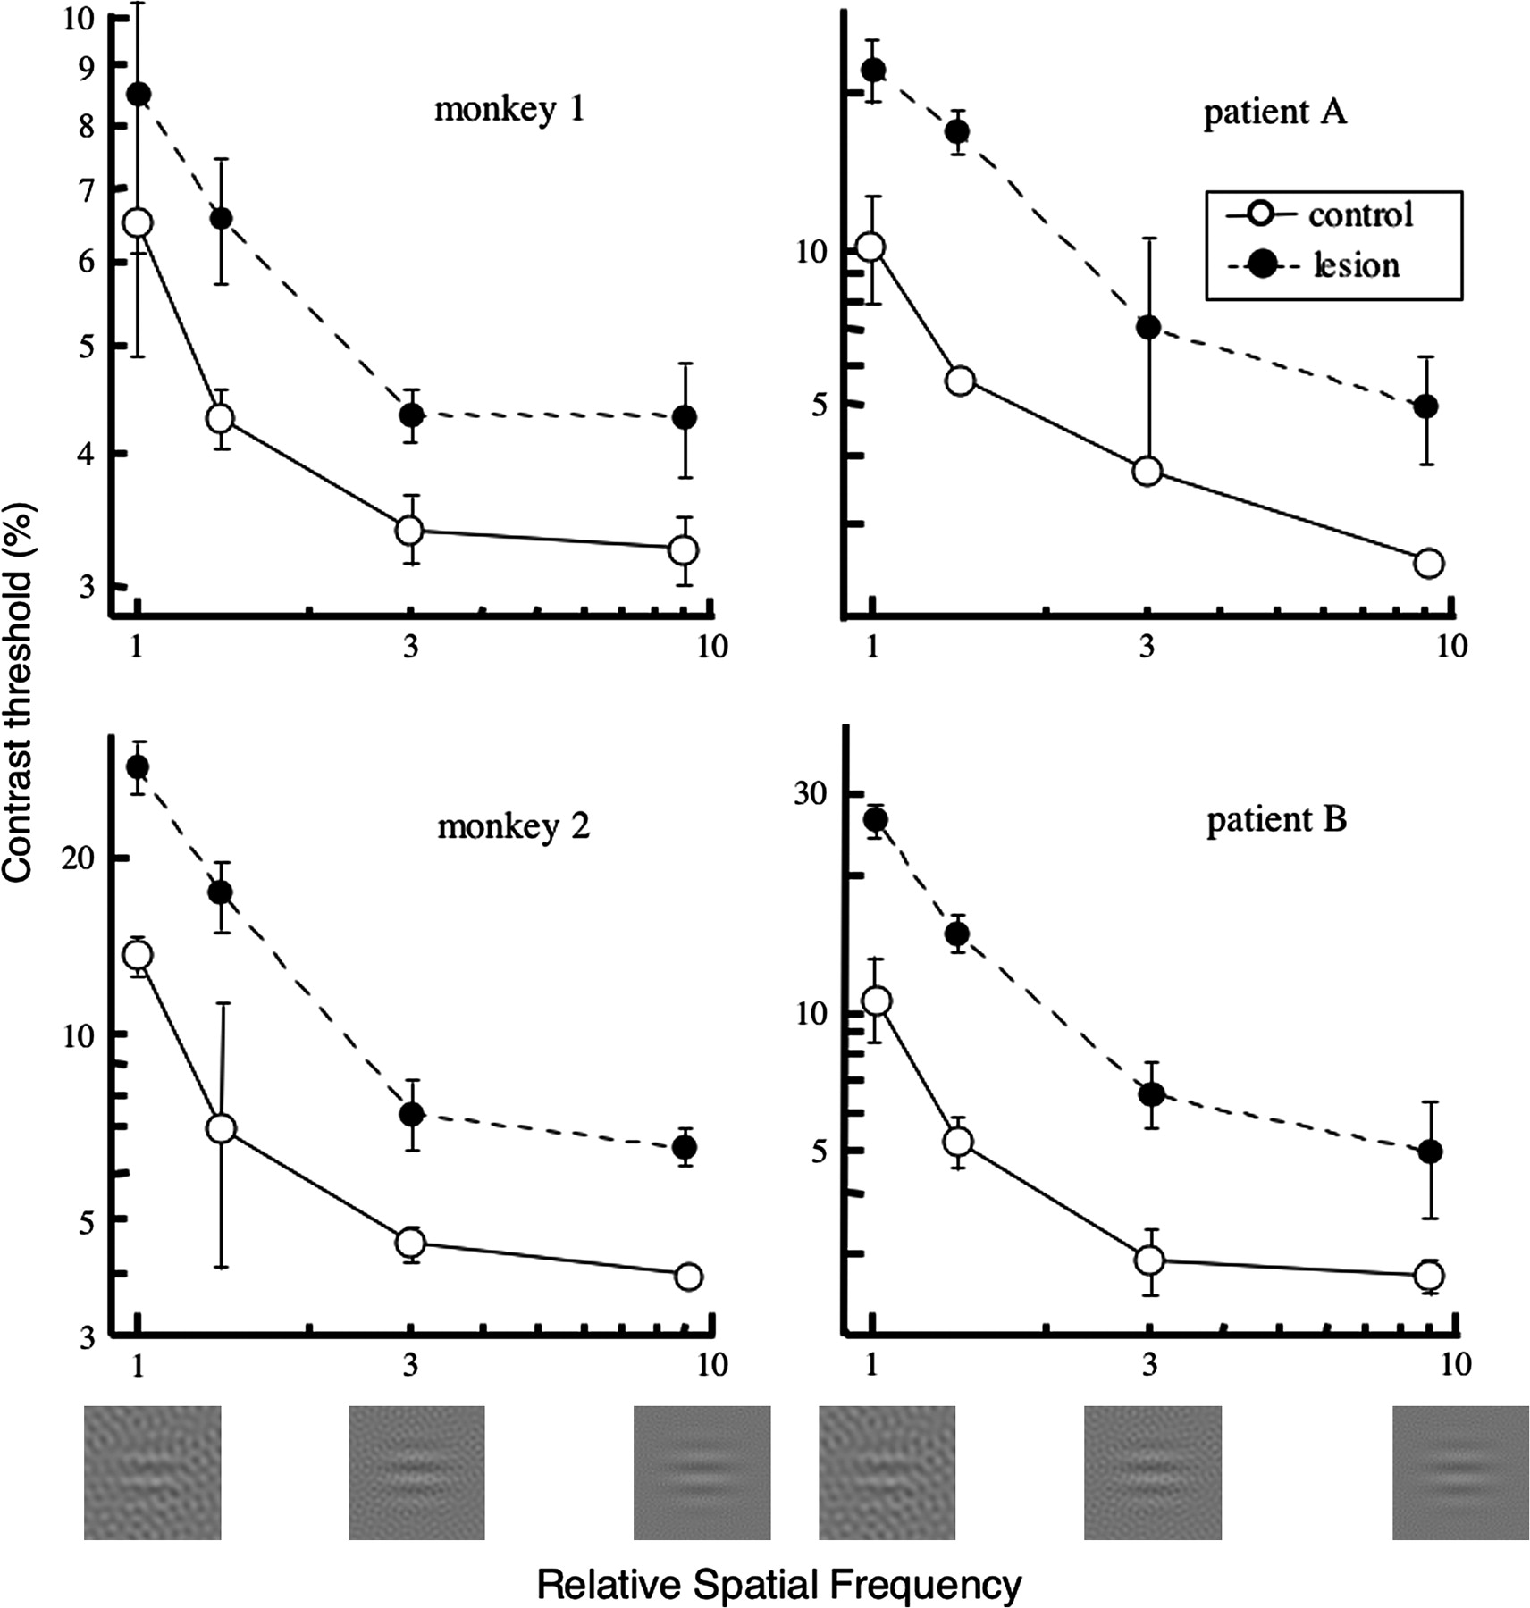
Figure 4. Contrast thresholds in control (open symbols) and lesion (filled symbols) regions of the visual field as a ...
Notes:
Figure 4. Contrast thresholds in control (open symbols) and lesion (filled symbols) regions of the visual field as a function of the spatial frequency of the masking noise. A relative spatial frequency of 1 indicates that the center spatial frequency of the 2D masking noise was the same as that of the test stimulus, whereas 9 indicates that the spatial frequency of the mask was 9-fold greater than that of the test (mean ± SD).
Unless provided in the caption above, the following copyright applies to the content of this slide: © The Author 2006. Published by Oxford University Press. All rights reserved. For permissions, please e-mail: journals.permissions@oxfordjournals.org

Slide 5
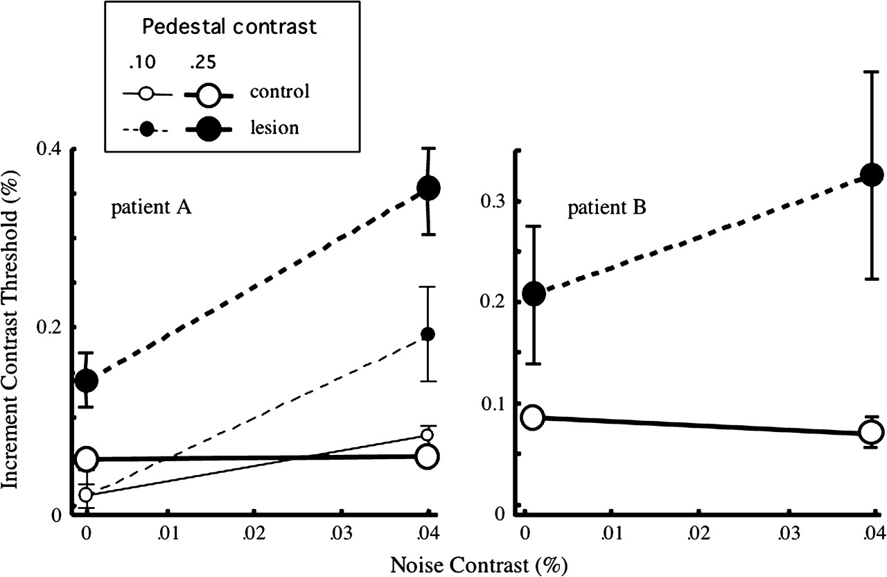
Figure 5. Contrast increment thresholds of the 2 human subjects as a function of the contrast of the masking noise. ...
Notes:
Figure 5. Contrast increment thresholds of the 2 human subjects as a function of the contrast of the masking noise. Results are shown for pedestal contrasts of 0.25 for both subjects, as well as 0.1 for patient A.
Unless provided in the caption above, the following copyright applies to the content of this slide: © The Author 2006. Published by Oxford University Press. All rights reserved. For permissions, please e-mail: journals.permissions@oxfordjournals.org

Slide 6
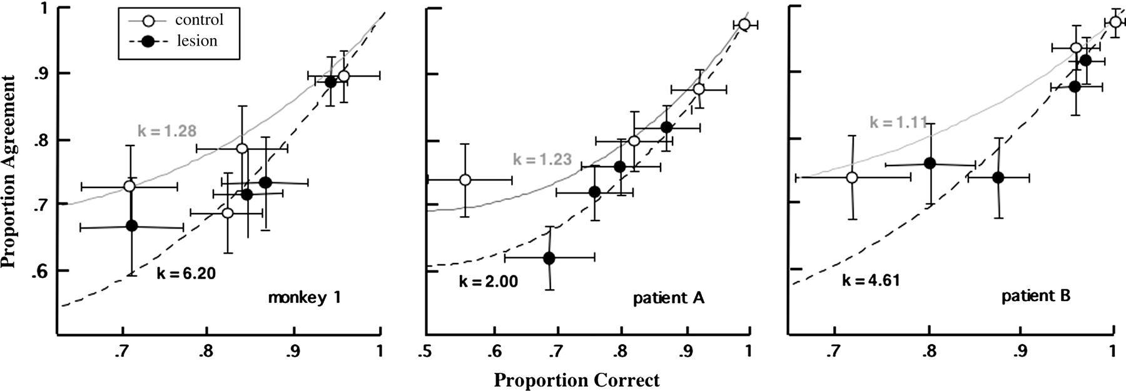
Figure 6. Proportion agreement (consistency) on successive testing of an identical series of stimuli as a function of ...
Notes:
Figure 6. Proportion agreement (consistency) on successive testing of an identical series of stimuli as a function of the proportion correct. The error bars show SDs calculated using a resampling procedure. The lines are fits of equation (1) (Appendix), showing how accuracy and consistency trade off at a fixed level of internal noise. The larger k measured in the lesioned visual field corresponds to greater variability.
Unless provided in the caption above, the following copyright applies to the content of this slide: © The Author 2006. Published by Oxford University Press. All rights reserved. For permissions, please e-mail: journals.permissions@oxfordjournals.org

Slide 7
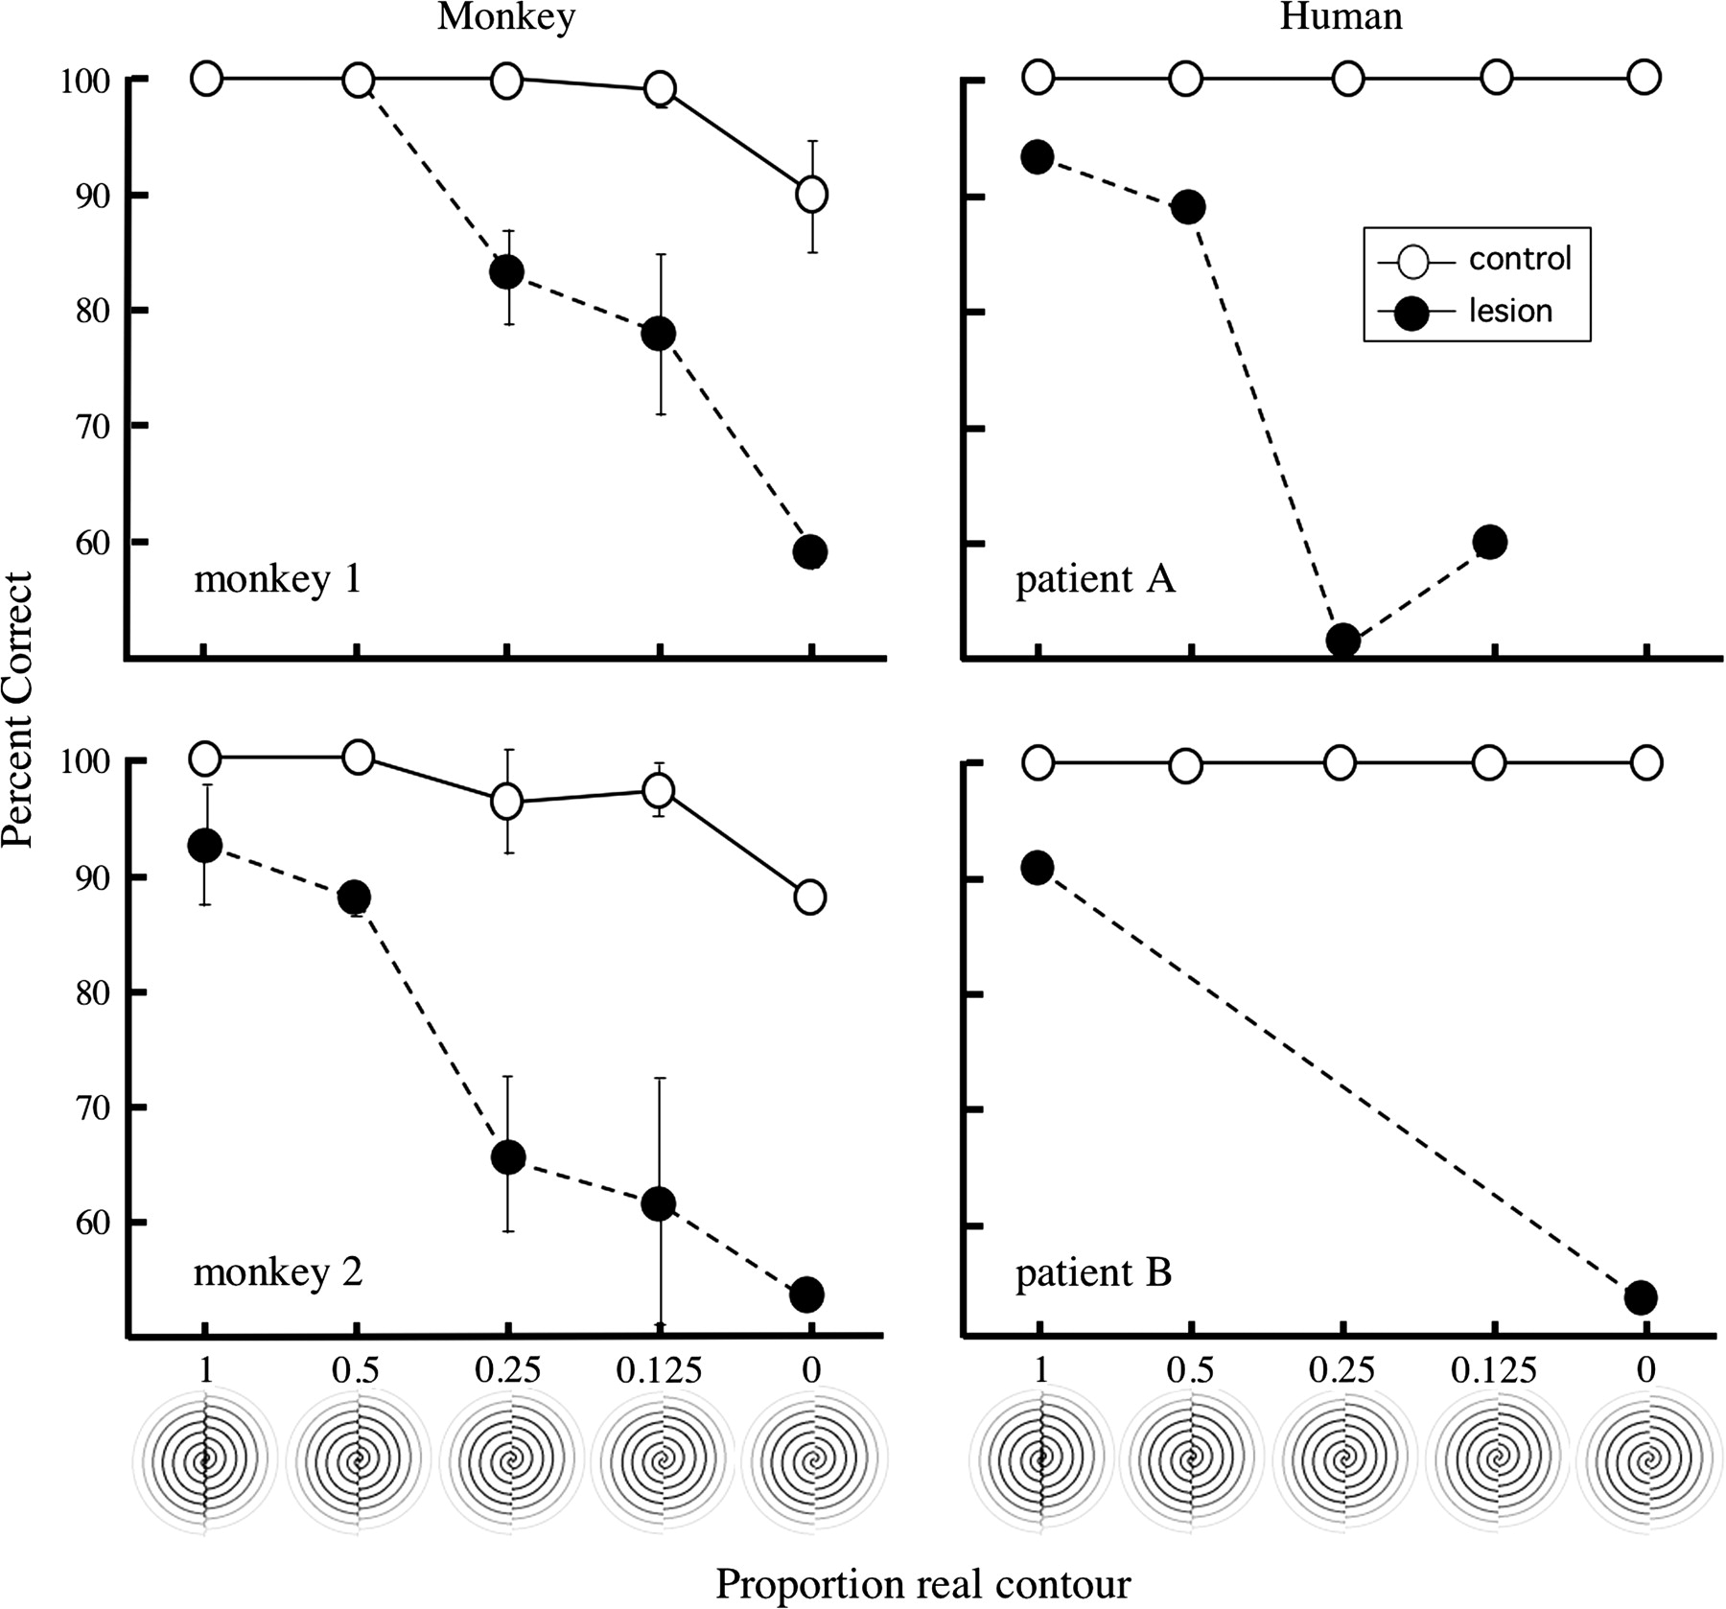
Figure 7. Percent correct performance of macaque and human subjects in discriminating the orientation of the real ...
Notes:
Figure 7. Percent correct performance of macaque and human subjects in discriminating the orientation of the real (abscissa values = 1–0.125) or illusory (abscissa value = 0) contour stimuli illustrated below the figure. Performance is shown for the control field (open symbols) and lesion-affected field (filled symbols).
Unless provided in the caption above, the following copyright applies to the content of this slide: © The Author 2006. Published by Oxford University Press. All rights reserved. For permissions, please e-mail: journals.permissions@oxfordjournals.org

Slide 8
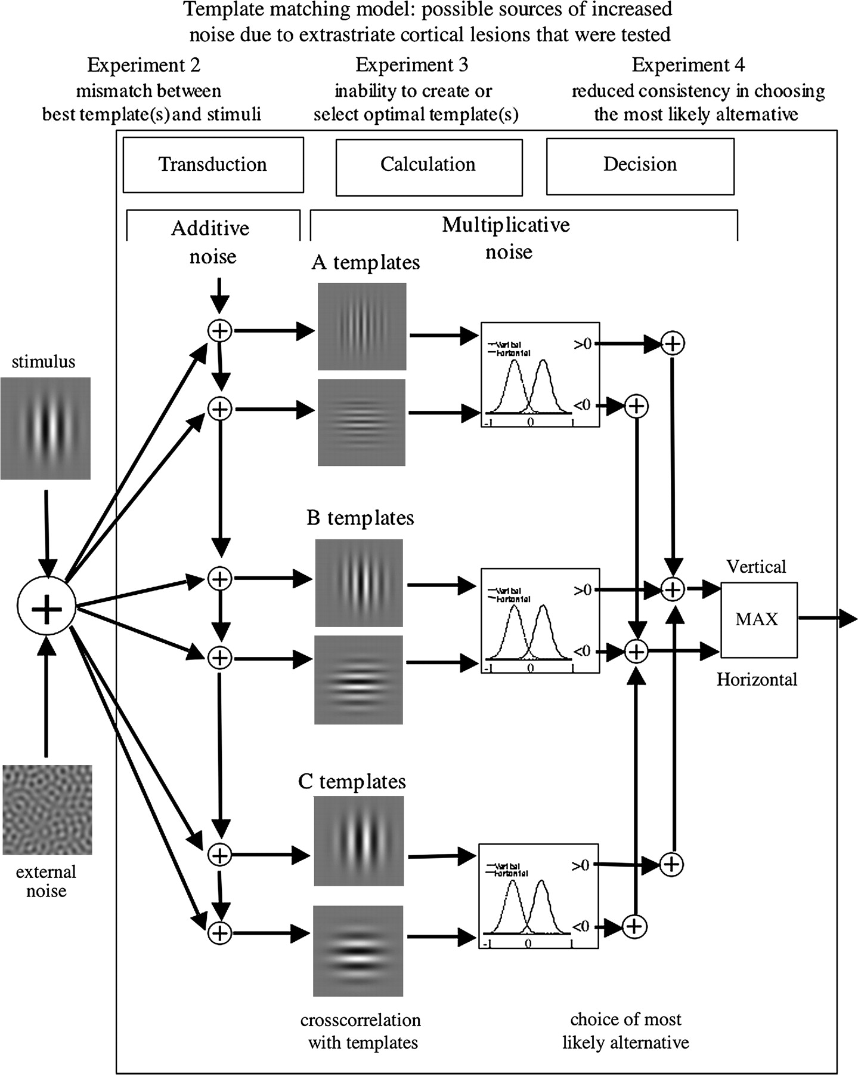
Figure 8. Mechanisms, investigated in this study, by which calculation efficiency might be reduced by extrastriate ...
Notes:
Figure 8. Mechanisms, investigated in this study, by which calculation efficiency might be reduced by extrastriate lesions. The figure illustrates a template-matching model for discrimination of the orientation of Gabor patches of grating. Each test stimulus (left) consists of a Gabor patch plus external noise. Additive noise is introduced to the model before template matching. The test stimuli are then compared (by cross-correlation) with vertical and horizontal pairs of stimulus templates (in this case illustrated by templates of different spatial frequency). Finally, the observer makes a decision about which orientation was most likely, given the neural evidence.
Unless provided in the caption above, the following copyright applies to the content of this slide: © The Author 2006. Published by Oxford University Press. All rights reserved. For permissions, please e-mail: journals.permissions@oxfordjournals.org

