Slide 1
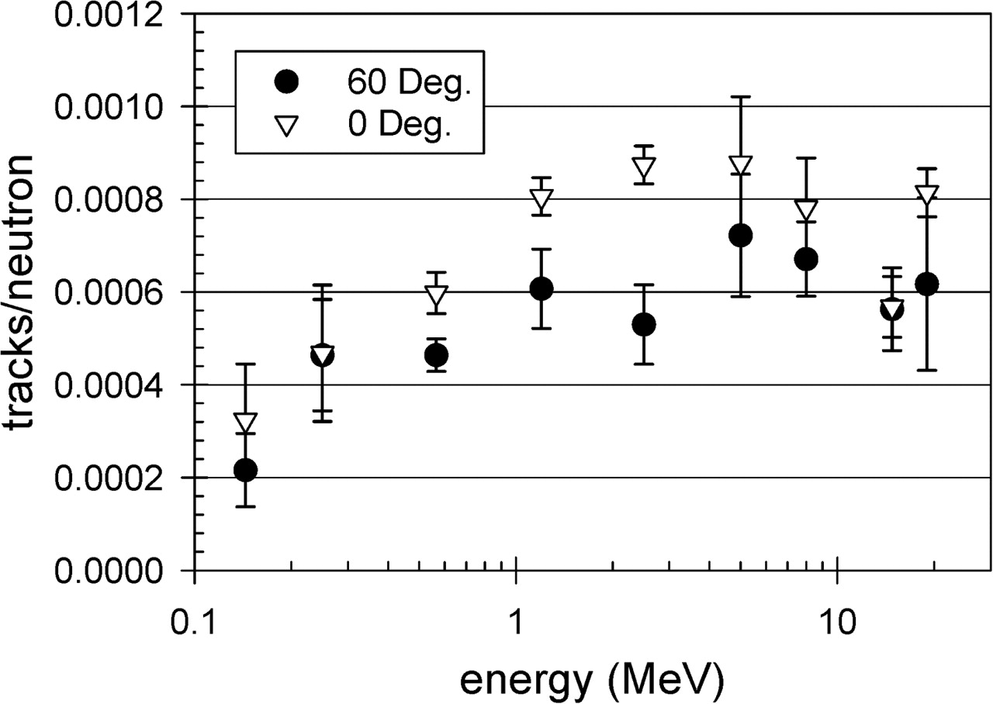
Figure 1. CR-39 efficiencies as a function of neutron energy averaged over foils with their faces oriented at 60° and ...
Notes:
Figure 1. CR-39 efficiencies as a function of neutron energy averaged over foils with their faces oriented at 60° and at 0° normal to the beam. The mean 60° to 0° efficiency ratio over all energies is 0.80 ± 0.04. The error bars indicate the standard deviations in the measurements for foils of the same energy and orientation.
Unless provided in the caption above, the following copyright applies to the content of this slide: Published by Oxford University Press (2006)

Slide 2
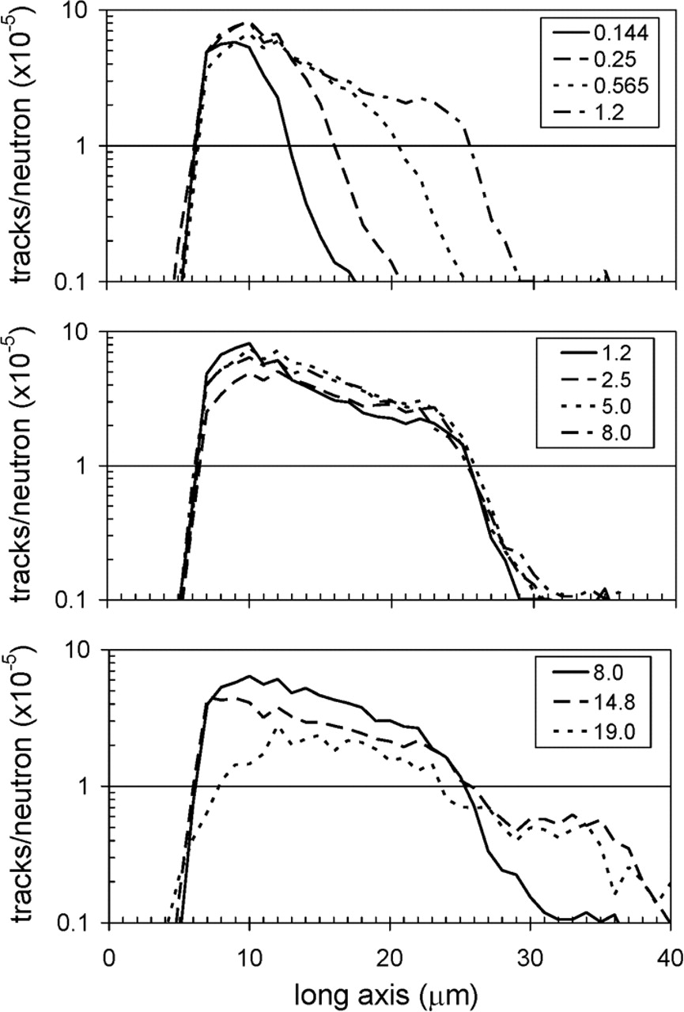
Figure 2. CR-39 track-size distributions for monoenergetic neutrons with energies ranging from 0.144 to 1.2 MeV (upper ...
Notes:
Figure 2. CR-39 track-size distributions for monoenergetic neutrons with energies ranging from 0.144 to 1.2 MeV (upper panel), from 1.2 to 8.0 MeV (middle panel) and from 8.0 to 19.0 MeV (lower panel).
Unless provided in the caption above, the following copyright applies to the content of this slide: Published by Oxford University Press (2006)

Slide 3
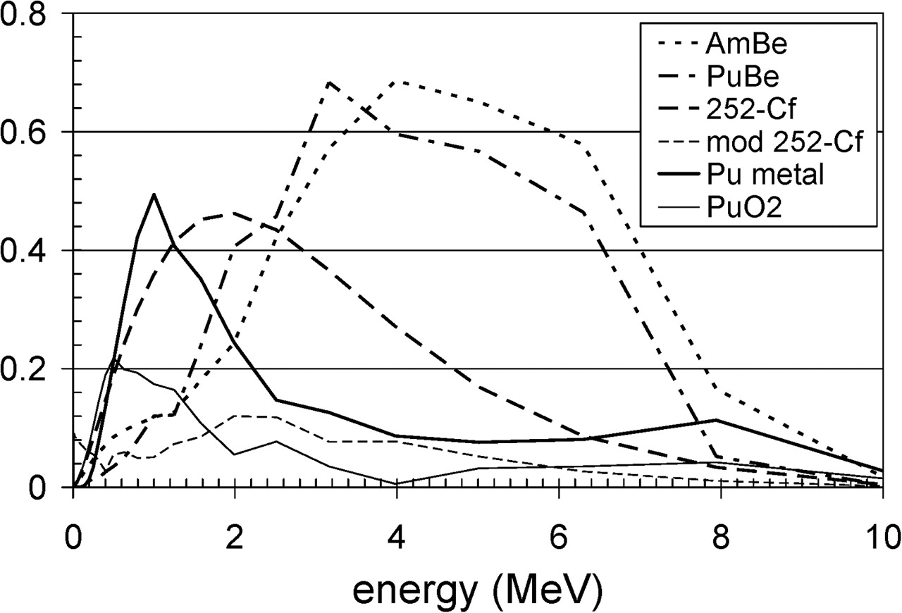
Figure 3. IAEA reference neutron source spectra.
Notes:
Figure 3. IAEA reference neutron source spectra.
Unless provided in the caption above, the following copyright applies to the content of this slide: Published by Oxford University Press (2006)

Slide 4
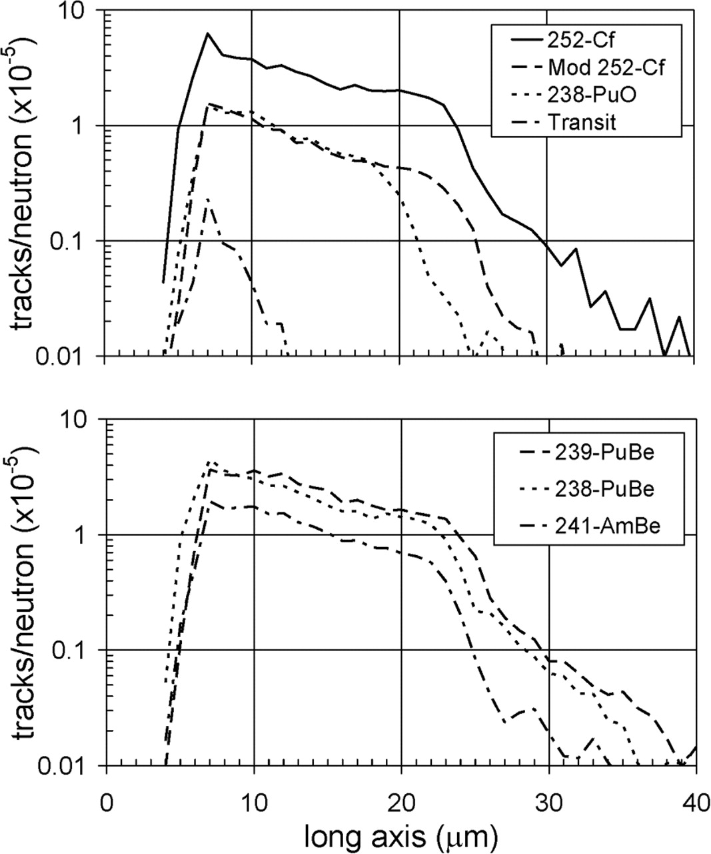
Figure 4. CR-39 track-size distributions for broad-spectrum fission neutron sources ²⁵²Cf, ...
Notes:
Figure 4. CR-39 track-size distributions for broad-spectrum fission neutron sources 252Cf, D2O-moderated 252Cf, 238PuO and a transit foil (upper panel) and for alpha-beryllium neutron sources 239PuBe, 238PuBe and 241AmBe (lower panel).
Unless provided in the caption above, the following copyright applies to the content of this slide: Published by Oxford University Press (2006)

Slide 5
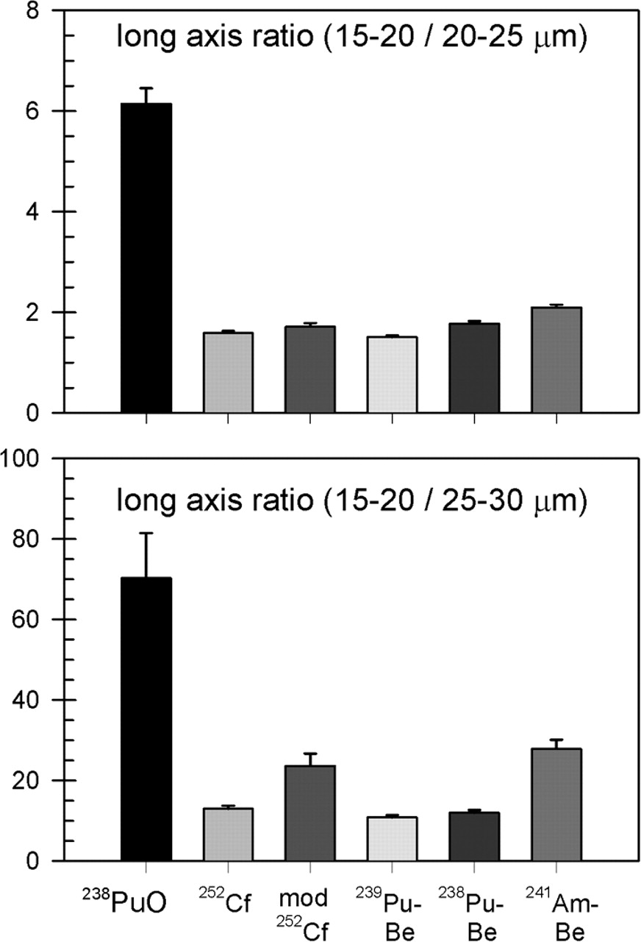
Figure 5. Ratios of CR-39 track-size distributions between 15 and 20 μm to those between 20 and 25 μm (upper panel) and ...
Notes:
Figure 5. Ratios of CR-39 track-size distributions between 15 and 20 μm to those between 20 and 25 μm (upper panel) and of distributions between 15 and 20 μm to those between 25 and 30 μm (lower panel). The error bars indicate the standard errors in the data.
Unless provided in the caption above, the following copyright applies to the content of this slide: Published by Oxford University Press (2006)

