Slide 1
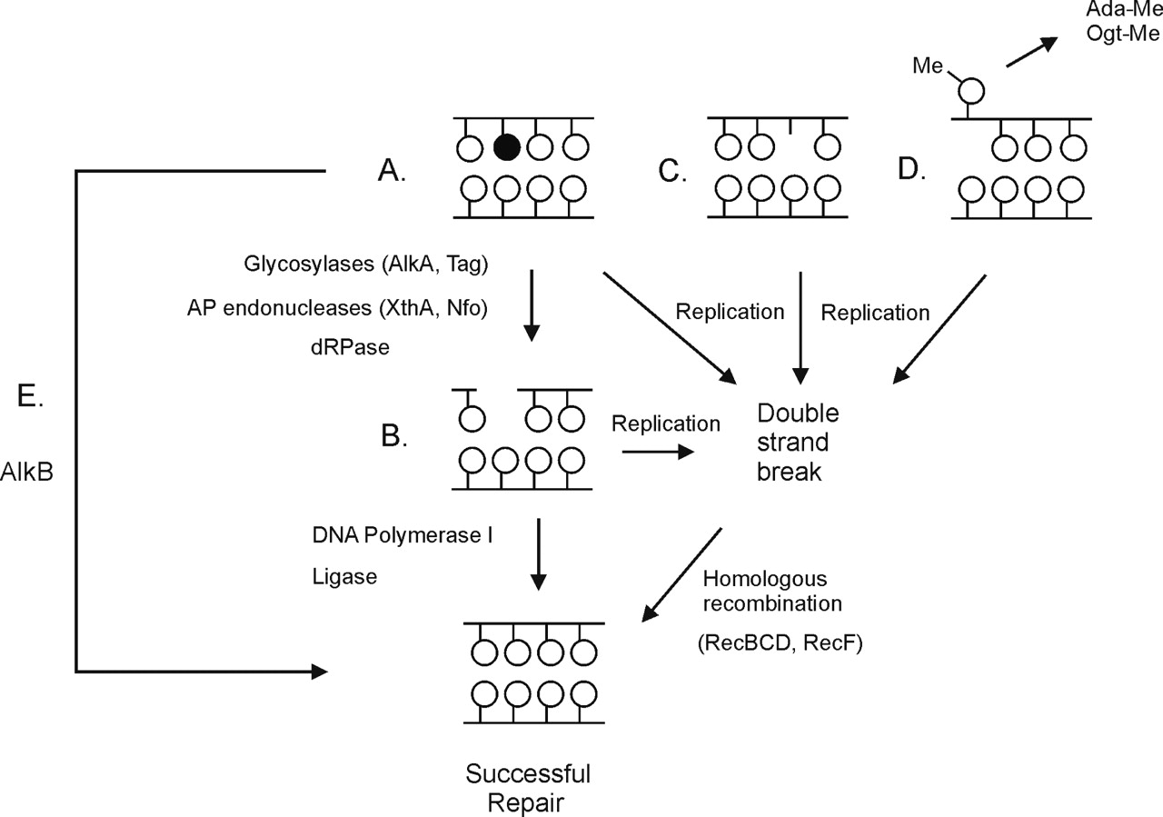
Figure 1 Methylation damage and repair pathways. (A) Replication-blocking lesions (filled circle) may provoke DSB ...
Notes:
Figure 1 Methylation damage and repair pathways. (A) Replication-blocking lesions (filled circle) may provoke DSB formation by replication fork breakdown or stalling. AlkA and Tag glycosylases remove methylated bases (filled circle) and the resulting abasic site is recognized and cleaved by the AP endonucleases XthA or Nfo, followed by repair, replication and ligation to restore the integrity of DNA. Replication through the nicked substrate, (B) results in replication fork collapse and DSB formation. (C) Depurination of methylated bases results in the formation of abasic sites which are replication-blocking lesions and may lead to replication fork stalling or breakdown and DSB formation. (D) Ada and Ogt methyltransferases remove methyl groups from oxygen residues on flipped out bases. If not repaired, O-methylated bases can block replication forks to form structures acted upon by RecBCD. (E) AlkB directly removes methyl groups from N1-methyladenine and N3-methylcytosine by oxidative demethylation. DSBs are repaired by the two major homologous recombination repair pathways, RecBCD and RecF. The RecF pathway includes RecF, RecJ, RecN, RecO, RecQ and RecR. Both pathways utilize RecA, RuvA, RuvB, RuvC and RecG.
Unless provided in the caption above, the following copyright applies to the content of this slide: © The Author 2006. Published by Oxford University Press. All rights reserved The online version of this article has been published under an open access model. Users are entitled to use, reproduce, disseminate, or display the open access version of this article for non-commercial purposes provided that: the original authorship is properly and fully attributed; the Journal and Oxford University Press are attributed as the original place of publication with the correct citation details given; if an article is subsequently reproduced or disseminated not in its entirety but only in part or as a derivative work this must be clearly indicated. For commercial re-use, please contact journals.permissions@oxfordjournals.org

Slide 2
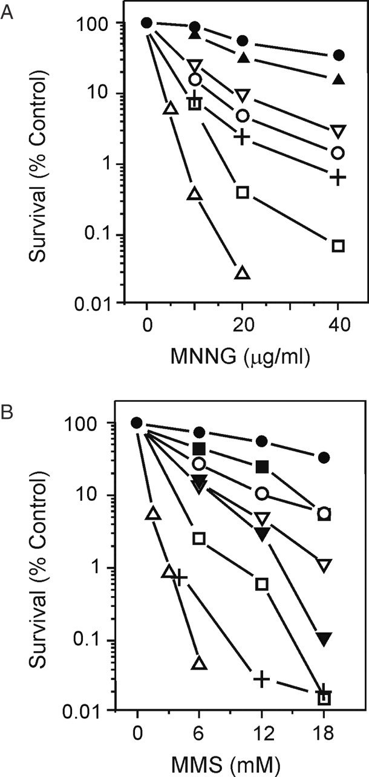
Figure 2 Survival of the wild-type and mutant strains to (A) MNNG and (B) MMS. (A) Wild-type, alkA, alkB and tag, ...
Notes:
Figure 2 Survival of the wild-type and mutant strains to (A) MNNG and (B) MMS. (A) Wild-type, alkA, alkB and tag, closed circles; alkB recF, alkB recBCD, closed triangles; alkA tag and alkA recBCD, open squares; recBCD, open circles; recBCD tag, inverted open triangles; alkA tag recBCD, right-side up open triangles; alkA tag recF, crosses. (B) Wild-type, tag, alkB, closed circles; alkA, closed squares; alkA tag, alkB recF, open squares; recBCD, alkB recBCD, open circles; alkA recBCD, inverted closed triangles; other symbols as for (A).
Unless provided in the caption above, the following copyright applies to the content of this slide: © The Author 2006. Published by Oxford University Press. All rights reserved The online version of this article has been published under an open access model. Users are entitled to use, reproduce, disseminate, or display the open access version of this article for non-commercial purposes provided that: the original authorship is properly and fully attributed; the Journal and Oxford University Press are attributed as the original place of publication with the correct citation details given; if an article is subsequently reproduced or disseminated not in its entirety but only in part or as a derivative work this must be clearly indicated. For commercial re-use, please contact journals.permissions@oxfordjournals.org

Slide 3
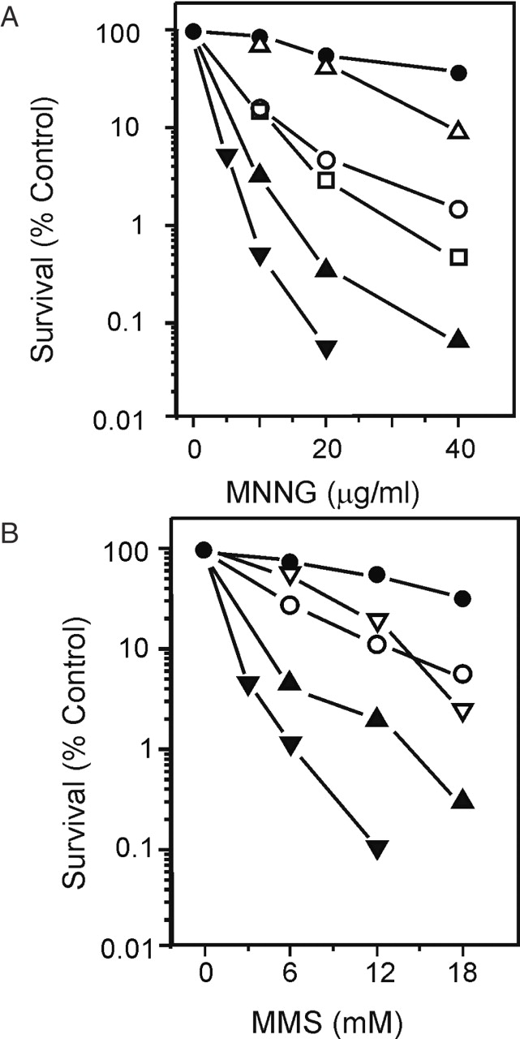
Figure 3 Survival of the wild-type and mutant strains to (A) MNNG and (B) MMS. (A) Wildtype, ogt, closed circles; ada, ...
Notes:
Figure 3 Survival of the wild-type and mutant strains to (A) MNNG and (B) MMS. (A) Wildtype, ogt, closed circles; ada, right-side up open triangles; recBCD, open circles; ada ogt, ada ogt recF, ada tag open squares; ada ogt recBCD, right-side up closed triangles; ada tag recBCD, inverted closed triangles. (B) Wild-type, ada, ogt, ada ogt, closed circles; ada ogt recF, ada ogt recBCD, right side up closed triangles; ada tag, upside down open triangles; other symbols as for (A).
Unless provided in the caption above, the following copyright applies to the content of this slide: © The Author 2006. Published by Oxford University Press. All rights reserved The online version of this article has been published under an open access model. Users are entitled to use, reproduce, disseminate, or display the open access version of this article for non-commercial purposes provided that: the original authorship is properly and fully attributed; the Journal and Oxford University Press are attributed as the original place of publication with the correct citation details given; if an article is subsequently reproduced or disseminated not in its entirety but only in part or as a derivative work this must be clearly indicated. For commercial re-use, please contact journals.permissions@oxfordjournals.org

Slide 4
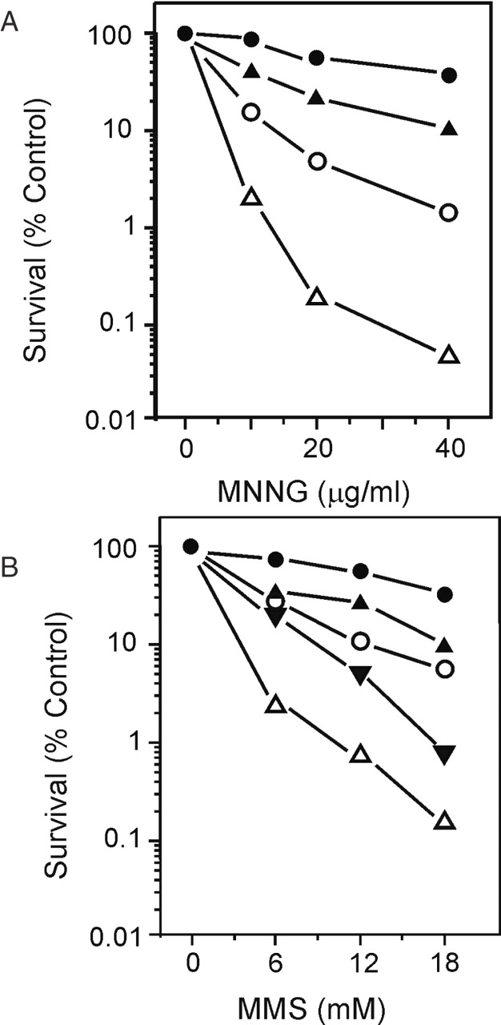
Figure 4 Survival of the wild-type and mutant strains to (A) MNNG and (B) MMS. (A) Wild-type, recD, recN, recJ, recQ, ...
Notes:
Figure 4 Survival of the wild-type and mutant strains to (A) MNNG and (B) MMS. (A) Wild-type, recD, recN, recJ, recQ, closed circles; recBCD, open circles; recF, recO, recR, right-side up closed triangles; recN recBCD, recQ recBCD, recF recBCD, right-side up open triangles. (B) Wild-type, recN, recQ, recJ, recD, closed circles; recBCD, open circles; recF, recO, right-side up closed triangles; recN recBCD, recQ recBCD, upside down closed triangles; recF recBCD, right-side up open triangles.
Unless provided in the caption above, the following copyright applies to the content of this slide: © The Author 2006. Published by Oxford University Press. All rights reserved The online version of this article has been published under an open access model. Users are entitled to use, reproduce, disseminate, or display the open access version of this article for non-commercial purposes provided that: the original authorship is properly and fully attributed; the Journal and Oxford University Press are attributed as the original place of publication with the correct citation details given; if an article is subsequently reproduced or disseminated not in its entirety but only in part or as a derivative work this must be clearly indicated. For commercial re-use, please contact journals.permissions@oxfordjournals.org

Slide 5
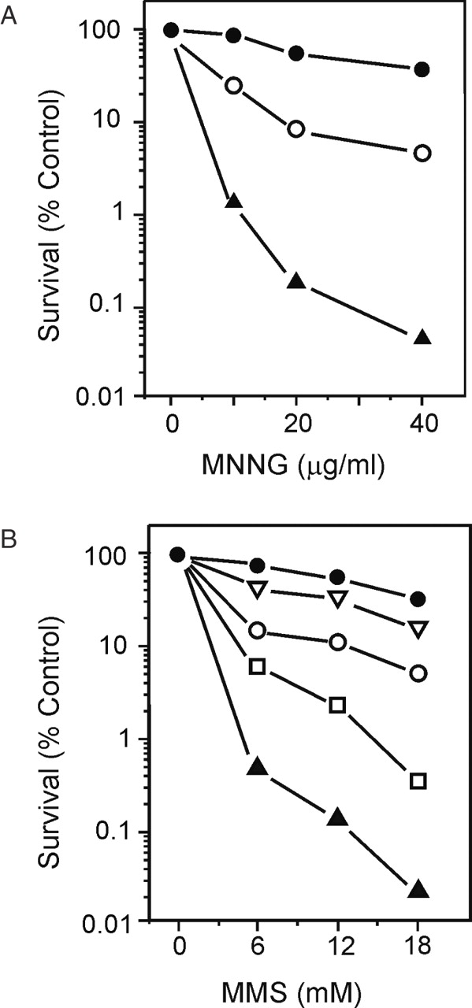
Figure 5 Survival of the wild-type and mutant strains to (A) MNNG and (B) MMS. (A) Wild-type, closed circles; ruvABC, ...
Notes:
Figure 5 Survival of the wild-type and mutant strains to (A) MNNG and (B) MMS. (A) Wild-type, closed circles; ruvABC, recG, ruvC, open circles; ruvC recG, recA, right-side up closed triangles. (B) recA, open squares, ruvC, upside down open triangles. Other symbols as for (A).
Unless provided in the caption above, the following copyright applies to the content of this slide: © The Author 2006. Published by Oxford University Press. All rights reserved The online version of this article has been published under an open access model. Users are entitled to use, reproduce, disseminate, or display the open access version of this article for non-commercial purposes provided that: the original authorship is properly and fully attributed; the Journal and Oxford University Press are attributed as the original place of publication with the correct citation details given; if an article is subsequently reproduced or disseminated not in its entirety but only in part or as a derivative work this must be clearly indicated. For commercial re-use, please contact journals.permissions@oxfordjournals.org

Slide 6
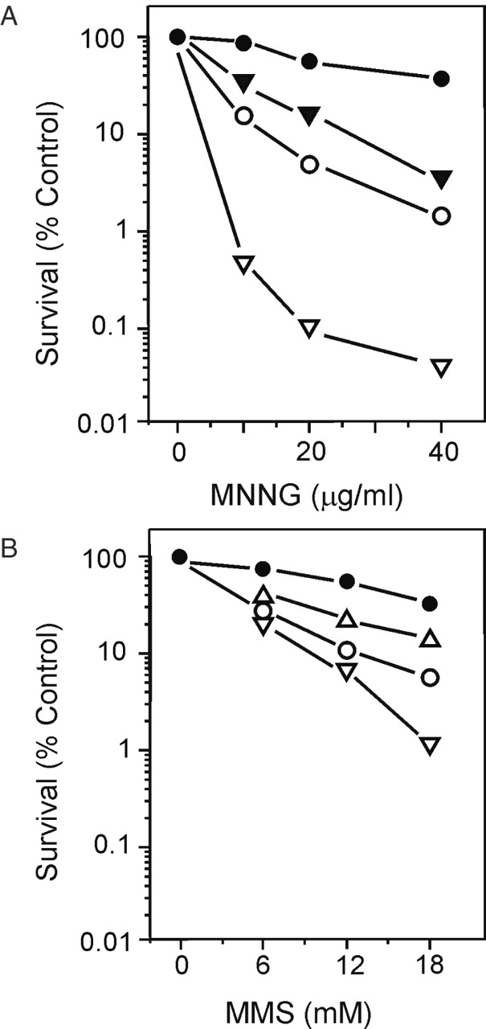
Figure 6 Survival of the wild-type and mutant strains to (A) MNNG and (B) MMS. (A) Wild-type, lexA3, uvrA, uvrD, sfiA, ...
Notes:
Figure 6 Survival of the wild-type and mutant strains to (A) MNNG and (B) MMS. (A) Wild-type, lexA3, uvrA, uvrD, sfiA, closed circles; recBCD, open circles; sfiA priA, upside down open triangles. (B) Wild-type, uvrA, uvrD, closed circles; lexA3, right side up open triangles; recBCD, open circles; sfi priA, upside down open triangles.
Unless provided in the caption above, the following copyright applies to the content of this slide: © The Author 2006. Published by Oxford University Press. All rights reserved The online version of this article has been published under an open access model. Users are entitled to use, reproduce, disseminate, or display the open access version of this article for non-commercial purposes provided that: the original authorship is properly and fully attributed; the Journal and Oxford University Press are attributed as the original place of publication with the correct citation details given; if an article is subsequently reproduced or disseminated not in its entirety but only in part or as a derivative work this must be clearly indicated. For commercial re-use, please contact journals.permissions@oxfordjournals.org

Slide 7
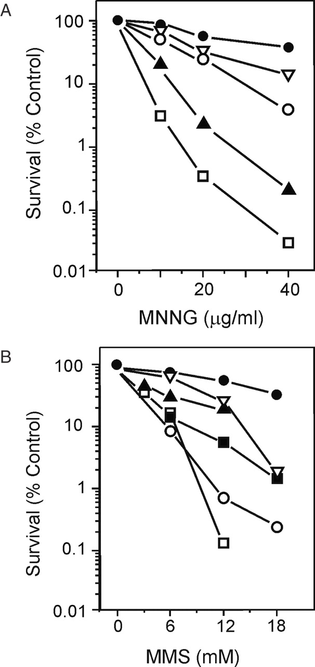
Figure 7 Survival of the wildtype and mutant strains to (A) MNNG and (B) MMS. (A) Wild-type, xth, nfo, ...
Notes:
Figure 7 Survival of the wildtype and mutant strains to (A) MNNG and (B) MMS. (A) Wild-type, xth, nfo, polA/F′polA+, closed circles; polA, open squares; polA/F′ Klenow fragment, polA/5′-3′ exo, right-side up closed triangles; xthA nfo, upside down open triangles; xth nfo recF, open circles. (B) Wild-type, xth, nfo, polA/F′polA+, closed circles; polA, open squares; polA/F′ Klenow fragment, right-side up closed triangles; polA/5′-3′ exo, solid squares; xthA nfo, upside down open triangles; xthA nfo recF, open circles.
Unless provided in the caption above, the following copyright applies to the content of this slide: © The Author 2006. Published by Oxford University Press. All rights reserved The online version of this article has been published under an open access model. Users are entitled to use, reproduce, disseminate, or display the open access version of this article for non-commercial purposes provided that: the original authorship is properly and fully attributed; the Journal and Oxford University Press are attributed as the original place of publication with the correct citation details given; if an article is subsequently reproduced or disseminated not in its entirety but only in part or as a derivative work this must be clearly indicated. For commercial re-use, please contact journals.permissions@oxfordjournals.org

