Slide 1
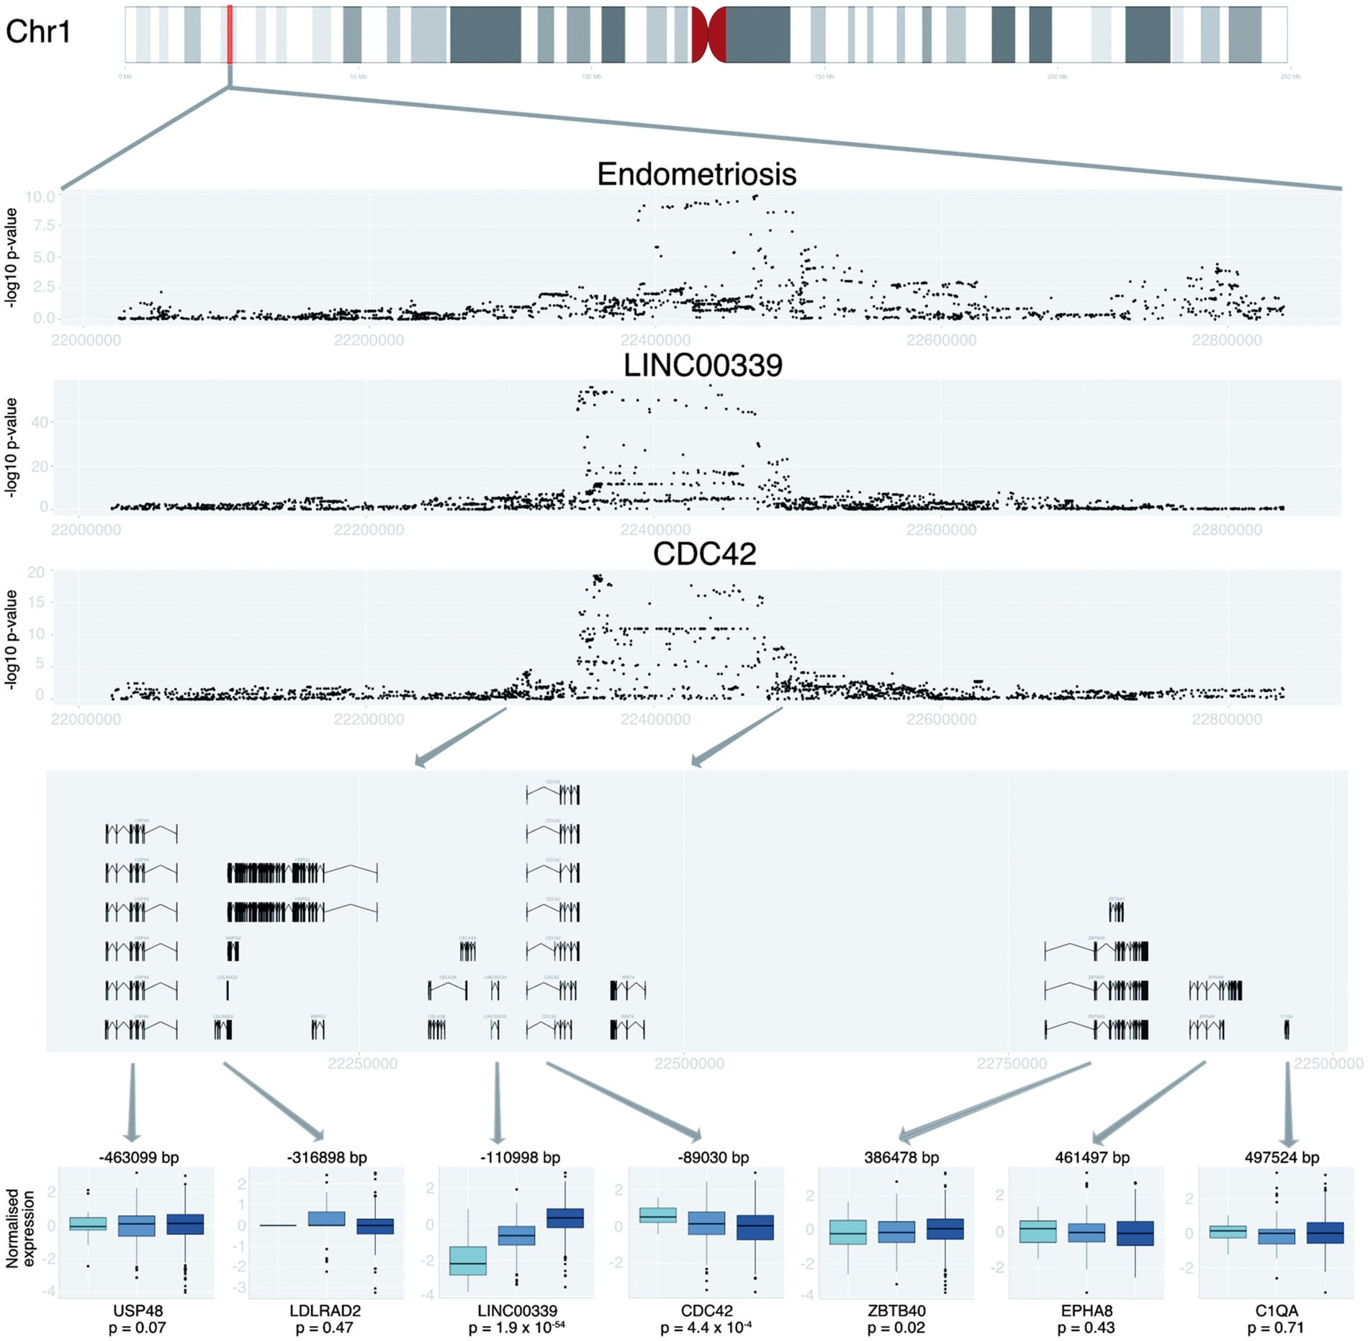
Figure 1. SNPs within the 1p36.12 region are associated with both endometriosis risk, and the expression levels of ...
Notes:
Figure 1. SNPs within the 1p36.12 region are associated with both endometriosis risk, and the expression levels of LINC00339 and CDC42. Association results for individual SNPs are plotted by position on chromosome 1 (X-axis) as –log10 p-values (Y-axis) for endometriosis risk (first panel), LINC00339 (second panel) and CDC42 (third panel) expression in the BSGS. The relative locations of genes within the 1p36.12 regions are shown in panel 4. The fifth panel shows the relationship between rs3820282 genotypes and transcript expression levels in BSGS for seven genes in the 1p36.12 region. Endometriosis association information for common SNPs with the key SNP (rs3820282) and significant association with endometriosis risk (P < 5 × 10−3). Fine mapping results were from 7,090 individuals (2,594 cases and 4,496 controls) in the combined Australian dataset SNPsPosition(hg19)LD with rs3820282 (r2)RAOARAF#caseRAF#controlOR*Prs3820282224682151AG0.1890.1621.244(1.126–1.375)1.84 × 10−5rs56318008224704070.95TC0.1860.1591.243(1.125–1.374)2.06 × 10−5rs55938609224704510.95CG0.1860.1591.240(1.121–1.372)2.88 × 10−5rs12037376224621110.90AG0.1930.1671.229(1.113–1.356)4.24 × 10−5rs2235529224504870.84AG0.1880.1611.216(1.107–1.335)4.61 × 10−5rs12404660224587940.79GA0.2220.1951.216(1.107–1.336)4.71 × 10−5rs7412010224364460.90CG0.1960.1701.211(1.100–1.333)9.71 × 10−5rs7515106224734100.61CT0.2400.2131.174(1.077–1.280)2.66 × 10−4rs2473295223548660.05GA0.7710.7481.156(1.058–1.263)1.39 × 10−3rs760923223572170.05TG0.7700.7481.154(1.057–1.261)1.44 × 10−3rs7521902224907240.61AC0.2640.2401.138(1.048–1.236)2.08 × 10−3#Risk allele frequency. *Odd ratios were calculated for the risk allele.
Unless provided in the caption above, the following copyright applies to the content of this slide: © The Author 2016. Published by Oxford University Press. All rights reserved. For Permissions, please email: journals.permissions@oup.com

Slide 2
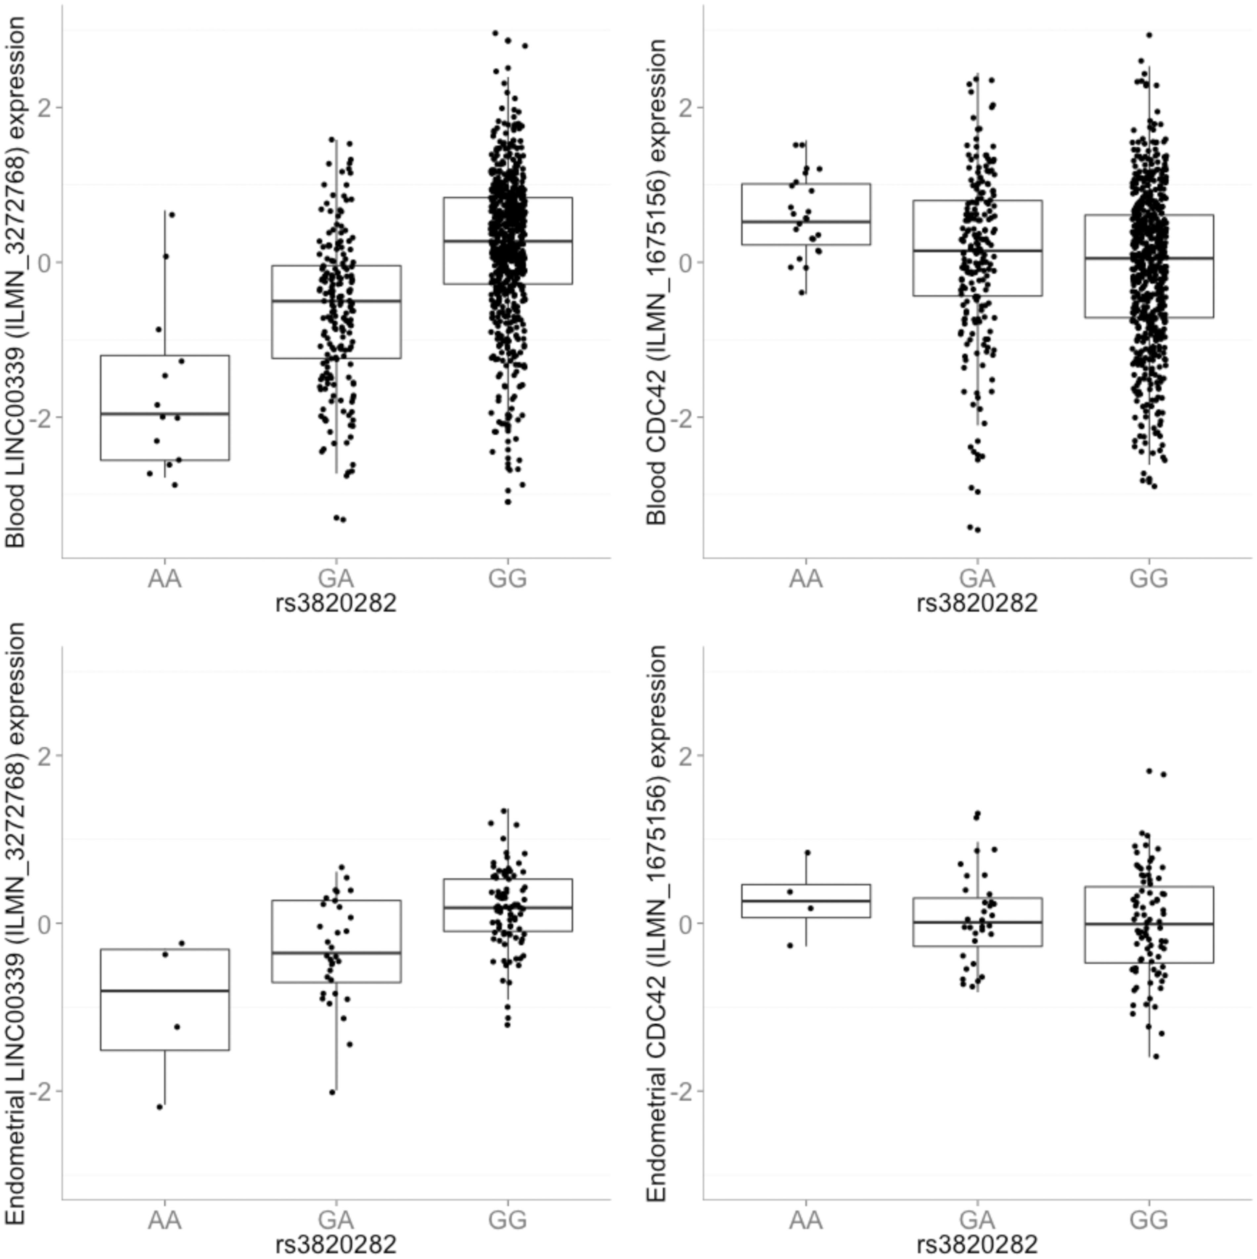
Figure 2. Expression levels of LINC00339 (left hand panels) and CDC42 (right hand panels) with eQTL effects for the ...
Notes:
Figure 2. Expression levels of LINC00339 (left hand panels) and CDC42 (right hand panels) with eQTL effects for the relationship between rs3820882 and gene expression in blood (top panel); rs3820282 and gene expression in endometrium (bottom panel). The overall estimated effect on LINC00339 (ILMN_3272768) of each additional copy of rs3820282 endometriosis risk allele [A] is − 0.86 in whole blood and −0.55 in endometrial tissue. The corresponding effect in CDC42 (ILMN_1675156) is 0.24 and 0.13, respectively. Effect of the fine-mapped (rs3820282) and original GWA sentinel (rs7521902) endometriosis SNPs on the expression levels of transcripts located within 1p36.12 locus. Expression levels of probes were measured in whole blood for 862 individuals from the Brisbane Systems Genetics Study [25]. Bold text denotes eQTLs with study wide significance. -Log10(P-value)Effect (SE)GeneProbeProbe start (bp)rs3820282 [A]rs7521902 [A]rs3820282 [A]rs7521902 [A]USP48ILMN_2285141220051167.1×10−26.1×10−1−0.07 (0.07)−0.03 (0.06)USP48ILMN_1756873220052533.8×10−17.4×10−1−0.06 (0.07)−0.02 (0.06)USP48ILMN_1738572220545387.4×10−18.7×10−10.02 (0.07)0.01 (0.06)USP48ILMN_1777726220551867.4×10−18.1×10−2−0.03 (0.10)0.16 (0.09)LDLRAD2ILMN_1734125221513174.7×10−11.5×10−1−0.14 (0.19)0.22 (0.15)LINC00339ILMN_3194087223572171.9×10−54 1.2×10−18−1.00 (0.06)−0.49 (0.05)LINC00339ILMN_327276822357427 1.0×10−34 2.5×10−14−0.86 (0.07)−0.45 (0.06)CDC42ILMN_1675156223791854.5×10−44.9×10−20.24 (0.07)0.11 (0.06)CDC42ILMN_1738424224190011.3×10−13.7×10−10.10 (0.07)0.05 (0.06)ZBTB40ILMN_1784037228546932.4×10−21.2×10−1−0.15 (0.07)−0.09 (0.06)EPHA8ILMN_1756989229297124.3×10−16.6×10−1−0.06 (0.07)0.03 (0.06)C1QAILMN_1737918229657397.1×10−15.2×10−10.05 (0.12)−0.07 (0.10)C1QCILMN_1785902229742176.1×10−16.3×10−1−0.09 (0.17)−0.07 (0.14)C1QBILMN_1796409229877906.1×10−19.7×10−10.08 (0.16)−0.01 (0.13)
Unless provided in the caption above, the following copyright applies to the content of this slide: © The Author 2016. Published by Oxford University Press. All rights reserved. For Permissions, please email: journals.permissions@oup.com

Slide 3
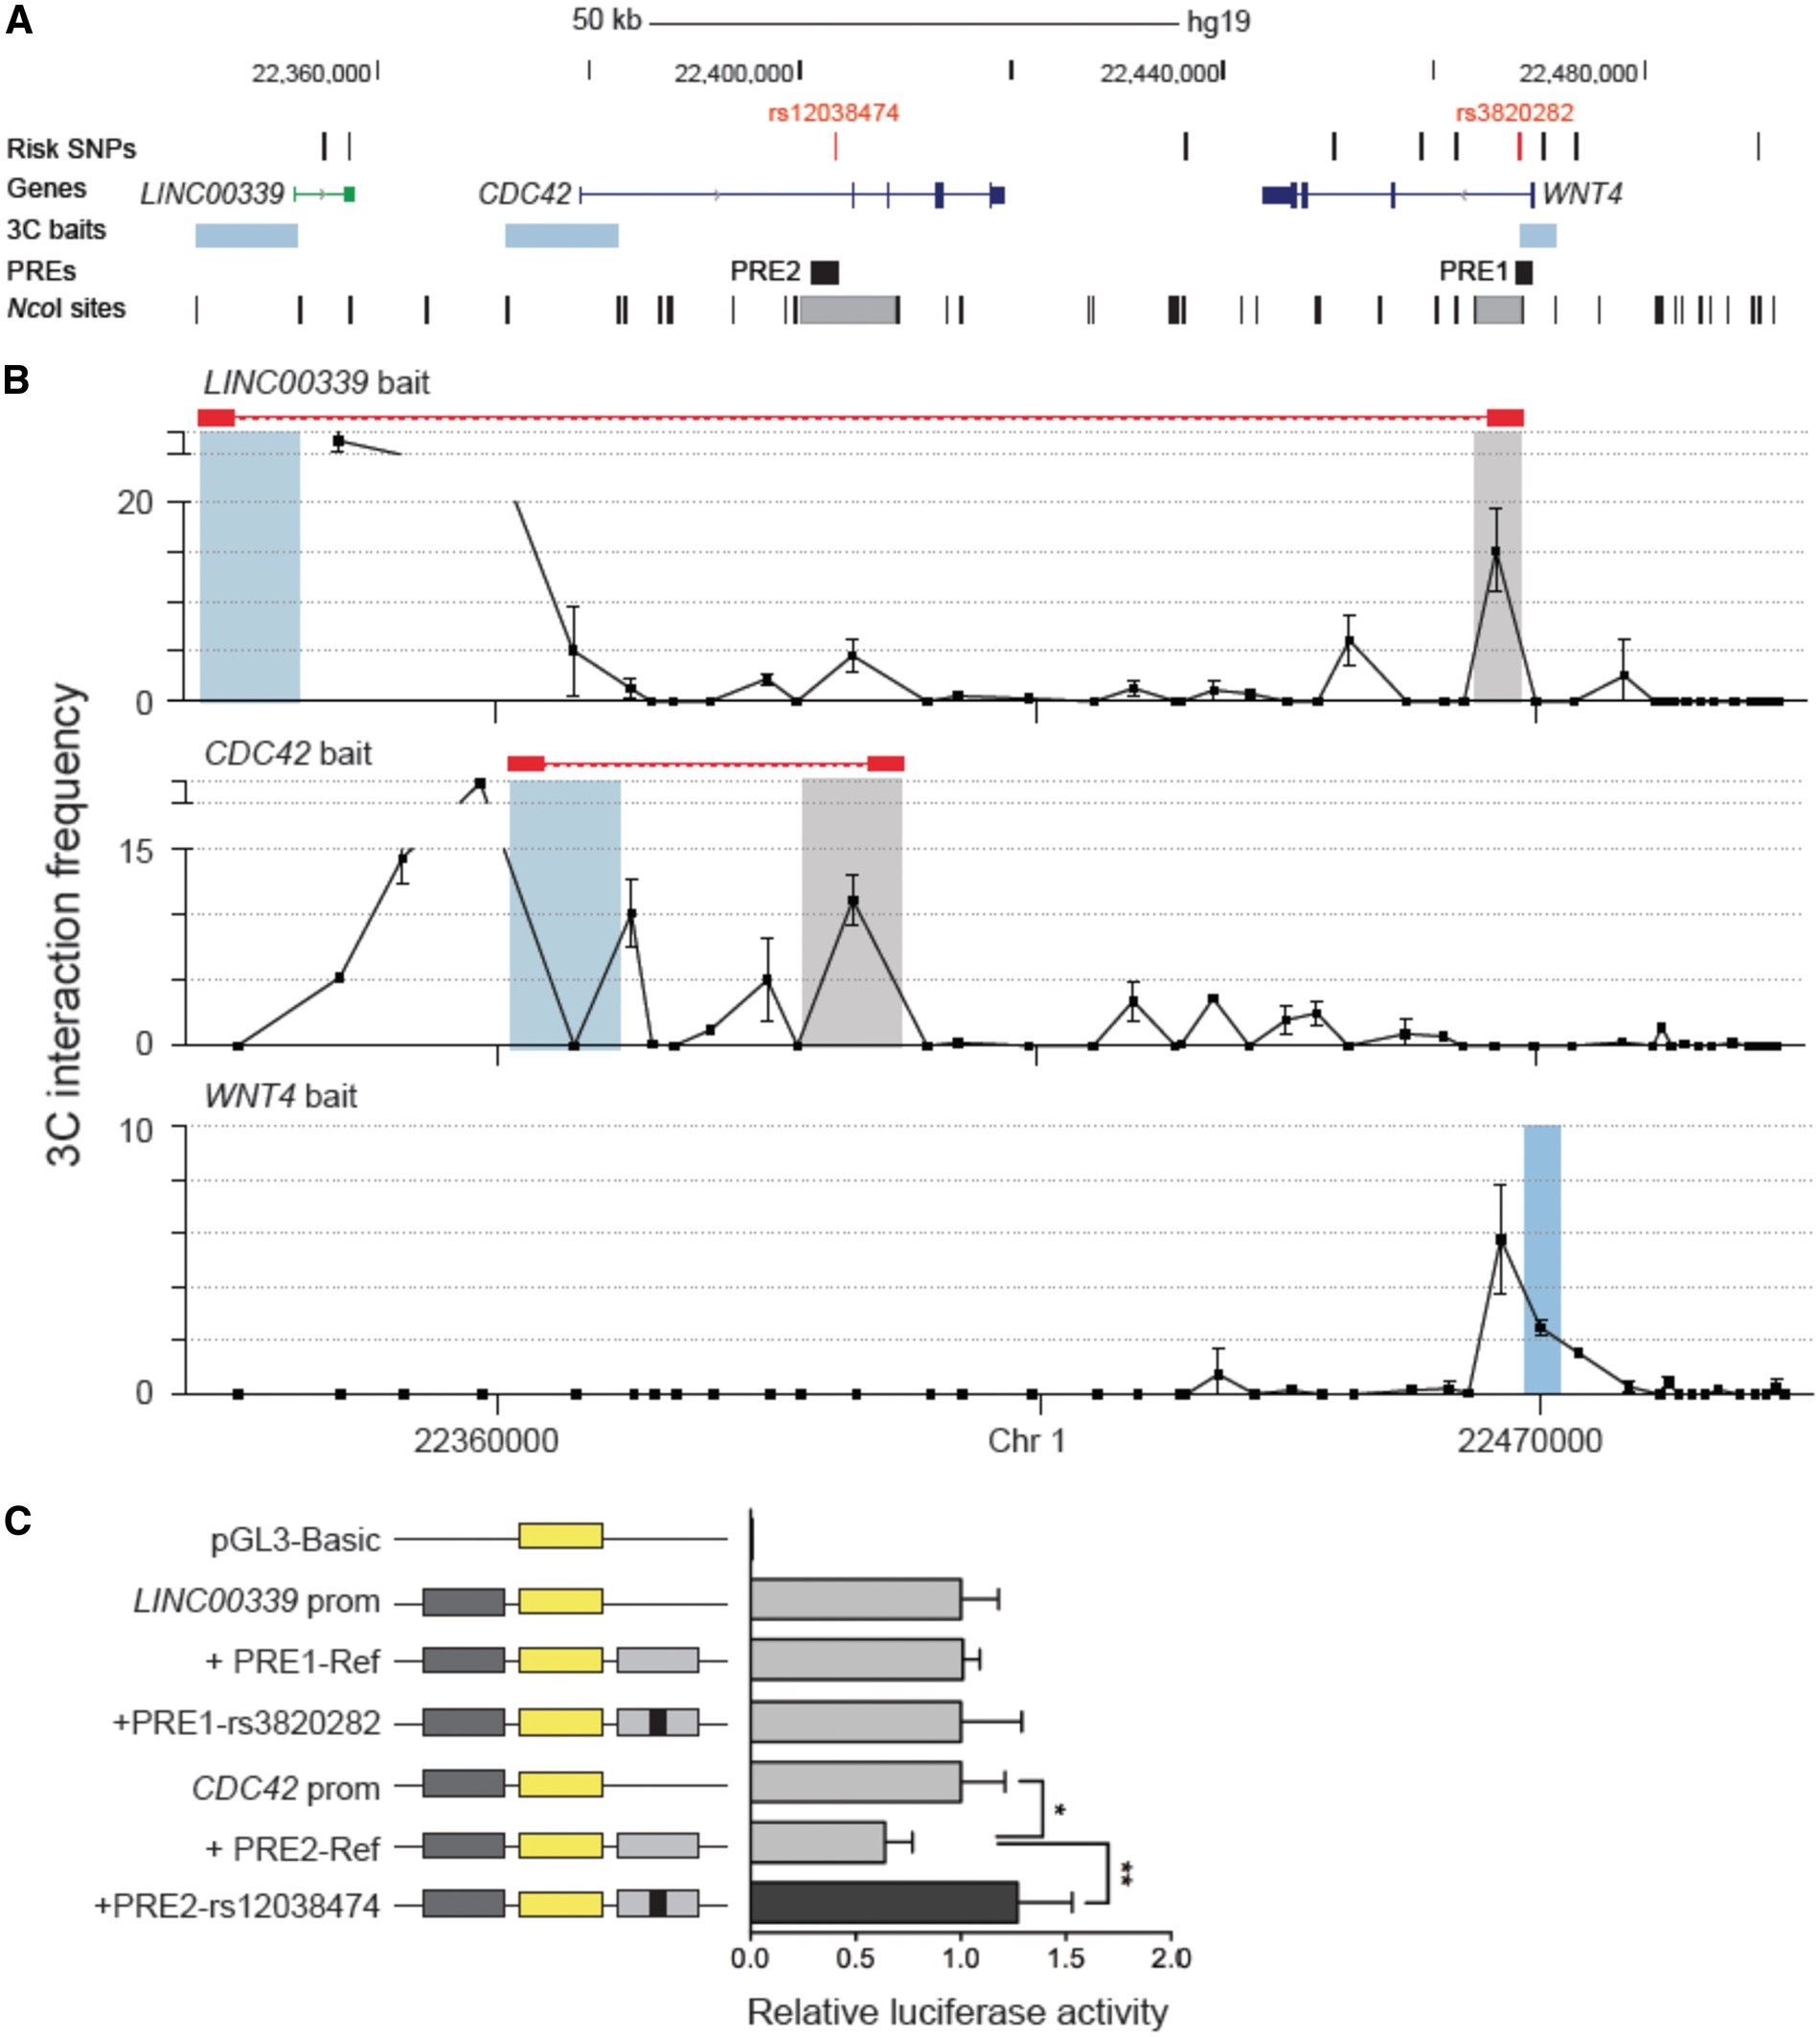
Figure 3. Candidate causal SNPs are located within PREs that interact with the LIN00339 or CDC42 promoters. (A) The ...
Notes:
Figure 3. Candidate causal SNPs are located within PREs that interact with the LIN00339 or CDC42 promoters. (A) The location of candidate causal SNPs are represented by black or red ticks, gene structures are depicted with exons (vertical boxes) joined by introns (lines). 3C anchors are shown as blue boxes, frequently interacting NcoI fragments as grey boxes and Putative Regulatory Elements (PRE1, PRE2) as black boxes. (B) 3C interaction profiles between LINC00339, CDC42 or WNT4 promoters and the 1p36 risk region in Ishikawa cell lines. 3C anchors are shown as blue boxes and frequent interactions highlighted with red connecting bars. Graphs represent one of three biological replicates. Error bars represent SD. (C) Luciferase reporter assays in Ishikawa cells. PREs containing the major SNP alleles (Ref) were cloned downstream of target gene promoter-driven constructs. Minor (risk-increasing) SNP alleles were engineered into the constructs and are designated by the rs ID of the corresponding SNP. Error bars denote 95% confidence intervals from three independent experiments. P-values were determined by 2-way ANOVA followed by Dunnett’s multiple comparisons test (*P < 0.05, **P < 0.01).
Unless provided in the caption above, the following copyright applies to the content of this slide: © The Author 2016. Published by Oxford University Press. All rights reserved. For Permissions, please email: journals.permissions@oup.com

