Slide 1
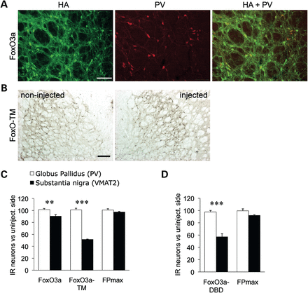
Figure 3. Pallidal PV neurons are less vulnerable to modulation of FOXO3 activity. AAV2/6 vectors modulating FOXO3 ...
Notes:
Figure 3. Pallidal PV neurons are less vulnerable to modulation of FOXO3 activity. AAV2/6 vectors modulating FOXO3 activity and the control FPmax vector were injected in the GP, analyzed 3 weeks later. (A) Immunostaining for HA in the GP demonstrating overexpression of FOXO3 in parvalbumin-positive (PV-IR) neurons. Scale bar: 100 µm. (B) PV immunohistochemistry in the GP of a FoxO-TM-injected rat. Note the similar number of PV-IR neurons in both the injected and non-injected sides. Scale bar: 200 µm. (C) Quantitative analysis of PV-IR and TH-IR neurons in the GP and SNpc, respectively. AAV2/6 vectors encoding FoxO3a, FoxO-TM or FPmax were injected either in GP or in SNpc (6.7 × 106 TU). Results are expressed as the percentage of immunoreactive neurons versus the non-injected hemisphere. (D) Similar results obtained following injection of FoxO-DBD and the control FPmax vector at a higher dose (2.7 × 107 TU). Note that PV-IR pallidal neurons were significantly less affected when compared with nigral neurons. Statistical analysis: SN: n = 6 for each group except FoxO-TM (n = 4) and FoxO-DBD (n = 9). GP: n = 6 for each group. (C) Two-way factorial ANOVA, significant interaction gene × brain region: F(2,28) = 64.2; **P = 0.008 and ***P = 0.0001, comparing neuronal loss between SN and GP. (D) Two-way factorial ANOVA, significant interaction gene × brain region: F(1,23) = 16.9; ***P = 0.0001, comparing neuronal loss between SN and GP.
Unless provided in the caption above, the following copyright applies to the content of this slide: © The Author 2013. Published by Oxford University Press. All rights reserved. For Permissions, please email: journals.permissions@oup.com

Slide 2
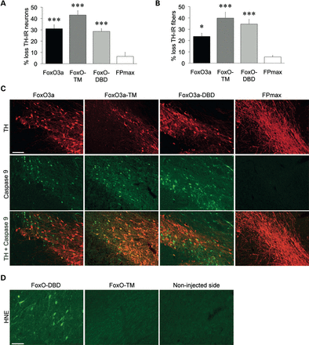
Figure 2. At a higher vector dose, all forms of FOXO3 lead to the loss of nigral neurons positive for DA markers and ...
Notes:
Figure 2. At a higher vector dose, all forms of FOXO3 lead to the loss of nigral neurons positive for DA markers and the dominant-negative FoxO-DBD produces oxidative damage. Significant loss of TH-positive neurons (A) and fibers (B) 3 weeks following injection of a high dose (2.7 × 107 TU) of AAV2/6 vectors modulating FOXO3 activity. Results represent the percentage loss of TH-positive neurons or TH striatal immunoreactivity, as compared with the contralateral non-injected hemisphere. Note that the FoxO3a and FoxO-DBD vectors also induce the loss of DA neurons with a high vector dose. Statistical analysis: FoxO3a n = 10, FoxO-TM n = 15, FoxO-DBD n = 9 and FPmax n = 6. (A) One-way ANOVA F(3,36) = 14.7: ***P < 0.001 relative to the FPmax control. (B) One-way ANOVA F(3,36) = 8.9: *P = 0.012, ***P < 0.001 relative to the FPmax control. (C) Activation of the apoptotic marker Caspase 9 in nigral TH-positive neurons. Note the presence of cleaved Caspase 9 with the vectors modulating FOXO3 activity. Scale bar: 100 µm (D) Immunostaining for HNE in the SNpc of FoxO-DBD-injected rats. Note that FoxO-TM does not induce any HNE accumulation despite a similar level of toxicity. Scale bar: 50 µm.
Unless provided in the caption above, the following copyright applies to the content of this slide: © The Author 2013. Published by Oxford University Press. All rights reserved. For Permissions, please email: journals.permissions@oup.com

Slide 3
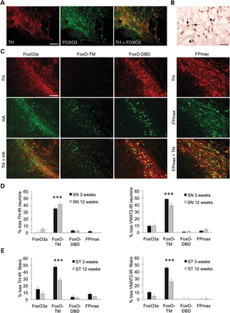
Figure 1. FOXO3 is endogenously expressed in rat nigral neurons, and constitutive FOXO3 activity leads to acute loss of ...
Notes:
Figure 1. FOXO3 is endogenously expressed in rat nigral neurons, and constitutive FOXO3 activity leads to acute loss of neurons positive for DA markers. (A) Fluorescence immunostaining showing co-localization of both TH (red) and FOXO3 (green) in adult rat nigral neurons. Scale bar: 100 µm. (B) Immunohistochemistry for FOXO3 in the adult rat SNpc showing either predominantly nuclear (arrows) or cytoplasmic (arrowheads) localization. Scale bar: 50 µm (C) Immunodetection demonstrates widespread transgene expression in the adult rat SNpc (TH colabeling) 12 weeks following AAV2/6 vector injection (6.7 × 106 TU). The FOXO3 forms are immunodetected using an N-terminal fused HA epitope. Scale bar: 100 µm. (D) Loss of neurons positive for TH and VMAT2, as compared with the non-injected hemisphere, at 3 and 12 weeks post-vector injection. Only the constitutively active FoxO-TM leads to an acute loss of DA neurons. (E) Loss of TH- and VMAT2-positive fibers in the striatum. Statistical analysis: at 3 weeks, n = 6 in each group, except FoxO-TM (n = 4). At 12 weeks: FoxO3a n = 10, FoxO-DBD n = 9, FoxO-TM and FPmax n = 8. (D) Two-way factorial ANOVA, group effect: for TH, F(3,49) = 62.6 and for VMAT2, F(3,49) = 60.0; ***P < 0.001 relative to the other groups. (E) Two-way factorial ANOVA, group effect: for TH, F(3,49) = 50.5 and for VMAT2, F(3,49) = 31.4; ***P < 0.001 relative to the other groups.
Unless provided in the caption above, the following copyright applies to the content of this slide: © The Author 2013. Published by Oxford University Press. All rights reserved. For Permissions, please email: journals.permissions@oup.com

Slide 4
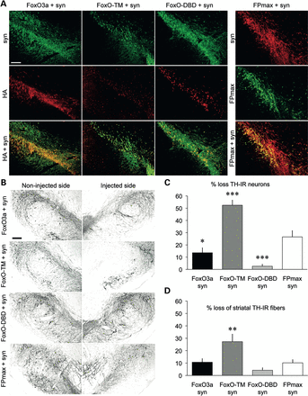
Figure 4. FOXO3 activity determines the fate of nigral DA neurons overexpressing human α-synuclein. (A) Immunostaining ...
Notes:
Figure 4. FOXO3 activity determines the fate of nigral DA neurons overexpressing human α-synuclein. (A) Immunostaining for α-synuclein and FOXO3 variants (HA) 12 weeks post-vector injection demonstrates co-expression of both transgenes in the adult rat SNpc. Scale bar: 200 µm. (B) Representative photomicrographs showing TH-IR neurons in the SNpc. Scale bar: 200 µm. (C) Loss of TH-IR neurons expressed as the percentage of the non-injected hemisphere. The AAV2/6-α-synuclein vector was co-injected with vectors modulating FOXO3 activity. FoxO-TM overexpression leads to increased loss of DA neurons, while a significant protection is observed with FoxO3a and FoxO-DBD. (D) Loss of DA fibers in the striatum measured by TH immunoreactivity. Statistical analysis: FoxO3a and FoxO-TM: n = 10, FoxO-DBD and FPmax: n = 9. (C) One-way ANOVA: F(3,34) = 31.3; *P = 0.024, ***P < 0.001 relative to FPmax. (D) One-way ANOVA: F(3,34) = 7.0; **P = 0.008 relative to FPmax.
Unless provided in the caption above, the following copyright applies to the content of this slide: © The Author 2013. Published by Oxford University Press. All rights reserved. For Permissions, please email: journals.permissions@oup.com

Slide 5
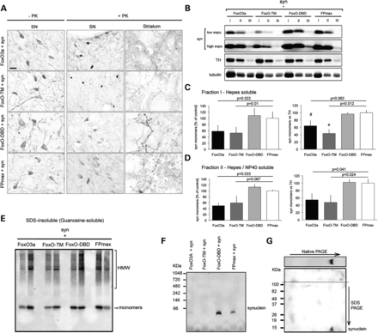
Figure 5. FOXO3 activity determines the accumulation and aggregation of α-synuclein in the nigrostriatal system. (A) ...
Notes:
Figure 5. FOXO3 activity determines the accumulation and aggregation of α-synuclein in the nigrostriatal system. (A) Active forms of FOXO3 (FoxO3a and FoxO-TM) lead to the formation of dense PK-resistant structures positive for α-synuclein in the neuronal soma. In contrast, nigral neurons expressing FoxO-DBD display a diffuse accumulation of PK-resistant α-synuclein. Striatal axons show a similar difference in the pattern of PK-resistant α-synuclein. Scale bar: 20 µm. (B) Western blot analysis of α-synuclein accumulation in the SN of injected animals. The membrane was probed with anti-α-synuclein (syn1), anti-TH and anti-α-tubulin antibodies. Note that FoxO3a and FoxO-TM decrease the level of monomeric α-synuclein in fraction I (Hepes) and II (NP40 1%). Fraction III contains SDS-soluble proteins. (C, D) Semi-quantitative evaluation of monomeric α-synuclein detected in the Hepes (C) and NP40 fractions (D). Results are expressed as a ratio of either α-synuclein/tubulin (left panel) or α-synuclein/TH optical density (right panel). Statistical analysis: n = 3 for each condition, one-way ANOVA with Fisher's LSD post hoc test: P-values relative to the FPmax control are indicated on each graph. (E) Immunodetection of α-synuclein in the insoluble fraction (guanidine) using the syn1 monoclonal antibody. A western blot representative of two animals per group is shown. The arrow identifies monomeric α-synuclein and the bracket HMW species. (F) Blue native PAGE gel separation of SNpc protein extracts solubilized in Hepes. Syn211 antibody recognizes human α-synuclein migrating at an apparent molecular size of 66 kDa. Note the reduced level of α-synuclein detected in the FoxO3a and FoxO-TM conditions. Conversely, FoxO-DBD increases α-synuclein accumulation. (G) 2D gel separation (native and SDS-PAGE) of Hepes-soluble proteins from a FoxO-DBD extract. Immunodetection identifies α-synuclein migrating at an apparent molecular weight of 66 kDa in native conditions and 14 kDa in denaturing conditions (syn1 antibody).
Unless provided in the caption above, the following copyright applies to the content of this slide: © The Author 2013. Published by Oxford University Press. All rights reserved. For Permissions, please email: journals.permissions@oup.com

Slide 6
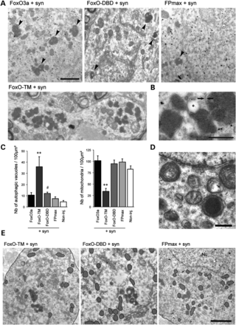
Figure 6. IEM reveals signs of enhanced autophagy in response to the constitutively active FoxO-TM. (A) Representative ...
Notes:
Figure 6. IEM reveals signs of enhanced autophagy in response to the constitutively active FoxO-TM. (A) Representative IEM of nigral DA neurons expressing human α-synuclein, showing the presence of autophagic structures with an electron dense matrix (arrowheads) in the cytosol. Note the presence of immunogold particles labeling human α-synuclein. In the FoxO-TM animal, there is a dense accumulation of autophagic vacuoles in discrete portions of the cytosol. Scale bar: 2 µm (B) Higher magnification of autophagic vacuoles. Note the presence of a single membrane (arrows) and a lipid droplet (*) typical of lipofuscin granules. Scale bar: 1 µm. (C) Quantitative IEM analysis of autophagic vacuole density in neuronal cytosol 16 weeks post-vector injection. The number of autophagic vacuoles per 100 µm2 is significantly increased in the FoxO-TM condition. In response to FoxO-DBD, there is a trend toward increased density. Statistical analysis: n = 17/20/46/18/20 for FoxO3a/FoxO-TM/FoxO-DBD/FPmax/non-injected, Kruskal–Wallis one-way ANOVA: #P = 0.073, **P = 0.0035 relative to FPmax (both groups, P < 0.001 versus non-injected). (D) Mitochondria density is significantly decreased in nigral neurons expressing FoxO-TM. Statistical analysis: n = 13/21/28/22/17 for FoxO3a/FoxO-TM/FoxO-DBD/FPmax/non-injected, Kruskal–Wallis one-way ANOVA: **P < 0.01 relative to all groups. (E) Representative IEM images showing a decreased number of mitochondria with FoxO-TM. Nu indicates the nucleus. Scale bar: 2 µm (F) Higher magnification of a FoxO-DBD/α-synuclein neuron showing degenerating mitochondria with discontinuous outer and inner membranes. Note the mitochondrial condensation in dense osmophilic pigments. Scale bar: 1 µm.
Unless provided in the caption above, the following copyright applies to the content of this slide: © The Author 2013. Published by Oxford University Press. All rights reserved. For Permissions, please email: journals.permissions@oup.com

Slide 7
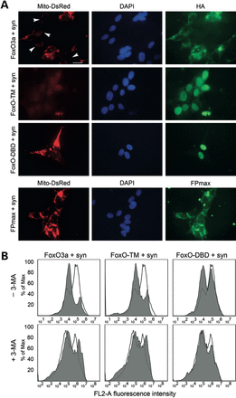
Figure 8. Active forms of FOXO3, but not FoxO-DBD, reduce the overall number of Mito-DsRed-labeled mitochondria in ...
Notes:
Figure 8. Active forms of FOXO3, but not FoxO-DBD, reduce the overall number of Mito-DsRed-labeled mitochondria in SH-SY5Y-expressing α-synuclein. (A) Immunostaining for HA, DAPI and Mito-DsRed 72 h post-infection shows a marked reduction of Mito-DsRed fluorescence in the FoxO-TM group and a decrease in some cells expressing FOXO3 (arrowheads). HA staining demonstrates the nuclear localization of FoxO-TM and FoxO-DBD at this time point. Scale bar: 20 µm. (B) Flow cytometry analysis of Mito-DsRed signal in SH-SY5Y infected with either FoxO3a vectors (shaded traces) or the FPmax control (open traces), with and without 3-MA, an autophagy inhibitor. There is a significant shift toward a low fluorescent population with FoxO3a and FoxO-TM that is not observed with FoxO-DBD or in any condition with 3-MA 72 h post-infection (representative result for n = 3).
Unless provided in the caption above, the following copyright applies to the content of this slide: © The Author 2013. Published by Oxford University Press. All rights reserved. For Permissions, please email: journals.permissions@oup.com

Slide 8
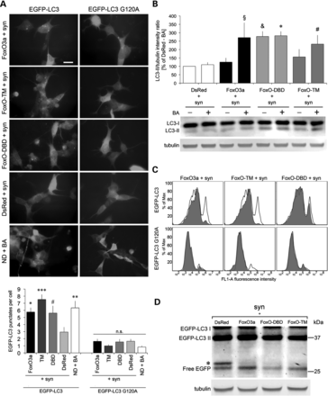
Figure 7. FOXO3 increases autophagic flux, and the dominant-negative FoxO-DBD inhibits lysosomal degradation in SH-SY5Y ...
Notes:
Figure 7. FOXO3 increases autophagic flux, and the dominant-negative FoxO-DBD inhibits lysosomal degradation in SH-SY5Y cells expressing α-synuclein. (A) Effect of vectors modulating FOXO3 activity in SH-SY5Y cells infected with either AAV2/6-PGK-EGFP-LC3 or G120A vectors. At 48 h post-infection, fluorescent puncta representing autophagosomes are increased with all FOXO vectors as compared with the DsRed2 control, and similarly to the nutrient deprivation group (ND) treated with BA. Scale bar: 20 µm. Statistical analysis: n = 3, one-way ANOVA with Fisher's LSD post hoc test, #P = 0.026, *P = 0.019, **P = 0.005, ***P = 0.0001 relative to DsRed. (B) Western blot analysis of protein extracts taken from SH-SY5Y cells infected with AAV2/6-CMV-FoxO variants or AAV2/6-CMV-DsRed, with and without BA. Membrane was probed with an anti-LC3B or anti-tubulin antibody as indicated. Graph represents the relative band intensity of LC3-II/tubulin. Note the difference in band intensity with and without BA in the active forms (FoxO3a and FoxO-TM), whereas there is no difference with FoxO-DBD 48 h post-infection. Statistical analysis: n = 3, one-way ANOVA with Fisher's LSD post hoc test, §P = 0.019, *P = 0.013, #P = 0.064 relative to DsRed + BA and &P = 0.011 relative to DsRed-BA. (C) Flow cytometry analysis of EGFP-LC3 and G120A expressing stable cell line infected with either the AAV2/6-CMV-FoxO forms (shaded traces) or AAV2/6-CMV-DsRed (open traces) 48 h post-infection. There is no decrease in fluorescence intensity of EGFP-LC3 in the FoxO-DBD group (n = 3). (D) Western blot analysis of protein extracts from infected SH-SY5Y cells stably expressing EGFP-LC3 48 h post-infection. Membrane was probed with an anti-GFP or anti-tubulin antibody. The band intensity of free EGFP is an indicator for autophagic flux, which is reduced in the FoxO-DBD group (n = 4).
Unless provided in the caption above, the following copyright applies to the content of this slide: © The Author 2013. Published by Oxford University Press. All rights reserved. For Permissions, please email: journals.permissions@oup.com

Slide 9
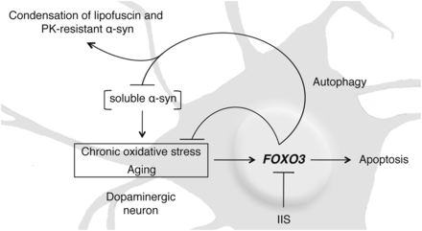
Figure 9. Proposed model for the role of FOXO3 in α-synuclein proteotoxicity. With age and degenerative disease, ...
Notes:
Figure 9. Proposed model for the role of FOXO3 in α-synuclein proteotoxicity. With age and degenerative disease, dopaminergic neurons are exposed to increased levels of α-synuclein and chronic oxidative stress. FOXO3 reduces α-synuclein proteotoxicity through the clearance of soluble α-synuclein and promotes the condensation of insoluble material that may contain inert forms of fibrillar α-synuclein. However, the overactivation of FOXO3 could ultimately be a mediator of neuronal cell death as demonstrated by the proapoptotic activity of the constitutively active form FoxO-TM and the neuronal protection observed with the dominant-negative FoxO-DBD.
Unless provided in the caption above, the following copyright applies to the content of this slide: © The Author 2013. Published by Oxford University Press. All rights reserved. For Permissions, please email: journals.permissions@oup.com

