Slide 1
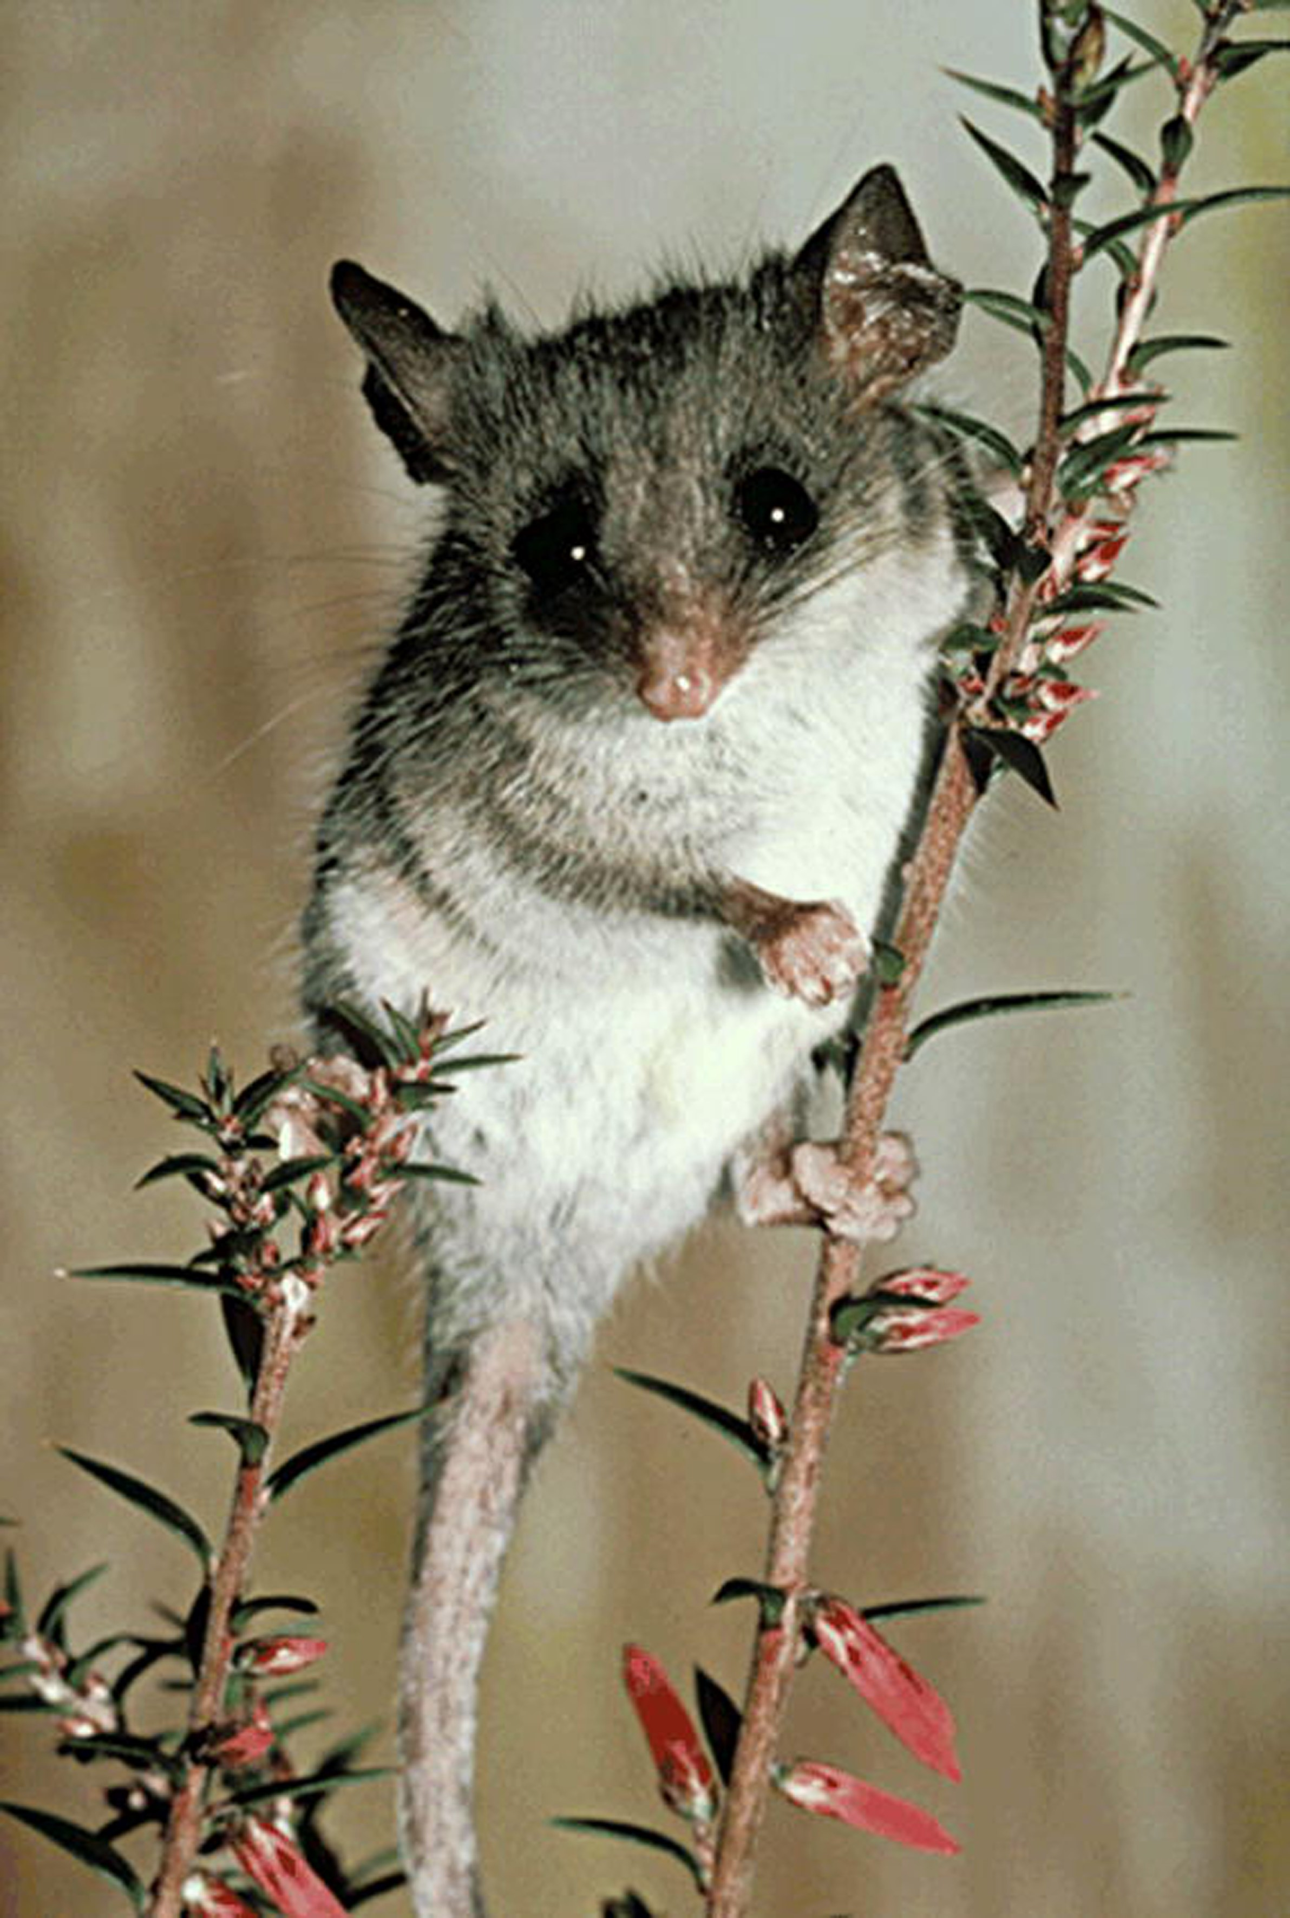
Figure 1 An adult Cercartetus lepidus from Tasmania. Used with permission of the photographer David Watts.
Notes:
Figure 1 An adult Cercartetus lepidus from Tasmania. Used with permission of the photographer David Watts.
Unless provided in the caption above, the following copyright applies to the content of this slide: © 2009 American Society of Mammalogists

Slide 2
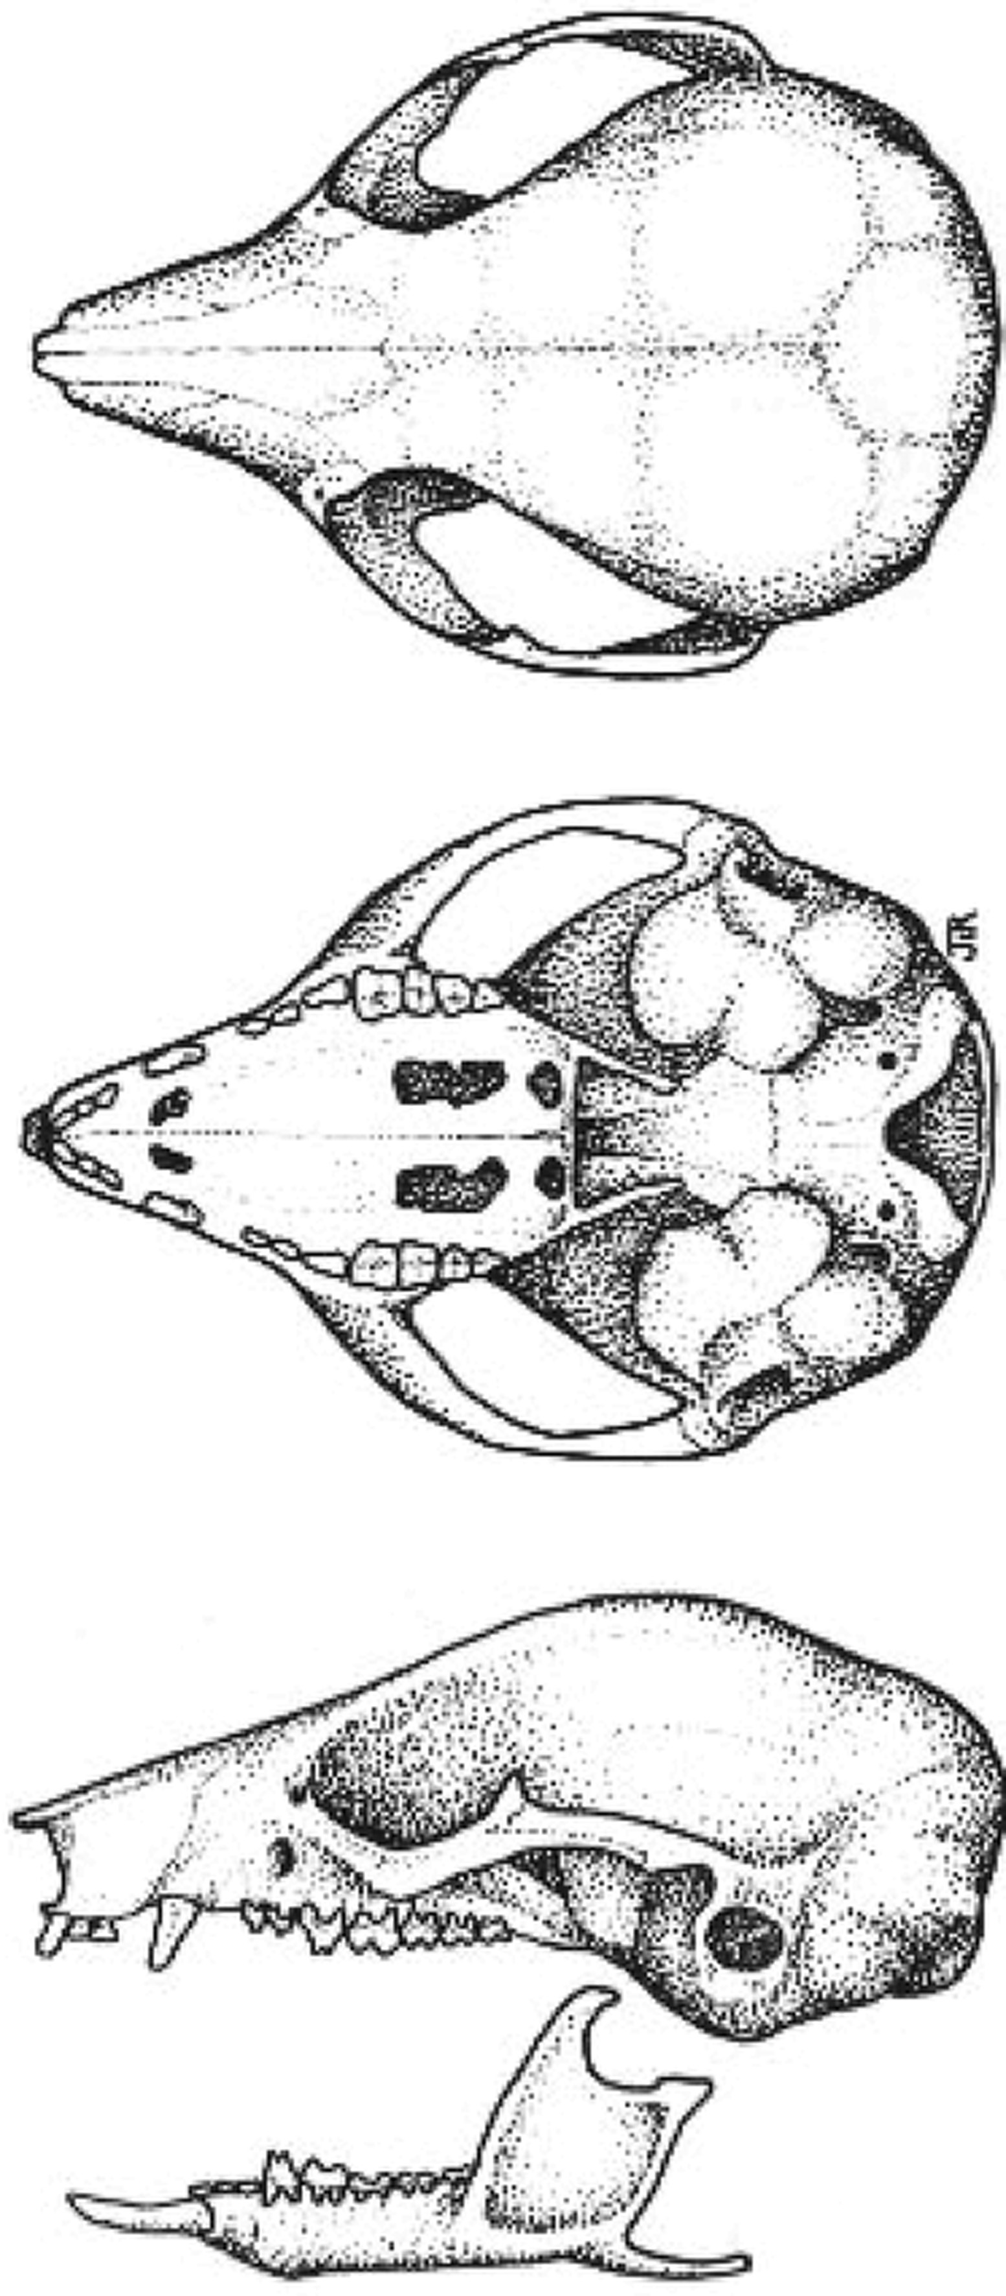
Figure 2 Dorsal, ventral, and lateral views of skull and lateral view of mandible of a male Cercartetus lepidus from ...
Notes:
Figure 2 Dorsal, ventral, and lateral views of skull and lateral view of mandible of a male Cercartetus lepidus from Golden Valley (near Deloraine), Tasmania (Queen Victoria Museum and Art Gallery number 1980/1/76). Collected by P. Wright in November 1979. Greatest length of skull is 19.6 mm. Used with permission of the illustrator Judy Rainbird.
Unless provided in the caption above, the following copyright applies to the content of this slide: © 2009 American Society of Mammalogists

Slide 3
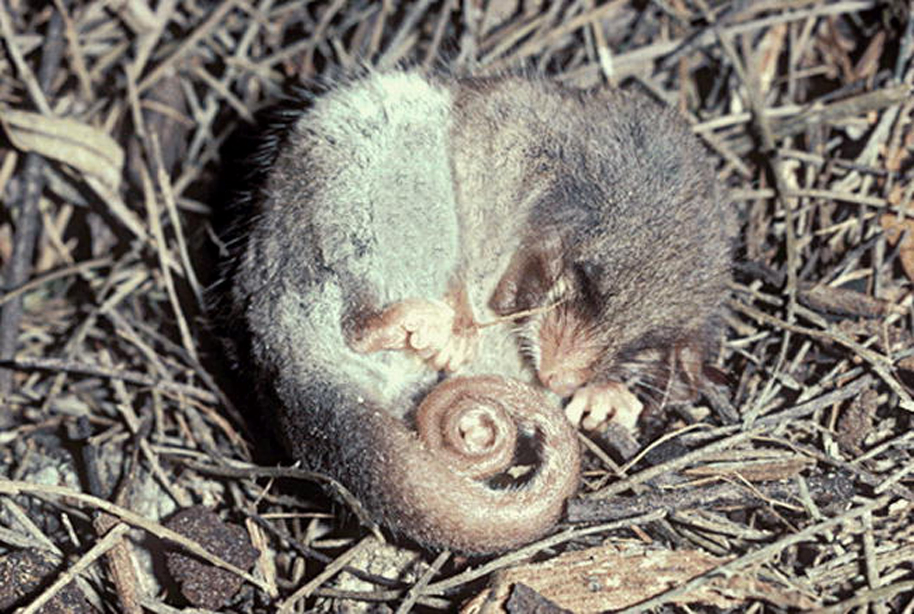
Figure 3 Cercartetus lepidus in a typical hibernating posture. Note the folded ears, also the spiraled tail and curled ...
Notes:
Figure 3 Cercartetus lepidus in a typical hibernating posture. Note the folded ears, also the spiraled tail and curled paws. The incrassated tail base is clearly visible. Used with permission of the photographer David Watts.
Unless provided in the caption above, the following copyright applies to the content of this slide: © 2009 American Society of Mammalogists

Slide 4
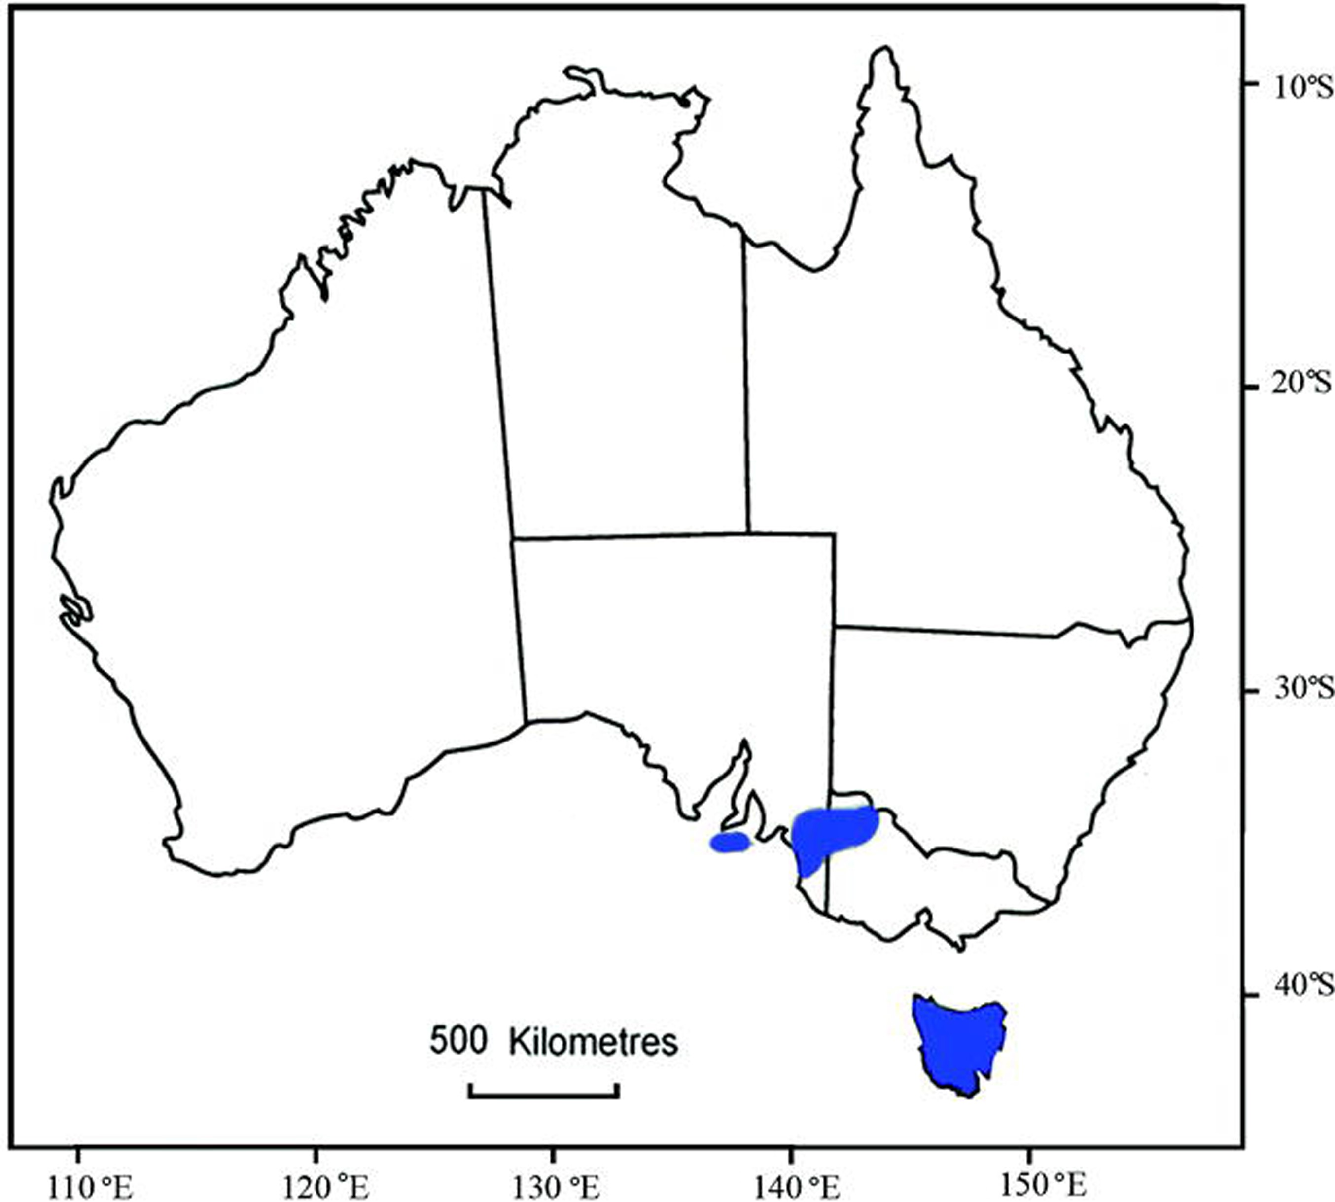
Figure 4 Geographic distribution of Cercartetus lepidus. Adapted from Van Dyck and Strahan (2008).
Notes:
Figure 4 Geographic distribution of Cercartetus lepidus. Adapted from Van Dyck and Strahan (2008).
Unless provided in the caption above, the following copyright applies to the content of this slide: © 2009 American Society of Mammalogists

Slide 5
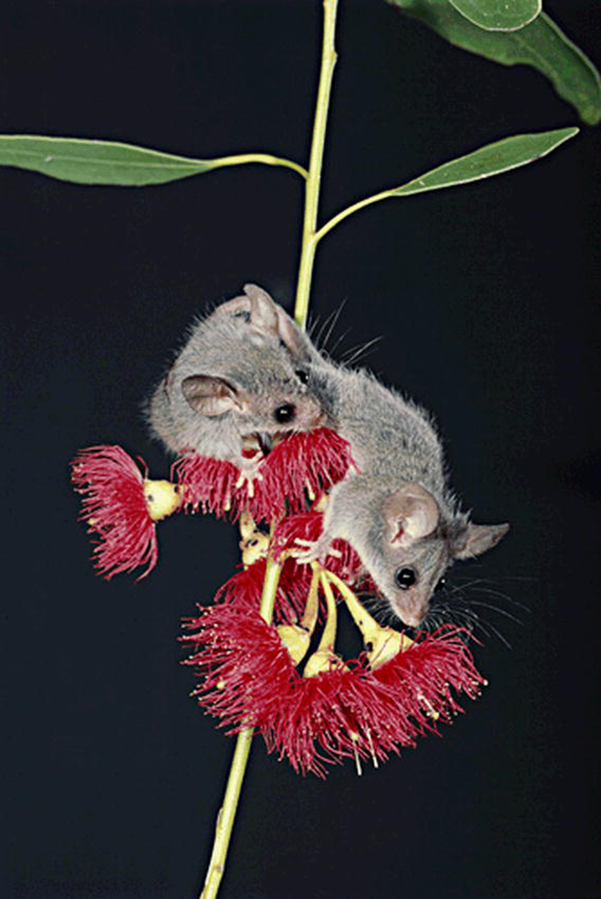
Figure 5 Cercartetus lepidus is a nondestructive visitor to a range of flowering plants and may play an important role ...
Notes:
Figure 5 Cercartetus lepidus is a nondestructive visitor to a range of flowering plants and may play an important role in pollination. Used with permission of the photographer David Watts.
Unless provided in the caption above, the following copyright applies to the content of this slide: © 2009 American Society of Mammalogists

