Slide 1
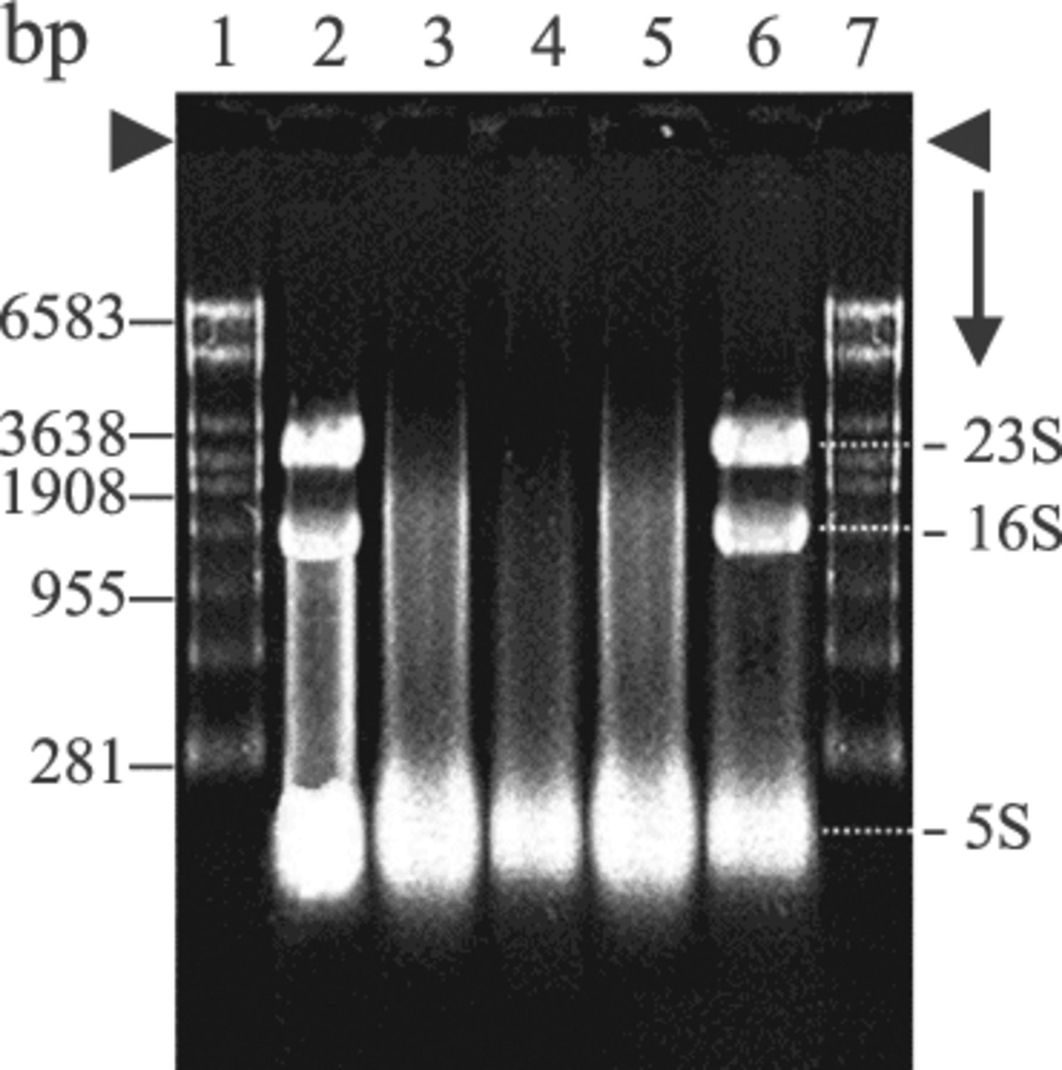
1 Comparison of RNA isolation methods. 1 µg of RNA from E. faecium ATCC 51559 was loaded on a 1.2% agarose gel ...
Notes:
1 Comparison of RNA isolation methods. 1 µg of RNA from E. faecium ATCC 51559 was loaded on a 1.2% agarose gel and run as described in Section 2. Lanes 1 and 7, RNA ladder; lane 2, total RNA by the Qiagen method; lane 3, RNA by the boiling method (chloroform extraction); lane 4, RNA by the boiling method (chloroform–methanol (1:2) extraction); lane 5, RNA by the boiling method (chloroform–methanol (2:1) extraction); lane 6, RNA by the hot phenol extraction method.
Unless provided in the caption above, the following copyright applies to the content of this slide: © 2003 Federation of European Microbiological Societies

Slide 2
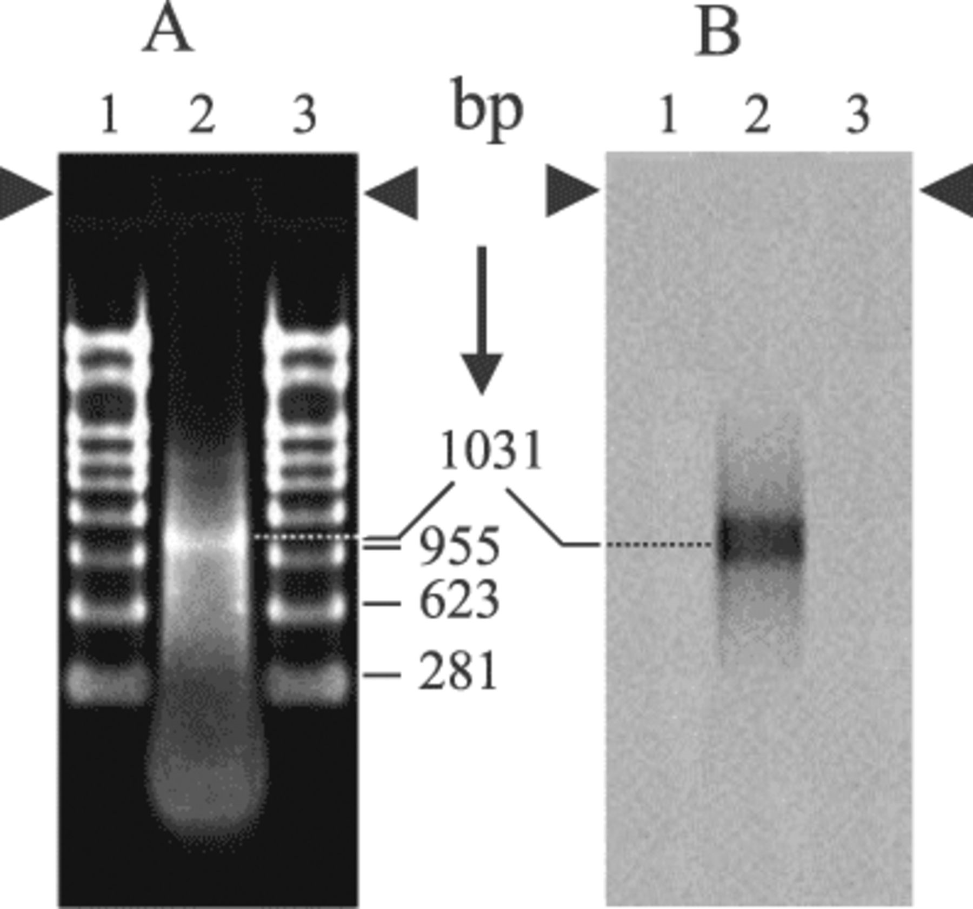
4 Northern blot analysis of full-length vanA gene transcript. Lanes 1 and 3, RNA ladder; lane 2, RNA from E. ...
Notes:
4 Northern blot analysis of full-length vanA gene transcript. Lanes 1 and 3, RNA ladder; lane 2, RNA from E. faecium ATCC 51559 (2 µg). A: Ethidium bromide-stained gel. B: Northern blot of gel in A probed with a DIG-labeled partial vanA gene PCR product.
Unless provided in the caption above, the following copyright applies to the content of this slide: © 2003 Federation of European Microbiological Societies

Slide 3
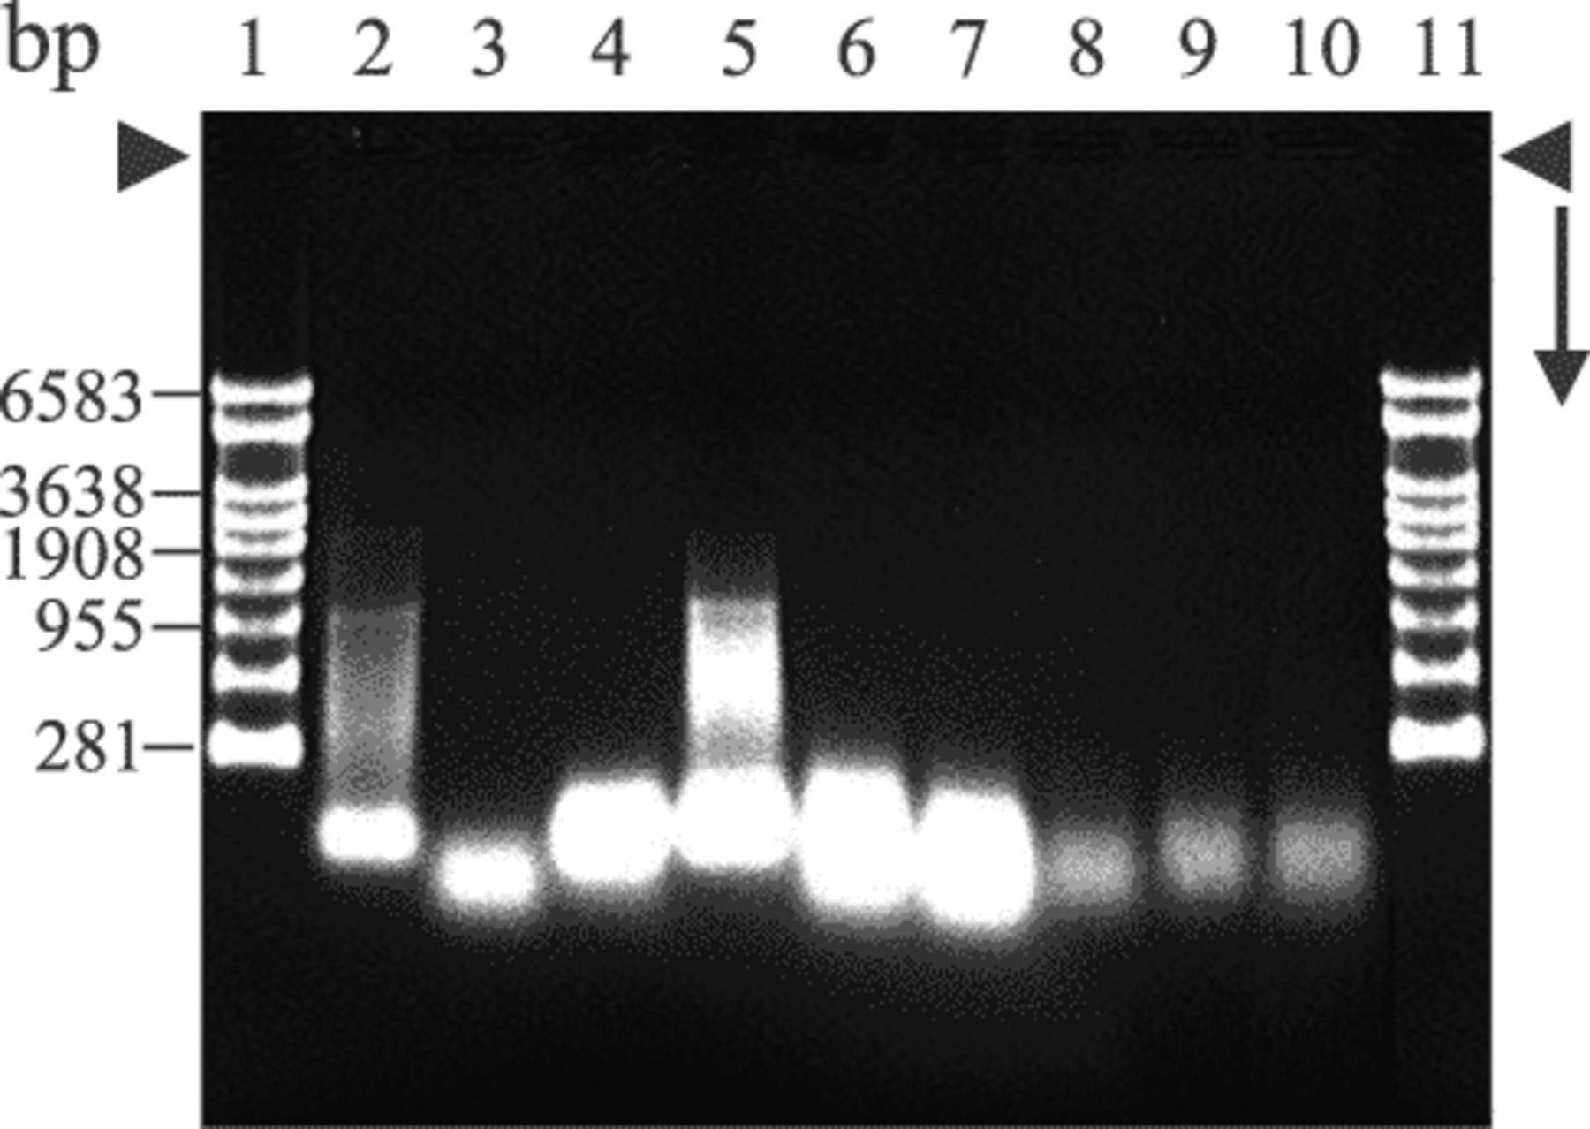
2 RNA isolation from different bacteria by the boiling chloroform extraction method. The amount of RNA loaded ...
Notes:
2 RNA isolation from different bacteria by the boiling chloroform extraction method. The amount of RNA loaded in each lane is indicated in parentheses after the bacterial species. Lanes 1 and 11, RNA ladder; lane 2, E. faecium (0.5 µg); lane 3, S. aureus (0.5 µg); lane 4, L. reuteri (1 µg); lane 5, L. lactis (1 µg); lane 6, A. veronii (1 µg); lane 7, E. coli (1 µg); lane 8, C. jejuni (0.2 µg); lane 9, S. typhimurium (0.2 µg); and lane 10, M. vanbaalenii (0.2 µg).
Unless provided in the caption above, the following copyright applies to the content of this slide: © 2003 Federation of European Microbiological Societies

Slide 4
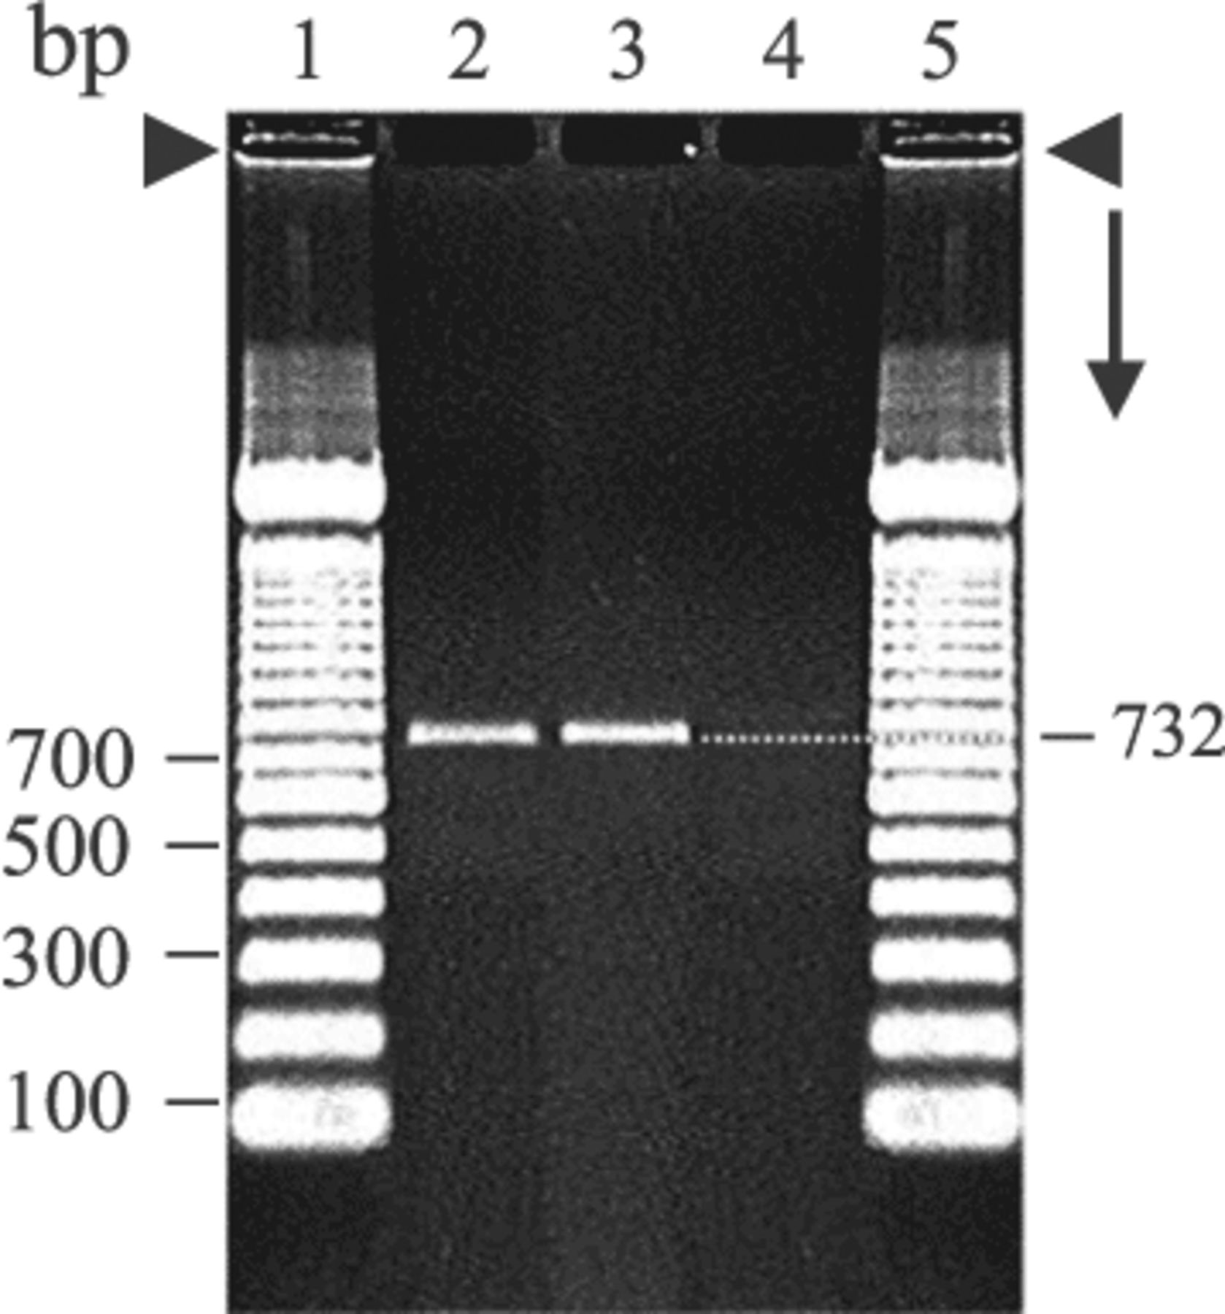
3 Amplification of the partial vanA gene by RT-PCR. Lanes 1 and 5, 100-bp DNA ladder; lane 2, RT-PCR from ...
Notes:
3 Amplification of the partial vanA gene by RT-PCR. Lanes 1 and 5, 100-bp DNA ladder; lane 2, RT-PCR from DNase-untreated sample; lane 3, RT-PCR from DNase-treated RNA sample; and lane 4, RT-PCR from DNase- and RNase-treated RNA sample.
Unless provided in the caption above, the following copyright applies to the content of this slide: © 2003 Federation of European Microbiological Societies

