Slide 1
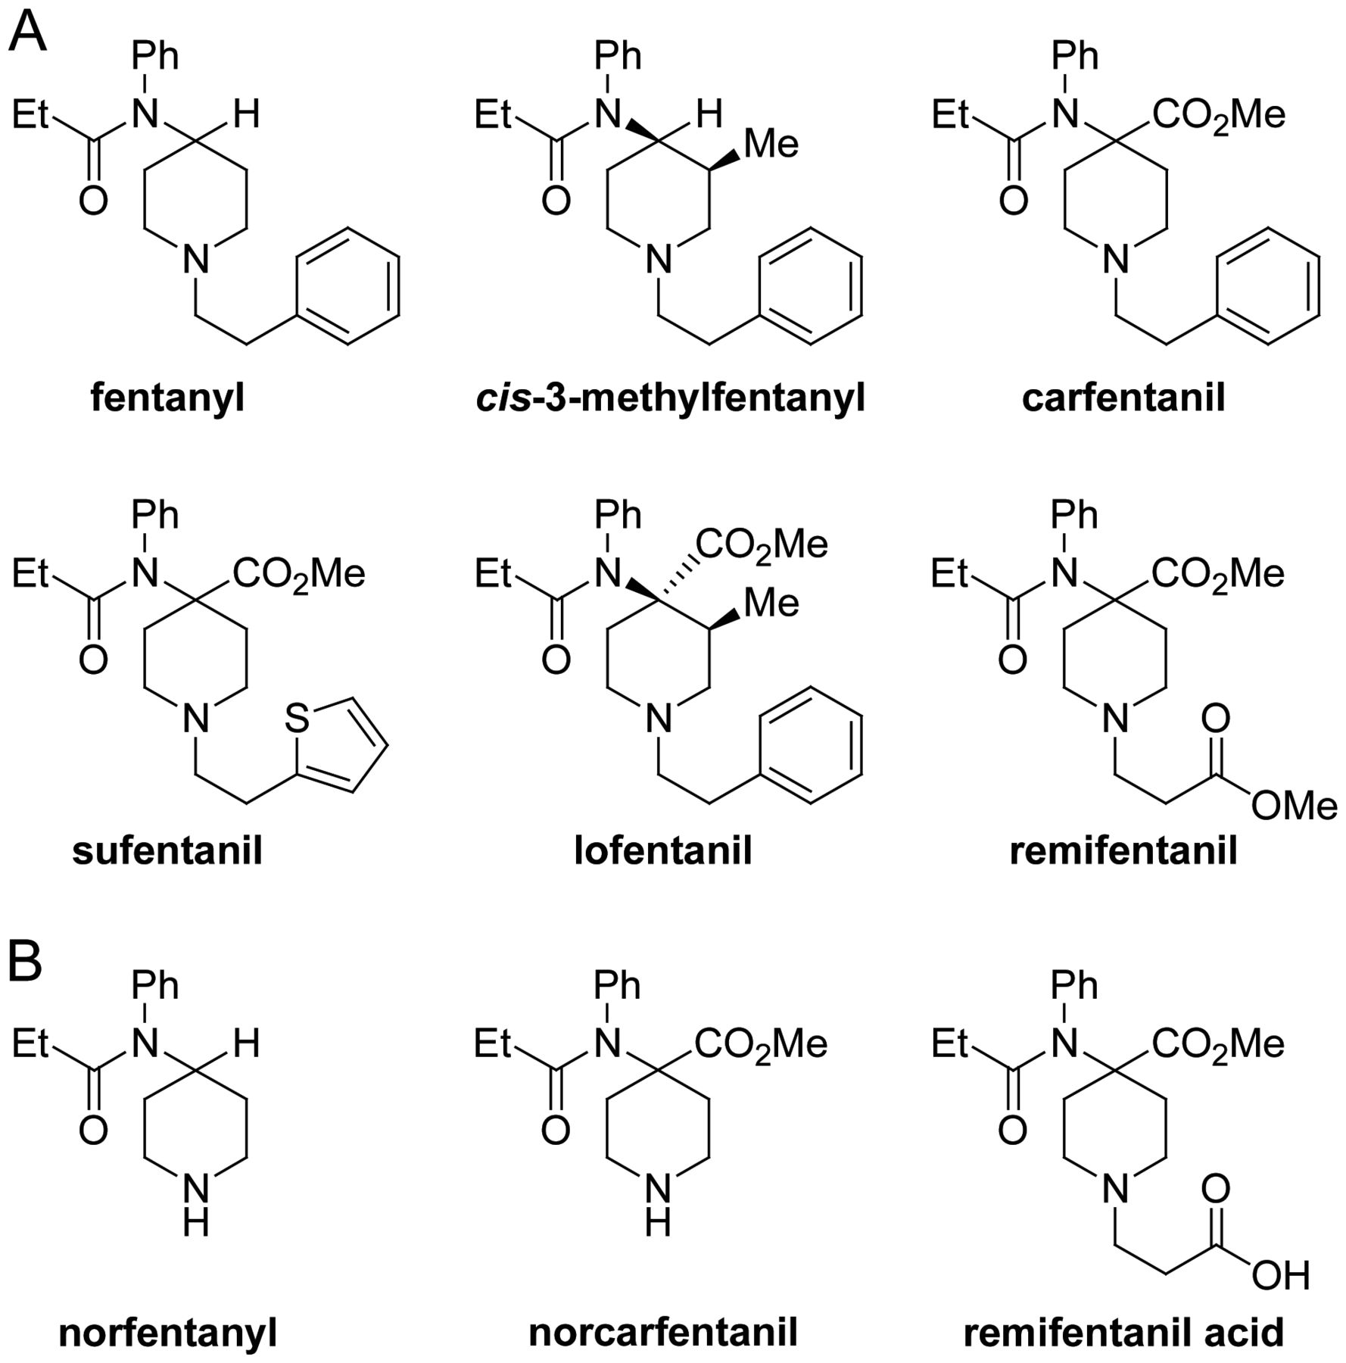
Figure 1. Structures of fentanyl compounds: fentanyl, sufentanil and remifentanil are analgesic-anaesthetics used in ...
Notes:
Figure 1. Structures of fentanyl compounds: fentanyl, sufentanil and remifentanil are analgesic-anaesthetics used in humans, and carfentanil is used in veterinary medicine to tranquillise large mammals (A); fentanyl and carfentanil are metabolized by the liver to nor compounds, and remifentanil reacts with blood enzymes to produce remifentanil acid; the metabolites are not especially biologically active and are excreted unchanged in urine (B).
Unless provided in the caption above, the following copyright applies to the content of this slide: © Crown copyright 2012

Slide 2
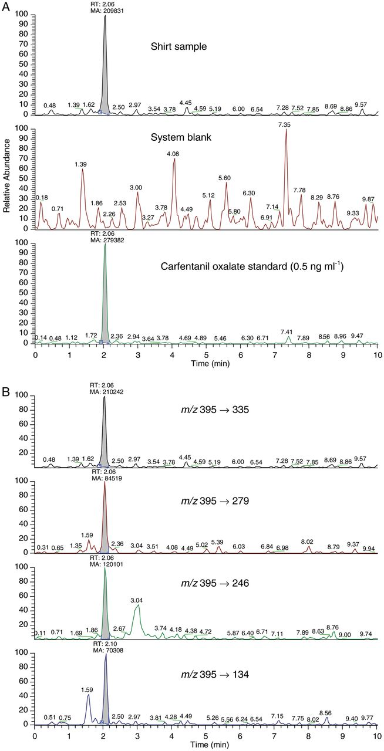
Figure 2. LC–MS-MS MRM detection of carfentanil on the shirt of Casualty 2: detection of carfentanil, monitoring ...
Notes:
Figure 2. LC–MS-MS MRM detection of carfentanil on the shirt of Casualty 2: detection of carfentanil, monitoring fragmentation m/z 395.3 → 335.1 (top), glassware control (middle, baseline magnified ∼10 times) and a carfentanil standard (bottom) (A); detection of carfentanil in the shirt extract monitoring four fragmentations of the protonated molecule m/z 395.3 (B).
Unless provided in the caption above, the following copyright applies to the content of this slide: © Crown copyright 2012

Slide 3
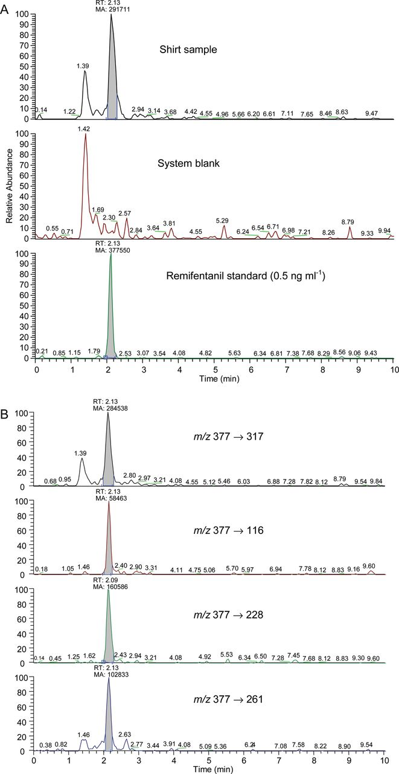
Figure 3. LC–MS-MS MRM detection of remifentanil on the shirt of Casualty 2: detection of remifentanil, monitoring the ...
Notes:
Figure 3. LC–MS-MS MRM detection of remifentanil on the shirt of Casualty 2: detection of remifentanil, monitoring the fragmentation m/z 377.1 → 317.1 (top), the glassware control (middle) and a remifentanil standard (bottom) (A); detection of remifentanil in a shirt extract monitoring four fragmentations of the protonated molecule m/z 377.1 (B).
Unless provided in the caption above, the following copyright applies to the content of this slide: © Crown copyright 2012

Slide 4
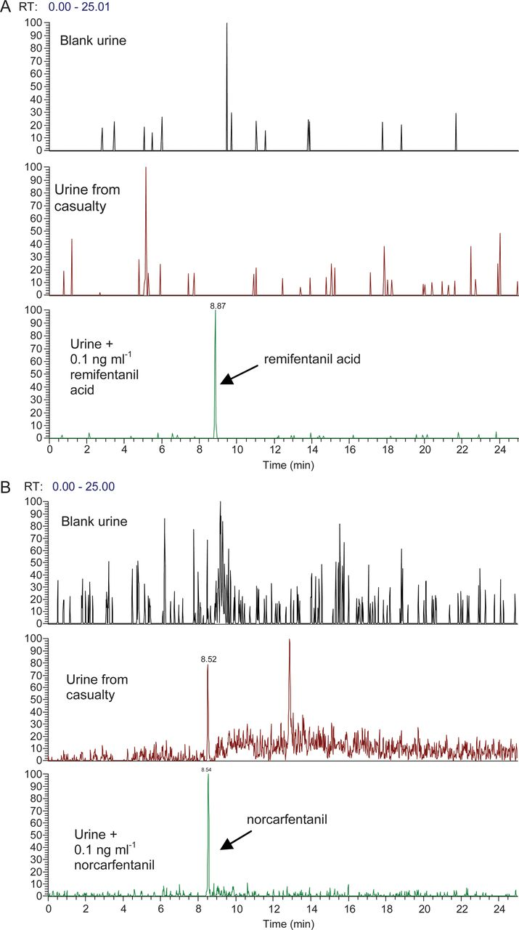
Figure 4. LC–MS-MS SRM chromatograms for the urine sample from Casualty 3: transition m/z 363.0 → 330.9 from an extract ...
Notes:
Figure 4. LC–MS-MS SRM chromatograms for the urine sample from Casualty 3: transition m/z 363.0 → 330.9 from an extract of blank urine (top), urine from Casualty 3 (middle) and spiked urine (bottom) showing the absence of remifentanil acid (A); transition m/z 291.0 → 259.0 from an extract of blank urine (top), urine from Casualty 3 (middle) and spiked urine (bottom) showing the presence of norcarfentanil (B).
Unless provided in the caption above, the following copyright applies to the content of this slide: © Crown copyright 2012

