Slide 1
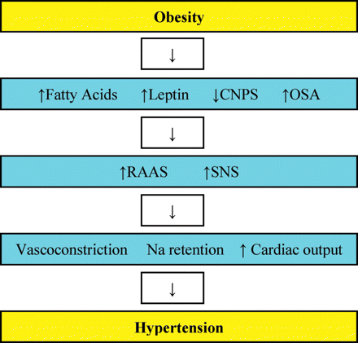
Figure 1 Hypothetical mechanisms by which obesity may contribute to HTN. CNPS, cardiac natriuretic peptide system; ...
Notes:
Figure 1 Hypothetical mechanisms by which obesity may contribute to HTN. CNPS, cardiac natriuretic peptide system; OSA, obstructive sleep apnoea; RAAS, renin–angiotensin–aldosterone system; SNS, sympathetic nervous system.
Unless provided in the caption above, the following copyright applies to the content of this slide: Published on behalf of the European Society of Cardiology. All rights reserved. © The Author 2011. For permissions please email: journals.permissions@oup.com

Slide 2
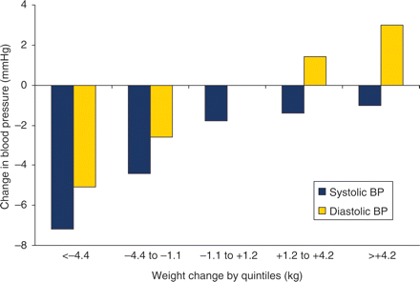
Figure 2 Weight and blood pressure appear to correlate in a linear relationship. The greatest blood pressure reduction ...
Notes:
Figure 2 Weight and blood pressure appear to correlate in a linear relationship. The greatest blood pressure reduction was seen among those who lost the most weight.
Unless provided in the caption above, the following copyright applies to the content of this slide: Published on behalf of the European Society of Cardiology. All rights reserved. © The Author 2011. For permissions please email: journals.permissions@oup.com

Slide 3
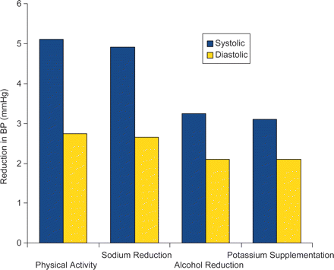
Figure 3 Estimated decrease in blood pressure mediated by non-pharmacological intervention in hypertension (modified ...
Notes:
Figure 3 Estimated decrease in blood pressure mediated by non-pharmacological intervention in hypertension (modified from Messerli et al.).73
Unless provided in the caption above, the following copyright applies to the content of this slide: Published on behalf of the European Society of Cardiology. All rights reserved. © The Author 2011. For permissions please email: journals.permissions@oup.com

Slide 4
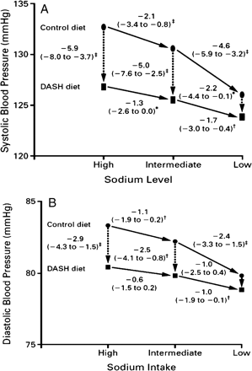
Figure 4 Combining modalities for reducing BP can have additive effects: DASH diet plus salt restriction reduced BP ...
Notes:
Figure 4 Combining modalities for reducing BP can have additive effects: DASH diet plus salt restriction reduced BP differentially for each level of salt intake. Reprinted with permission from Sacks et al.83 *P < 0.05, †P < 0.01, ‡P < 0.001.
Unless provided in the caption above, the following copyright applies to the content of this slide: Published on behalf of the European Society of Cardiology. All rights reserved. © The Author 2011. For permissions please email: journals.permissions@oup.com

