Slide 1
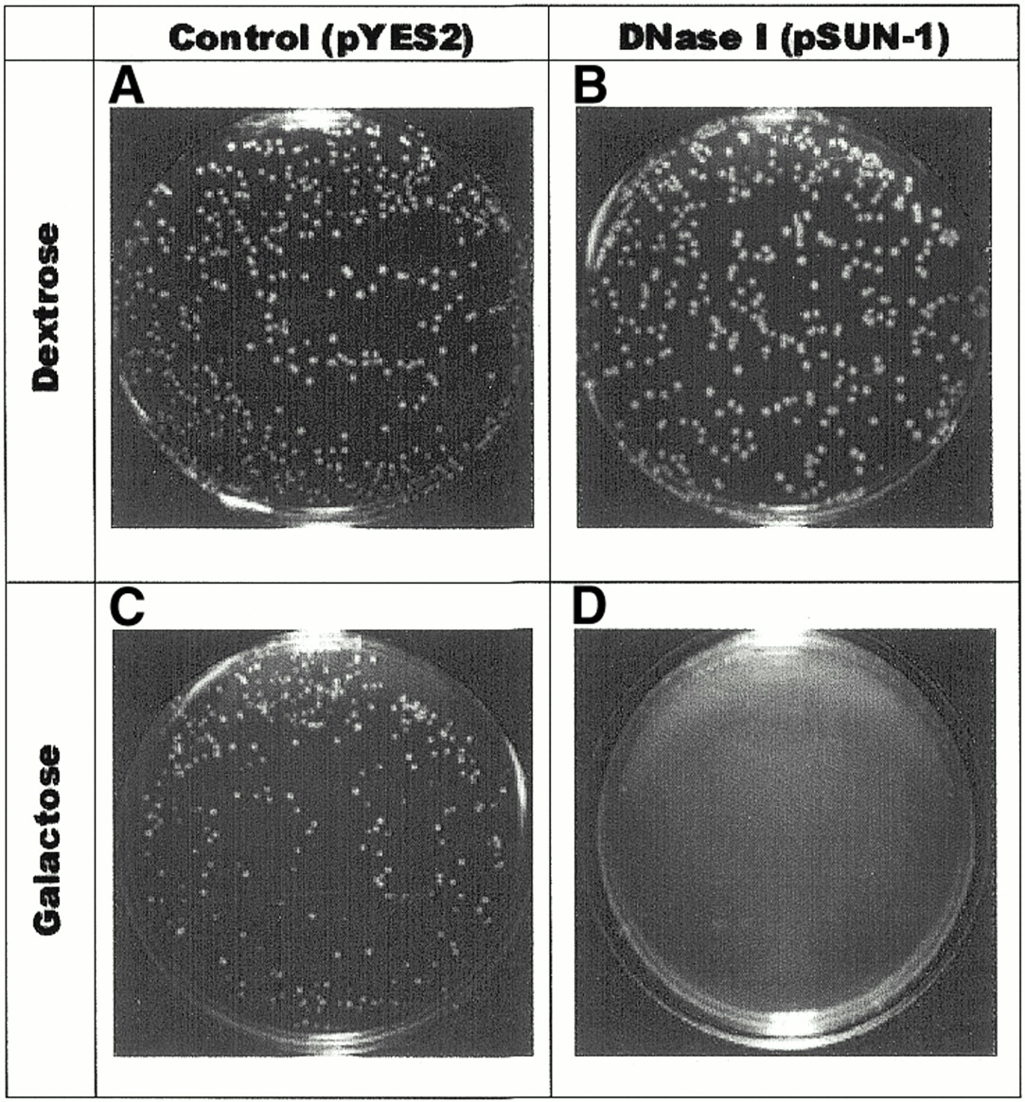
Figure 1. Cytotoxicity of DNase I. Equal numbers of control cells containing the vector (pYES2) alone (A and ...
Notes:
Figure 1. Cytotoxicity of DNase I. Equal numbers of control cells containing the vector (pYES2) alone (A and C) or cells containing the DNase I plasmid (pSUN-1) (B and D) were plated on SD-Ura medium containing dextrose (A and B) or galactose (C and D). Expression of DNase I under control of a galactose responsive promoter is toxic to yeast (D).
Unless provided in the caption above, the following copyright applies to the content of this slide:

Slide 2
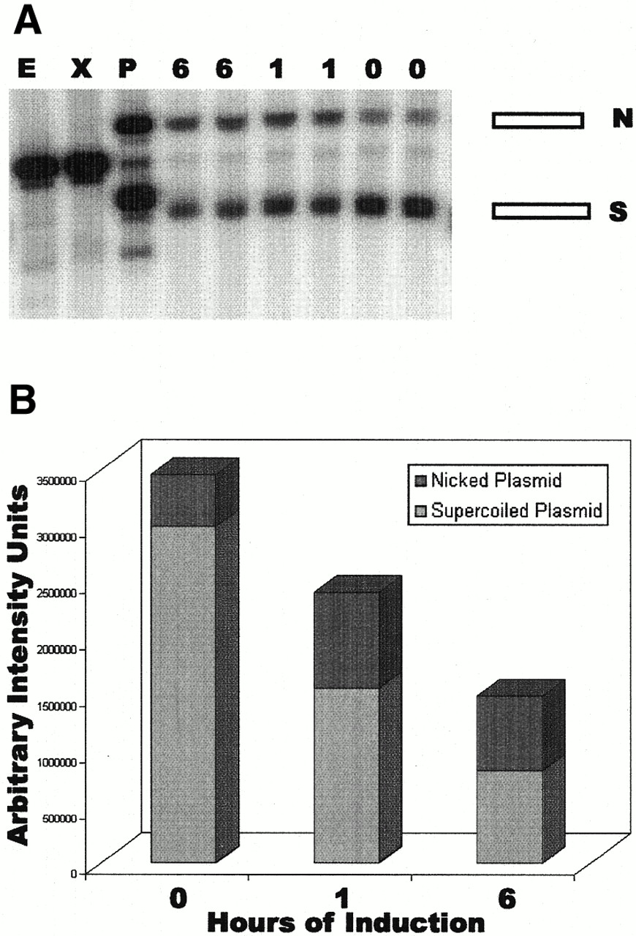
Figure 2. DNase I expressed in vivo introduces nicks in and degrades plasmid DNA. Southern blot (A) and ...
Notes:
Figure 2. DNase I expressed in vivo introduces nicks in and degrades plasmid DNA. Southern blot (A) and PhosphorImager quantification (B) of pSUN-1 plasmid DNA during 6 h of growth in galactose. Results are shown for duplicate independent transformants in (A) and averaged in (B). Samples from cells expressing DNase I under control of a galactose responsive promoter were removed for analysis after 0, 1 and 6 h of incubation, as indicated. Migration positions of supercoiled (S) and nicked (N) plasmid DNA are indicated. Standards in (A) are: plasmid DNA cut with PvuII (P), no sites; EcoRI (E) or XbaI (X), one site. The major species changed from supercoiled to nicked plasmid DNA and the total plasmid DNA present decreased during the incubation.
Unless provided in the caption above, the following copyright applies to the content of this slide:

Slide 3
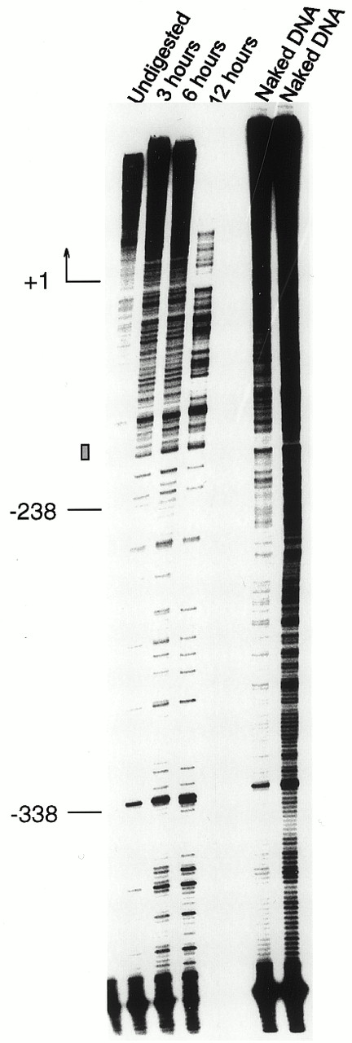
Figure 3. Time course of DNase I degradation of DNA in vivo. Primer extension mapping of cutting sites in the ...
Notes:
Figure 3. Time course of DNase I degradation of DNA in vivo. Primer extension mapping of cutting sites in the pSUN-1 plasmid after induction of expression of DNase I for 0, 3, 6 and 12 h, as indicated. Patterns are compared with those from digestion of protein-free DNA with DNase I in vitro, as indicated. The primer was located 222 bp upstream of the GAL1 promoter TATA box and the region mapped extended to the beginning of the transcriptionally active DNase I gene. Numbers to the left of the gel are coordinates relative to the start of the DNase I coding sequence. The rectangular box denotes the position of the TATA box.
Unless provided in the caption above, the following copyright applies to the content of this slide:

Slide 4
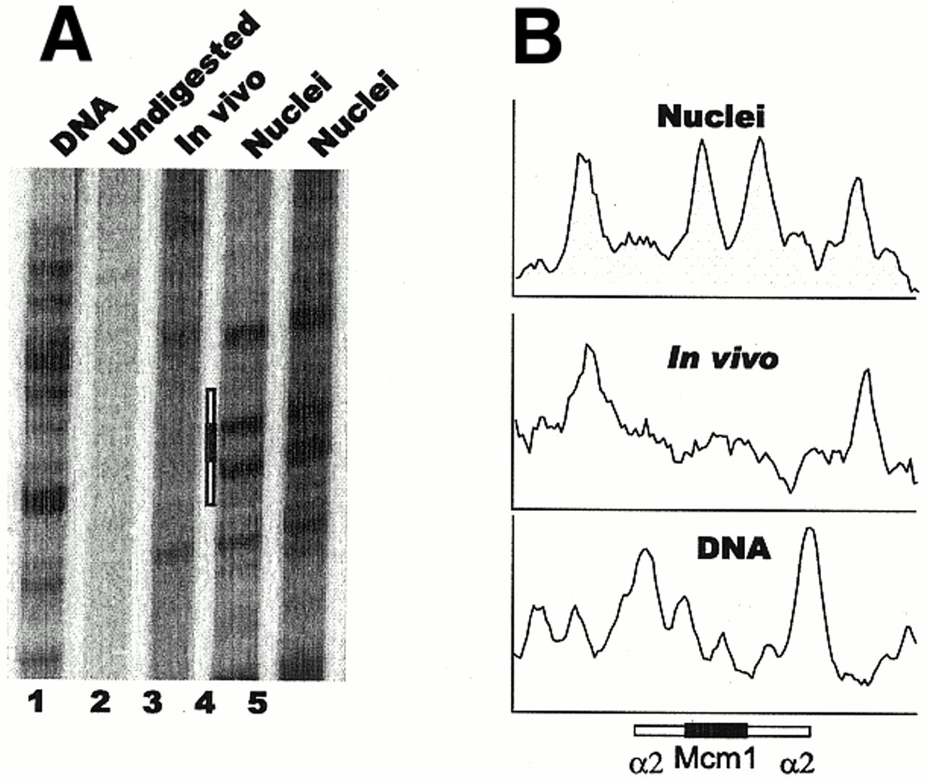
Figure 4. DNase I footprinting of the genomic Matα2p–Mcm1p complex binding site in intact cells and isolated ...
Notes:
Figure 4. DNase I footprinting of the genomic Matα2p–Mcm1p complex binding site in intact cells and isolated nuclei. (A) Primer extension mapping of DNase I cutting sites around the α2#1 operator (chromosome III, 29194–29224 m.u.). Lane 1, protein-free DNA digested with DNase I in vitro. Lane 2, DNA from α-cells containing pSUN-1 grown in dextrose where the DNase I gene is repressed. Lane 3, DNA from α-cells containing pSUN-1 grown for 6 h in galactose where the DNase I gene is expressed. Lanes 4 and 5, DNA from α-cell nuclei isolated from wild-type cells and digested with two concentrations of DNase I in vitro. (B) Densitometric scans of data in lanes 1 (DNA), 3 (In vivo) and 4 (Nuclei) of (A). The rectangles indicate the location of the α2 operator and show the location of the binding sites for Matα2p flanking that for the Mcm1p homodimer.
Unless provided in the caption above, the following copyright applies to the content of this slide:

Slide 5
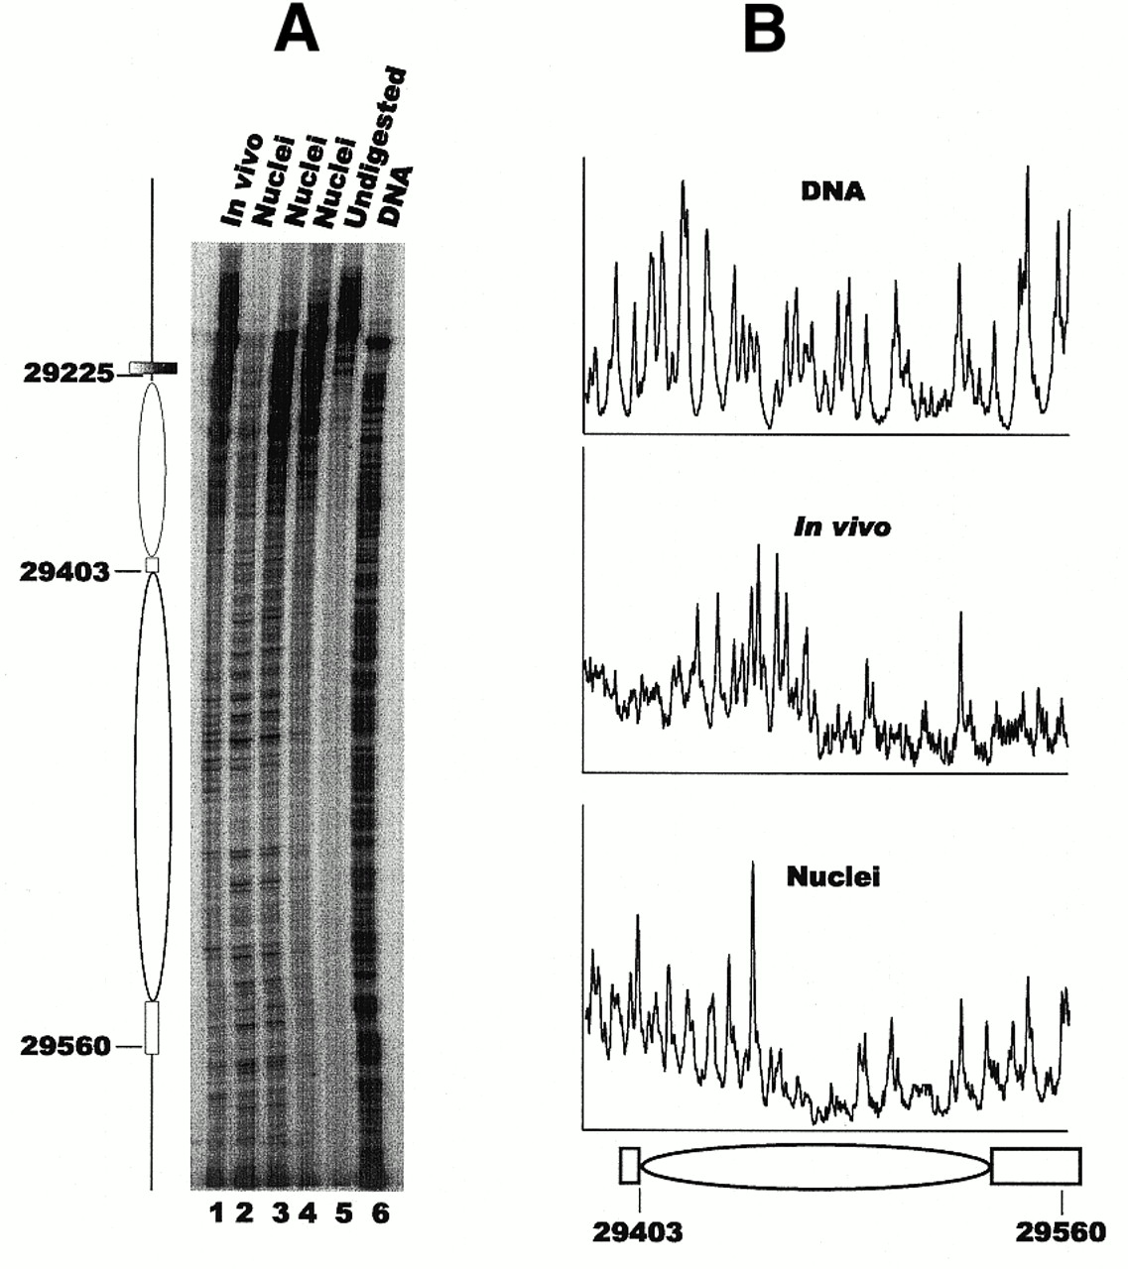
Figure 5. Chromatin structure of the recombination enhancer in vivo. (A) Primer extension analysis of DNase I ...
Notes:
Figure 5. Chromatin structure of the recombination enhancer in vivo. (A) Primer extension analysis of DNase I cutting sites in the second nucleosome of the RE domain at 29403–29560 m.u. of chromosome III, near the α2#1 operator. Features of chromatin structure previously determined by analysis of MNase cutting sites (17) are shown to the left of the autoradiogram. Ellipses mark inferred positions of nucleosomes. Open rectangles indicate linkers. The filled box marks the location of the α2 operator. Lane 1, DNA from α-cells containing pSUN-1 grown for 6 h in galactose where the DNase I gene is expressed. Lanes 2–4, DNA from α-cell nuclei isolated from wild-type cells and digested with three concentrations of DNase I in vitro. Lane 5, DNA from α-cells containing pSUN-1 grown for 6 h in dextrose where the DNase I gene is repressed. Lane 6, protein-free DNA digested with DNase I in vitro. (B) Densitometric scans of data in lanes 6 (DNA), 1 (In vivo) and 3 (Nuclei) of (A). Features of chromatin structure previously determined by analysis of MNase cutting sites are shown below the scans.
Unless provided in the caption above, the following copyright applies to the content of this slide:

Slide 6
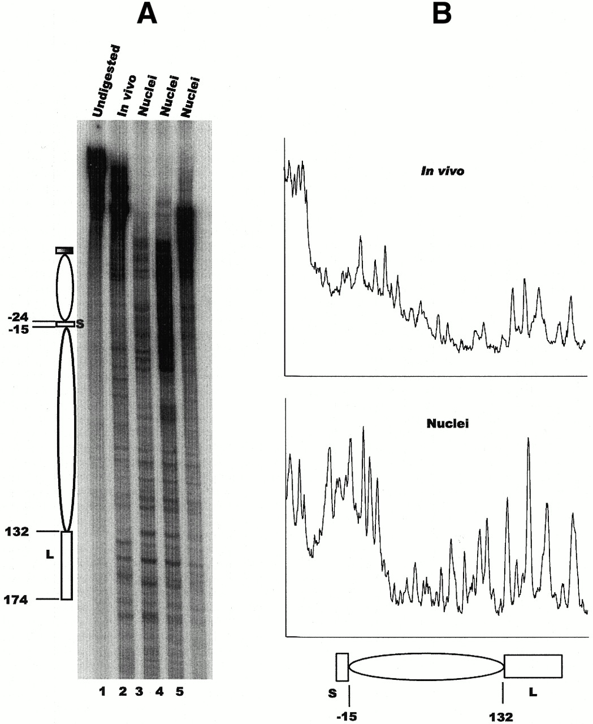
Figure 6. Chromatin structure of the STE6 promoter in vivo. (A) Primer extension analysis of DNase I cutting ...
Notes:
Figure 6. Chromatin structure of the STE6 promoter in vivo. (A) Primer extension analysis of DNase I cutting sites in the first two nucleosomes of the STE6 domain adjacent to the α2 operator. Features of chromatin structure previously determined by analysis of MNase cutting sites (20) are shown to the left of the autoradiogram. Ellipses mark inferred positions of nucleosomes. Open rectangles indicate linkers, either short (S) or long (L). The filled box marks the location of the α2 operator. Lane 1, DNA from α-cells containing pSUN-1 grown for 6 h in dextrose where the DNase I gene is repressed. Lane 2, DNA from α-cells containing pSUN-1 grown for 6 h in galactose where the DNase I gene is expressed. Lanes 3–5, DNA from α-cell nuclei isolated from wild-type cells and digested with three concentrations of DNase I in vitro. (B) Densitometric scans of data in lanes 2 (In vivo) and 3 (Nuclei) of (A). Features of chromatin structure previously determined by analysis of MNase cutting sites are shown below the scans.
Unless provided in the caption above, the following copyright applies to the content of this slide:

Slide 7
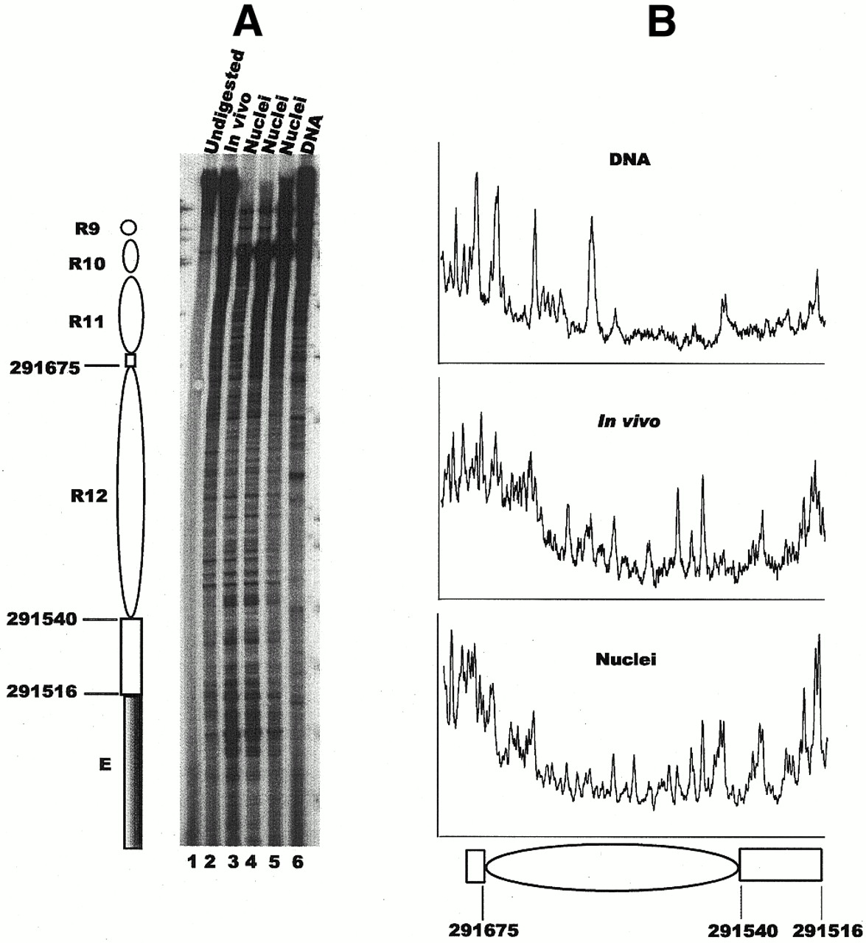
Figure 7. Chromatin structure of a nucleosome adjacent to the E silencer at HMRain vivo. (A) Primer extension ...
Notes:
Figure 7. Chromatin structure of a nucleosome adjacent to the E silencer at HMRain vivo. (A) Primer extension analysis of DNase I cutting sites in the first nucleosome of the HMR domain adjacent to the E silencer. Features of chromatin structure previously determined by analysis of MNase cutting sites (19) are shown to the left of the autoradiogram. Ellipses mark inferred positions of nucleosomes. Open rectangles indicate linkers. The filled box marks the location of the E silencer. Lane 1, DNA from α-cells containing pSUN-1 grown for 6 h in dextrose where the DNase I gene is repressed. Lane 2, DNA from α-cells containing pSUN-1 grown for 6 h in galactose where the DNase I gene is expressed. Lanes 3–5, DNA from α-cell nuclei isolated from wild-type cells and digested with three concentrations of DNase I in vitro. Lane 6, protein-free DNA digested with DNase I in vitro. (B) Densitometric scans of data for nucleosome R12 in lanes 6 (DNA), 2 (In vivo) and 3 (Nuclei) of (A). Features of chromatin structure previously determined by analysis of MNase cutting sites are shown below the scans. The linker to the right is adjacent to the E silencer.
Unless provided in the caption above, the following copyright applies to the content of this slide:

