Slide 1
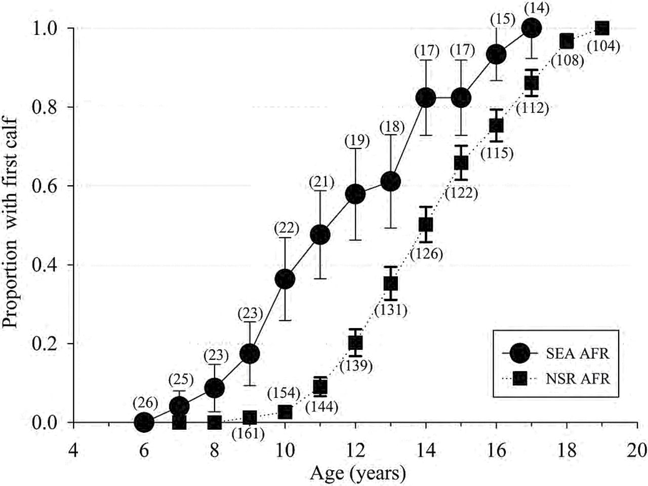
Fig. 1.— The proportion (± SE) of the female population reaching reproductive maturity as defined by the age of 1st ...
Notes:
Fig. 1.— The proportion (± SE) of the female population reaching reproductive maturity as defined by the age of 1st observed calf for known-age killer whales (Orcinus orca) of the eastern North Pacific free-ranging population (NSR, northern and southern residents from 1975 to 2014) and for the captive population at SeaWorld Parks and Entertainment (SEA, 1985–2015) based on animals of known-age and at an estimated age based on length at capture. The number in parenthesis represents total number of females having attained each age group. AFR = age of 1st reproduction.
Unless provided in the caption above, the following copyright applies to the content of this slide: © The Author 2015. Published by Oxford University Press on behalf of American Society of Mammalogists.This is an Open Access article distributed under the terms of the Creative Commons Attribution Non-Commercial License (http://creativecommons.org/licenses/by-nc/4.0/), which permits non-commercial re-use, distribution, and reproduction in any medium, provided the original work is properly cited. For commercial re-use, please contact journals.permissions@oup.com

Slide 2
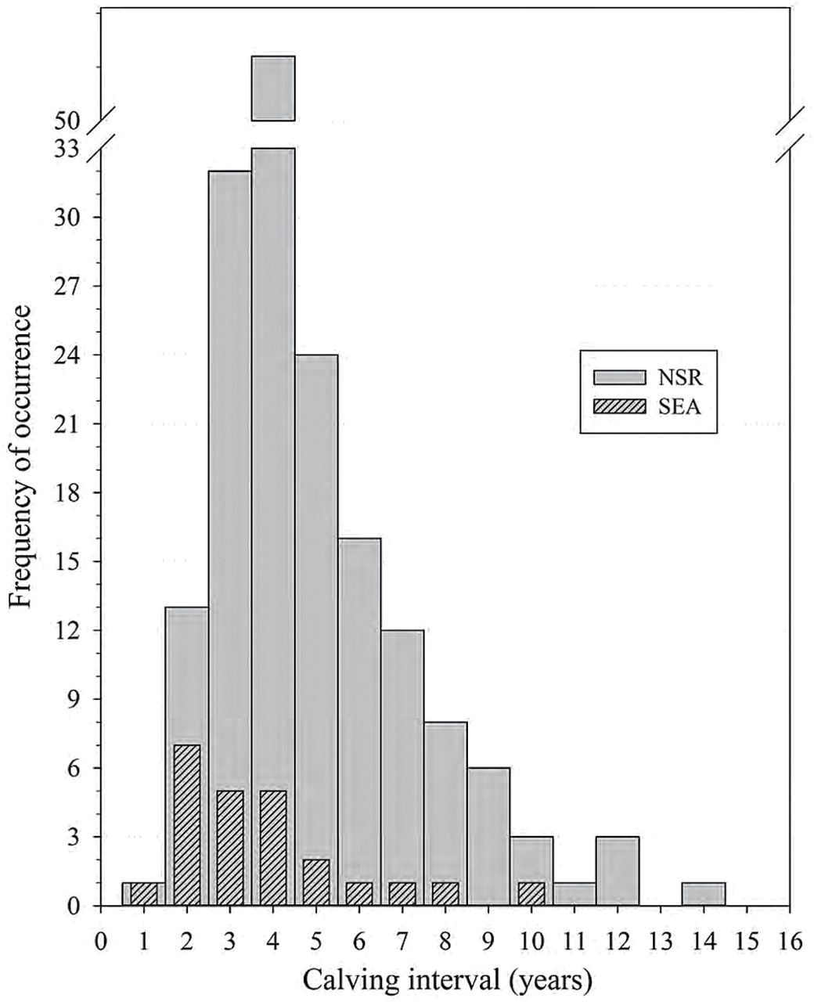
Fig. 2.— Frequency distribution of killer whale (Orcinus orca) calving intervals (CI) for known-age animals of the ...
Notes:
Fig. 2.— Frequency distribution of killer whale (Orcinus orca) calving intervals (CI) for known-age animals of the eastern North Pacific free-ranging population (NSR, northern and southern residents from 1975 to 2014, n = 174 CI) and for the captive population at SeaWorld Parks and Entertainment (SEA, 1985–2015, n = 24 CI) based on animals of known-age and an estimated age based on length at capture.
Unless provided in the caption above, the following copyright applies to the content of this slide: © The Author 2015. Published by Oxford University Press on behalf of American Society of Mammalogists.This is an Open Access article distributed under the terms of the Creative Commons Attribution Non-Commercial License (http://creativecommons.org/licenses/by-nc/4.0/), which permits non-commercial re-use, distribution, and reproduction in any medium, provided the original work is properly cited. For commercial re-use, please contact journals.permissions@oup.com

Slide 3
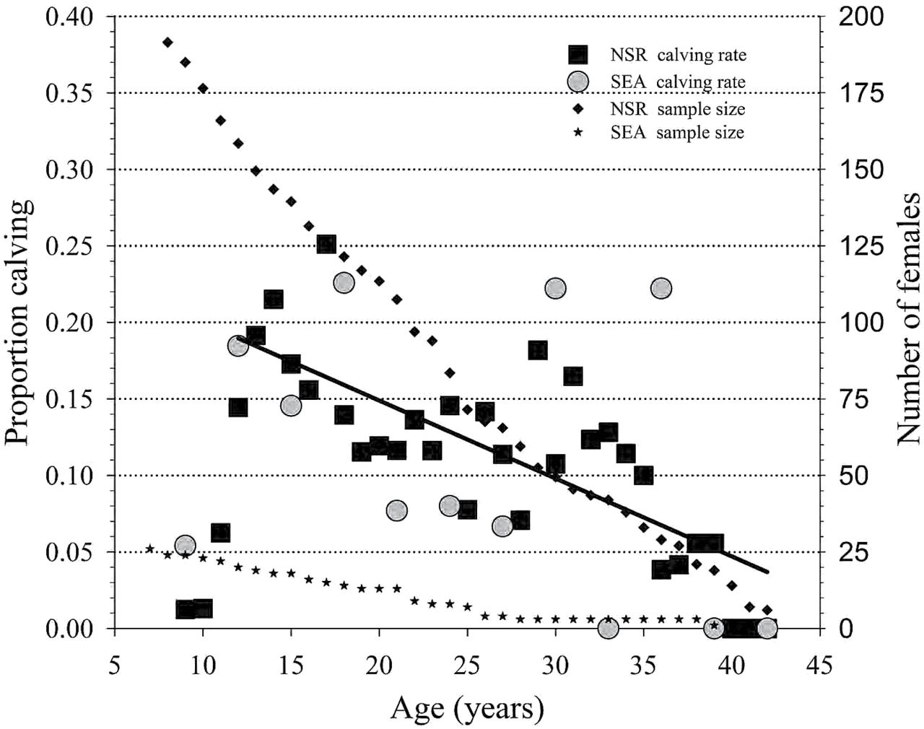
Fig. 3.— Age-specific fecundity for known-age killer whales (Orcinus orca) of the eastern North Pacific free-ranging ...
Notes:
Fig. 3.— Age-specific fecundity for known-age killer whales (Orcinus orca) of the eastern North Pacific free-ranging population (NSR, northern and southern residents from 1975 to 2014) and for the captive population at SeaWorld Parks and Entertainment (SEA, 1985–2015) based on animals of known-age and an estimated age based on length at capture. The linear regression line (Y = 0.251 − 0.00509 * Age) in the figure depicts this significant (r2 = 0.46, P < 0.001) decline in observed fecundity with age.
Unless provided in the caption above, the following copyright applies to the content of this slide: © The Author 2015. Published by Oxford University Press on behalf of American Society of Mammalogists.This is an Open Access article distributed under the terms of the Creative Commons Attribution Non-Commercial License (http://creativecommons.org/licenses/by-nc/4.0/), which permits non-commercial re-use, distribution, and reproduction in any medium, provided the original work is properly cited. For commercial re-use, please contact journals.permissions@oup.com

Slide 4
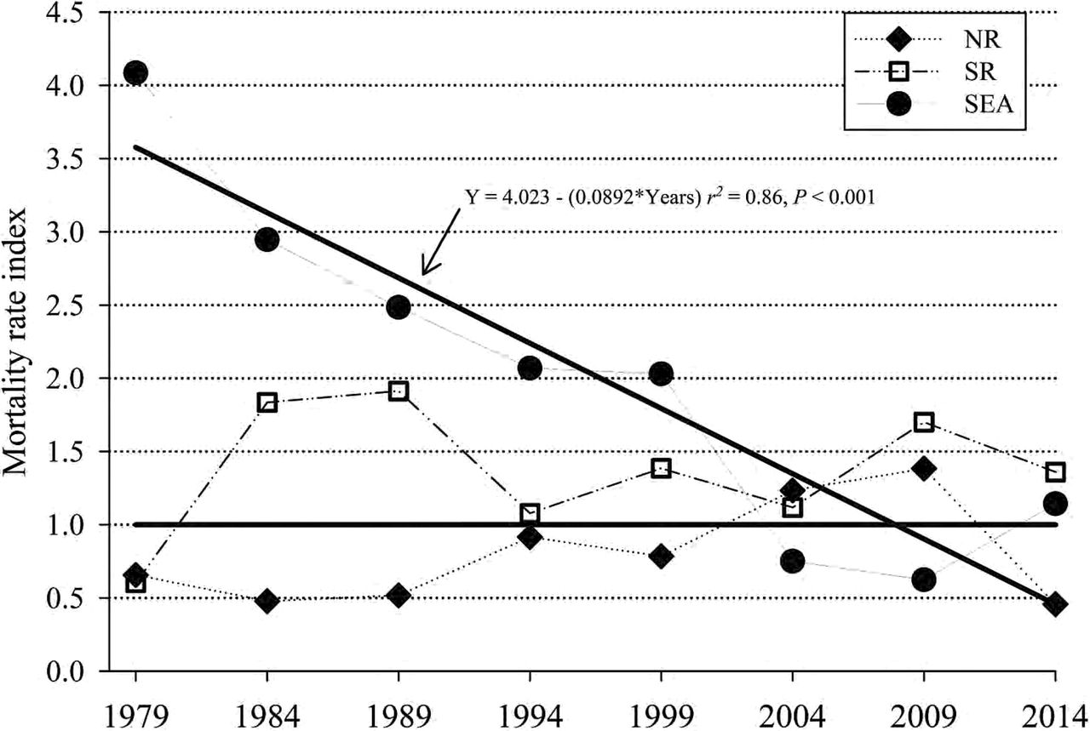
Fig. 4.— The mortality rate index (actual divided by expected mortality rates) of the northern resident (NR, ♦), ...
Notes:
Fig. 4.— The mortality rate index (actual divided by expected mortality rates) of the northern resident (NR, ♦), southern resident (SR, □), and SeaWorld (SEA, ●) killer whales (Orcinus orca). The horizontal black line is the expected mortality rate (EMR) reference index (EMR/EMR). The EMR was determined from the age-specific (0–9.5, 10–19.5, 20–29.5, > 30 years) mortality rate of free-ranging killer whales (NR and SR from 1975 to 2015). Next, the actual mortality rates in ~5-year blocks for NR and SR (starting in 1979) and ~5-year blocks for SEA (1965–1979, then 5-year blocks) for each age group were determined and the sum of actual mortality rate was divided by sum of EMR. The solid black line marked by an arrow is the regression of the SEA mortality rate index by time and it demonstrates a significant (P < 0.001) decrease in mortality rates over time.
Unless provided in the caption above, the following copyright applies to the content of this slide: © The Author 2015. Published by Oxford University Press on behalf of American Society of Mammalogists.This is an Open Access article distributed under the terms of the Creative Commons Attribution Non-Commercial License (http://creativecommons.org/licenses/by-nc/4.0/), which permits non-commercial re-use, distribution, and reproduction in any medium, provided the original work is properly cited. For commercial re-use, please contact journals.permissions@oup.com

Slide 5
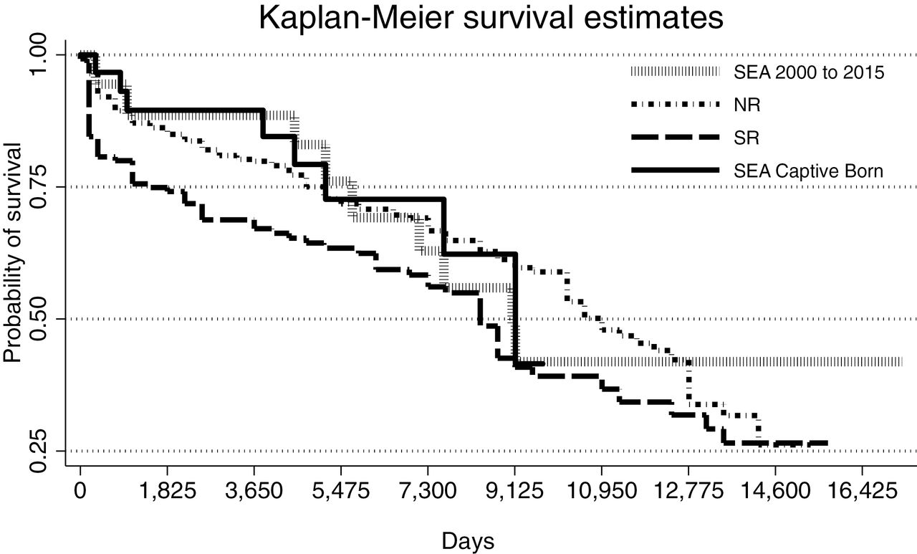
Fig. 5.— Kaplan–Meier survival curves for the proportion of killer whales (Orcinus orca) alive over time (days) for ...
Notes:
Fig. 5.— Kaplan–Meier survival curves for the proportion of killer whales (Orcinus orca) alive over time (days) for northern resident 1975–2014 (NR, n = 363), southern resident 1975–2015 (SR, n = 146), SEA (2000–2015, n = 39), and captive-born at SeaWorld Parks (SEA captive-born, 1985–2015, n = 31) killer whales. Significant differences (χ2 = 7.3, P = 0.007) were only detected between SR and NR populations.
Unless provided in the caption above, the following copyright applies to the content of this slide: © The Author 2015. Published by Oxford University Press on behalf of American Society of Mammalogists.This is an Open Access article distributed under the terms of the Creative Commons Attribution Non-Commercial License (http://creativecommons.org/licenses/by-nc/4.0/), which permits non-commercial re-use, distribution, and reproduction in any medium, provided the original work is properly cited. For commercial re-use, please contact journals.permissions@oup.com

Slide 6
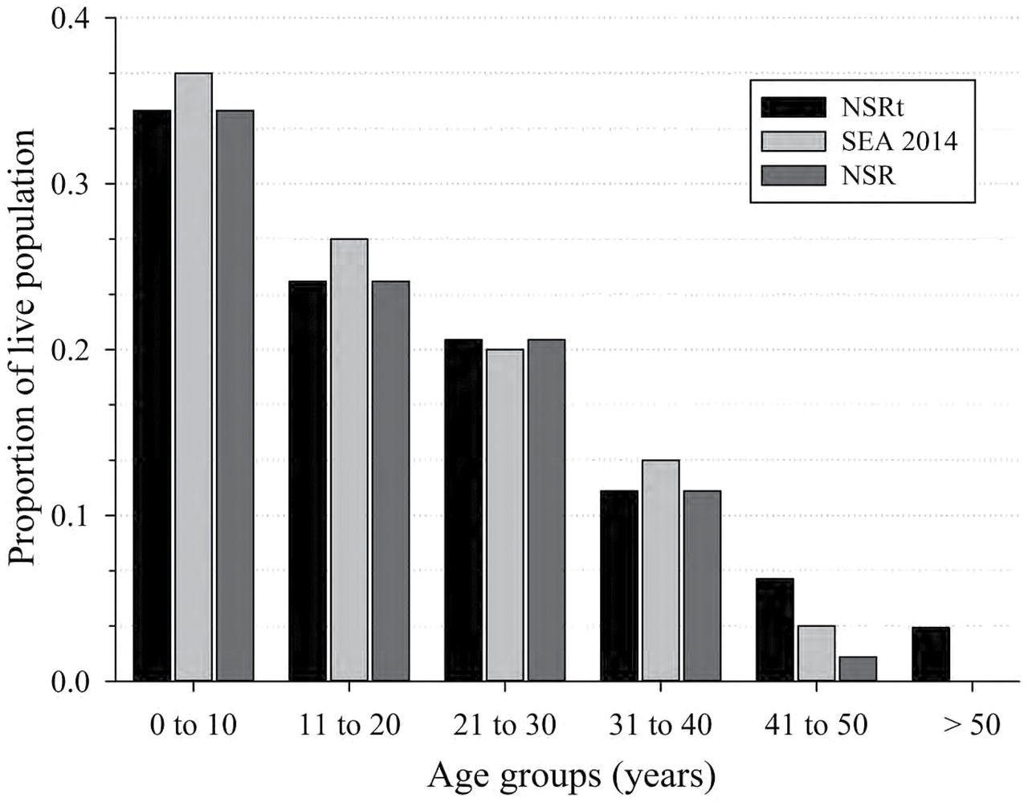
Fig. 6.— The population age structure for free-ranging killer whales (Orcinus orca) of the eastern North Pacific (NSR, ...
Notes:
Fig. 6.— The population age structure for free-ranging killer whales (Orcinus orca) of the eastern North Pacific (NSR, northern and southern resident population from 1975 to 2015) for males and females of known-age (NSR) and for all NSR animals (estimated age + known age, NSRt) as reported on 31 December 2014. The population age structure of captive killer whales at SeaWorld Parks and Entertainment (SEA) includes known-age animals and animals whose age was estimated based on length at capture. No differences (P > 0.05) were detected in the distribution patterns of age group categories among the 3 population types prior to the 41- to 50-year category. In that category, the number of animals present as a proportion of the living population for NSR was lower than that of the value for animals of estimated age NSRt (Z = 2.38, P = 0.017).
Unless provided in the caption above, the following copyright applies to the content of this slide: © The Author 2015. Published by Oxford University Press on behalf of American Society of Mammalogists.This is an Open Access article distributed under the terms of the Creative Commons Attribution Non-Commercial License (http://creativecommons.org/licenses/by-nc/4.0/), which permits non-commercial re-use, distribution, and reproduction in any medium, provided the original work is properly cited. For commercial re-use, please contact journals.permissions@oup.com

