Slide 1
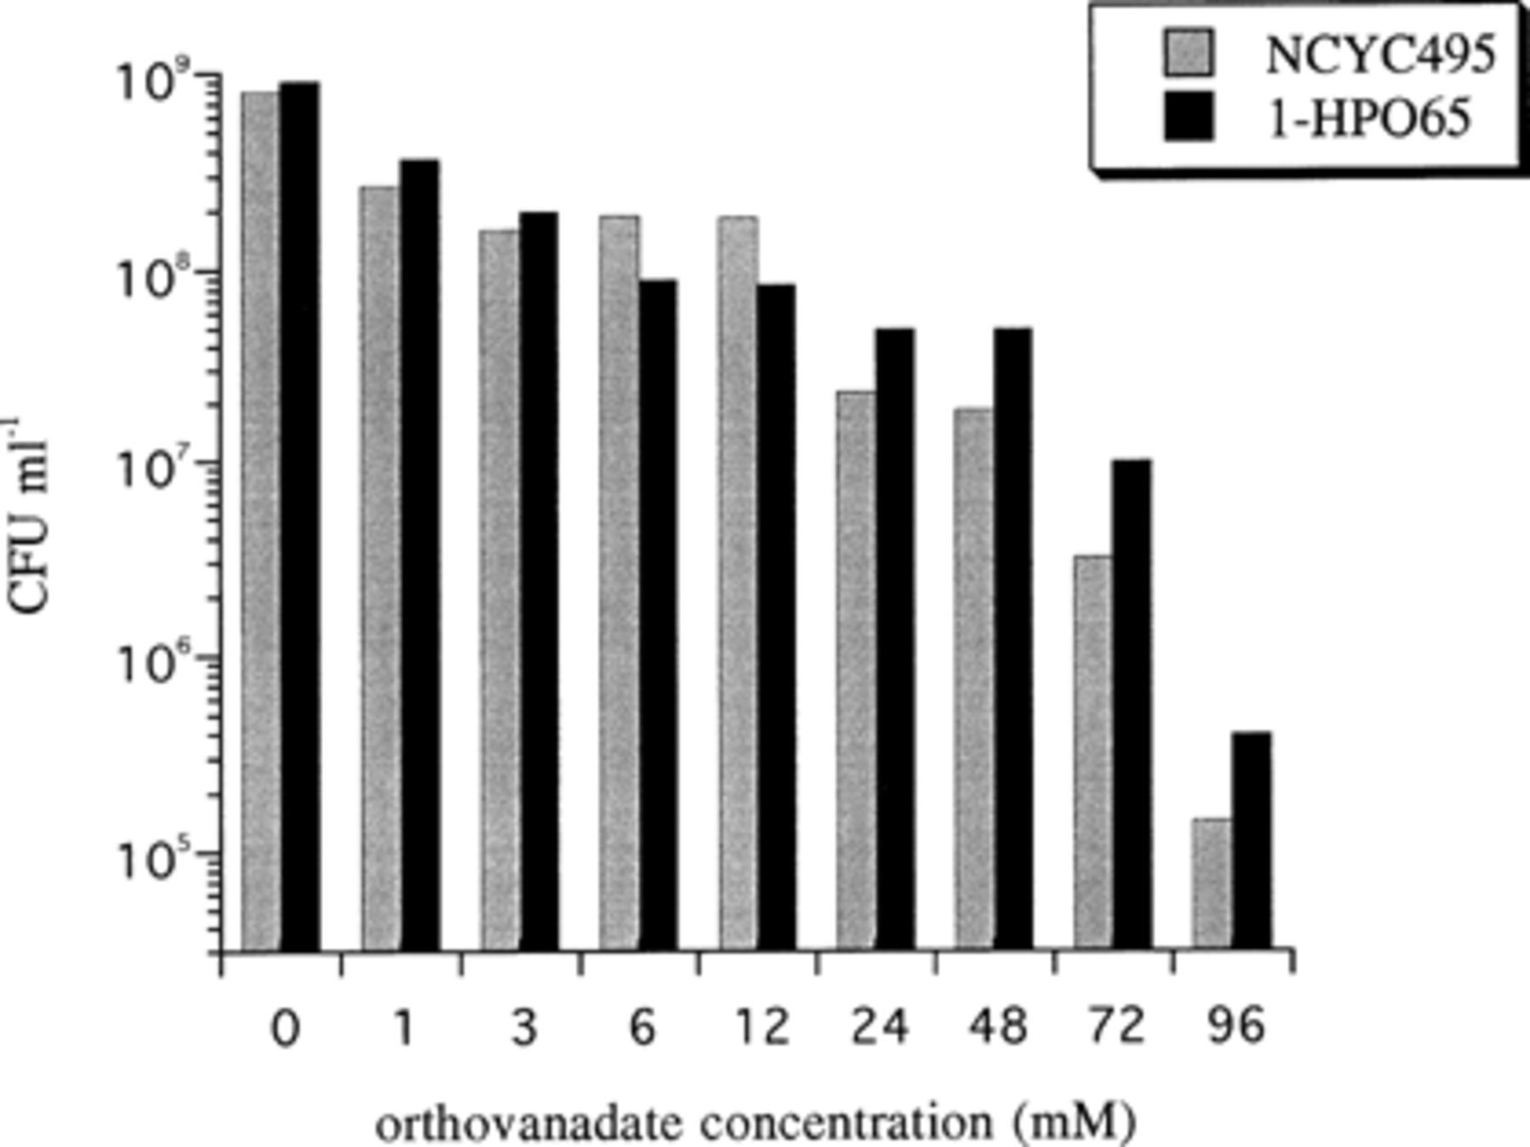
1 The effect of vanadate on growth of two different strains of H. polymorpha. Viable count of cultures on GYNB ...
Notes:
1 The effect of vanadate on growth of two different strains of H. polymorpha. Viable count of cultures on GYNB or VGYNB (at different vanadate concentrations, ranging from 1 to 96 mM) of two H. polymorpha strains at 48 h from inoculation. The viable counts of the cultures at time 0 varied from 3.0 to 4.4×104 CFU ml−1. The data shown are representative of two independent experiments.
Unless provided in the caption above, the following copyright applies to the content of this slide: Copyright © 1997 Federation of European Microbiological Societies. Published by Elsevier Science B.V.

Slide 2
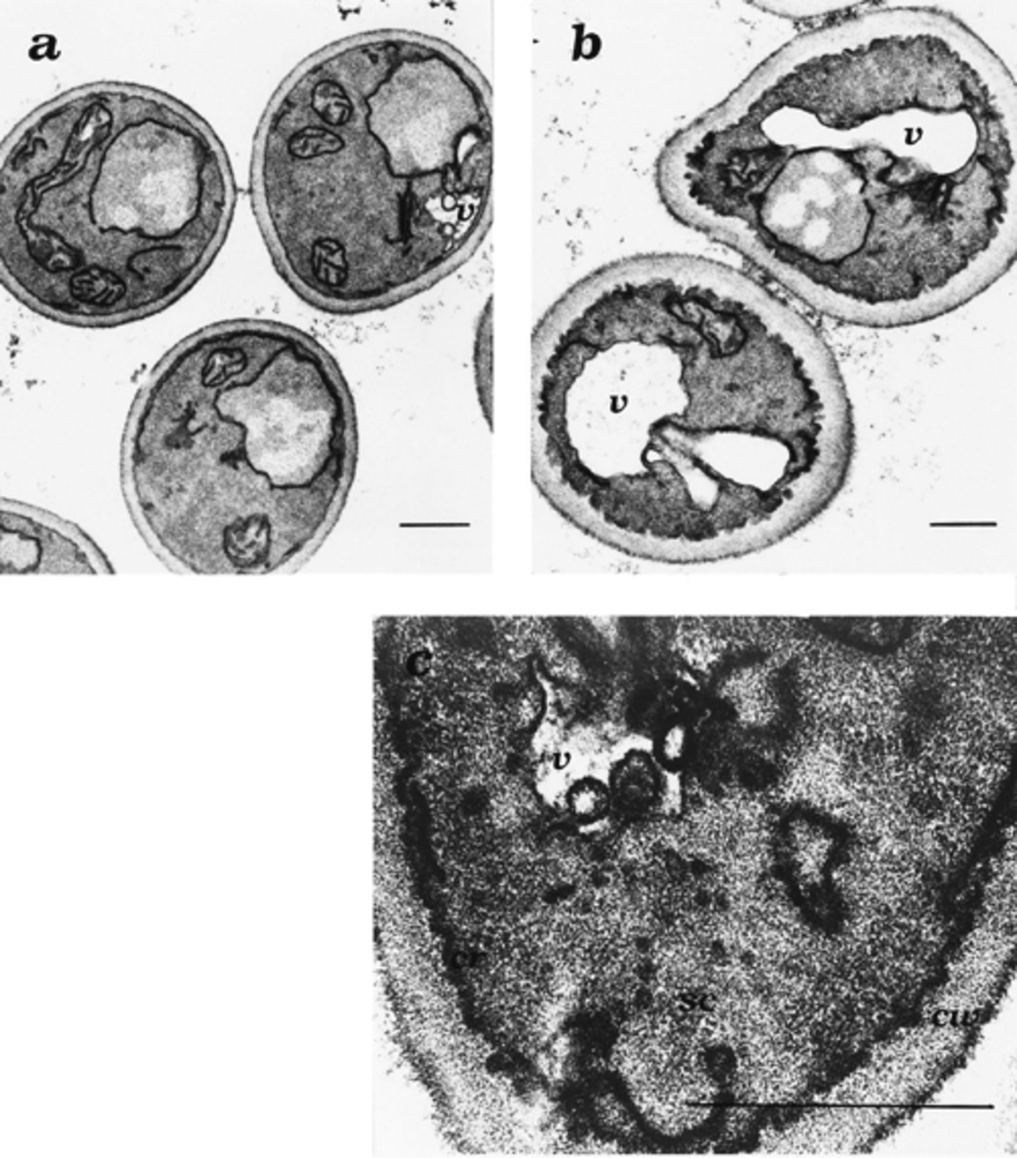
2 Ultrastructural changes induced by vanadate in H. polymorpha. Cells grown to exponential phase on GYNB (a) or ...
Notes:
2 Ultrastructural changes induced by vanadate in H. polymorpha. Cells grown to exponential phase on GYNB (a) or VGYNB (b,c) were fixed in potassium permanganate for visualization of morphological and ultrastructural modifications by transmission electron microscopy. a,b: Low-power image of whole cells (24.000×). Bar: 0.5 μm. c: High-power image of a cell portion (112.500×). Bar: 0.5 μm. v=vacuole, sc=small cytoplasmic vesicles, cw=cell wall, cr=cristae.
Unless provided in the caption above, the following copyright applies to the content of this slide: Copyright © 1997 Federation of European Microbiological Societies. Published by Elsevier Science B.V.

Slide 3
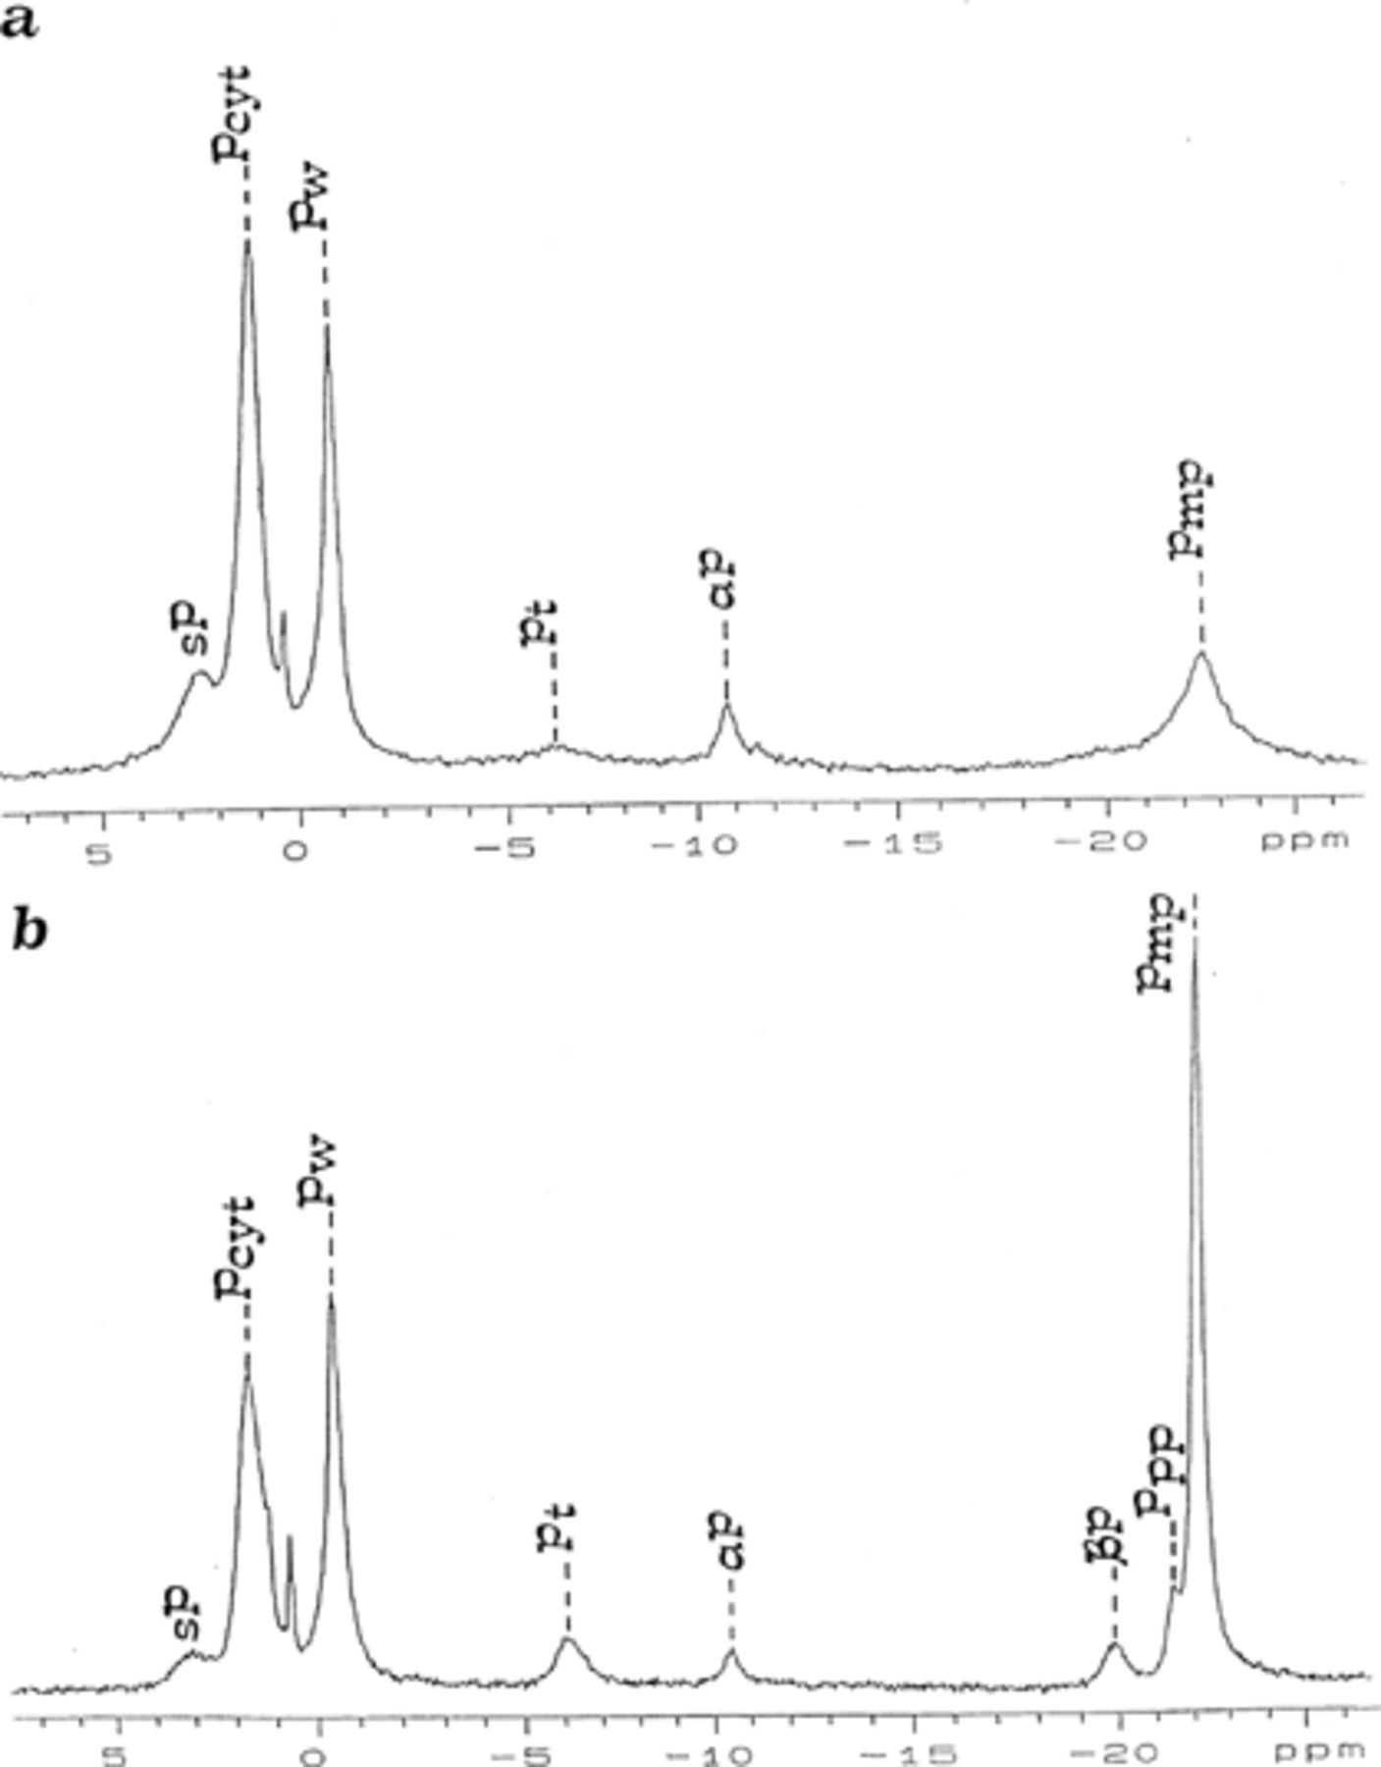
3 ³¹P-NMR spectra of H. polymorpha cells grown on (a) GYNB or (b) VGYNB. Starting from low field (on ...
Notes:
3 31P-NMR spectra of H. polymorpha cells grown on (a) GYNB or (b) VGYNB. Starting from low field (on the left) the resonances are assigned as follows: the resonance at +2.5 ppm (SP) was assigned to the P of sugar phosphate; the next intense peak at about +1 ppm (P cyt) is due to cytosolic phosphate; the peak at about −1 ppm (PW) was assigned to phosphomannans of the cell wall; at −6 ppm (Pt) to the terminal phosphate of polyphosphate chains as well as the γP of ATP or the βP of ADP molecules; at −10.5 ppm (αP) to the primary phosphate of nucleoside phosphates such as the αP of the ATP and ADP molecules; at about −20 ppm (βP) to the penultimate P of different compounds such as the βP of the ATP molecule; at −21.5 ppm (Ppp) to the penultimate P of polyphosphates; the peak at −22.5 ppm (Pmp) was assigned to the middle P of polyphosphate chains. The spectra shown are from a single experiment, and are representative of two independent determinations.
Unless provided in the caption above, the following copyright applies to the content of this slide: Copyright © 1997 Federation of European Microbiological Societies. Published by Elsevier Science B.V.

