Slide 1
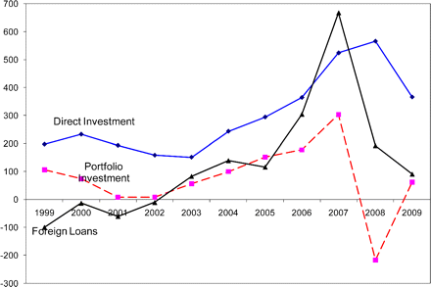
Figure 1 Capital flows to emerging market economies (in billion US$) The sample includes 24 emerging economies listed ...
Notes:
Figure 1 Capital flows to emerging market economies (in billion US$) The sample includes 24 emerging economies listed in Table 4. Source: IMF's World Economic Outlook database.
Unless provided in the caption above, the following copyright applies to the content of this slide: © The Author 2010. Published by Oxford University Press on behalf of The Society for Financial Studies. All rights reserved. For Permissions, please e-mail: journals.permissions@oup.com.

Slide 2
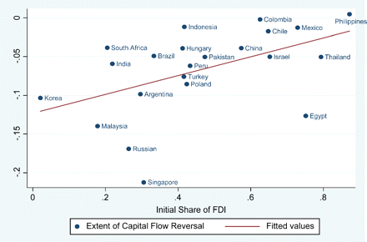
Figure 2 The extent of capital flow reversal versus the initial share of FDI On the vertical axis is the change in ...
Notes:
Figure 2 The extent of capital flow reversal versus the initial share of FDI On the vertical axis is the change in capital inflow/GDP from 2007 to 2009, and on the horizontal axis is the share of FDI inflow in the country's total inflows in 2007. The slope coefficient is 0.12 with a t-statistic of 2.53.
Unless provided in the caption above, the following copyright applies to the content of this slide: © The Author 2010. Published by Oxford University Press on behalf of The Society for Financial Studies. All rights reserved. For Permissions, please e-mail: journals.permissions@oup.com.

Slide 3
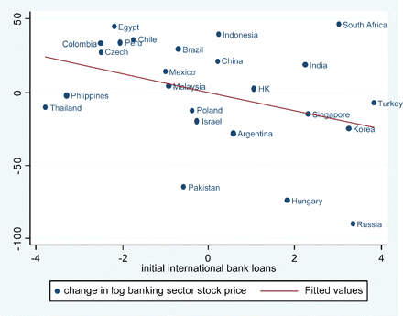
Figure 3 Change in log banking stock prices vs. pre-crisis international bank loans (conditional scatter plot) On the ...
Notes:
Figure 3 Change in log banking stock prices vs. pre-crisis international bank loans (conditional scatter plot) On the vertical axis is the change in log bank-sector stock price from July 1, 2007, to December 31, 2008. On the horizontal axis is the pre-crisis inflow of loans/GDP averaged over 2002–2006. This partial scatter plot is conditioned on pre-crisis foreign direct investments and portfolio investments over GDP. The slope coefficient is –6.38 with a standard error of 3.24. Source: IMF's WEO database and Datastream.
Unless provided in the caption above, the following copyright applies to the content of this slide: © The Author 2010. Published by Oxford University Press on behalf of The Society for Financial Studies. All rights reserved. For Permissions, please e-mail: journals.permissions@oup.com.

