Slide 1
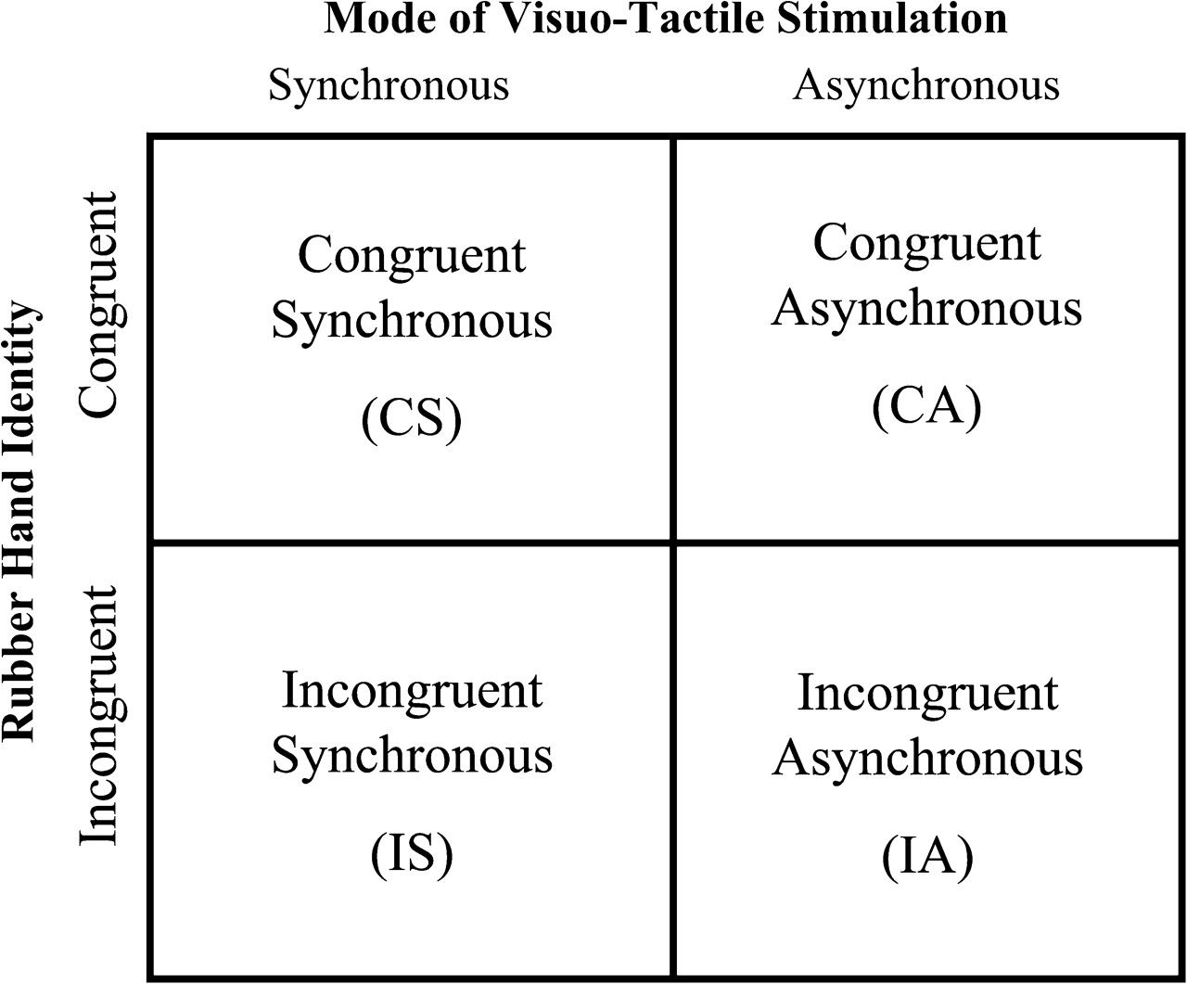
Figure 1. The 2 × 2 factorial experimental design.
Notes:
Figure 1. The 2 × 2 factorial experimental design.
Unless provided in the caption above, the following copyright applies to the content of this slide: © The Author 2006. Published by Oxford University Press. All rights reserved. For permissions, please e-mail: journals.permissions@oxfordjournals.org

Slide 2
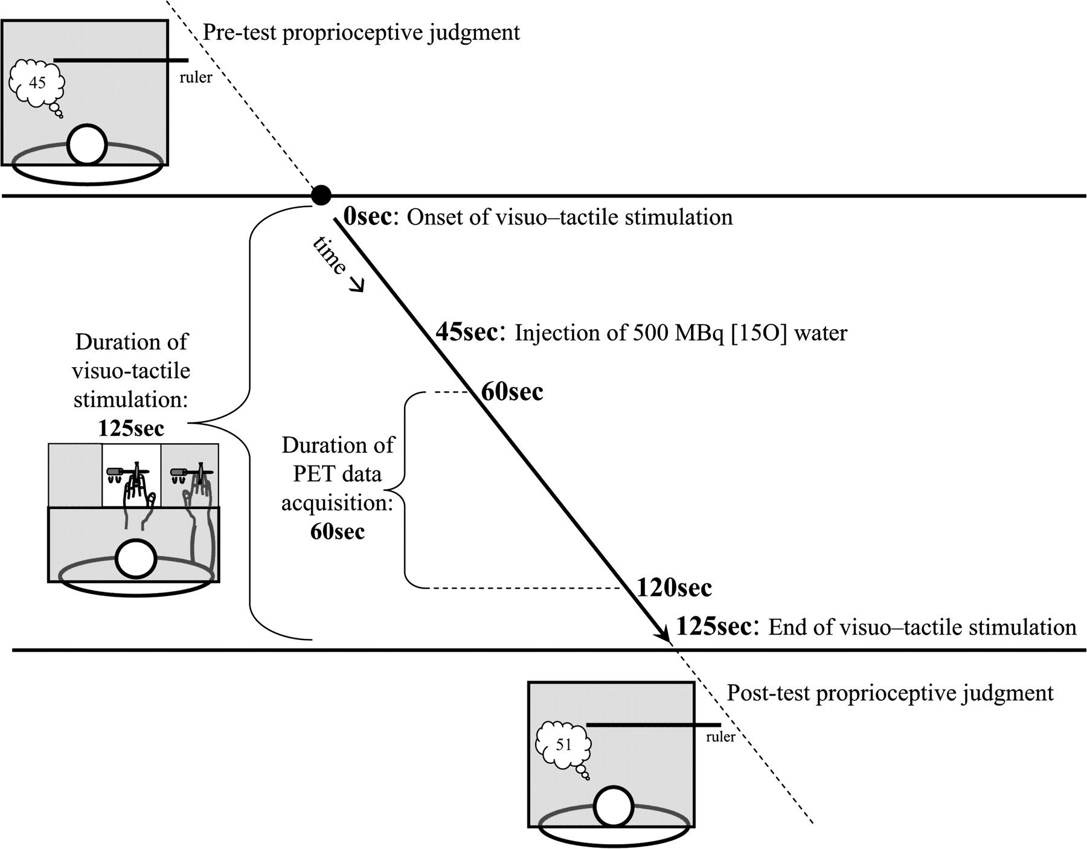
Figure 2. The experimental setup and temporal sequence of events. At the beginning of the trial, participants judged ...
Notes:
Figure 2. The experimental setup and temporal sequence of events. At the beginning of the trial, participants judged the felt location of their own middle finger. Then the rubber hand appeared and visuotactile stimulation was delivered for 125 s. Acquisition of the PET data began 60 s after the onset of visuotactile stimulation and lasted for 60 s. In the condition shown, the participant is looking at an incongruent rubber hand identity with respect to his/her own stimulated hand. At the end of trial, participants judged anew the felt location of their own middle finger.
Unless provided in the caption above, the following copyright applies to the content of this slide: © The Author 2006. Published by Oxford University Press. All rights reserved. For permissions, please e-mail: journals.permissions@oxfordjournals.org

Slide 3
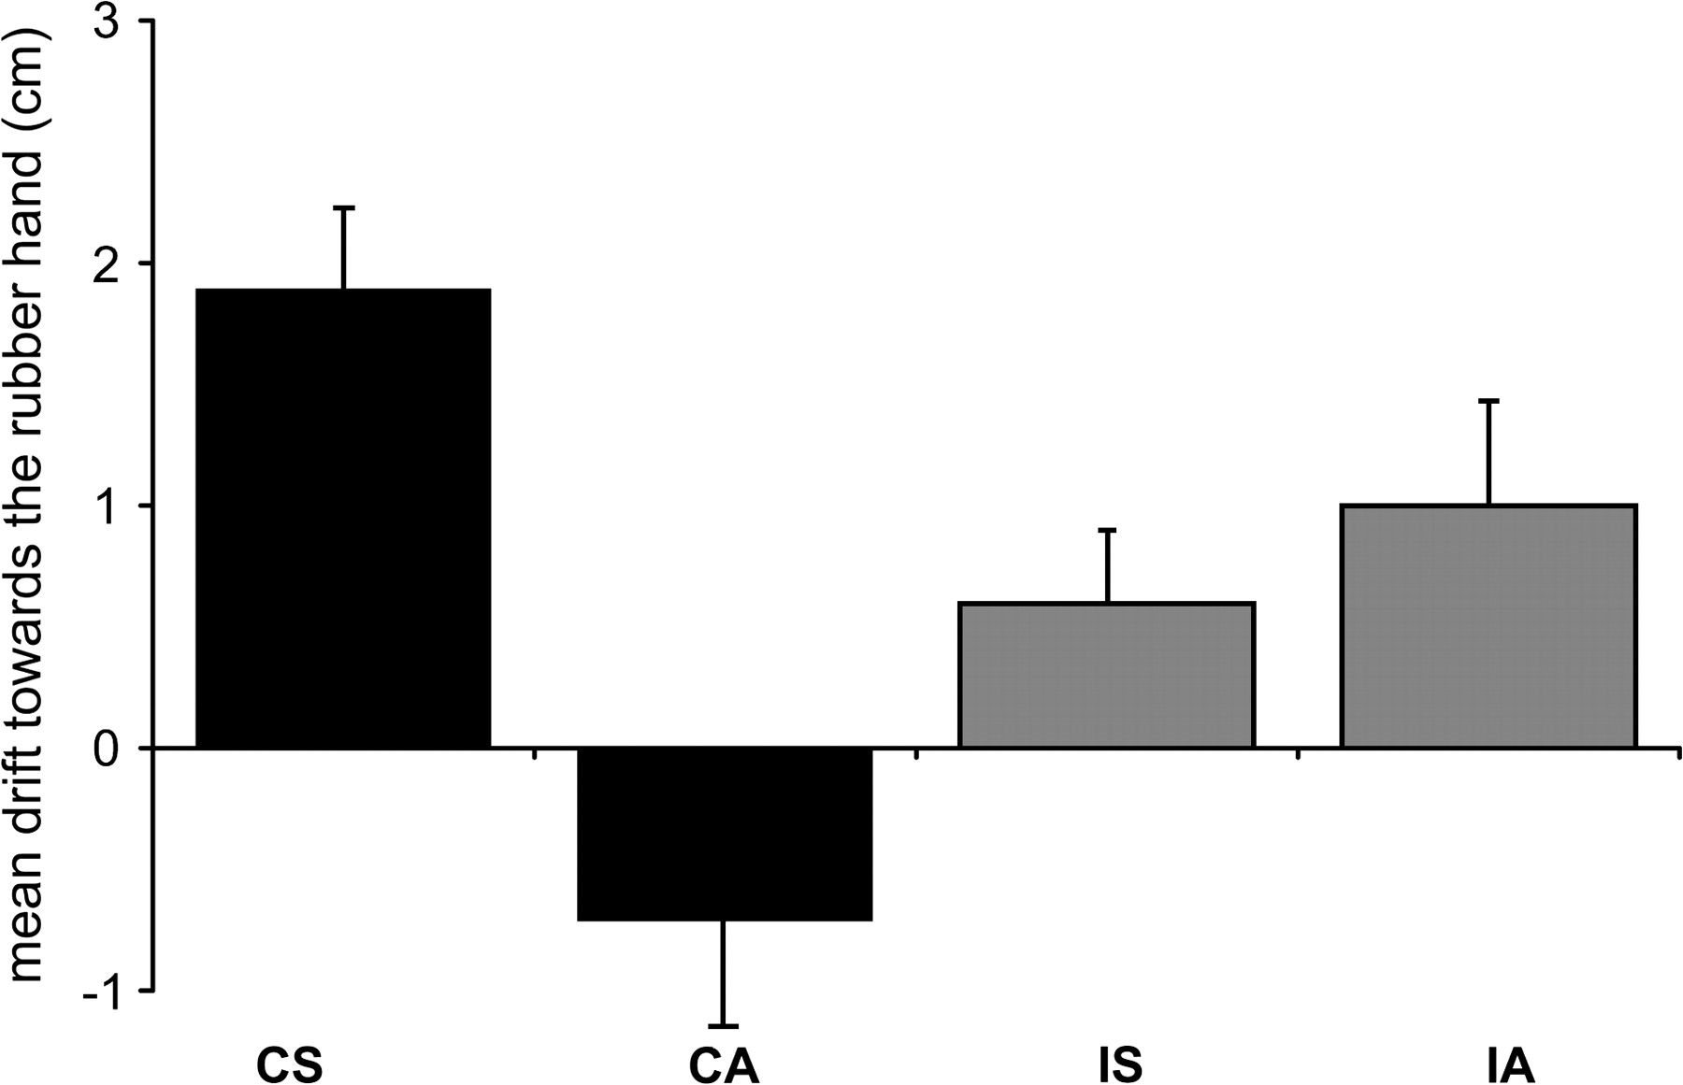
Figure 3. Mean proprioceptive drifts averaged over 10 participants across conditions. Error bars indicate standard ...
Notes:
Figure 3. Mean proprioceptive drifts averaged over 10 participants across conditions. Error bars indicate standard errors. Point “zero” represents the felt position of the participant's hand prior to stimulation. A positive proprioceptive drift represents a mislocalization toward the rubber hand. CS: congruent rubber hand/synchronous stimulation, CA: congruent rubber hand/asynchronous stimulation, IS: incongruent rubber hand/synchronous stimulation, IA: incongruent rubber hand/asynchronous stimulation.
Unless provided in the caption above, the following copyright applies to the content of this slide: © The Author 2006. Published by Oxford University Press. All rights reserved. For permissions, please e-mail: journals.permissions@oxfordjournals.org

Slide 4
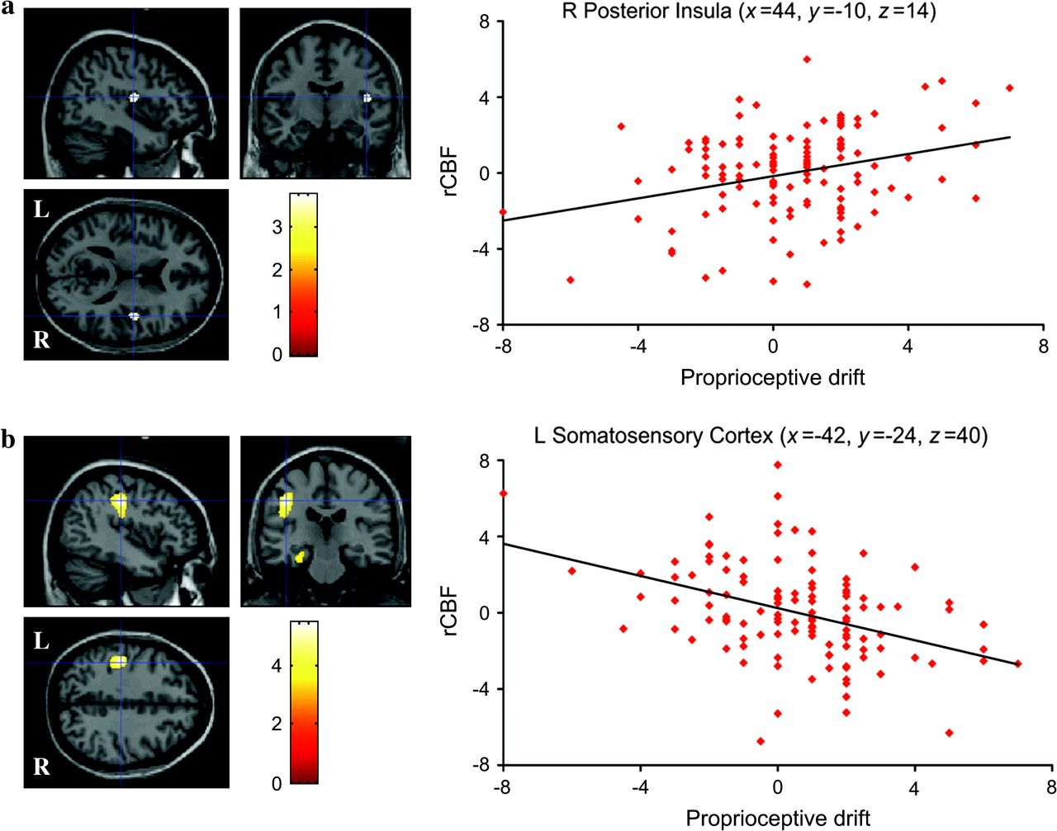
Figure 4. (a) Activity in the right posterior insula (x = 44, y = −10, z = 14) was positively correlated (t = 3.41, P < ...
Notes:
Figure 4. (a) Activity in the right posterior insula (x = 44, y = −10, z = 14) was positively correlated (t = 3.41, P < 0.05) with the proprioceptive drift toward the rubber hand. (b) Activity in the left somatosensory cortex (x = −42, y = −24, z = 40) was negatively correlated (t = −4.84, P < 0.05) with the proprioceptive drift toward the rubber hand. Positive drifts indicate a drift toward the rubber hand, and negative drifts indicate a drift away from the rubber hand. Activations show averaged data over 10 participants (L = Left, R = Right).
Unless provided in the caption above, the following copyright applies to the content of this slide: © The Author 2006. Published by Oxford University Press. All rights reserved. For permissions, please e-mail: journals.permissions@oxfordjournals.org

