Slide 1
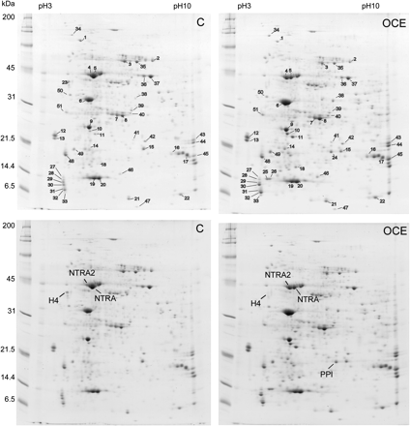
Fig. 1. The effect of inhibition of CP activity leaf protein on tobacco and composition. Proteins were extracted from ...
Notes:
Fig. 1. The effect of inhibition of CP activity leaf protein on tobacco and composition. Proteins were extracted from leaf 16 of control and OCE plants at 8 weeks and were separated on bi-dimensional gels. Proteins with major differences in abundance are indicated (1–51) in upper panels. The position of the proteins with the greatest differences: two Rubisco activase forms (NTRA and NTRA2), histone 4 (H4) and putative pepyidylprolyl isomerise (PPI) are indicated in the lower panels.
Unless provided in the caption above, the following copyright applies to the content of this slide: © The Author [2008]. Published by Oxford University Press [on behalf of the Society for Experimental Biology]. All rights reserved. For Permissions, please e-mail: journals.permissions@oxfordjournals.org

Slide 2
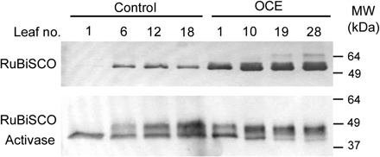
Fig. 2. Western blot analysis of the abundance of the Rubisco large subunit, and Rubisco activase in leaves at ...
Notes:
Fig. 2. Western blot analysis of the abundance of the Rubisco large subunit, and Rubisco activase in leaves at different positions on the stem of 14-week-old plants. Soluble proteins were extracted from leaves at the positions on the stems as indicted, with leaf 1 being at the bottom of each plant and leaf 18 or 28 being the youngest mature leaf on the control and OCE plants, respectively. 10 μg and 30 μg aliquots of leaf protein were loaded per well for the detection of Rubisco and Rubisco activase proteins, respectively.
Unless provided in the caption above, the following copyright applies to the content of this slide: © The Author [2008]. Published by Oxford University Press [on behalf of the Society for Experimental Biology]. All rights reserved. For Permissions, please e-mail: journals.permissions@oxfordjournals.org

Slide 3
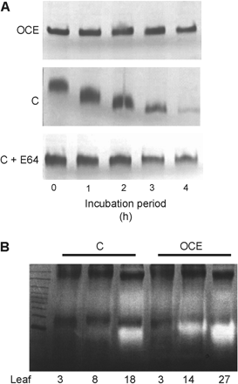
Fig. 3. Protection of Rubisco from degradation by OC-1 in OCE plants and by E64 in control (C) plants in vitro ...
Notes:
Fig. 3. Protection of Rubisco from degradation by OC-1 in OCE plants and by E64 in control (C) plants in vitro assays. (A) The abundance of the Rubisco holoenzyme protein was detected in soluble protein extracts from 4-week-old control (C) and OCE plants on non-denaturing PAGE gels stained with Coomassie Brilliant Blue. (B) In-gel activity assay showing degradation of the gelatine substrate by endogenous proteinases from extracts of leaves of 14-week-old OCE and control (C) plants. Extracts were prepared from leaves at the bottom (3), middle (8, 14), and top (18, 27) leaf ranks. Equal amounts of soluble protein (40 μg per well) extracted from C and OCE plants were compared in all instances.
Unless provided in the caption above, the following copyright applies to the content of this slide: © The Author [2008]. Published by Oxford University Press [on behalf of the Society for Experimental Biology]. All rights reserved. For Permissions, please e-mail: journals.permissions@oxfordjournals.org

Slide 4
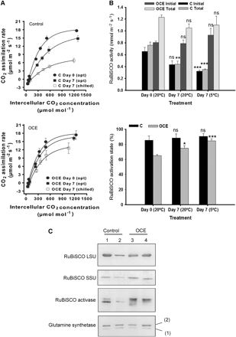
Fig. 4. Effects of dark chilling on photosynthesis, Rubisco activity and activation state and relative abundance of ...
Notes:
Fig. 4. Effects of dark chilling on photosynthesis, Rubisco activity and activation state and relative abundance of Rubisco, Rubisco activase, and glutamine synthetase in the leaves of 6-week-old OCE and control tobacco plants. CO2 response curves for photosynthesis (A) in control and OCE leaves were measured at day 1 (closed circle), after 7 d of growth under optimal conditions (Opt: closed square) and after 7 nights of dark chilling (Chilled; open square). Initial and total Rubisco activities and the Rubisco activation state in control and OCE leaves measured at day 1, after 7 d of growth under optimal conditions and after 7 nights of dark chilling (B). Immunodetection of Rubisco, Rubisco activase, and glutamine synthetase (C) in soluble protein extracts from control and OCE leaves at the beginning of the experiment (lanes 1 and 3) and after 7 nights of dark chilling (lanes 2 and 4).
Unless provided in the caption above, the following copyright applies to the content of this slide: © The Author [2008]. Published by Oxford University Press [on behalf of the Society for Experimental Biology]. All rights reserved. For Permissions, please e-mail: journals.permissions@oxfordjournals.org

Slide 5
Fig. 5. Immunogold labelling detection of Rubisco protein in palisade cells of 6-week-old control and OCE tobacco ...
Notes:
Fig. 5. Immunogold labelling detection of Rubisco protein in palisade cells of 6-week-old control and OCE tobacco leaves. High magnification of a cross-section of a control leaf showing the structure of the palisade cells with immunogold labelling (A), and higher magnification images of the intracellular structure showing the compartmention of the label in wild-type and OCE leaves (B, C). The presence of Rubisco protein in chloroplasts and vesicular bodies outside the chloroplast is indicated in (B) and (C). Areas of immunogold are indicated by black arrows. CY, cytosol; IS, intercellular space; P, plastoglobulus; RVB, Rubisco vesicular body; S, stroma; SG, starch grain; T, thylakoid membranes; V, vacuole.
Unless provided in the caption above, the following copyright applies to the content of this slide: © The Author [2008]. Published by Oxford University Press [on behalf of the Society for Experimental Biology]. All rights reserved. For Permissions, please e-mail: journals.permissions@oxfordjournals.org

Slide 6
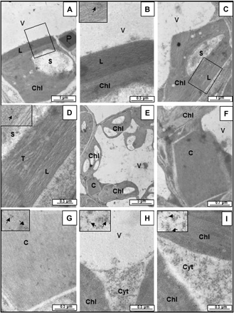
Fig. 6. Transmission electron micrographs of immunogold labelling detection of OCI protein in the palisade cells of ...
Notes:
Fig. 6. Transmission electron micrographs of immunogold labelling detection of OCI protein in the palisade cells of 6-week-old control and OCE tobacco leaves. Chloroplasts in OCE leaves with an unusual fibril structure below the chloroplast envelope (A, C); enhanced images of the unusual structure below the chloroplast envelope (B, D). In both cases the chloroplasts (A, C) show labelling for OC-1 protein (B, D). A section of the OCE leaf shows the presence of a cystatin inclusion body (E) together with a higher magnification image showing that the cystatin inclusion body is present in the cytosol. (F) and has a crystalline structure with positive labelling for the OC-1 protein (G). The presence of immunogold label in the cytosol of the OCE leaves (H, I). C, cystatin inclusion body; Chl, chloroplast; Cyt, cytosol; L, unusual chloroplast structure; S, starch; T, thylakoid; V, vacuole.
Unless provided in the caption above, the following copyright applies to the content of this slide: © The Author [2008]. Published by Oxford University Press [on behalf of the Society for Experimental Biology]. All rights reserved. For Permissions, please e-mail: journals.permissions@oxfordjournals.org

Slide 7
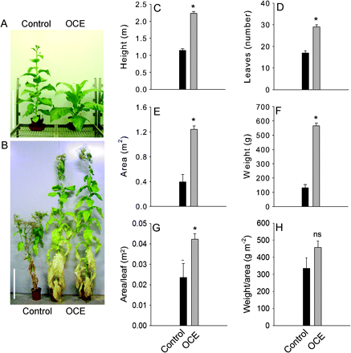
Fig. 7. Comparisons of growth and development in OCE and control plants. Phenotypes of control and OCE plants are ...
Notes:
Fig. 7. Comparisons of growth and development in OCE and control plants. Phenotypes of control and OCE plants are shown at (A) 8 weeks and (B) 14 weeks. The white vertical bar indicates a height of 0.5 m. After both genotypes had flowered at 14 weeks the following parameters were measured: plant height (C); leaf number (D); total leaf area (E); leaf weight (F); average area per leaf (G); average leaf weight per leaf area (H). Mean values ±SE (n=3). Significant differences between control and OCE plants are indicated by asterisk (P <0.05); ns, not significant.
Unless provided in the caption above, the following copyright applies to the content of this slide: © The Author [2008]. Published by Oxford University Press [on behalf of the Society for Experimental Biology]. All rights reserved. For Permissions, please e-mail: journals.permissions@oxfordjournals.org

Slide 8
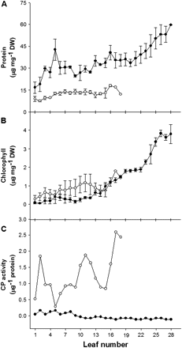
Fig. 8. Comparisons of leaf soluble protein and chlorophyll contents and cysteine proteinase activities in ...
Notes:
Fig. 8. Comparisons of leaf soluble protein and chlorophyll contents and cysteine proteinase activities in 14-week-old OCE and control tobacco plants. Soluble protein content (A); chlorophyll content (B); cysteine proteinase (CP) activity (C). Open and closed symbols represent control and OCE plants, respectively. Mean values ±SE (n=3 for A and B; n=1 for C).
Unless provided in the caption above, the following copyright applies to the content of this slide: © The Author [2008]. Published by Oxford University Press [on behalf of the Society for Experimental Biology]. All rights reserved. For Permissions, please e-mail: journals.permissions@oxfordjournals.org

Slide 9
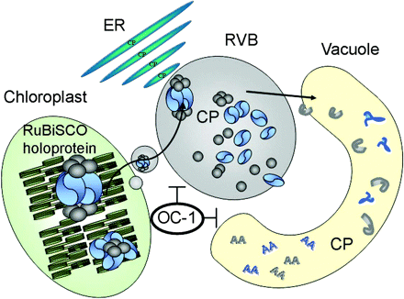
Fig. 9. A hypothetical model for Rubisco degradation via autophagy and the plant vesicle trafficking system. AA, ...
Notes:
Fig. 9. A hypothetical model for Rubisco degradation via autophagy and the plant vesicle trafficking system. AA, amino acids; CP, cysteine proteinase; ER, endoplasmic reticulum; OC-1, oryzacystatin-1; RVB, Rubisco vesicular body.
Unless provided in the caption above, the following copyright applies to the content of this slide: © The Author [2008]. Published by Oxford University Press [on behalf of the Society for Experimental Biology]. All rights reserved. For Permissions, please e-mail: journals.permissions@oxfordjournals.org

