Slide 1
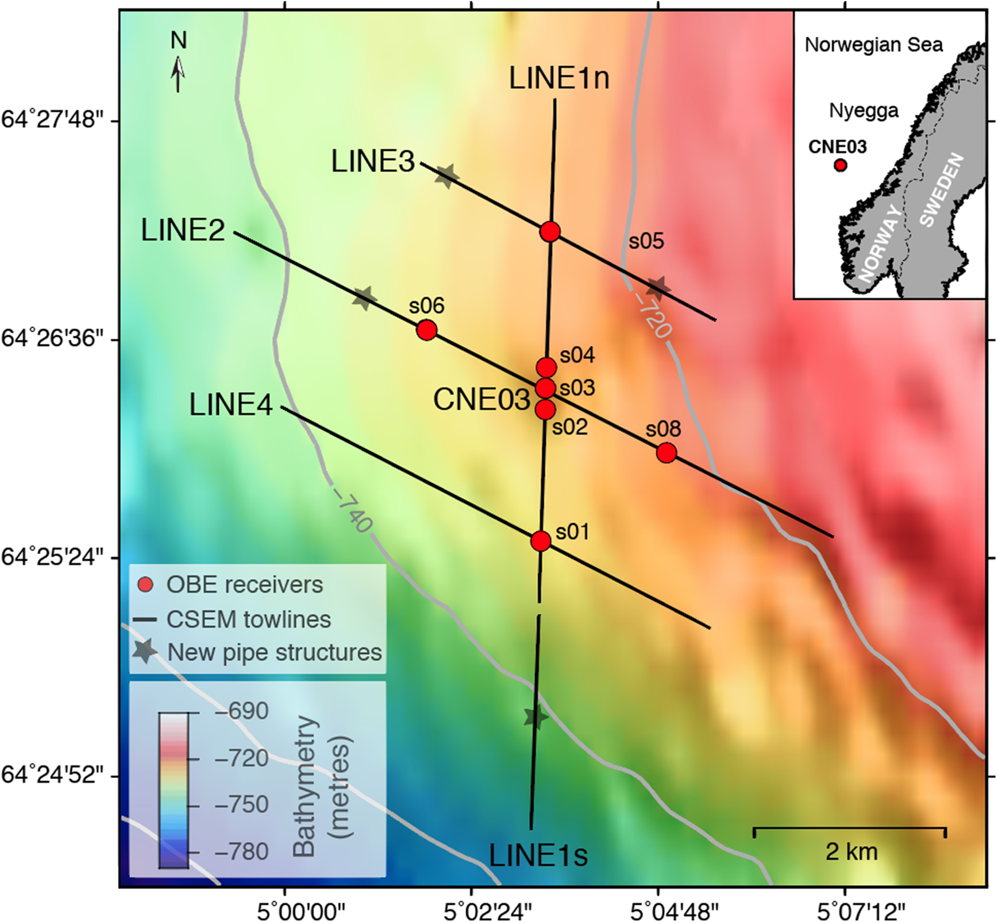
Figure 1. A map illustrating the CSEM survey layout at the CNE03 pockmark area. CSEM data from survey lines 1s (south), ...
Notes:
Figure 1. A map illustrating the CSEM survey layout at the CNE03 pockmark area. CSEM data from survey lines 1s (south), 1n (north), 2, 3 and 4 were collected using seven OBEs, the DASI transmitter and a Vulcan towed receiver. Line 1 was divided into two separate towlines because the transmitter was switched off and on, as done between each towline. Towlines 1n and 2 are coincident with seismic reflection data (Westbrook et al.2008b). The stars denote the locations of newly discovered resistive pipe-like structures (further details in Section 6.1). Inset map: the location of the CNE03 pockmark, at Nyegga region, offshore Norway.
Unless provided in the caption above, the following copyright applies to the content of this slide: © The Author(s) 2018. Published by Oxford University Press on behalf of The Royal Astronomical Society.This article is published and distributed under the terms of the Oxford University Press, Standard Journals Publication Model (https://academic.oup.com/journals/pages/about_us/legal/notices)

Slide 2
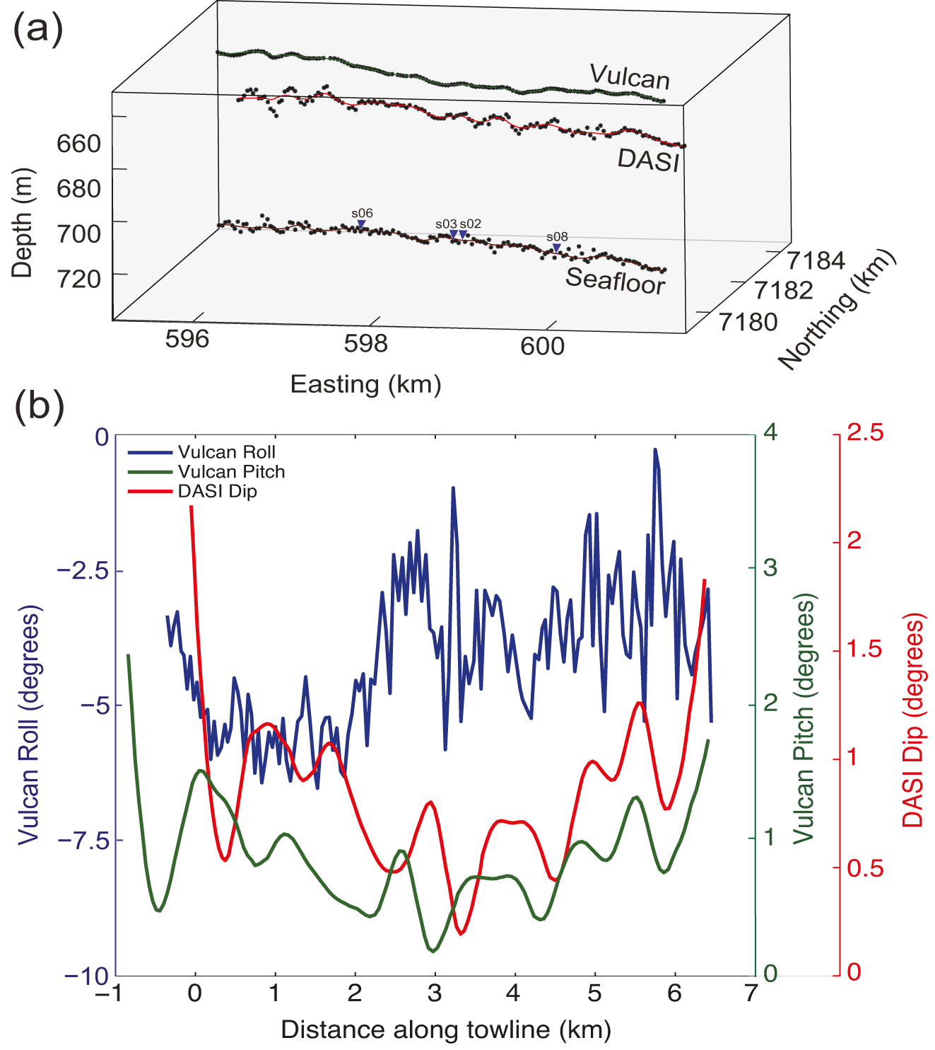
Figure 2. CSEM system navigation along towline 2. (a) Position and depth of the seafloor, OBE, DASI and Vulcan. Blue ...
Notes:
Figure 2. CSEM system navigation along towline 2. (a) Position and depth of the seafloor, OBE, DASI and Vulcan. Blue inverted triangles represent the OBE, black dots the raw data and lines the smoothed data that were used for the inversion. (b) Plot showing DASI dip, Vulcan pitch and roll information employed by the inversion. The DASI dip is assumed, derived from the Vulcan pitch data. Vulcan pitch and DASI dip data are smoothed. We note that for all survey lines, the difference between Vulcan and DASI heading is ⩽4°.
Unless provided in the caption above, the following copyright applies to the content of this slide: © The Author(s) 2018. Published by Oxford University Press on behalf of The Royal Astronomical Society.This article is published and distributed under the terms of the Oxford University Press, Standard Journals Publication Model (https://academic.oup.com/journals/pages/about_us/legal/notices)

Slide 3
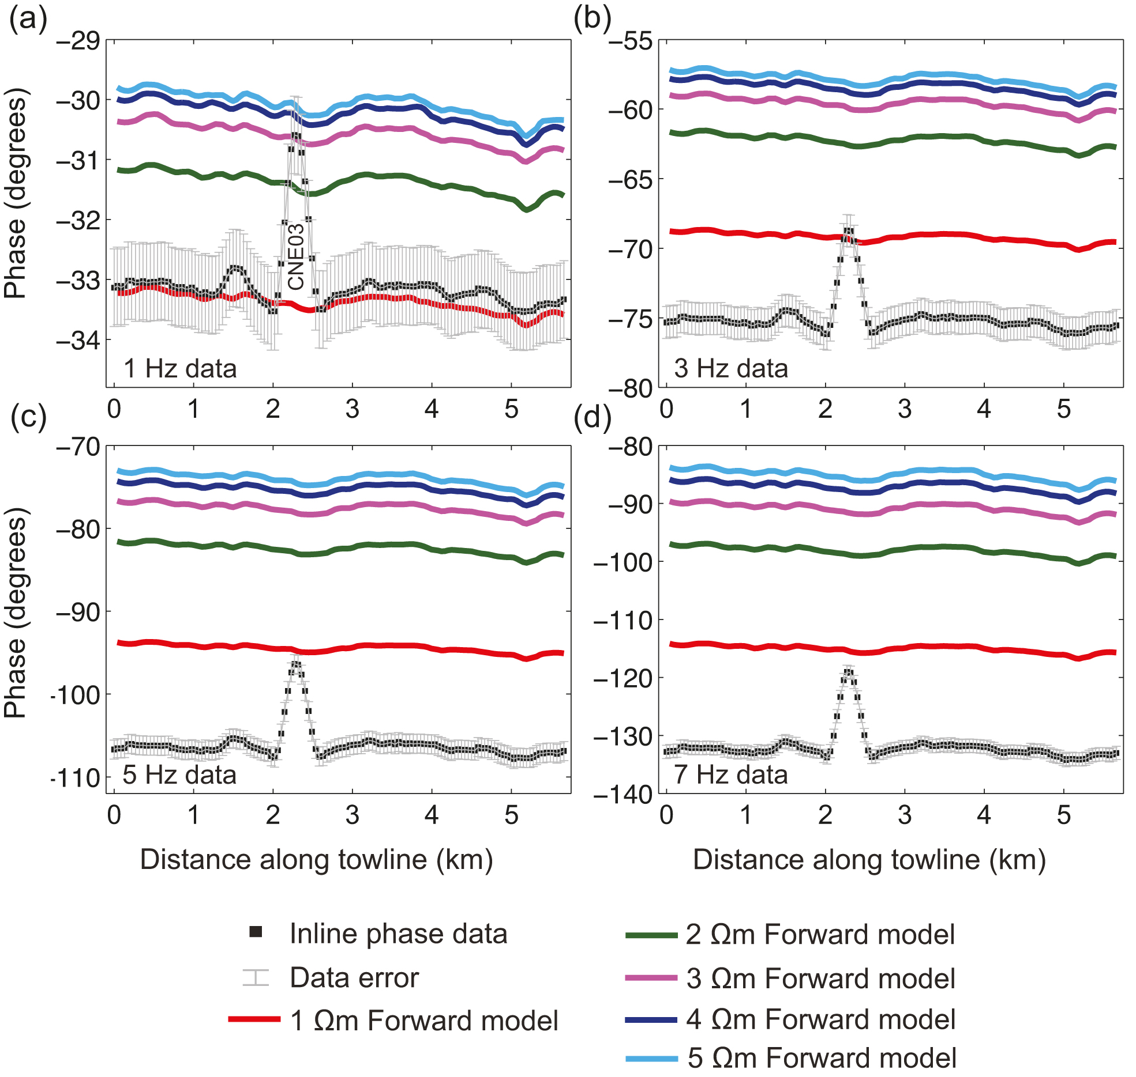
Figure 3. Line 1n: Vulcan inline electric field unshifted phase data versus 2-D forward models. (a) The 1 Hz phase data ...
Notes:
Figure 3. Line 1n: Vulcan inline electric field unshifted phase data versus 2-D forward models. (a) The 1 Hz phase data are in proximity to the 1 Ωm forward model at background sediment areas. The phase data at the peak of the CNE03 anomaly corresponds to the 3 Ωm forward model. (b) 3 Hz phase data. (c) 5 Hz phase data. (d) 7 Hz phase data. Note that the 3, 5 and 7 Hz harmonics successively drift further away from the 1 Ωm forward model response.
Unless provided in the caption above, the following copyright applies to the content of this slide: © The Author(s) 2018. Published by Oxford University Press on behalf of The Royal Astronomical Society.This article is published and distributed under the terms of the Oxford University Press, Standard Journals Publication Model (https://academic.oup.com/journals/pages/about_us/legal/notices)

Slide 4
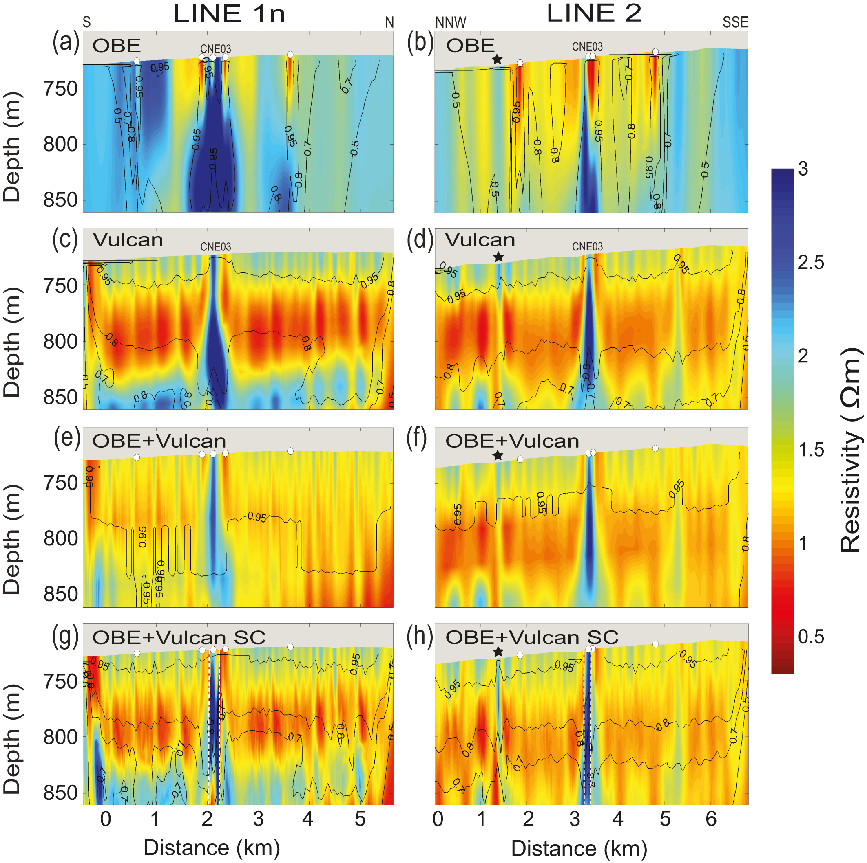
Figure 8. Inversion models of survey line 1n [(a), (c), (e), (g)] and line 2 [(b), (d), (f), (h)]: OBE and Vulcan data ...
Notes:
Figure 8. Inversion models of survey line 1n [(a), (c), (e), (g)] and line 2 [(b), (d), (f), (h)]: OBE and Vulcan data sets were inverted separately and simultaneously. All inversions employed a quadrilateral mesh. The sensitivity contours indicate the level of the data sensitivity to the model parameters. The circles represent the OBE positions. The star denote a newly discovered gas hydrate structure along line 2. (g) and (h) panels: Lines 1n and 2 showing the OBE and Vulcan combined inversions, whereas the CNE03 pipe structure is seismically constrained (SC) laterally, as denoted by the bounding white dashed lines. The lateral resistivity variations (striped pattern) observed in (c)–(h) are artefacts, most likely results from the uncertainty in Vulcan geometry. The striped pattern is visually enhanced due to a vertical exaggeration of ≈40 (chosen for ideal visualization of the CNE03 anomalous structure), and the spatial horizontal to vertical (H:V ratio = 6) roughness regularization that we use in this study. Further details about the striped artefact pattern are given in the Supporting Information.
Unless provided in the caption above, the following copyright applies to the content of this slide: © The Author(s) 2018. Published by Oxford University Press on behalf of The Royal Astronomical Society.This article is published and distributed under the terms of the Oxford University Press, Standard Journals Publication Model (https://academic.oup.com/journals/pages/about_us/legal/notices)

Slide 5
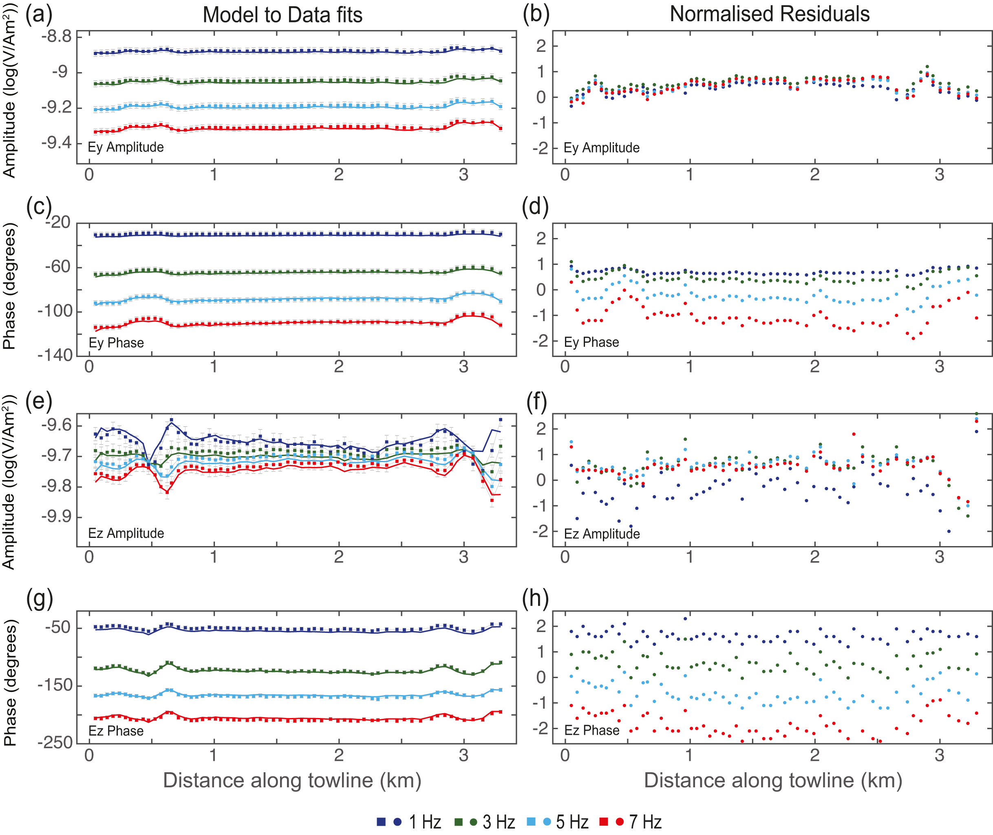
Figure 7. The model responses, data and normalized residuals of the smooth inversion applied to towline 3 Vulcan data. ...
Notes:
Figure 7. The model responses, data and normalized residuals of the smooth inversion applied to towline 3 Vulcan data. The inversion includes four frequencies: 1, 3, 5 and 7 Hz. In the model to data fit plots, the vertical axes are individually scaled while the residuals are all on the same scale. The lines represent the model, squares the data and the error bars are in grey (a, c, e and g). The normalized residuals are given as dots (b, d, f and h). Two subtle resistive anomalies observed at ∼0.5 and ∼3 km distance along the towline, which corresponds to the vertical resistors shown in towline 3 inversion model (Fig. 6a). These anomalous resistors (possibly gas hydrate features) subtly bias the Ey phase and Ezamplitude normalized residuals in a frequency-dependent pattern.
Unless provided in the caption above, the following copyright applies to the content of this slide: © The Author(s) 2018. Published by Oxford University Press on behalf of The Royal Astronomical Society.This article is published and distributed under the terms of the Oxford University Press, Standard Journals Publication Model (https://academic.oup.com/journals/pages/about_us/legal/notices)

Slide 6
Figure 6. Vulcan towline 3: real and synthetic unconstrained inversion models. (a) Real data inversion model. (b) A ...
Notes:
Figure 6. Vulcan towline 3: real and synthetic unconstrained inversion models. (a) Real data inversion model. (b) A synthetic forward model that includes resistive structures derived from the real data inversion. (c) Synthetic data inversion model. The stars denote newly discovered vertical resistors. The models shown in (a) and (c) are superimposed with Jacobian sensitivity contours (thin lines), which illustrates the inversion sensitivity to spatial variations in resistivity. The thick lines in (b) and (c) bound the areas with different resistivity.
Unless provided in the caption above, the following copyright applies to the content of this slide: © The Author(s) 2018. Published by Oxford University Press on behalf of The Royal Astronomical Society.This article is published and distributed under the terms of the Oxford University Press, Standard Journals Publication Model (https://academic.oup.com/journals/pages/about_us/legal/notices)

Slide 7
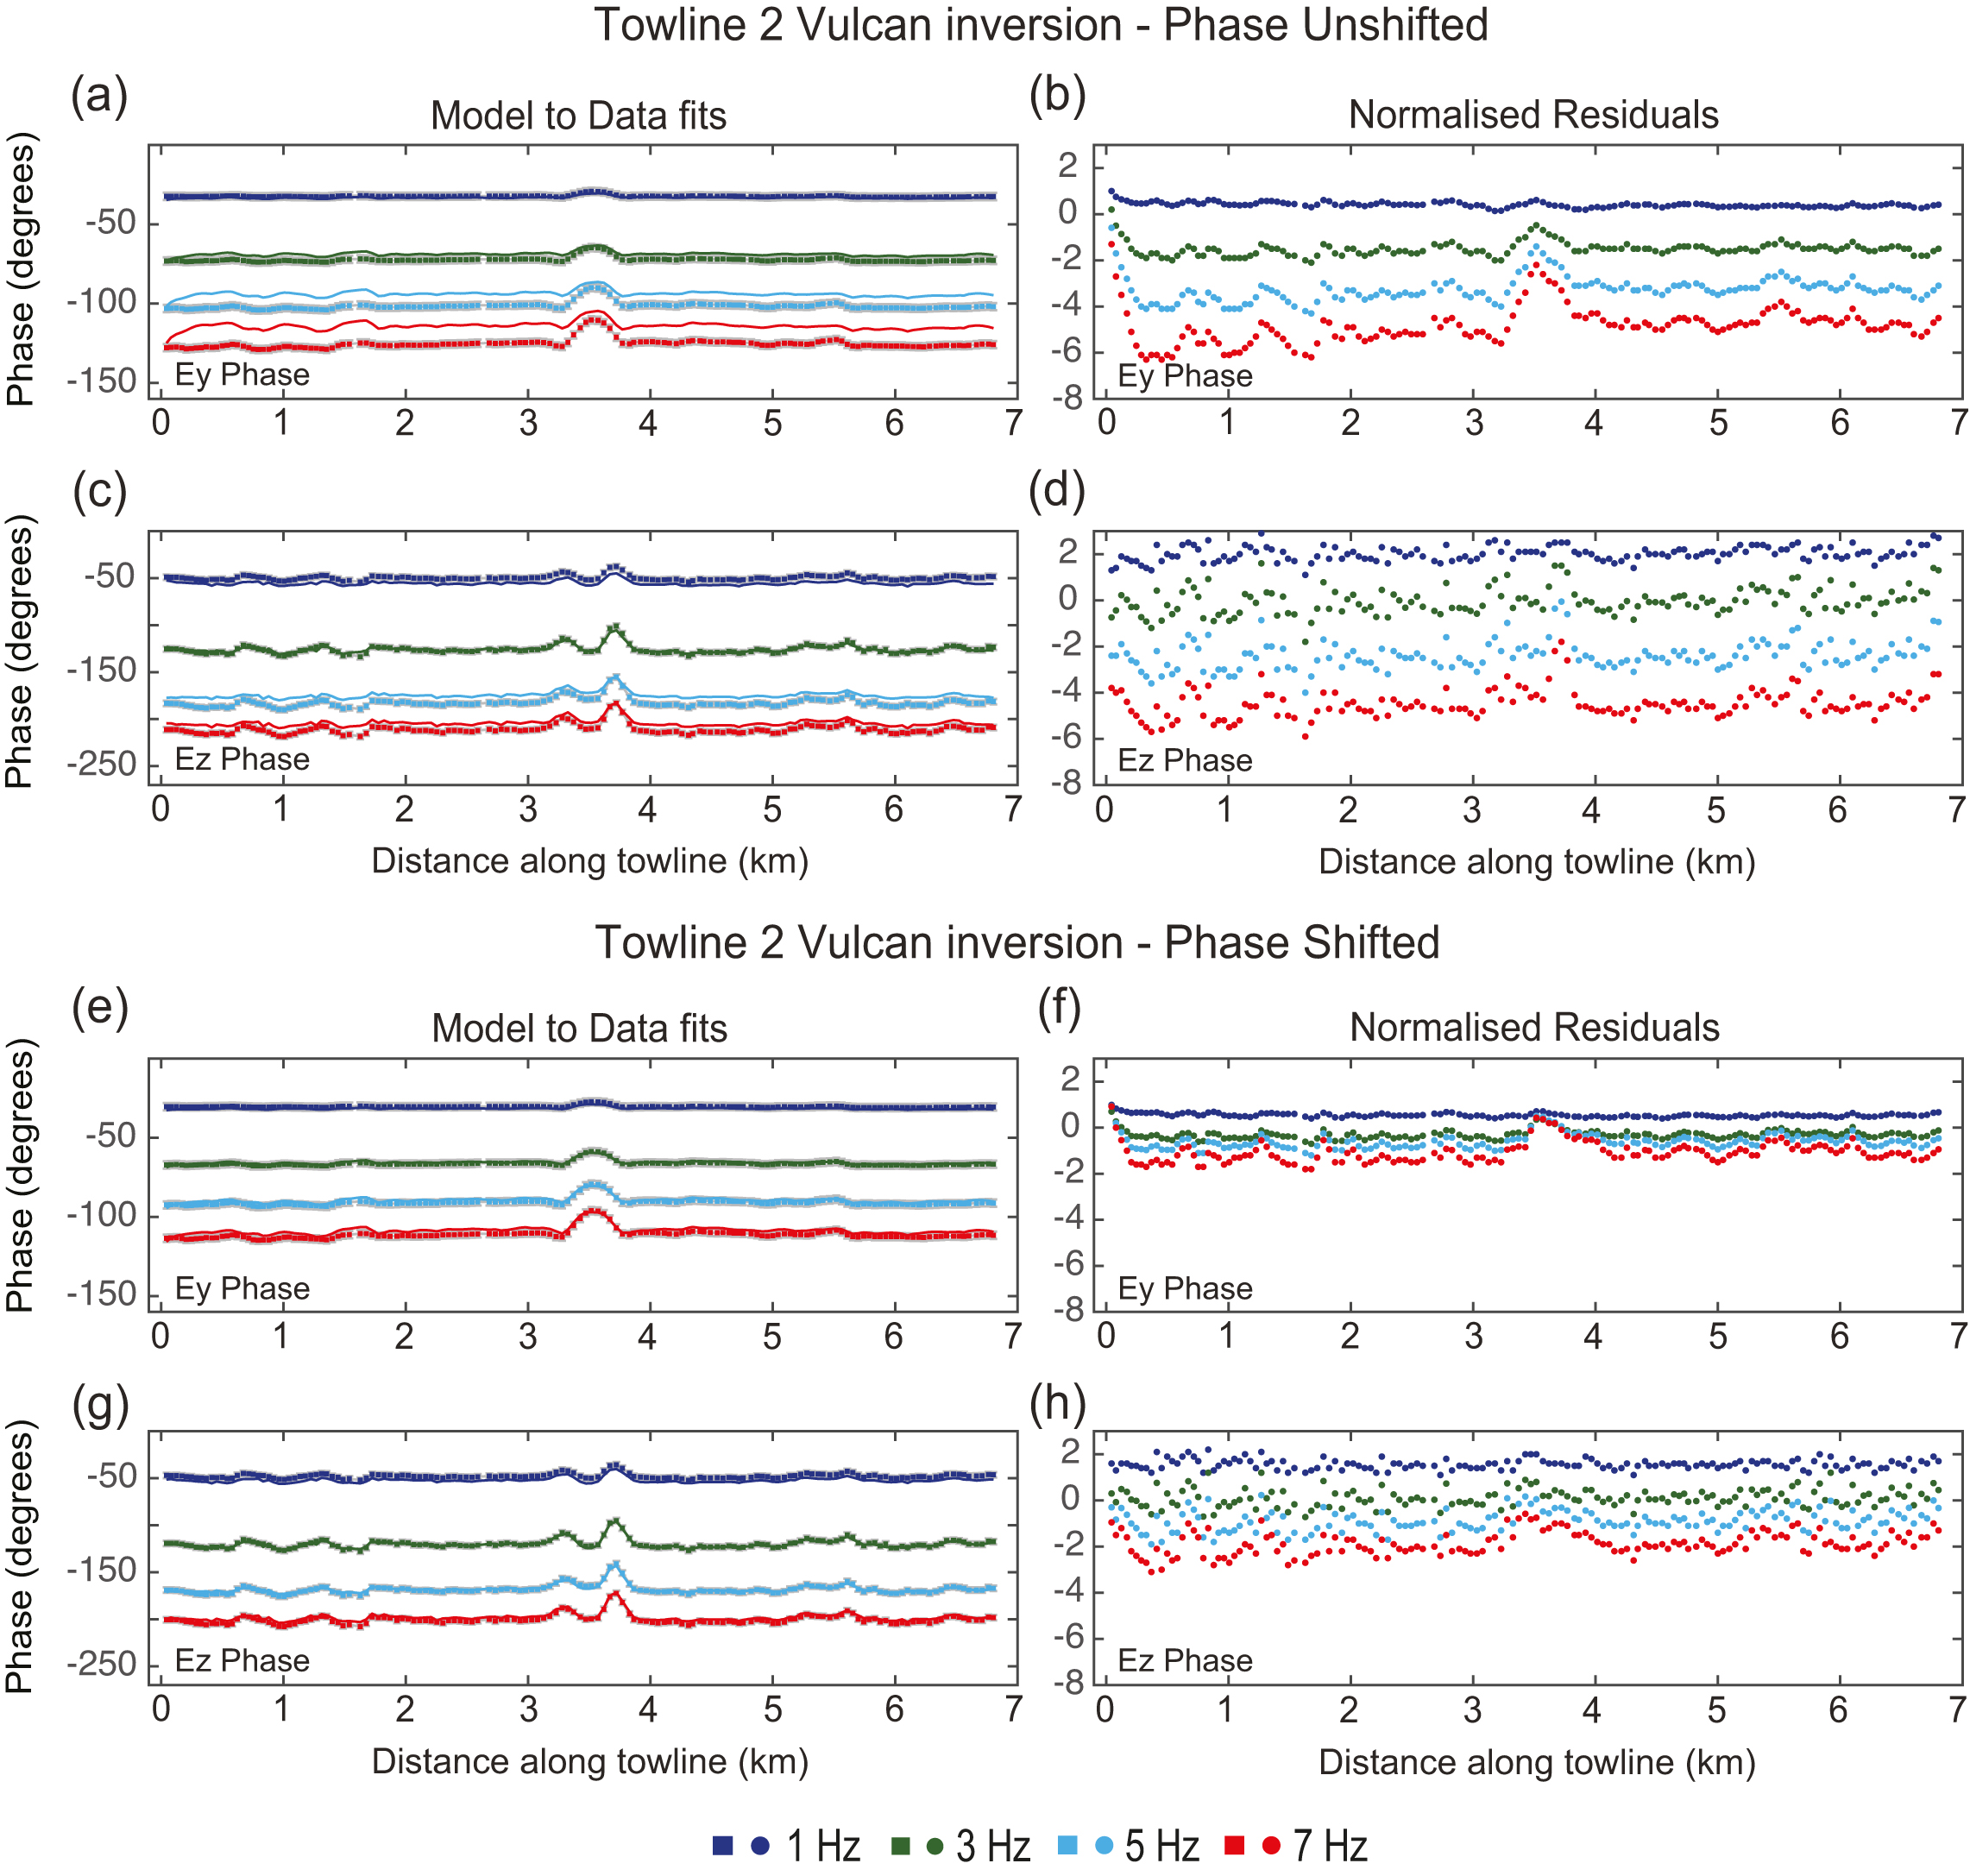
Figure 5. A comparison between the responses of two Vulcan inversions: towline 2 with unshifted and shifted phase data. ...
Notes:
Figure 5. A comparison between the responses of two Vulcan inversions: towline 2 with unshifted and shifted phase data. The inline (Ey) and vertical (Ez) electric fields phase responses are presented for each of the used frequencies. The lines represent the model, squares the data, error bars are in grey and the normalized residuals are given as dots. (a–d) The model responses, data and normalized residuals responses of the inversion with unshifted phase data. This inversion could not converge to an RMS misfit below 2.1 after 17 iterations. (e–h) The model responses, data and normalized residuals responses of the inversion with shifted phase data. This inversion converged to an RMS target misfit of 0.9 after 6 iterations. In the unshifted phase inversion, the model does not fit the data and the normalized residuals are ∼2–3 times greater than the residuals observed in the shifted phase inversion. The elevation in phase observed between 3 and 4 km along the towline denotes the CNE03 pipe-like structure.
Unless provided in the caption above, the following copyright applies to the content of this slide: © The Author(s) 2018. Published by Oxford University Press on behalf of The Royal Astronomical Society.This article is published and distributed under the terms of the Oxford University Press, Standard Journals Publication Model (https://academic.oup.com/journals/pages/about_us/legal/notices)

Slide 8
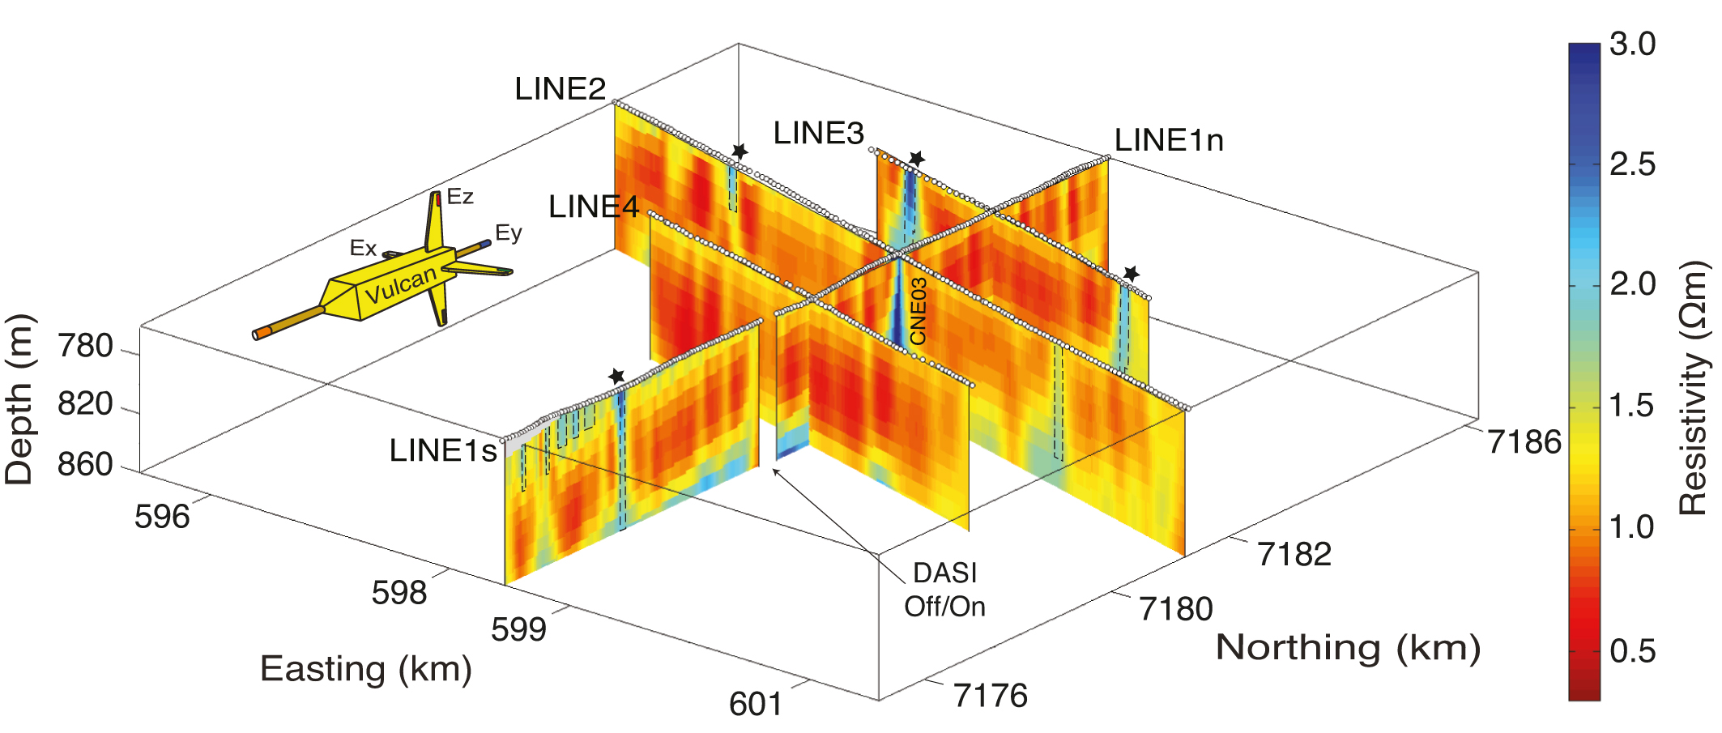
Figure 4. Fence diagram showing the Vulcan inversion models for survey lines 1–4. Areas bounded by dashed lines denote ...
Notes:
Figure 4. Fence diagram showing the Vulcan inversion models for survey lines 1–4. Areas bounded by dashed lines denote vertical resistors that were detected. The stars indicate robust resistive features (⩾2 Ωm), presumably gas hydrate deposits. Left corner: a diagram of Vulcan — a deep-towed fixed-offset CSEM receiver.
Unless provided in the caption above, the following copyright applies to the content of this slide: © The Author(s) 2018. Published by Oxford University Press on behalf of The Royal Astronomical Society.This article is published and distributed under the terms of the Oxford University Press, Standard Journals Publication Model (https://academic.oup.com/journals/pages/about_us/legal/notices)

