Slide 1
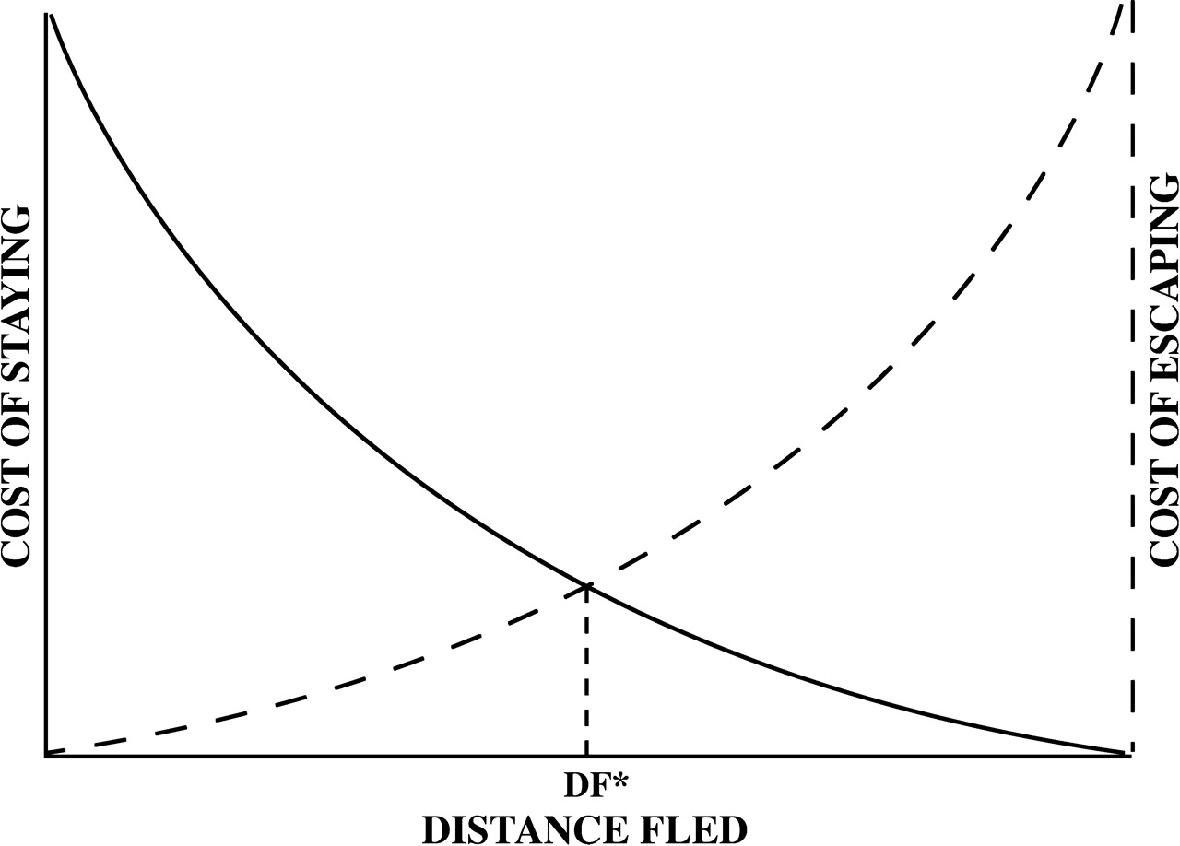
Figure 1 A simple model in which predicted distance fled occurs when the predation risk (cost of not fleeing) for a ...
Notes:
Figure 1 A simple model in which predicted distance fled occurs when the predation risk (cost of not fleeing) for a prey fleeing that distance equals the opportunity cost (cost of escape) of fleeing. Thus, the intersection of the risk and cost curves gives the predicted distance fled, DF*.
Unless provided in the caption above, the following copyright applies to the content of this slide: © The Author 2006. Published by Oxford University Press on behalf of the International Society for Behavioral Ecology. All rights reserved. For permissions, please e-mail: journals.permissions@oxfordjournals.org

Slide 2
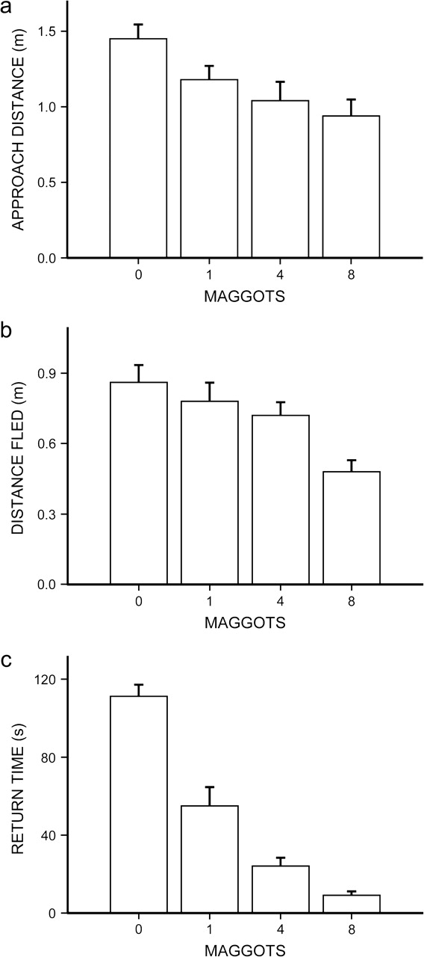
Figure 2 Escape and return to food source by Podarcis lilfordi when varying numbers of maggots were present. (a) ...
Notes:
Figure 2 Escape and return to food source by Podarcis lilfordi when varying numbers of maggots were present. (a) Approach distance. (b) Distance fled. (c) Time to return. Main bars show means. Error bars represent 1.0 standard error.
Unless provided in the caption above, the following copyright applies to the content of this slide: © The Author 2006. Published by Oxford University Press on behalf of the International Society for Behavioral Ecology. All rights reserved. For permissions, please e-mail: journals.permissions@oxfordjournals.org

