Slide 1
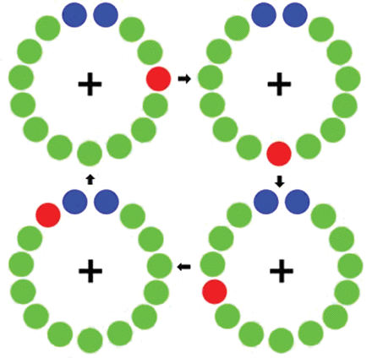
Figure 1. Motor paradigm. Participants fixated on the cross hair as the red dot moved clockwise toward the blue dots, ...
Notes:
Figure 1. Motor paradigm. Participants fixated on the cross hair as the red dot moved clockwise toward the blue dots, displacing each green dot in turn. Participants were instructed to make one flexion-extension movement each time the red dot was within the blue area, but only one movement per revolution (figure and caption adapted from Wilson et al. 2010).
Unless provided in the caption above, the following copyright applies to the content of this slide: © The Author 2013. Published by Oxford University Press.This is an Open Access article distributed under the terms of the Creative Commons Attribution Non-Commercial License (http://creativecommons.org/licenses/by-nc/3.0/), which permits non-commercial re-use, distribution, and reproduction in any medium, provided the original work is properly cited. For commercial re-use, please contact journals.permissions@oup.com

Slide 2
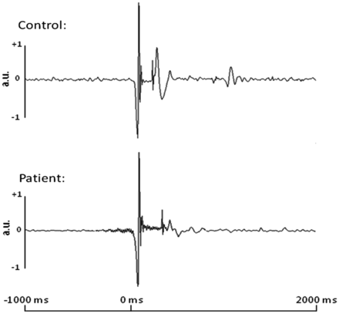
Figure 2. Single-trial accelerometer signals from a representative control and patient with PD. Time in ms is denoted ...
Notes:
Figure 2. Single-trial accelerometer signals from a representative control and patient with PD. Time in ms is denoted on the x-axis, while acceleration in arbitrary units (a.u.) is noted on the y-axis. All patients and controls exhibited a sharp change in signal amplitude at movement onset; this change was marked as 0 ms in each trial. This sharp change in accelerometer signal amplitude allowed precise definitions of movement onset during individual trials, regardless of participant group.
Unless provided in the caption above, the following copyright applies to the content of this slide: © The Author 2013. Published by Oxford University Press.This is an Open Access article distributed under the terms of the Creative Commons Attribution Non-Commercial License (http://creativecommons.org/licenses/by-nc/3.0/), which permits non-commercial re-use, distribution, and reproduction in any medium, provided the original work is properly cited. For commercial re-use, please contact journals.permissions@oup.com

Slide 3
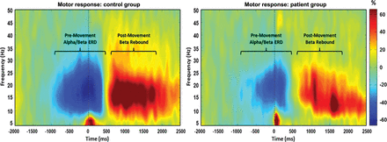
Figure 3. Average time–frequency spectra in controls and patients with PD during movement. Time (in ms) is denoted on ...
Notes:
Figure 3. Average time–frequency spectra in controls and patients with PD during movement. Time (in ms) is denoted on the x-axis, with 0 ms defined as movement onset. Frequency (in Hz) is shown on the y-axis. The average patterns of alpha and beta premovement desynchronization and PMBR during the hand movement task, expressed as percent difference from baseline, are shown in the control group on the left. The reduced alpha and beta desynchronizations, as well as a diminished beta rebound in the same region, can be discerned in the PD group average on the right. In addition, the lower-frequency gamma response that occurred at movement onset can be seen in the average plot of the patients with PD. This gamma response was present in a subset of patients and controls (see Supplementary Data).
Unless provided in the caption above, the following copyright applies to the content of this slide: © The Author 2013. Published by Oxford University Press.This is an Open Access article distributed under the terms of the Creative Commons Attribution Non-Commercial License (http://creativecommons.org/licenses/by-nc/3.0/), which permits non-commercial re-use, distribution, and reproduction in any medium, provided the original work is properly cited. For commercial re-use, please contact journals.permissions@oup.com

Slide 4
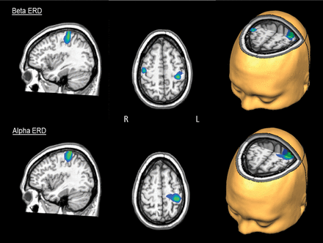
Figure 4. Activation differences during the premovement beta ERD and the alpha ERD. The peak difference in the beta ERD ...
Notes:
Figure 4. Activation differences during the premovement beta ERD and the alpha ERD. The peak difference in the beta ERD response (top panel) was within the left motor hand knob feature of the precentral gyrus and extended onto the adjacent postcentral gyrus (P = 0.035, corrected). Differences seen in the right precentral gyrus near the hand knob region were not significant after permutation testing (P < 0.005, uncorrected and P = 0.107, corrected). The peak difference in the alpha ERD response corresponded to the left postcentral gyrus near the hand knob region (P < 0.05, corrected). All images have been thresholded at P = 0.001, uncorrected, and reflect areas of greater activation in controls compared with patients with PD.
Unless provided in the caption above, the following copyright applies to the content of this slide: © The Author 2013. Published by Oxford University Press.This is an Open Access article distributed under the terms of the Creative Commons Attribution Non-Commercial License (http://creativecommons.org/licenses/by-nc/3.0/), which permits non-commercial re-use, distribution, and reproduction in any medium, provided the original work is properly cited. For commercial re-use, please contact journals.permissions@oup.com

